Slide 1


OCEANIDES
OPC TIN: TO FOLLOW
Plumbing, Siphoning, and Pest Management Services OPC
(02) 8633 8486 | Globe 0917 671 6383 | Smart 0939 245 6217
marketing@oceanidessepticandpest.com
COMPANY PROFILE
One partner for
your property
service needs
Plumbing. Septic services. Pest management.
Cleaning. Renovation. Treatment systems.
Commercial / Industrial / Residential
OCEANIDES
AI conceptual illustration; not a project or engineering design.
oceanidesph.com | facebook.com/OceanidesMalabanan
REVIEW DRAFT
marketing@oceanidessepticandpest.com | corporate@oceanidessepticandpest.com
01
Notes:
Company profile
Owner interview 2026-10-11; old profile supplied 2026-10-12. No unverified establishment date is asserted.
Owner review draft. Sources: interview2026-10-11, old PDF and current role/client/address confirmations2026-10-12. Reference imagery is labeled; no logo implies endorsement. Original PPTXv4 preserved. OPC tax details still to follow.

Slide 2
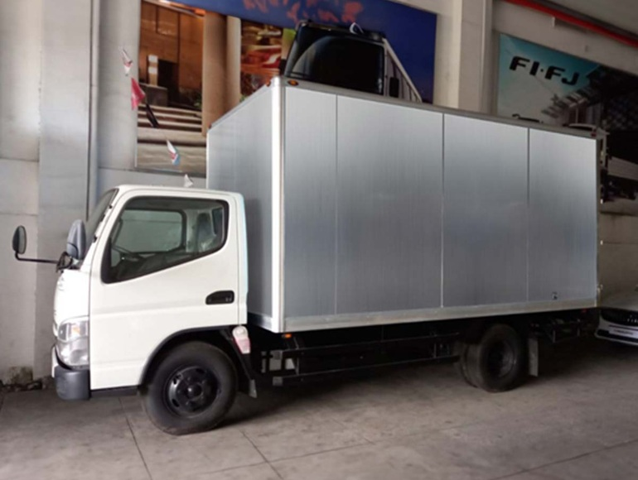
OCEANIDES
OPC TIN: TO FOLLOW
Plumbing, Siphoning, and Pest Management Services OPC
(02) 8633 8486 | Globe 0917 671 6383 | Smart 0939 245 6217
marketing@oceanidessepticandpest.com
Essential services, one point of contact
Oceanides brings plumbing, septic tank services, pest
management, cleaning and property improvement
together for commercial, industrial and residential
clients.
Our service relationships grew through recurring plumbing, septic
tank and grease tank work. We have expanded our offer under
Oceanides Plumbing, Siphoning, and Pest Management Services
OPC.
Priority service in Metro Manila and nearby provinces.
Oceanides asset-library photograph
Nationwide work by arrangement.
OCEANIDES
oceanidesph.com | facebook.com/OceanidesMalabanan
REVIEW DRAFT
marketing@oceanidessepticandpest.com | corporate@oceanidessepticandpest.com
02
Notes:
About Oceanides
Company history is date-neutral: old source says established2021, DTI certificate2022, BIR trade registration2023. Current SEC certificate still required.
Owner review draft. Sources: interview2026-10-11, old PDF and current role/client/address confirmations2026-10-12. Reference imagery is labeled; no logo implies endorsement. Original PPTXv4 preserved. OPC tax details still to follow.

Slide 3
OCEANIDES
OPC TIN: TO FOLLOW
Plumbing, Siphoning, and Pest Management Services OPC
(02) 8633 8486 | Globe 0917 671 6383 | Smart 0939 245 6217
marketing@oceanidessepticandpest.com
Our purpose and service values
OUR VISION
OUR MISSION
Be a long-term service partner that clients trust with
Provide professional, reliable
their property maintenance and improvement
property services with clear
needs.
scope, responsive coordination
and care for the client's site.
OUR VALUES
Quality. Integrity. Respect.
Teamwork. Customer satisfaction.
OCEANIDES
oceanidesph.com | facebook.com/OceanidesMalabanan
REVIEW DRAFT
marketing@oceanidessepticandpest.com | corporate@oceanidessepticandpest.com
03
Notes:
Mission, vision and values
Adapted from old profile page3, expanding plumbing wording to the owner-confirmed service offer. These are statements of purpose, not measured results.
Owner review draft. Sources: interview2026-10-11, old PDF and current role/client/address confirmations2026-10-12. Reference imagery is labeled; no logo implies endorsement. Original PPTXv4 preserved. OPC tax details still to follow.

Slide 4
OCEANIDES
OPC TIN: TO FOLLOW
Plumbing, Siphoning, and Pest Management Services OPC
(02) 8633 8486 | Globe 0917 671 6383 | Smart 0939 245 6217
marketing@oceanidessepticandpest.com
A broader range of property services
SEPTIC AND DRAINAGE
REPAIRS AND PROPERTY CARE
PEST AND TREATMENT SYSTEMS
Septic tank siphoning
Plumbing
Pest management
Manual septic tank cleaning
Excavation
Onsite wastewater treatment
Drain and pipe declogging
General cleaning
systems
Grease tank and trap cleaning
Renovation, restoration and leak
repairs
Air-conditioning cleaning
OCEANIDES
oceanidesph.com | facebook.com/OceanidesMalabanan
REVIEW DRAFT
marketing@oceanidessepticandpest.com | corporate@oceanidessepticandpest.com
04
Notes:
Service directory
All eleven service categories from owner interview included. Service scope and schedule agreed per engagement.
Owner review draft. Sources: interview2026-10-11, old PDF and current role/client/address confirmations2026-10-12. Reference imagery is labeled; no logo implies endorsement. Original PPTXv4 preserved. OPC tax details still to follow.

Slide 5








OCEANIDES
OPC TIN: TO FOLLOW
Plumbing, Siphoning, and Pest Management Services OPC
(02) 8633 8486 | Globe 0917 671 6383 | Smart 0939 245 6217
marketing@oceanidessepticandpest.com
Selected clients and service experience
Property, industrial and business clients
Ayala Land
Avida Land
Toyota
Eagle Cement
UNIQLO
Starmall
San Miguel Beer
Hotel Sogo
San Miguel Properties
OCEANIDES
Company-supplied service history. Engagements relate to individual sites and service scopes; no endorsement is implied.
oceanidesph.com | facebook.com/OceanidesMalabanan
REVIEW DRAFT
marketing@oceanidessepticandpest.com | corporate@oceanidessepticandpest.com
05
Notes:
Selected clients and service experience
Relationship source: owner interview and current user confirmation2026-10-12. Not independently verified by brand-mark downloads. No group-wide contract or endorsement asserted. Specific branches/sites and scopes to be completed in supporting records.
{"brand": "Ayala Land", "file": "ayala-land.svg", "source_page": "https://ayalaland.com/", "asset_url": "https://ayalaland.com/assets/images/logo.svg", "retrieved": "2026-10-12", "provenance": "Official website asset referenced by current site HTML", "service_history_source": "interview", "bytes": 3147, "status": "downloaded", "raster_file": "ayala-land.png", "raster_dimensions": [1000, 218], "visible_content_bbox": [4, 1, 999, 215]}
{"brand": "Avida Land (current official inline mark)", "file": "avida-inline.svg", "raster_file": "avida-inline.png", "source_page": "https://www.avidaland.com/", "asset_url": "https://www.avidaland.com/#inline-svg-16", "retrieved": "2026-10-12", "provenance": "Unmodified inline SVG from current official homepage; default currentColor rasterized black. Prior-profile burgundy mark also preserved.", "service_history_source": "old-profile", "status": "downloaded", "raster_dimensions": [1000, 390], "visible_content_bbox": [0, 2, 990, 389]}
{"brand": "Toyota", "file": "toyota.svg", "source_page": "https://brand.toyota.com/guidelines/visual/logos", "asset_url": "https://brand.toyota.com/content/dam/brandhub/VIS_toyota_logo_horiz_black_RGB_2021.svg", "retrieved": "2026-10-12", "provenance": "Official website asset referenced by current site HTML", "service_history_source": "old-profile", "bytes": 3230, "status": "downloaded", "raster_file": "toyota.png", "raster_dimensions": [1000, 268], "visible_content_bbox": [0, 0, 999, 268]}
{"brand": "Eagle Cement", "file": "eagle-cement.png", "source_page": "https://www.eaglecement.com.ph/", "asset_url": "https://www.eaglecement.com.ph/wp-content/uploads/2020/08/ECC-COLORED-LOGO-without-tm.png", "retrieved": "2026-10-12", "provenance": "Official website asset referenced by current site HTML", "service_history_source": "interview", "bytes": 15508, "status": "downloaded", "raster_dimensions": [146, 72], "visible_content_bbox": [1, 1, 146, 72]}
{"brand": "UNIQLO", "file": "old-profile-p09-X17.jpg", "source_document": "C:/Users/ADMIN/Downloads/Blue Modern Company Profile Presentation .pdf", "source_page": 9, "source_object": "X17.jpg", "retrieved": "2026-10-12", "provenance": "Original embedded raster extracted losslessly from user-supplied prior company profile; not independently downloaded from brand website", "service_history_source": "old-profile", "status": "user-reference-fallback", "raster_dimensions": [368, 366], "visible_content_bbox": [0, 0, 368, 366]}
{"brand": "Starmall", "file": "starmall.png", "source_page": "https://www.starmalls.com.ph/", "asset_url": "https://www.starmalls.com.ph/wp-content/uploads/2021/01/logo-1024x311.png", "retrieved": "2026-10-12", "provenance": "Official website asset referenced by current site HTML", "service_history_source": "old-profile", "bytes": 86662, "status": "downloaded", "raster_dimensions": [1024, 311], "visible_content_bbox": [14, 50, 982, 252]}
{"brand": "Hotel Sogo", "file": "hotel-sogo.jpg", "source_page": "https://www.hotelsogo.com/public/", "asset_url": "https://www.hotelsogo.com/public/images/logo.jpg", "retrieved": "2026-10-12", "provenance": "Official website asset referenced by current site HTML", "service_history_source": "interview", "bytes": 86042, "status": "downloaded", "raster_dimensions": [483, 198], "visible_content_bbox": [0, 0, 483, 198]}
{"brand": "San Miguel Properties", "file": "old-profile-p10-X15.png", "source_document": "C:/Users/ADMIN/Downloads/Blue Modern Company Profile Presentation .pdf", "source_page": 10, "source_object": "X15.png", "retrieved": "2026-10-12", "provenance": "Original embedded raster extracted losslessly from user-supplied prior company profile; not independently downloaded from brand website", "service_history_source": "old-profile", "status": "user-reference-fallback", "raster_dimensions": [500, 253], "visible_content_bbox": [31, 18, 467, 237]}
Owner review draft. Sources: interview2026-10-11, old PDF and current role/client/address confirmations2026-10-12. Reference imagery is labeled; no logo implies endorsement. Original PPTXv4 preserved. OPC tax details still to follow.

Slide 6









OCEANIDES
OPC TIN: TO FOLLOW
Plumbing, Siphoning, and Pest Management Services OPC
(02) 8633 8486 | Globe 0917 671 6383 | Smart 0939 245 6217
marketing@oceanidessepticandpest.com
Selected clients and service experience
Food-service and other client experience
Jollibee Foods Corporation
Mang Inasal
KFC
Kenny Rogers Roasters
Papa Johns
Yellow Cab Pizza Co.
Siomai King
GH Greenhills
Brenton (BVMIC)
OCEANIDES
Company-supplied service history. Engagements relate to individual sites and service scopes; no endorsement is implied.
oceanidesph.com | facebook.com/OceanidesMalabanan
REVIEW DRAFT
marketing@oceanidessepticandpest.com | corporate@oceanidessepticandpest.com
06
Notes:
Selected clients and service experience
Relationship source: owner interview and current user confirmation2026-10-12. Not independently verified by brand-mark downloads. No group-wide contract or endorsement asserted. Specific branches/sites and scopes to be completed in supporting records.
{"brand": "Jollibee Group / Jollibee Foods Corporation", "file": "jollibee-group.png", "source_page": "https://www.jollibeegroup.com/", "asset_url": "https://www.jollibeegroup.com/wp-content/themes/main/assets/img/jfc_2025_transparent_logo.png", "retrieved": "2026-10-12", "provenance": "Current official corporate identity asset referenced by company homepage; different from Jollibee restaurant mascot", "service_history_source": "interview", "bytes": 77283, "status": "downloaded", "raster_dimensions": [727, 266], "visible_content_bbox": [57, 15, 670, 244]}
{"brand": "Mang Inasal", "file": "mang-inasal.svg", "source_page": "https://www.manginasal.ph/", "asset_url": "https://www.manginasal.ph/wp-content/uploads/2024/12/mang-inasal-3.svg", "retrieved": "2026-10-12", "provenance": "Official website asset referenced by current site HTML", "service_history_source": "interview", "bytes": 33337, "status": "downloaded", "raster_file": "mang-inasal.png", "raster_dimensions": [1000, 559], "visible_content_bbox": [0, 0, 1000, 559]}
{"brand": "KFC", "file": "kfc.svg", "source_page": "https://www.kfc.com.ph/", "asset_url": "https://cdn.tictuk.com/04d917c0-7bcd-6ced-acad-3e4db2bcbfd5/assets/logoDesktopHeader.svg", "retrieved": "2026-10-12", "provenance": "Official website asset referenced by current site HTML", "service_history_source": "interview", "bytes": 3407, "status": "downloaded", "raster_file": "kfc.png", "raster_dimensions": [1000, 315], "visible_content_bbox": [0, 0, 1000, 315]}
{"brand": "Kenny Rogers Roasters", "file": "kenny-rogers.png", "source_page": "https://kennyrogersdelivery.com.ph/home_-2/", "asset_url": "https://kennyrogersdelivery.com.ph/wp-content/uploads/2025/03/KRRLogo.png", "retrieved": "2026-10-12", "provenance": "Official website asset referenced by current site HTML", "service_history_source": "interview", "bytes": 80535, "status": "downloaded", "raster_dimensions": [350, 181], "visible_content_bbox": [24, 9, 324, 171]}
{"brand": "Papa Johns", "file": "old-profile-p09-X12.png", "source_document": "C:/Users/ADMIN/Downloads/Blue Modern Company Profile Presentation .pdf", "source_page": 9, "source_object": "X12.png", "retrieved": "2026-10-12", "provenance": "Original embedded raster extracted losslessly from user-supplied prior company profile; not independently downloaded from brand website", "service_history_source": "old-profile", "status": "user-reference-fallback", "raster_dimensions": [640, 640], "visible_content_bbox": [28, 204, 613, 437]}
{"brand": "Yellow Cab Pizza Co.", "file": "yellow-cab.png", "source_page": "https://delivery.yellowcabpizza.com/", "asset_url": "https://mgi-deliveryportal.s3.amazonaws.com/assets/YellowCab_Logo.png", "retrieved": "2026-10-12", "provenance": "Official website asset referenced by current site HTML", "service_history_source": "old-profile", "bytes": 31729, "status": "downloaded", "raster_dimensions": [500, 239], "visible_content_bbox": [20, 11, 474, 229]}
{"brand": "Siomai King", "file": "old-profile-p10-X11.jpg", "source_document": "C:/Users/ADMIN/Downloads/Blue Modern Company Profile Presentation .pdf", "source_page": 10, "source_object": "X11.jpg", "retrieved": "2026-10-12", "provenance": "Original embedded raster extracted losslessly from user-supplied prior company profile; not independently downloaded from brand website", "service_history_source": "old-profile", "status": "user-reference-fallback", "raster_dimensions": [225, 225], "visible_content_bbox": [0, 0, 225, 225]}
{"brand": "GH Greenhills", "file": "old-profile-p10-X12.png", "source_document": "C:/Users/ADMIN/Downloads/Blue Modern Company Profile Presentation .pdf", "source_page": 10, "source_object": "X12.png", "retrieved": "2026-10-12", "provenance": "Original embedded raster extracted losslessly from user-supplied prior company profile; not independently downloaded from brand website", "service_history_source": "old-profile", "status": "user-reference-fallback", "raster_dimensions": [225, 225], "visible_content_bbox": [0, 0, 225, 225]}
{"brand": "BVMIC - Brenton International Venture Manufacturing Corporation", "file": "old-profile-p10-X17.png", "source_document": "C:/Users/ADMIN/Downloads/Blue Modern Company Profile Presentation .pdf", "source_page": 10, "source_object": "X17.png", "retrieved": "2026-10-12", "provenance": "Original embedded raster extracted losslessly from user-supplied prior company profile; not independently downloaded from brand website", "service_history_source": "old-profile", "status": "user-reference-fallback", "raster_dimensions": [480, 480], "visible_content_bbox": [24, 130, 457, 351]}
Owner review draft. Sources: interview2026-10-11, old PDF and current role/client/address confirmations2026-10-12. Reference imagery is labeled; no logo implies endorsement. Original PPTXv4 preserved. OPC tax details still to follow.

Slide 7
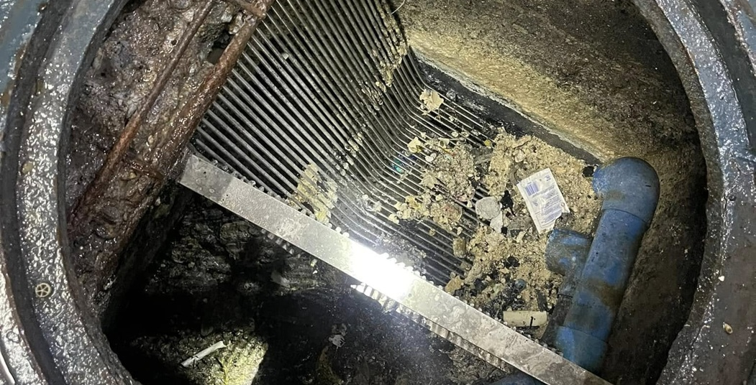
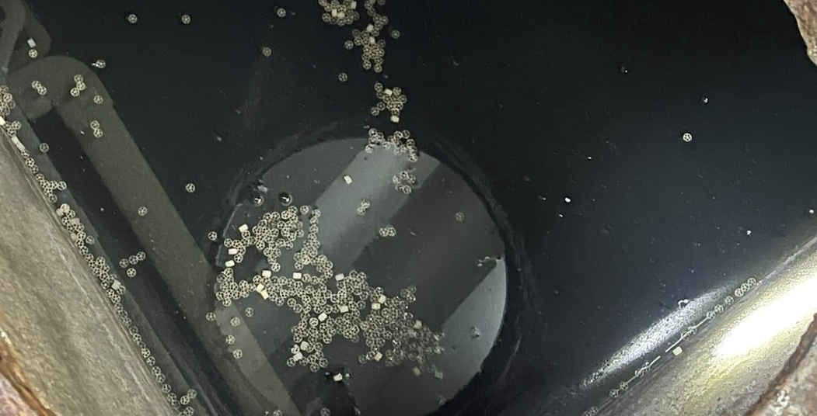
OCEANIDES
OPC TIN: TO FOLLOW
Plumbing, Siphoning, and Pest Management Services OPC
(02) 8633 8486 | Globe 0917 671 6383 | Smart 0939 245 6217
marketing@oceanidessepticandpest.com
Cleaning work: before and after
BEFORE CLEANING
AFTER CLEANING
OCEANIDES
Actual Oceanides photographs show the chamber condition before and after cleaning.
The specific project site, service date and approved case-study details are still to be added.
oceanidesph.com | facebook.com/OceanidesMalabanan
REVIEW DRAFT
marketing@oceanidessepticandpest.com | corporate@oceanidessepticandpest.com
07
Notes:
Actual work photographs
Existing before-1.jpg and after-1.jpg; provenance clients/oceanides/kuya-marvin/organic/VALUE-WEEK-01.md. Site/date/client not supplied. No client logo associated with these images.
Owner review draft. Sources: interview2026-10-11, old PDF and current role/client/address confirmations2026-10-12. Reference imagery is labeled; no logo implies endorsement. Original PPTXv4 preserved. OPC tax details still to follow.

Slide 8
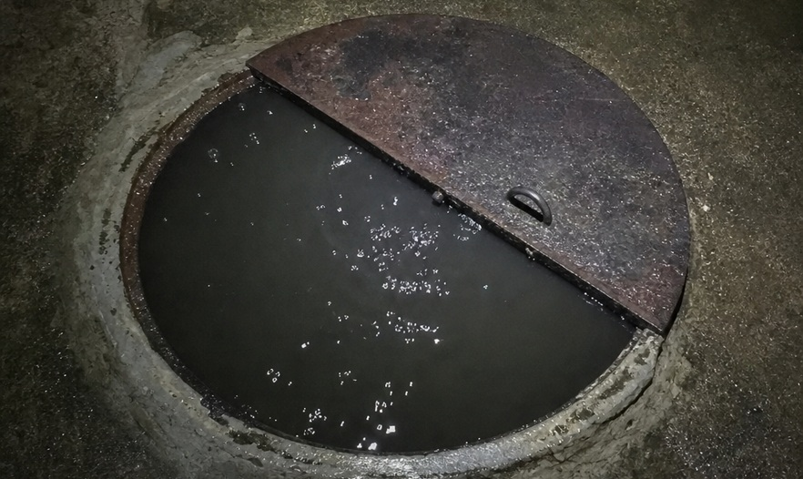
OCEANIDES
OPC TIN: TO FOLLOW
Plumbing, Siphoning, and Pest Management Services OPC
(02) 8633 8486 | Globe 0917 671 6383 | Smart 0939 245 6217
marketing@oceanidessepticandpest.com
Septic Tank Siphoning
Plan septic tank servicing before an overflow
disrupts your property.
Oceanides provides septic tank siphoning for commercial, industrial,
and residential properties. We coordinate access, the work area, and the
agreed service schedule with your site representative.
Review of tank access and service requirements
Removal of accumulated septic contents within the agreed scope
Coordination with site personnel during the work
Recommendations for the next service based on site conditions
AI-generated service illustration
OCEANIDES
Plan servicing around your operations and reduce
avoidable tank-related disruption.
oceanidesph.com | facebook.com/OceanidesMalabanan
REVIEW DRAFT
marketing@oceanidessepticandpest.com | corporate@oceanidessepticandpest.com
08
Notes:
Septic Tank Siphoning
Scope based on owner interview. Final method, personnel requirements and price follow site review. A planned service schedule helps your team address tank buildup and reduce the risk of avoidable disruption.
AI-generated service illustration; source image: clients/oceanides/assets/tb2-hero-manhole.png
Owner review draft. Sources: interview2026-10-11, old PDF and current role/client/address confirmations2026-10-12. Reference imagery is labeled; no logo implies endorsement. Original PPTXv4 preserved. OPC tax details still to follow.

Slide 9
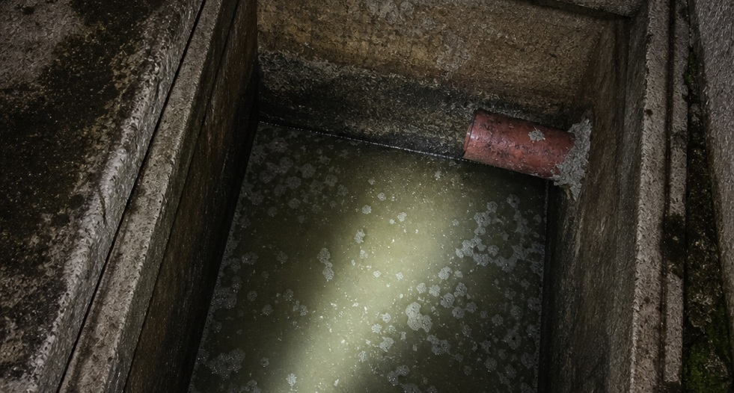
OCEANIDES
OPC TIN: TO FOLLOW
Plumbing, Siphoning, and Pest Management Services OPC
(02) 8633 8486 | Globe 0917 671 6383 | Smart 0939 245 6217
marketing@oceanidessepticandpest.com
Manual Septic Tank Cleaning
Address deposits and buildup that require more
detailed cleaning.
Oceanides assesses deposits that need detailed cleaning beyond
siphoning. The method follows tank condition and access. Any
confined-space entry requires qualified personnel, suitable
equipment, and applicable safety procedures.
Assessment of remaining sludge and solid deposits
Selection of a suitable cleaning method
Detailed cleaning within the agreed work area
AI-generated service illustration
Site turnover and maintenance observations
Choose a cleaning plan that matches tank conditions, access
OCEANIDES
and safety requirements.
oceanidesph.com | facebook.com/OceanidesMalabanan
REVIEW DRAFT
marketing@oceanidessepticandpest.com | corporate@oceanidessepticandpest.com
09
Notes:
Manual Septic Tank Cleaning
Scope based on owner interview. Final method, personnel requirements and price follow site review. A site-specific cleaning plan helps resolve buildup while making the work requirements clear before service begins.
AI-generated service illustration; source image: clients/oceanides/assets/tb2-hero-tank.png
Owner review draft. Sources: interview2026-10-11, old PDF and current role/client/address confirmations2026-10-12. Reference imagery is labeled; no logo implies endorsement. Original PPTXv4 preserved. OPC tax details still to follow.

Slide 10
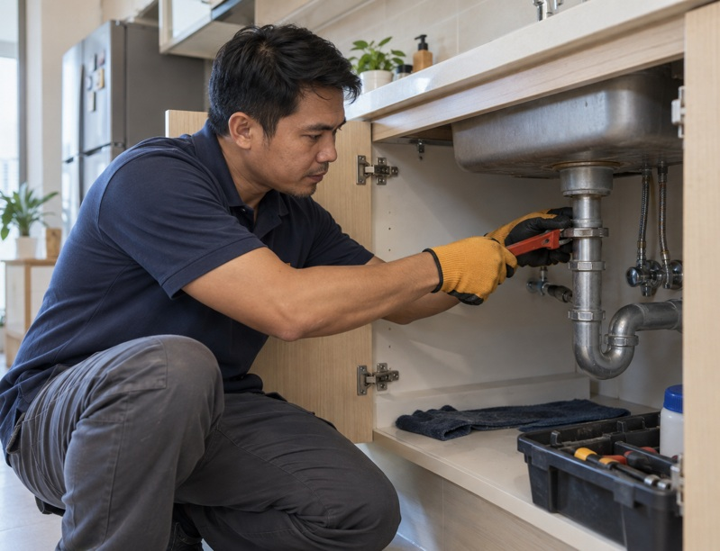
OCEANIDES
OPC TIN: TO FOLLOW
Plumbing, Siphoning, and Pest Management Services OPC
(02) 8633 8486 | Globe 0917 671 6383 | Smart 0939 245 6217
marketing@oceanidessepticandpest.com
Plumbing Services
Keep your property's water supply and drainage
working.
Oceanides handles plumbing assessment, repairs, and installation work for
existing properties and renovation projects. We identify the affected area
and explain the proposed work before implementation.
Water supply and drainage assessment
Pipe and fixture repair or replacement
Installation and alteration within the approved scope
Functional checks and site turnover
AI-generated service illustration
OCEANIDES
Coordinate repair and maintenance concerns through one point of contact.
oceanidesph.com | facebook.com/OceanidesMalabanan
REVIEW DRAFT
marketing@oceanidessepticandpest.com | corporate@oceanidessepticandpest.com
10
Notes:
Plumbing Services
Scope based on owner interview. Final method, personnel requirements and price follow site review. One point of contact for plumbing concerns helps your team coordinate repairs and planned improvements.
AI-generated service illustration; source image: clients/oceanides/company-profile/assets-interview/plumbing-service.png
Owner review draft. Sources: interview2026-10-11, old PDF and current role/client/address confirmations2026-10-12. Reference imagery is labeled; no logo implies endorsement. Original PPTXv4 preserved. OPC tax details still to follow.

Slide 11
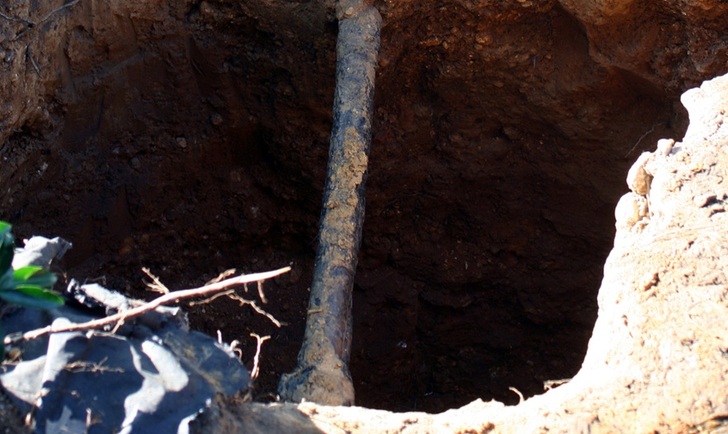
OCEANIDES
OPC TIN: TO FOLLOW
Plumbing, Siphoning, and Pest Management Services OPC
(02) 8633 8486 | Globe 0917 671 6383 | Smart 0939 245 6217
marketing@oceanidessepticandpest.com
Excavation Services
Create access for the underground work your
property needs.
Oceanides provides excavation support for plumbing, drainage, septic
tank, and related property works. The method and boundaries follow a
site review, utility coordination, and the approved work scope.
Site access and excavation scope review
Coordination of known utilities and work boundaries
Excavation for agreed plumbing or drainage works
Backfilling and surface reinstatement where included
Stock: IntangibleArts / Wikimedia Commons, CC BY 2.0; cropped
OCEANIDES
Coordinate excavation, repairs and reinstatement
through one agreed work scope.
oceanidesph.com | facebook.com/OceanidesMalabanan
REVIEW DRAFT
marketing@oceanidessepticandpest.com | corporate@oceanidessepticandpest.com
11
Notes:
Excavation Services
Scope based on owner interview. Final method, personnel requirements and price follow site review. Coordinating excavation with the main repair helps your team plan access, work areas, and reinstatement together.
Stock: IntangibleArts / Wikimedia Commons, CC BY 2.0; cropped; source image: clients/oceanides/company-profile/assets-refresh/service-stock/excavation-water-main-wikimedia.jpg
{
"downloaded_on": "2026-10-12",
"purpose": "Illustrative service images for Oceanides company-profile revision",
"assets": [
{
"filename": "general-cleaning-pexels-6195278.jpg",
"source": "https://www.pexels.com/photo/cleaners-cleaning-the-tiled-floor-6195278/",
"download": "https://images.pexels.com/photos/6195278/pexels-photo-6195278.jpeg?auto=compress&cs=tinysrgb&w=1800",
"photographer": "Tima Miroshnichenko",
"published": "2020-12-15",
"captured": "2020-12-10",
"license": "Pexels License",
"license_url": "https://www.pexels.com/license/",
"service": "General cleaning",
"caption": "Stock photo of cleaning work; not an Oceanides project",
"dimensions": [
1800,
2700
],
"sha256": "afcdcd0292f110a6970926c48dbfb3ef59203fae4ca50a9200ebf257c83c94c3",
"downloaded_on": "2026-10-12",
"status": "visually-inspected",
"changes": "Source image unchanged. Presentation cropping may be applied for placement.",
"visual_review": "Shows two uniformed cleaners, one mopping and one vacuuming. Relevant service illustration. Crop lower two-thirds to retain action."
},
{
"filename": "excavation-water-main-wikimedia.jpg",
"source": "https://commons.wikimedia.org/wiki/File:DC_WASA_lead_water_main.jpg",
"original_source": "https://www.flickr.com/photos/intangible/2697774899/in/photostream/",
"download": "https://upload.wikimedia.org/wikipedia/commons/4/40/DC_WASA_lead_water_main.jpg",
"photographer": "IntangibleArts",
"captured": "2008-07-07",
"license": "CC BY 2.0",
"license_url": "https://creativecommons.org/licenses/by/2.0/",
"service": "Excavation",
"caption": "Excavation exposing a water-service pipe. IntangibleArts / Wikimedia Commons, CC BY 2.0; not an Oceanides project",
"changes": "Source image unchanged. Presentation cropping may be applied for placement.",
"dimensions": [
1000,
1500
],
"sha256": "8f9d166fe47231e50940da8a86355f89628a162a6098288f68d7e58e77a9d149",
"downloaded_on": "2026-10-12",
"status": "visually-inspected",
"visual_review": "Shows excavation exposing an underground water pipe; no workers or confined-space entry. Image is contextual stock, not an Oceanides worksite. Include photographer and CC BY 2.0 credit; note cropped if placed with crop."
},
{
"filename": "aircon-service-pexels-5463576.jpg",
"source": "https://www.pexels.com/photo/man-taping-a-hose-5463576/",
"download": "https://images.pexels.com/photos/5463576/pexels-photo-5463576.jpeg?cs=srgb&dl=pexels-jose-andres-pacheco-cortes-3641213-5463576.jpg&fm=jpg",
"photographer": "Jose Andres Pacheco Cortes",
"published": "2020-09-28",
"captured": "2020-07-22",
"license": "Pexels License",
"license_url": "https://www.pexels.com/license/",
"service": "Air-conditioning cleaning",
"caption": "Stock air-conditioning maintenance photo; not an Oceanides project",
"downloaded_on": "2026-10-12",
"dimensions": [
4000,
6000
],
"sha256": "a6c64efe110e3e0ac8f706b9949c43fafb4c127422ee3e0c261389aa8886d5ac",
"status": "visually-inspected",
"changes": "Source image unchanged. Presentation cropping may be applied for placement.",
"visual_review": "Shows maintenance of a recognizable outdoor air-conditioning unit, not filter washing. Caption must say maintenance. No Oceanides project or manufacturer partnership is asserted."
}
]
}
Owner review draft. Sources: interview2026-10-11, old PDF and current role/client/address confirmations2026-10-12. Reference imagery is labeled; no logo implies endorsement. Original PPTXv4 preserved. OPC tax details still to follow.

Slide 12
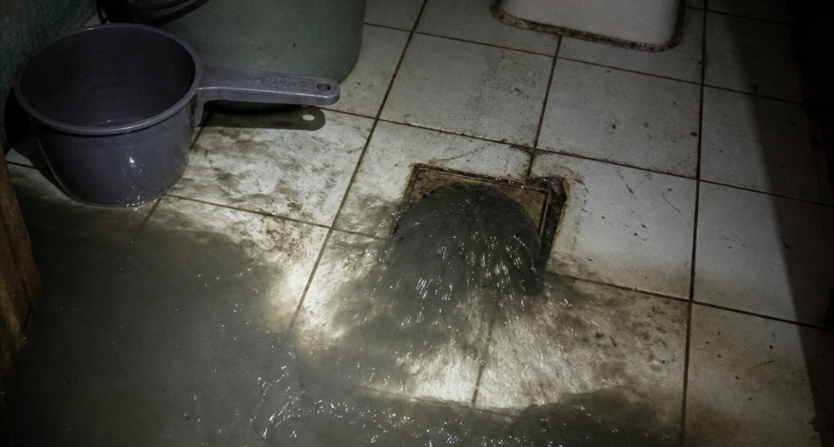
OCEANIDES
OPC TIN: TO FOLLOW
Plumbing, Siphoning, and Pest Management Services OPC
(02) 8633 8486 | Globe 0917 671 6383 | Smart 0939 245 6217
marketing@oceanidessepticandpest.com
Drain and Pipe Declogging
Address slow drains and blocked lines before
problems spread.
Oceanides assesses drainage blockages and applies a suitable
clearing method based on pipe condition, access, and the likely
cause. Recurring blockages may require a separate repair or
further inspection.
Review of the affected drainage line
Clearing of accessible blockages within scope
Water-flow checks after the work
AI-generated drainage illustration
Advice on recurring issues and further repairs
Understand whether a recurring problem needs cleaning,
OCEANIDES
inspection or repair.
oceanidesph.com | facebook.com/OceanidesMalabanan
REVIEW DRAFT
marketing@oceanidessepticandpest.com | corporate@oceanidessepticandpest.com
12
Notes:
Drain and Pipe Declogging
Scope based on owner interview. Final method, personnel requirements and price follow site review. Clear findings help you decide whether a drain needs cleaning, repair, or a planned maintenance schedule.
AI-generated drainage illustration; source image: clients/oceanides/assets/tb2-hero-banyo.png
Owner review draft. Sources: interview2026-10-11, old PDF and current role/client/address confirmations2026-10-12. Reference imagery is labeled; no logo implies endorsement. Original PPTXv4 preserved. OPC tax details still to follow.

Slide 13
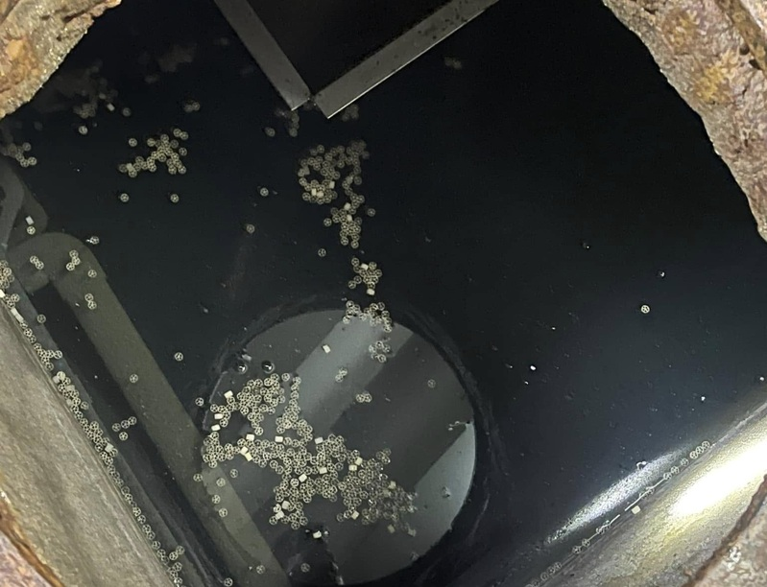
OCEANIDES
OPC TIN: TO FOLLOW
Plumbing, Siphoning, and Pest Management Services OPC
(02) 8633 8486 | Globe 0917 671 6383 | Smart 0939 245 6217
marketing@oceanidessepticandpest.com
Grease tank and trap cleaning
Keep grease buildup from becoming a recurring
kitchen drainage problem.
Oceanides provides grease tank and grease trap cleaning for food-service
properties and other sites with grease-management needs. Work is
coordinated around access and your operating schedule.
Assessment of grease tank or trap access
Removal of accumulated grease and settled waste
Cleaning of accessible internal areas within scope
Recommendations for a practical cleaning schedule
Oceanides asset-library photograph; client/site not specified
OCEANIDES
Manage grease buildup with a cleaning schedule suited to your kitchen.
oceanidesph.com | facebook.com/OceanidesMalabanan
REVIEW DRAFT
marketing@oceanidessepticandpest.com | corporate@oceanidessepticandpest.com
13
Notes:
Grease Tank and Trap Cleaning
Scope based on owner interview. Final method, personnel requirements and price follow site review. Routine servicing helps your team manage grease buildup and maintain kitchen drainage.
Oceanides asset-library photograph; client/site not specified; source image: clients/oceanides/assets/after-1.jpg
Owner review draft. Sources: interview2026-10-11, old PDF and current role/client/address confirmations2026-10-12. Reference imagery is labeled; no logo implies endorsement. Original PPTXv4 preserved. OPC tax details still to follow.

Slide 14

OCEANIDES
OPC TIN: TO FOLLOW
Plumbing, Siphoning, and Pest Management Services OPC
(02) 8633 8486 | Globe 0917 671 6383 | Smart 0939 245 6217
marketing@oceanidessepticandpest.com
Pest Management Services
Protect the spaces where people work, stay, and
dine.
Oceanides develops a pest-management scope around the pest
concern, property use, and site findings. Programs can support
restaurants, hotels, condominiums, offices, warehouses, and residential
properties.
Site inspection and pest concern assessment
Treatment plan for the identified concern
Coordination of preparation and re-entry instructions
Follow-up and prevention advice within the agreed program
AI-generated service illustration
OCEANIDES
Combine treatment, prevention advice and follow-up
in one agreed program.
oceanidesph.com | facebook.com/OceanidesMalabanan
REVIEW DRAFT
marketing@oceanidessepticandpest.com | corporate@oceanidessepticandpest.com
14
Notes:
Pest Management Services
Scope based on owner interview. Final method, personnel requirements and price follow site review. A planned program combines treatment with practical prevention advice and clearer follow-up responsibilities.
AI-generated service illustration; source image: clients/oceanides/company-profile/assets-interview/pest-control-service.png
Owner review draft. Sources: interview2026-10-11, old PDF and current role/client/address confirmations2026-10-12. Reference imagery is labeled; no logo implies endorsement. Original PPTXv4 preserved. OPC tax details still to follow.

Slide 15

OCEANIDES
OPC TIN: TO FOLLOW
Plumbing, Siphoning, and Pest Management Services OPC
(02) 8633 8486 | Globe 0917 671 6383 | Smart 0939 245 6217
marketing@oceanidessepticandpest.com
General Cleaning Services
Present a cleaner, better-cared-for space to
everyone who enters.
Oceanides provides cleaning support for commercial and
residential properties. Cleaning areas, frequency, materials, and
exclusions are defined with the client before work starts.
Site walkthrough and cleaning checklist
Cleaning of agreed rooms and common areas
Coordination around occupancy and site access
Completion review with the client representative
Representative stock photograph; not an Oceanides project
Use a clear checklist to coordinate cleaning and review
OCEANIDES
completion.
oceanidesph.com | facebook.com/OceanidesMalabanan
REVIEW DRAFT
marketing@oceanidessepticandpest.com | corporate@oceanidessepticandpest.com
15
Notes:
General Cleaning Services
Scope based on owner interview. Final method, personnel requirements and price follow site review. A clear checklist makes it easier to coordinate cleaning work and review the result.
Representative stock photograph; not an Oceanides project; source image: clients/oceanides/company-profile/assets-refresh/service-stock/general-cleaning-pexels-6195278.jpg
{
"downloaded_on": "2026-10-12",
"purpose": "Illustrative service images for Oceanides company-profile revision",
"assets": [
{
"filename": "general-cleaning-pexels-6195278.jpg",
"source": "https://www.pexels.com/photo/cleaners-cleaning-the-tiled-floor-6195278/",
"download": "https://images.pexels.com/photos/6195278/pexels-photo-6195278.jpeg?auto=compress&cs=tinysrgb&w=1800",
"photographer": "Tima Miroshnichenko",
"published": "2020-12-15",
"captured": "2020-12-10",
"license": "Pexels License",
"license_url": "https://www.pexels.com/license/",
"service": "General cleaning",
"caption": "Stock photo of cleaning work; not an Oceanides project",
"dimensions": [
1800,
2700
],
"sha256": "afcdcd0292f110a6970926c48dbfb3ef59203fae4ca50a9200ebf257c83c94c3",
"downloaded_on": "2026-10-12",
"status": "visually-inspected",
"changes": "Source image unchanged. Presentation cropping may be applied for placement.",
"visual_review": "Shows two uniformed cleaners, one mopping and one vacuuming. Relevant service illustration. Crop lower two-thirds to retain action."
},
{
"filename": "excavation-water-main-wikimedia.jpg",
"source": "https://commons.wikimedia.org/wiki/File:DC_WASA_lead_water_main.jpg",
"original_source": "https://www.flickr.com/photos/intangible/2697774899/in/photostream/",
"download": "https://upload.wikimedia.org/wikipedia/commons/4/40/DC_WASA_lead_water_main.jpg",
"photographer": "IntangibleArts",
"captured": "2008-07-07",
"license": "CC BY 2.0",
"license_url": "https://creativecommons.org/licenses/by/2.0/",
"service": "Excavation",
"caption": "Excavation exposing a water-service pipe. IntangibleArts / Wikimedia Commons, CC BY 2.0; not an Oceanides project",
"changes": "Source image unchanged. Presentation cropping may be applied for placement.",
"dimensions": [
1000,
1500
],
"sha256": "8f9d166fe47231e50940da8a86355f89628a162a6098288f68d7e58e77a9d149",
"downloaded_on": "2026-10-12",
"status": "visually-inspected",
"visual_review": "Shows excavation exposing an underground water pipe; no workers or confined-space entry. Image is contextual stock, not an Oceanides worksite. Include photographer and CC BY 2.0 credit; note cropped if placed with crop."
},
{
"filename": "aircon-service-pexels-5463576.jpg",
"source": "https://www.pexels.com/photo/man-taping-a-hose-5463576/",
"download": "https://images.pexels.com/photos/5463576/pexels-photo-5463576.jpeg?cs=srgb&dl=pexels-jose-andres-pacheco-cortes-3641213-5463576.jpg&fm=jpg",
"photographer": "Jose Andres Pacheco Cortes",
"published": "2020-09-28",
"captured": "2020-07-22",
"license": "Pexels License",
"license_url": "https://www.pexels.com/license/",
"service": "Air-conditioning cleaning",
"caption": "Stock air-conditioning maintenance photo; not an Oceanides project",
"downloaded_on": "2026-10-12",
"dimensions": [
4000,
6000
],
"sha256": "a6c64efe110e3e0ac8f706b9949c43fafb4c127422ee3e0c261389aa8886d5ac",
"status": "visually-inspected",
"changes": "Source image unchanged. Presentation cropping may be applied for placement.",
"visual_review": "Shows maintenance of a recognizable outdoor air-conditioning unit, not filter washing. Caption must say maintenance. No Oceanides project or manufacturer partnership is asserted."
}
]
}
Owner review draft. Sources: interview2026-10-11, old PDF and current role/client/address confirmations2026-10-12. Reference imagery is labeled; no logo implies endorsement. Original PPTXv4 preserved. OPC tax details still to follow.

Slide 16
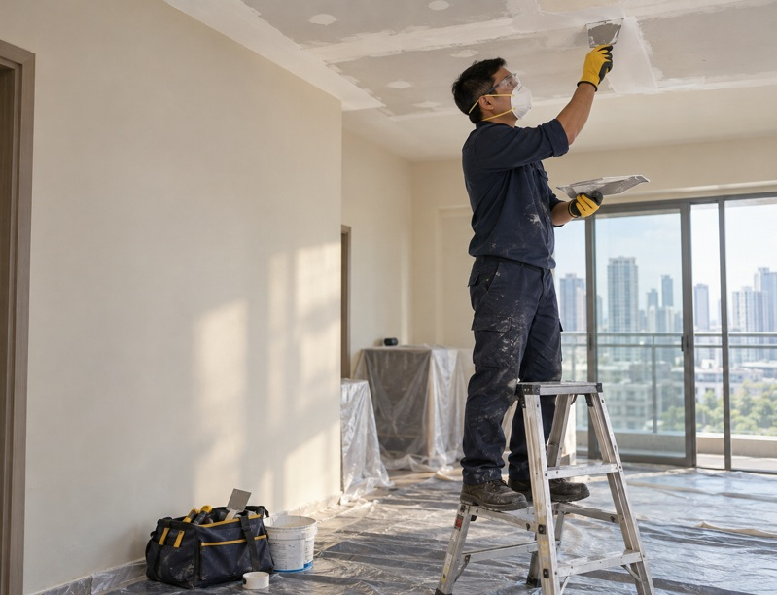
OCEANIDES
OPC TIN: TO FOLLOW
Plumbing, Siphoning, and Pest Management Services OPC
(02) 8633 8486 | Globe 0917 671 6383 | Smart 0939 245 6217
marketing@oceanidessepticandpest.com
Renovation, restoration and leak repairs
Repair damaged spaces and plan improvements with a
defined scope.
Oceanides accepts renovation and restoration work for homes,
condominiums, and commercial properties, including ceiling repairs and
water-leak concerns. The proposed work follows a site assessment, with
specialist involvement where the project requires it.
Site assessment of damage and requested improvements
Ceiling repair and restoration within scope
Water-leak investigation and proposed corrective work
Renovation coordination and agreed finish review
AI-generated service illustration
OCEANIDES
Coordinate related repairs, access, schedules and turnover in one scope.
oceanidesph.com | facebook.com/OceanidesMalabanan
REVIEW DRAFT
marketing@oceanidessepticandpest.com | corporate@oceanidessepticandpest.com
16
Notes:
Renovation, Restoration and Leak Repairs
Scope based on owner interview. Final method, personnel requirements and price follow site review. Combining related repair work under one coordinated scope helps your team manage access, schedules, and turnover.
AI-generated service illustration; source image: clients/oceanides/company-profile/assets-interview/renovation-service.png
Owner review draft. Sources: interview2026-10-11, old PDF and current role/client/address confirmations2026-10-12. Reference imagery is labeled; no logo implies endorsement. Original PPTXv4 preserved. OPC tax details still to follow.

Slide 17
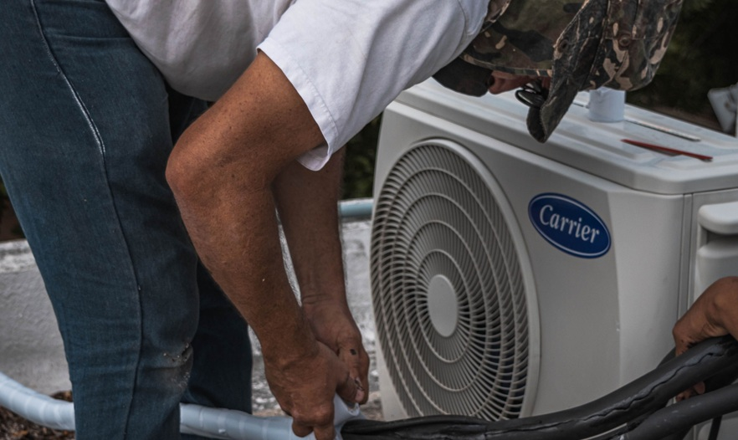
OCEANIDES
OPC TIN: TO FOLLOW
Plumbing, Siphoning, and Pest Management Services OPC
(02) 8633 8486 | Globe 0917 671 6383 | Smart 0939 245 6217
marketing@oceanidessepticandpest.com
Air-Conditioning Cleaning
Include your air-conditioning units in your property
maintenance plan.
Oceanides provides air-conditioning cleaning based on unit type,
access, and condition. Cleaning findings that require repair or further
technical work are discussed separately with the client.
Review of unit type and service access
Cleaning of agreed accessible components
Drainage and visible-condition observations
Basic operation check after cleaning
Stock air-conditioning maintenance photo; not an Oceanides project
OCEANIDES
Plan unit upkeep and identify issues that need
technical attention.
oceanidesph.com | facebook.com/OceanidesMalabanan
REVIEW DRAFT
marketing@oceanidessepticandpest.com | corporate@oceanidessepticandpest.com
17
Notes:
Air-Conditioning Cleaning
Scope based on owner interview. Final method, personnel requirements and price follow site review. Planned cleaning helps you manage unit upkeep and identify concerns that need further attention.
Stock air-conditioning maintenance photo; not an Oceanides project; source image: clients/oceanides/company-profile/assets-refresh/service-stock/aircon-service-pexels-5463576.jpg
{
"downloaded_on": "2026-10-12",
"purpose": "Illustrative service images for Oceanides company-profile revision",
"assets": [
{
"filename": "general-cleaning-pexels-6195278.jpg",
"source": "https://www.pexels.com/photo/cleaners-cleaning-the-tiled-floor-6195278/",
"download": "https://images.pexels.com/photos/6195278/pexels-photo-6195278.jpeg?auto=compress&cs=tinysrgb&w=1800",
"photographer": "Tima Miroshnichenko",
"published": "2020-12-15",
"captured": "2020-12-10",
"license": "Pexels License",
"license_url": "https://www.pexels.com/license/",
"service": "General cleaning",
"caption": "Stock photo of cleaning work; not an Oceanides project",
"dimensions": [
1800,
2700
],
"sha256": "afcdcd0292f110a6970926c48dbfb3ef59203fae4ca50a9200ebf257c83c94c3",
"downloaded_on": "2026-10-12",
"status": "visually-inspected",
"changes": "Source image unchanged. Presentation cropping may be applied for placement.",
"visual_review": "Shows two uniformed cleaners, one mopping and one vacuuming. Relevant service illustration. Crop lower two-thirds to retain action."
},
{
"filename": "excavation-water-main-wikimedia.jpg",
"source": "https://commons.wikimedia.org/wiki/File:DC_WASA_lead_water_main.jpg",
"original_source": "https://www.flickr.com/photos/intangible/2697774899/in/photostream/",
"download": "https://upload.wikimedia.org/wikipedia/commons/4/40/DC_WASA_lead_water_main.jpg",
"photographer": "IntangibleArts",
"captured": "2008-07-07",
"license": "CC BY 2.0",
"license_url": "https://creativecommons.org/licenses/by/2.0/",
"service": "Excavation",
"caption": "Excavation exposing a water-service pipe. IntangibleArts / Wikimedia Commons, CC BY 2.0; not an Oceanides project",
"changes": "Source image unchanged. Presentation cropping may be applied for placement.",
"dimensions": [
1000,
1500
],
"sha256": "8f9d166fe47231e50940da8a86355f89628a162a6098288f68d7e58e77a9d149",
"downloaded_on": "2026-10-12",
"status": "visually-inspected",
"visual_review": "Shows excavation exposing an underground water pipe; no workers or confined-space entry. Image is contextual stock, not an Oceanides worksite. Include photographer and CC BY 2.0 credit; note cropped if placed with crop."
},
{
"filename": "aircon-service-pexels-5463576.jpg",
"source": "https://www.pexels.com/photo/man-taping-a-hose-5463576/",
"download": "https://images.pexels.com/photos/5463576/pexels-photo-5463576.jpeg?cs=srgb&dl=pexels-jose-andres-pacheco-cortes-3641213-5463576.jpg&fm=jpg",
"photographer": "Jose Andres Pacheco Cortes",
"published": "2020-09-28",
"captured": "2020-07-22",
"license": "Pexels License",
"license_url": "https://www.pexels.com/license/",
"service": "Air-conditioning cleaning",
"caption": "Stock air-conditioning maintenance photo; not an Oceanides project",
"downloaded_on": "2026-10-12",
"dimensions": [
4000,
6000
],
"sha256": "a6c64efe110e3e0ac8f706b9949c43fafb4c127422ee3e0c261389aa8886d5ac",
"status": "visually-inspected",
"changes": "Source image unchanged. Presentation cropping may be applied for placement.",
"visual_review": "Shows maintenance of a recognizable outdoor air-conditioning unit, not filter washing. Caption must say maintenance. No Oceanides project or manufacturer partnership is asserted."
}
]
}
Owner review draft. Sources: interview2026-10-11, old PDF and current role/client/address confirmations2026-10-12. Reference imagery is labeled; no logo implies endorsement. Original PPTXv4 preserved. OPC tax details still to follow.

Slide 18
OCEANIDES
OPC TIN: TO FOLLOW
Plumbing, Siphoning, and Pest Management Services OPC
(02) 8633 8486 | Globe 0917 671 6383 | Smart 0939 245 6217
marketing@oceanidessepticandpest.com
Onsite wastewater treatment systems
A treatment system at your property, backed by agreed operating support.
Begin with a site assessment to define a suitable treatment approach and a complete operating plan.
Your property
Technical assessment
Operating plan
Wastewater flows, tanks, space and
Treatment approach, capacity,
Maintenance, monitoring, sludge
maintenance records
installation and costs
removal and agreed support
OCEANIDES
Compare the proposed system with your current maintenance pattern before deciding.
oceanidesph.com | facebook.com/OceanidesMalabanan
REVIEW DRAFT
marketing@oceanidessepticandpest.com | corporate@oceanidessepticandpest.com
18
Notes:
Onsite treatment system offer
Owner calls this Septage Treatment Facility. Wastewater source and volume, technology, supplier, design capacity and discharge requirements are not yet established. Generic process diagram below is a project scoping diagram, not a technical flow sheet.
Owner review draft. Sources: interview2026-10-11, old PDF and current role/client/address confirmations2026-10-12. Reference imagery is labeled; no logo implies endorsement. Original PPTXv4 preserved. OPC tax details still to follow.

Slide 19
OCEANIDES
OPC TIN: TO FOLLOW
Plumbing, Siphoning, and Pest Management Services OPC
(02) 8633 8486 | Globe 0917 671 6383 | Smart 0939 245 6217
marketing@oceanidessepticandpest.com
What changes with a treatment system?
Your current service pattern
A proposed treatment plan
Start with the property's actual operating records.
Assess the complete operating requirements.
Tank condition and available space
System capacity and installation works
Siphoning and cleaning frequency
Energy, monitoring and sludge removal
Disruption, access and service cost
Maintenance, support fees and responsibilities
OCEANIDES
Any reduction in cost or service frequency must be supported by a site-specific assessment.
oceanidesph.com | facebook.com/OceanidesMalabanan
REVIEW DRAFT
marketing@oceanidessepticandpest.com | corporate@oceanidessepticandpest.com
19
Notes:
Treatment planning
Decision framework only; no fixed saving, zero-siphoning, automatic self-treatment or maintenance-free guarantee. Economics and service intervals depend on the chosen system and site.
Owner review draft. Sources: interview2026-10-11, old PDF and current role/client/address confirmations2026-10-12. Reference imagery is labeled; no logo implies endorsement. Original PPTXv4 preserved. OPC tax details still to follow.

Slide 20
OCEANIDES
OPC TIN: TO FOLLOW
Plumbing, Siphoning, and Pest Management Services OPC
(02) 8633 8486 | Globe 0917 671 6383 | Smart 0939 245 6217
marketing@oceanidessepticandpest.com
Installation is the start of ongoing support
01
02
03
04
Assess
Propose
Install
Support
Review flows, tanks,
Define technology,
Coordinate delivery,
Agree servicing, guidance
access and operating
capacity, scope and costs.
checks and handover.
and document
needs.
assistance.
OCEANIDES
Support terms and permit-document responsibilities are agreed in writing. Regulatory decisions remain with the
relevant authority.
oceanidesph.com | facebook.com/OceanidesMalabanan
REVIEW DRAFT
marketing@oceanidessepticandpest.com | corporate@oceanidessepticandpest.com
20
Notes:
Treatment project and after-sales support
Proposed sequence. Support duration, fees, warranty, response arrangements and client operating duties to be agreed. Permit-document assistance is not guaranteed regulatory approval.
Owner review draft. Sources: interview2026-10-11, old PDF and current role/client/address confirmations2026-10-12. Reference imagery is labeled; no logo implies endorsement. Original PPTXv4 preserved. OPC tax details still to follow.

Slide 21
OCEANIDES
OPC TIN: TO FOLLOW
Plumbing, Siphoning, and Pest Management Services OPC
(02) 8633 8486 | Globe 0917 671 6383 | Smart 0939 245 6217
marketing@oceanidessepticandpest.com
Organizational structure
Agosto Cepriano
CEO / Founder
Allan
Operations
Neil
Finance / HR Manager
Supervisor / Team Leader
Marketing Head
Finance and accounting
Drivers, servicers and helpers
Digital marketing
HR and administration
Onsite service coordination
Sales and inquiry coordination
Client support: Floreza | Digital marketing: Queenie and Aubrey
OCEANIDES
Current names and roles confirmed. Reporting lines remain for management confirmation.
oceanidesph.com | facebook.com/OceanidesMalabanan
REVIEW DRAFT
marketing@oceanidessepticandpest.com | corporate@oceanidessepticandpest.com
21
Notes:
Organizational structure
Names and existing roles confirmed current by user2026-10-12. Reporting lines are proposed for management confirmation. Operations supervisor is a role, not an invented named manager. No headcount or new specialist license asserted.
Owner review draft. Sources: interview2026-10-11, old PDF and current role/client/address confirmations2026-10-12. Reference imagery is labeled; no logo implies endorsement. Original PPTXv4 preserved. OPC tax details still to follow.

Slide 22
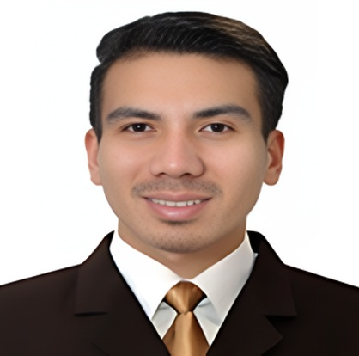
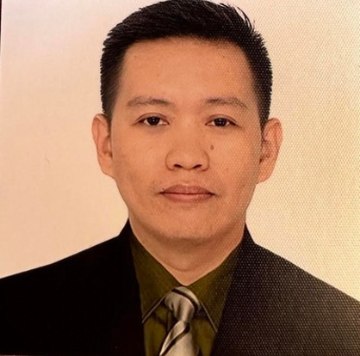

OCEANIDES
OPC TIN: TO FOLLOW
Plumbing, Siphoning, and Pest Management Services OPC
(02) 8633 8486 | Globe 0917 671 6383 | Smart 0939 245 6217
marketing@oceanidessepticandpest.com
Leadership and management
Agosto Cepriano
Allan
Neil
CEO / Founder
Finance / HR Manager
Marketing Head
Company leadership and strategic
Finance, people and administrative
OCEANIDES
Marketing direction and client acquisition.
direction.
coordination.
oceanidesph.com | facebook.com/OceanidesMalabanan
REVIEW DRAFT
marketing@oceanidessepticandpest.com | corporate@oceanidessepticandpest.com
22
Notes:
Leadership and management
Portraits extracted unchanged from old profile pages6 and8. User confirmed all names/roles current2026-10-12. No surnames for staff invented. Photo framing only; no generated people.
Owner review draft. Sources: interview2026-10-11, old PDF and current role/client/address confirmations2026-10-12. Reference imagery is labeled; no logo implies endorsement. Original PPTXv4 preserved. OPC tax details still to follow.

Slide 23



OCEANIDES
OPC TIN: TO FOLLOW
Plumbing, Siphoning, and Pest Management Services OPC
(02) 8633 8486 | Globe 0917 671 6383 | Smart 0939 245 6217
marketing@oceanidessepticandpest.com
Marketing and client support
Queenie
Aubrey
Floreza
Digital Marketing Specialist
Digital Marketing Specialist
Customer Service Representative
Digital campaigns and online lead
Digital channels and campaign
OCEANIDES
Client inquiries and service coordination.
generation.
coordination.
oceanidesph.com | facebook.com/OceanidesMalabanan
REVIEW DRAFT
marketing@oceanidessepticandpest.com | corporate@oceanidessepticandpest.com
23
Notes:
Marketing and client support
Portraits extracted unchanged from old profile pages6 and8. User confirmed all names/roles current2026-10-12. No surnames for staff invented. Photo framing only; no generated people.
Owner review draft. Sources: interview2026-10-11, old PDF and current role/client/address confirmations2026-10-12. Reference imagery is labeled; no logo implies endorsement. Original PPTXv4 preserved. OPC tax details still to follow.

Slide 24
OCEANIDES
OPC TIN: TO FOLLOW
Plumbing, Siphoning, and Pest Management Services OPC
(02) 8633 8486 | Globe 0917 671 6383 | Smart 0939 245 6217
marketing@oceanidessepticandpest.com
Company and project documentation
Documentation is coordinated during supplier accreditation and project scoping.
Company registration
Current OPC registration, tax and business-permit records
Service-specific records
Documents applicable to the agreed work and service provider
Treatment and disposal
Relevant facility records, agreements and supporting documentation
Project handover
Agreed completion records, operating guidance and service reports
OCEANIDES
Review status: current OPC documents and service-specific supporting copies are still to be inserted.
oceanidesph.com | facebook.com/OceanidesMalabanan
REVIEW DRAFT
marketing@oceanidessepticandpest.com | corporate@oceanidessepticandpest.com
24
Notes:
Supplier documentation
Old profile pages13-22 contain historical sole-proprietor records and Reed provider records. Current OPC SEC certificate, BIR COR and current business permit not supplied. Do not label applicant affidavit, individual PCO accreditation or payment receipt as Oceanides facility permits. No agency logo badges used as proof.
Owner review draft. Sources: interview2026-10-11, old PDF and current role/client/address confirmations2026-10-12. Reference imagery is labeled; no logo implies endorsement. Original PPTXv4 preserved. OPC tax details still to follow.

Slide 25
OCEANIDES
OPC TIN: TO FOLLOW
Plumbing, Siphoning, and Pest Management Services OPC
(02) 8633 8486 | Globe 0917 671 6383 | Smart 0939 245 6217
marketing@oceanidessepticandpest.com
A clear process for every engagement
01
Tell us what your site needs
Share the location, property type, service concern, and preferred schedule.
02
Review the scope
Oceanides assesses the information and arranges a site visit where needed.
03
Approve the proposal
Review the work scope, price, schedule, site requirements, and agreed responsibilities.
04
Coordinate the service
Our team works with your representative on access, implementation, and progress updates.
05
Review and plan ahead
OCEANIDES
Confirm completion and discuss any recommended follow-up or recurring service needs.
oceanidesph.com | facebook.com/OceanidesMalabanan
REVIEW DRAFT
marketing@oceanidessepticandpest.com | corporate@oceanidessepticandpest.com
25
Notes:
Service coordination
Proposed client engagement workflow. All scope, cost, timing and responsibilities documented in the service agreement.
Owner review draft. Sources: interview2026-10-11, old PDF and current role/client/address confirmations2026-10-12. Reference imagery is labeled; no logo implies endorsement. Original PPTXv4 preserved. OPC tax details still to follow.

Slide 26
OCEANIDES
OPC TIN: TO FOLLOW
Plumbing, Siphoning, and Pest Management Services OPC
(02) 8633 8486 | Globe 0917 671 6383 | Smart 0939 245 6217
marketing@oceanidessepticandpest.com
Metro Manila first. Wider reach by arrangement.
PRIORITY SERVICE AREAS
EXTENDED COVERAGE
Metro Manila
Central and Northern Luzon
Cavite, Laguna, Batangas and Rizal
Bulacan, Pampanga and Bataan
Nationwide projects by
arrangement
Zambales, including Subic and Olongapo
OCEANIDES
Detailed city and municipality coverage follows in the appendix.
Service availability, travel requirements and schedules are confirmed for each request.
oceanidesph.com | facebook.com/OceanidesMalabanan
REVIEW DRAFT
marketing@oceanidessepticandpest.com | corporate@oceanidessepticandpest.com
26
Notes:
Service coverage overview
Owner-confirmed priority service areas. Availability depends on service/site/schedule. Detailed190LGUs in appendix; nationwidebyarrangement. No instantarrivalpromise.
Owner review draft. Sources: interview2026-10-11, old PDF and current role/client/address confirmations2026-10-12. Reference imagery is labeled; no logo implies endorsement. Original PPTXv4 preserved. OPC tax details still to follow.

Slide 27
OCEANIDES
OPC TIN: TO FOLLOW
Plumbing, Siphoning, and Pest Management Services OPC
(02) 8633 8486 | Globe 0917 671 6383 | Smart 0939 245 6217
marketing@oceanidessepticandpest.com
Let us review your property service needs
Arrange a site assessment or discuss a service proposal with Oceanides.
0917 671 6383
0939 245 6217
(02) 8633 8486
Tramo Street Corner Dandan
Pasay City, Philippines 1300
marketing@oceanidessepticandpest.com
corporate@oceanidessepticandpest.com
OCEANIDES
Please share the service, site location and preferred schedule so we can coordinate the next step.
oceanidesph.com | facebook.com/OceanidesMalabanan
REVIEW DRAFT
marketing@oceanidessepticandpest.com | corporate@oceanidessepticandpest.com
27
Notes:
Contact Oceanides
Mobiles and primary landline agree between new letterhead and oldprofile. Conflicting secondlandline omitted pendingconfirmation. Address supplied by user screenshot2026-10-12: TramoStreetCornerDandan,PasayCity,Philippines1300. OPC TIN userconfirmedtofollow. Website and Facebook from client configuration. No unverified office number added.
Owner review draft. Sources: interview2026-10-11, old PDF and current role/client/address confirmations2026-10-12. Reference imagery is labeled; no logo implies endorsement. Original PPTXv4 preserved. OPC tax details still to follow.

Slide 28
OCEANIDES
OPC TIN: TO FOLLOW
Plumbing, Siphoning, and Pest Management Services OPC
(02) 8633 8486 | Globe 0917 671 6383 | Smart 0939 245 6217
marketing@oceanidessepticandpest.com
Metro Manila
Coverage appendix | Cities and municipalities
Caloocan
Marikina
Quezon City
Las Piñas
Muntinlupa
San Juan
Makati
Navotas
Taguig
Malabon
Parañaque
Valenzuela
Mandaluyong
Pasay
Pateros
Manila
Pasig
OCEANIDES
Geographic names: PSA PSGC. Service schedule and availability confirmed upon inquiry.
oceanidesph.com | facebook.com/OceanidesMalabanan
REVIEW DRAFT
marketing@oceanidessepticandpest.com | corporate@oceanidessepticandpest.com
28
Notes:
Coverage appendix - Metro Manila
Owner service coverage. Geographic names verified against PSA PSGC: https://psa.gov.ph/classification/psgc/summary
Owner review draft. Sources: interview2026-10-11, old PDF and current role/client/address confirmations2026-10-12. Reference imagery is labeled; no logo implies endorsement. Original PPTXv4 preserved. OPC tax details still to follow.

Slide 29
OCEANIDES
OPC TIN: TO FOLLOW
Plumbing, Siphoning, and Pest Management Services OPC
(02) 8633 8486 | Globe 0917 671 6383 | Smart 0939 245 6217
marketing@oceanidessepticandpest.com
Cavite
Coverage appendix | Cities and municipalities
Bacoor
Alfonso
Naic
Carmona
Amadeo
Noveleta
Cavite City
General Emilio Aguinaldo
Rosario
Dasmariñas
Indang
Silang
General Trias
Kawit
Tanza
Imus
Magallanes
Ternate
Tagaytay
Maragondon
General Mariano Alvarez
Trece Martires
Mendez
OCEANIDES
Geographic names: PSA PSGC. Service schedule and availability confirmed upon inquiry.
oceanidesph.com | facebook.com/OceanidesMalabanan
REVIEW DRAFT
marketing@oceanidessepticandpest.com | corporate@oceanidessepticandpest.com
29
Notes:
Coverage appendix - Cavite
Owner service coverage. Geographic names verified against PSA PSGC: https://psa.gov.ph/classification/psgc/citimuni/0402100000
Owner review draft. Sources: interview2026-10-11, old PDF and current role/client/address confirmations2026-10-12. Reference imagery is labeled; no logo implies endorsement. Original PPTXv4 preserved. OPC tax details still to follow.

Slide 30
OCEANIDES
OPC TIN: TO FOLLOW
Plumbing, Siphoning, and Pest Management Services OPC
(02) 8633 8486 | Globe 0917 671 6383 | Smart 0939 245 6217
marketing@oceanidessepticandpest.com
Laguna
Coverage appendix | Cities and municipalities
Biñan
Famy
Paete
Cabuyao
Kalayaan
Pagsanjan
Calamba
Liliw
Pakil
San Pablo
Los Baños
Pangil
San Pedro
Luisiana
Pila
Santa Rosa
Lumban
Rizal
Alaminos
Mabitac
Santa Cruz
Bay
Magdalena
Santa Maria
Calauan
Majayjay
Siniloan
Cavinti
Nagcarlan
Victoria
OCEANIDES
Geographic names: PSA PSGC. Service schedule and availability confirmed upon inquiry.
oceanidesph.com | facebook.com/OceanidesMalabanan
REVIEW DRAFT
marketing@oceanidessepticandpest.com | corporate@oceanidessepticandpest.com
30
Notes:
Coverage appendix - Laguna
Owner service coverage. Geographic names verified against PSA PSGC: https://psa.gov.ph/classification/psgc/citimuni/0403400000
Owner review draft. Sources: interview2026-10-11, old PDF and current role/client/address confirmations2026-10-12. Reference imagery is labeled; no logo implies endorsement. Original PPTXv4 preserved. OPC tax details still to follow.

Slide 31
OCEANIDES
OPC TIN: TO FOLLOW
Plumbing, Siphoning, and Pest Management Services OPC
(02) 8633 8486 | Globe 0917 671 6383 | Smart 0939 245 6217
marketing@oceanidessepticandpest.com
Batangas
Coverage appendix | Cities and municipalities
Batangas City
Ibaan
San Juan
Calaca
Laurel
San Luis
Lipa
Lemery
San Nicolas
Santo Tomas
Lian
San Pascual
Tanauan
Lobo
Santa Teresita
Agoncillo
Mabini
Taal
Alitagtag
Malvar
Talisay
Balayan
Mataasnakahoy
Taysan
Balete
Nasugbu
Tingloy
Bauan
Padre Garcia
Tuy
Calatagan
Rosario
Cuenca
San Jose
OCEANIDES
Geographic names: PSA PSGC. Service schedule and availability confirmed upon inquiry.
oceanidesph.com | facebook.com/OceanidesMalabanan
REVIEW DRAFT
marketing@oceanidessepticandpest.com | corporate@oceanidessepticandpest.com
31
Notes:
Coverage appendix - Batangas
Owner service coverage. Geographic names verified against PSA PSGC: https://psa.gov.ph/classification/psgc/citimuni/0401000000
Owner review draft. Sources: interview2026-10-11, old PDF and current role/client/address confirmations2026-10-12. Reference imagery is labeled; no logo implies endorsement. Original PPTXv4 preserved. OPC tax details still to follow.

Slide 32
OCEANIDES
OPC TIN: TO FOLLOW
Plumbing, Siphoning, and Pest Management Services OPC
(02) 8633 8486 | Globe 0917 671 6383 | Smart 0939 245 6217
marketing@oceanidessepticandpest.com
Rizal
Coverage appendix | Cities and municipalities
Antipolo
Cardona
San Mateo
Angono
Jala-Jala
Tanay
Baras
Rodriguez
Taytay
Binangonan
Morong
Teresa
Cainta
Pililla
OCEANIDES
Geographic names: PSA PSGC. Service schedule and availability confirmed upon inquiry.
oceanidesph.com | facebook.com/OceanidesMalabanan
REVIEW DRAFT
marketing@oceanidessepticandpest.com | corporate@oceanidessepticandpest.com
32
Notes:
Coverage appendix - Rizal
Owner service coverage. Geographic names verified against PSA PSGC: https://psa.gov.ph/classification/psgc/citimuni/0405800000
Owner review draft. Sources: interview2026-10-11, old PDF and current role/client/address confirmations2026-10-12. Reference imagery is labeled; no logo implies endorsement. Original PPTXv4 preserved. OPC tax details still to follow.

Slide 33
OCEANIDES
OPC TIN: TO FOLLOW
Plumbing, Siphoning, and Pest Management Services OPC
(02) 8633 8486 | Globe 0917 671 6383 | Smart 0939 245 6217
marketing@oceanidessepticandpest.com
Bulacan
Coverage appendix | Cities and municipalities
Baliwag
Bustos
Paombong
Malolos
Calumpit
Plaridel
Meycauayan
Guiguinto
Pulilan
San Jose del Monte
Hagonoy
San Ildefonso
Angat
Marilao
San Miguel
Balagtas
Norzagaray
San Rafael
Bocaue
Obando
Santa Maria
Bulacan
Pandi
Doña Remedios Trinidad
OCEANIDES
Geographic names: PSA PSGC. Service schedule and availability confirmed upon inquiry.
oceanidesph.com | facebook.com/OceanidesMalabanan
REVIEW DRAFT
marketing@oceanidessepticandpest.com | corporate@oceanidessepticandpest.com
33
Notes:
Coverage appendix - Bulacan
Owner service coverage. Geographic names verified against PSA PSGC: https://psa.gov.ph/classification/psgc/citimuni/0301400000
Owner review draft. Sources: interview2026-10-11, old PDF and current role/client/address confirmations2026-10-12. Reference imagery is labeled; no logo implies endorsement. Original PPTXv4 preserved. OPC tax details still to follow.

Slide 34
OCEANIDES
OPC TIN: TO FOLLOW
Plumbing, Siphoning, and Pest Management Services OPC
(02) 8633 8486 | Globe 0917 671 6383 | Smart 0939 245 6217
marketing@oceanidessepticandpest.com
Pampanga and Angeles
Coverage appendix | Cities and municipalities
Angeles
Guagua
San Luis
Mabalacat
Lubao
San Simon
San Fernando
Macabebe
Santa Ana
Apalit
Magalang
Santa Rita
Arayat
Masantol
Santo Tomas
Bacolor
Mexico
Sasmuan
Candaba
Minalin
Floridablanca
Porac
OCEANIDES
Geographic names: PSA PSGC. Service schedule and availability confirmed upon inquiry.
oceanidesph.com | facebook.com/OceanidesMalabanan
REVIEW DRAFT
marketing@oceanidessepticandpest.com | corporate@oceanidessepticandpest.com
34
Notes:
Coverage appendix - Pampanga and Angeles
Owner service coverage. Geographic names verified against PSA PSGC: https://psa.gov.ph/classification/psgc/summary
Owner review draft. Sources: interview2026-10-11, old PDF and current role/client/address confirmations2026-10-12. Reference imagery is labeled; no logo implies endorsement. Original PPTXv4 preserved. OPC tax details still to follow.

Slide 35
OCEANIDES
OPC TIN: TO FOLLOW
Plumbing, Siphoning, and Pest Management Services OPC
(02) 8633 8486 | Globe 0917 671 6383 | Smart 0939 245 6217
marketing@oceanidessepticandpest.com
Zambales and Olongapo
Coverage appendix | Cities and municipalities
Olongapo
Iba
San Marcelino
Botolan
Masinloc
San Narciso
Cabangan
Palauig
Santa Cruz
Candelaria
San Antonio
Subic
Castillejos
San Felipe
OCEANIDES
Geographic names: PSA PSGC. Service schedule and availability confirmed upon inquiry.
oceanidesph.com | facebook.com/OceanidesMalabanan
REVIEW DRAFT
marketing@oceanidessepticandpest.com | corporate@oceanidessepticandpest.com
35
Notes:
Coverage appendix - Zambales and Olongapo
Owner service coverage. Geographic names verified against PSA PSGC: https://psa.gov.ph/classification/psgc/summary
Owner review draft. Sources: interview2026-10-11, old PDF and current role/client/address confirmations2026-10-12. Reference imagery is labeled; no logo implies endorsement. Original PPTXv4 preserved. OPC tax details still to follow.

Slide 36
OCEANIDES
OPC TIN: TO FOLLOW
Plumbing, Siphoning, and Pest Management Services OPC
(02) 8633 8486 | Globe 0917 671 6383 | Smart 0939 245 6217
marketing@oceanidessepticandpest.com
Bataan
Coverage appendix | Cities and municipalities
Balanga
Hermosa
Orani
Abucay
Limay
Orion
Bagac
Mariveles
Pilar
Dinalupihan
Morong
Samal
OCEANIDES
Geographic names: PSA PSGC. Service schedule and availability confirmed upon inquiry.
oceanidesph.com | facebook.com/OceanidesMalabanan
REVIEW DRAFT
marketing@oceanidessepticandpest.com | corporate@oceanidessepticandpest.com
36
Notes:
Coverage appendix - Bataan
Owner service coverage. Geographic names verified against PSA PSGC: https://psa.gov.ph/classification/psgc/citimuni/0300800000
Owner review draft. Sources: interview2026-10-11, old PDF and current role/client/address confirmations2026-10-12. Reference imagery is labeled; no logo implies endorsement. Original PPTXv4 preserved. OPC tax details still to follow.

