Slide 1


Company
profile
Property services for homes
and company facilities
AI-generated conceptual illustration
Company profile
01
Notes:
Company legal name, five service groups, delivery and current contacts: clients/oceanides/company-profile/profile-content.json and premium-content.json.
Design inspiration: supplied Oceanides.pptx, especially slides 1, 2, 3, 4, 6, 9, 12 and 23. Reference images, equipment, staff and third-party marks are not reused.
Logo: company-profile/assets/logo-transparent.png. Full emblem and alpha retained.
Cover illustration: company-profile/assets/cover-property-minimal.png. Source brief: company-profile/assets/generated-sources.json.

Slide 2
Company background
Oceanides coordinates property services for homes,
condominiums and company facilities.
We remain your main contact for scheduling, site access
and service coordination from inquiry to turnover.
2021
Septic and plumbing services
Oceanides Plumbing Services was established.
Today
A broader property service offering
Five service groups for the care and upkeep of homes and facilities.
Company profile
02
Notes:
Company legal name, five service groups, delivery and current contacts: clients/oceanides/company-profile/profile-content.json and premium-content.json.
Design inspiration: supplied Oceanides.pptx, especially slides 1, 2, 3, 4, 6, 9, 12 and 23. Reference images, equipment, staff and third-party marks are not reused.
Founding-year source: user-provided Oceanides.pptx, slide 1, "Oceanides Plumbing Services was established in 2021".
Current offering: premium-content.json. No intervening milestone dates or years-of-experience claim inferred.
Mission: Provide professional service through clear assessment, practical solutions and cost-conscious planning.
Vision: Be a trusted service partner for the care and upkeep of homes and facilities.

Slide 3
Our services
01
Siphoning
Septic tank servicing based on
tank conditions and site access.
02
Plumbing
Assessment and repair of drainage,
pipe and water leak problems.
03
Renovation & restoration
Repairs and improvements tailored
to the property and agreed scope.
04
Pest control
Service planning based on pest concerns
and a property assessment.
05
Sewage treatment plant (STP)
Coordination of projects that treat
building wastewater on site.
Company profile
03
Notes:
Company legal name, five service groups, delivery and current contacts: clients/oceanides/company-profile/profile-content.json and premium-content.json.
Design inspiration: supplied Oceanides.pptx, especially slides 1, 2, 3, 4, 6, 9, 12 and 23. Reference images, equipment, staff and third-party marks are not reused.

Slide 4
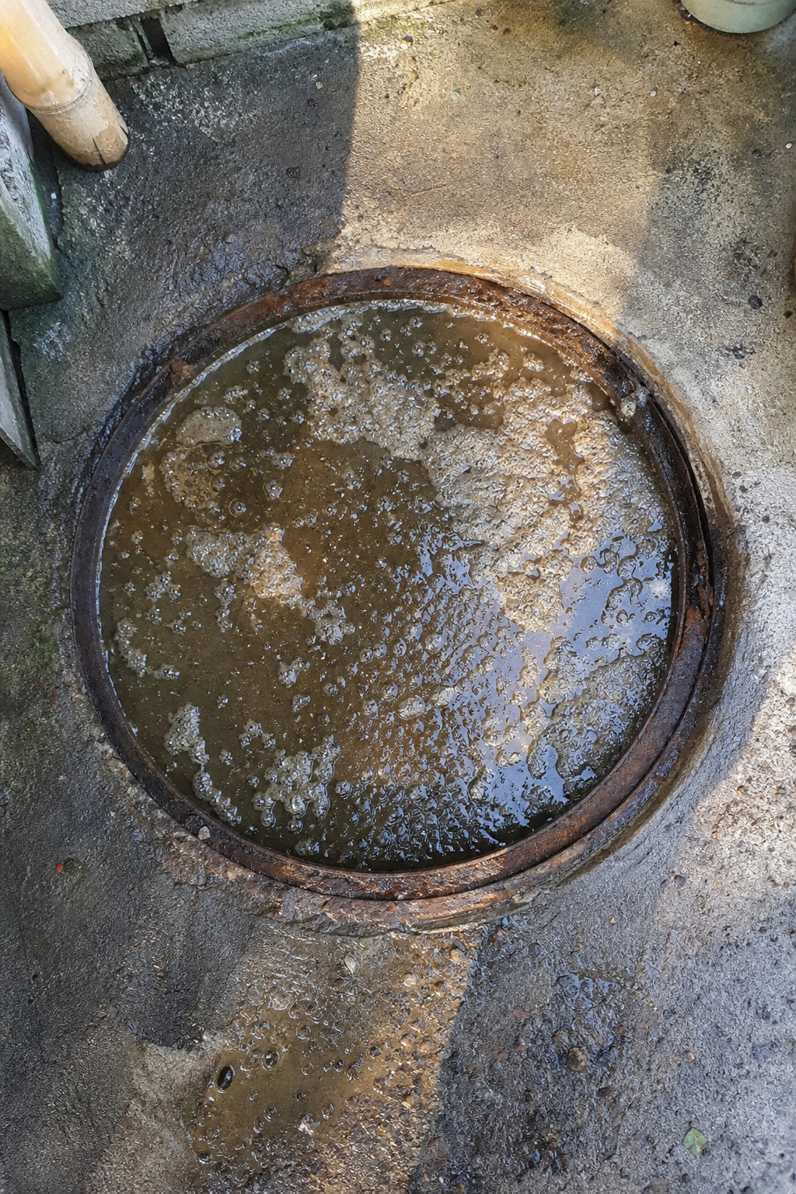

Siphoning
Septic tank servicing based on
tank conditions and site access.
Service scope
Septic tank siphoning
Septic tank cleaning
Site and service assessment
Actual Oceanides job photos
Before service
After service
Company profile
04
Notes:
Company legal name, five service groups, delivery and current contacts: clients/oceanides/company-profile/profile-content.json and premium-content.json.
Design inspiration: supplied Oceanides.pptx, especially slides 1, 2, 3, 4, 6, 9, 12 and 23. Reference images, equipment, staff and third-party marks are not reused.
Matched before/after pair: clients/oceanides/assets/tb2-ba2-before.png and tb2-ba2-after.png. Neil confirmed these as real job photos on 2026-08-01.
Original image proportions and complete evidence retained. Results describe this documented job, not a universal service guarantee.

Slide 5

Plumbing
Assessment and repair of
drainage, pipe and water
leak problems.
Drain declogging
Plumbing and pipe
leak repairs
Troubleshooting based
on site findings
AI-generated service illustration
Company profile
05
Notes:
Company legal name, five service groups, delivery and current contacts: clients/oceanides/company-profile/profile-content.json and premium-content.json.
Design inspiration: supplied Oceanides.pptx, especially slides 1, 2, 3, 4, 6, 9, 12 and 23. Reference images, equipment, staff and third-party marks are not reused.
Illustration: company-profile/assets/plumbing-service.png. Source brief: company-profile/assets/generated-sources.json. It does not depict Oceanides personnel or an actual completed job.

Slide 6

Renovation & restoration
Repair and improvement work
tailored to the property and
agreed scope.
House and condominium
renovation
Ceiling repair or replacement
Roof leak repair and waterproofing
House cleaning within scope
AI-generated service illustration
Company profile
06
Notes:
Company legal name, five service groups, delivery and current contacts: clients/oceanides/company-profile/profile-content.json and premium-content.json.
Design inspiration: supplied Oceanides.pptx, especially slides 1, 2, 3, 4, 6, 9, 12 and 23. Reference images, equipment, staff and third-party marks are not reused.
Service scope includes restoration, ceiling repair or replacement, roof leak repair and waterproofing, and house cleaning within the agreed scope.
Illustration: company-profile/assets/renovation-service.png. Source brief: company-profile/assets/generated-sources.json. It does not depict Oceanides personnel or an actual completed project.

Slide 7

Pest control
Service planning based on
reported pest concerns and
a property assessment.
Assessment of pest activity
Treatment scope based
on site findings
Scheduling and
contractor coordination
AI-generated service illustration
Company profile
07
Notes:
Company legal name, five service groups, delivery and current contacts: clients/oceanides/company-profile/profile-content.json and premium-content.json.
Design inspiration: supplied Oceanides.pptx, especially slides 1, 2, 3, 4, 6, 9, 12 and 23. Reference images, equipment, staff and third-party marks are not reused.
Illustration: company-profile/assets/pest-control-service.png. Source brief: company-profile/assets/generated-sources.json. It does not depict Oceanides personnel or an actual completed job.

Slide 8
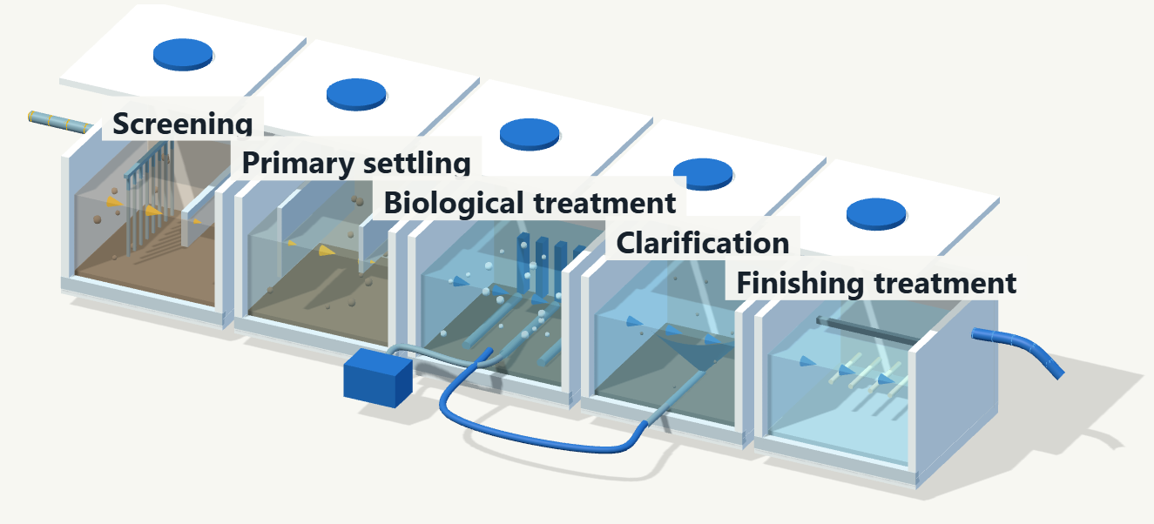
On-site sewage treatment
plant (STP)
An STP treats building wastewater
before discharge through a suitable
outlet. Oceanides coordinates the
assessment and technical proposal.
Suitability depends on wastewater
volume, space, outlet requirements
and operating costs. Sludge removal
and equipment care continue.
Illustrative process. Actual design follows assessment.
Company profile
08
Notes:
Company legal name, five service groups, delivery and current contacts: clients/oceanides/company-profile/profile-content.json and premium-content.json.
Design inspiration: supplied Oceanides.pptx, especially slides 1, 2, 3, 4, 6, 9, 12 and 23. Reference images, equipment, staff and third-party marks are not reused.
Suitability depends on wastewater volume, available space, outlet requirements and operating costs. Capacity, treatment performance and maintenance follow the agreed technical proposal. Sludge removal and equipment care continue after installation.
Visual: existing approved film overview frame, company-profile/assets/premium/stp-process-source.png. The model illustrates a general domestic-wastewater process, not an exact supplier design or Oceanides-owned facility.
https://www.youtube.com/watch?v=w_60iJEAf4c
https://www.epa.gov/npdes/peak-flows-sewage-treatment-plants
https://www.fujicleanusa.com/homeowners-faq
https://r7.emb.gov.ph/wp-content/uploads/2022/05/OPMS-DISCHARGE-PERMIT-Application-Guideline.pdf

Slide 9
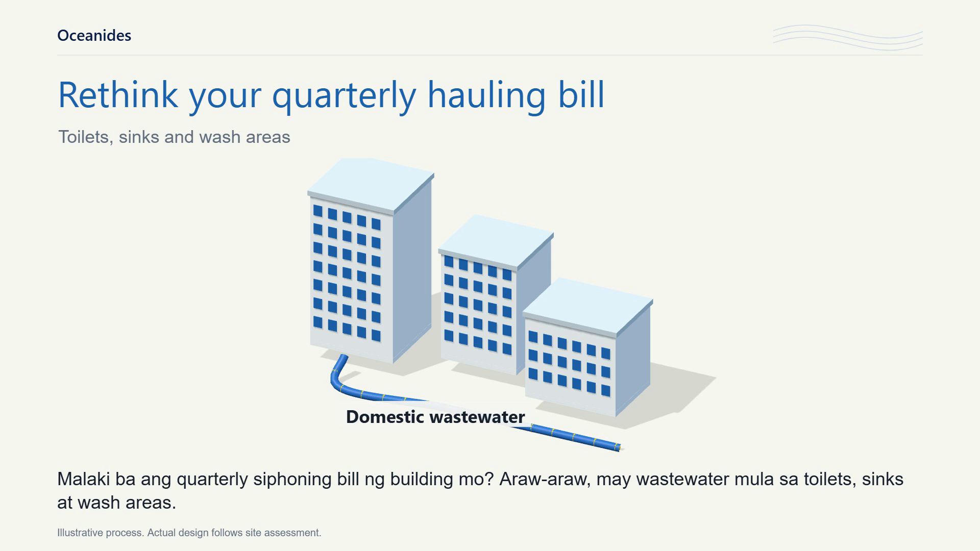
Notes:
Company legal name, five service groups, delivery and current contacts: clients/oceanides/company-profile/profile-content.json and premium-content.json.
Design inspiration: supplied Oceanides.pptx, especially slides 1, 2, 3, 4, 6, 9, 12 and 23. Reference images, equipment, staff and third-party marks are not reused.
Click the film to play. Native PowerPoint media controls support pause and replay.
Duration: 99.733 seconds. Original approved narration, music and image sequence retained byte-for-byte.
The film shows an illustrative treatment process. Capacity, treatment design, outlet requirements and operating costs follow the technical proposal.
https://www.youtube.com/watch?v=w_60iJEAf4c
https://www.epa.gov/npdes/peak-flows-sewage-treatment-plants
https://www.fujicleanusa.com/homeowners-faq
https://r7.emb.gov.ph/wp-content/uploads/2022/05/OPMS-DISCHARGE-PERMIT-Application-Guideline.pdf

Slide 10
Site assessment and quotation
Tell us the service you need, the
property location and your preferred
inspection schedule. We will coordinate
the assessment and prepare a quotation.
01
Assess
Review the concern, site access
and work requirements.
02
Quote
Confirm scope and pricing
before scheduling.
0917 671 6383
03
Coordinate
marketing@oceanidessepticandpest.com
Arrange the team or specialist
and coordinate site access.
Tramo Street Corner Dandan,
Pasay City, Philippines 1300
04
Turn over
Review the agreed work and
follow-up within scope.
Final scope, pricing and scheduling depend on the site assessment and agreed quotation.
Company profile
10
Notes:
Company legal name, five service groups, delivery and current contacts: clients/oceanides/company-profile/profile-content.json and premium-content.json.
Design inspiration: supplied Oceanides.pptx, especially slides 1, 2, 3, 4, 6, 9, 12 and 23. Reference images, equipment, staff and third-party marks are not reused.
Share your supplier requirements so we can coordinate company documents and project information for your review.
Tell us the service you need, the property location and your preferred inspection schedule. We will coordinate the assessment and prepare a quotation based on the findings.
Oceanides Plumbing Siphoning & Pest Management Services OPC

