Slide 1

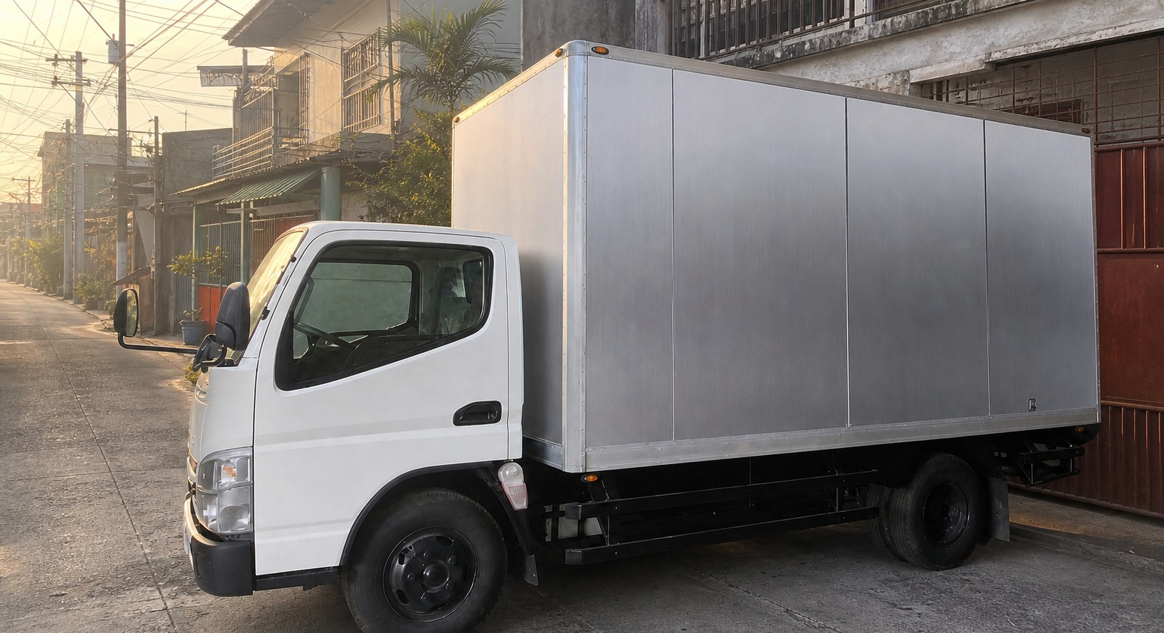
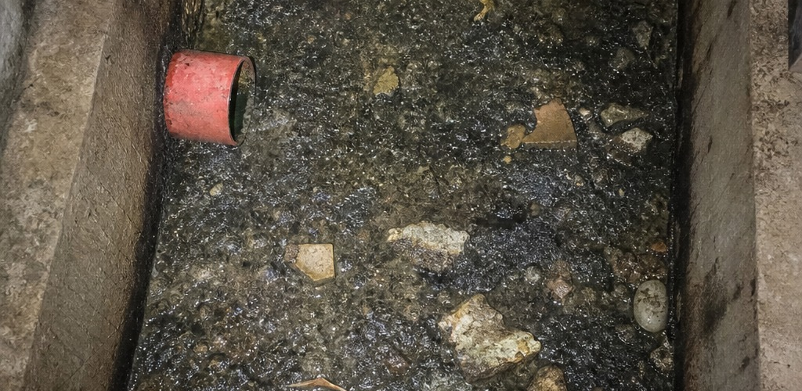
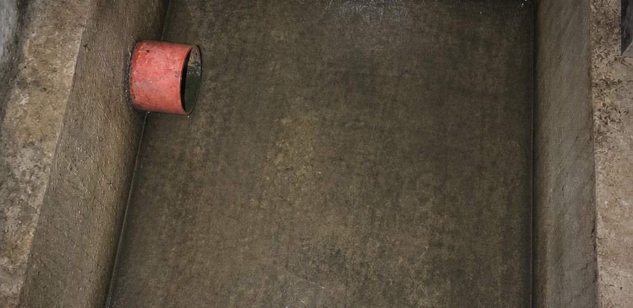
OCEANIDES
Plumbing Siphoning &
Pest Management Services OPC
COMPANY PROFILE
Property services. One coordinated point of contact.
BEFORE
AFTER
Siphoning / Plumbing / Renovation & restoration / Pest control
OCEANIDES
0917 671 6383
01
marketing@oceanidessepticandpest.com
Notes:
Logo: latest JPG supplied by Neil on 2026-10-01, canonical clients/oceanides/assets/logo.jpg.
Service scope, Oceanides coordination and intended audience: user briefing in this chat.
Phone, email and address: user-supplied Facebook Page screenshot 1000040025.jpg; phone also explicitly confirmed by Neil.
Legal company name: workflows/oceanides_business_model.md, existing company records.
Design reference: Metro Rod Services Explained brochure https://www.metrorod.co.uk/app/themes/metrorod-v2.0.1/assets/flipbook/newcastle/common/data/catalogue.pdf ; Oceanides colors from clients/oceanides/DESIGN.md.
No assertion of supplier accreditation, equipment ownership, licenses, project volume, treatment-system capability or maintenance-free operation.
Cover vehicle: clients/oceanides/assets/tb2-truck-street.png, approved real vehicle source in client design/asset records.Matched cover pair: clients/oceanides/assets/tb2-ba3-before.png and tb2-ba3-after.png, confirmed real job photos in the same asset-builder records.

Slide 2
OCEANIDES
Homes / Condominiums / Company facilities
COMPANY OVERVIEW
Oceanides coordinates property services for homes, condominiums and company
facilities. Our service offering covers siphoning, plumbing, renovation and
restoration, and pest control.
ONE CONTACT THROUGH TURNOVER
Oceanides remains your main contact from the initial inquiry to turnover. We
coordinate the site assessment, quotation and service delivery, including
specialist contractors where the work requires them.
SERVICE PORTFOLIO
SIPHONING
PLUMBING
Septic tank siphoning and cleaning.
Declogging and pipe leak repairs.
RENOVATION &
PEST CONTROL
RESTORATION
Assessment-based service coordination.
House and condominium improvements.
OCEANIDES
0917 671 6383
02
marketing@oceanidessepticandpest.com
Notes:
Logo: latest JPG supplied by Neil on 2026-10-01, canonical clients/oceanides/assets/logo.jpg.
Service scope, Oceanides coordination and intended audience: user briefing in this chat.
Phone, email and address: user-supplied Facebook Page screenshot 1000040025.jpg; phone also explicitly confirmed by Neil.
Legal company name: workflows/oceanides_business_model.md, existing company records.
Design reference: Metro Rod Services Explained brochure https://www.metrorod.co.uk/app/themes/metrorod-v2.0.1/assets/flipbook/newcastle/common/data/catalogue.pdf ; Oceanides colors from clients/oceanides/DESIGN.md.
No assertion of supplier accreditation, equipment ownership, licenses, project volume, treatment-system capability or maintenance-free operation.

Slide 3


SIPHONING
& PLUMBING
BEFORE SERVICE / SAME SITE
SEPTIC TANK SERVICES
PLUMBING SERVICES
Septic tank siphoning
Drain declogging
Septic tank cleaning
Plumbing and pipe leak repairs
Service coordination and site
Troubleshooting based on site findings
assessment
ACTUAL SITE WORK
BEFORE
& AFTER
The photographs show the same site
before and after service.
Final scope follows site access and tank or pipe
conditions.
AFTER SERVICE / SAME SITE
OCEANIDES
0917 671 6383
03
marketing@oceanidessepticandpest.com
Notes:
Logo: latest JPG supplied by Neil on 2026-10-01, canonical clients/oceanides/assets/logo.jpg.
Service scope, Oceanides coordination and intended audience: user briefing in this chat.
Phone, email and address: user-supplied Facebook Page screenshot 1000040025.jpg; phone also explicitly confirmed by Neil.
Legal company name: workflows/oceanides_business_model.md, existing company records.
Design reference: Metro Rod Services Explained brochure https://www.metrorod.co.uk/app/themes/metrorod-v2.0.1/assets/flipbook/newcastle/common/data/catalogue.pdf ; Oceanides colors from clients/oceanides/DESIGN.md.
No assertion of supplier accreditation, equipment ownership, licenses, project volume, treatment-system capability or maintenance-free operation.
Matched before/after pair: clients/oceanides/assets/tb2-ba2-before.png and tb2-ba2-after.png. Neil confirmed real job photos on 2026-08-01; see client DESIGN.md and asset-builder source.

Slide 4
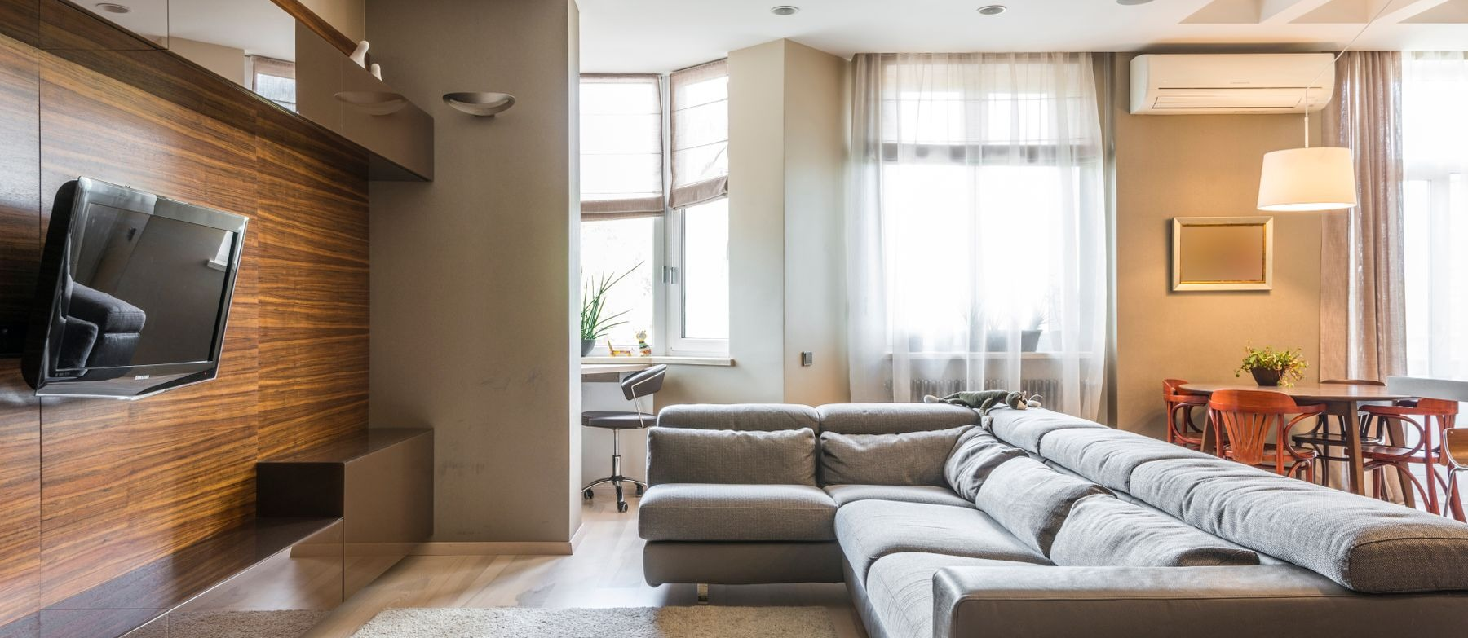
RENOVATION
& RESTORATION
Illustrative interior photograph / Max Vakhtbovych, Pexels
HOUSES & CONDOMINIUMS
Repair and improvement work for houses and condominiums, with a quotation
tailored to the site and the agreed scope.
House and condominium renovation
Restoration and ceiling repair or replacement
Roof leak repair and waterproofing
House cleaning within the agreed scope
Oceanides coordinates the field team or specialist contractor for the agreed work.
OCEANIDES
0917 671 6383
04
marketing@oceanidessepticandpest.com
Notes:
Logo: latest JPG supplied by Neil on 2026-10-01, canonical clients/oceanides/assets/logo.jpg.
Service scope, Oceanides coordination and intended audience: user briefing in this chat.
Phone, email and address: user-supplied Facebook Page screenshot 1000040025.jpg; phone also explicitly confirmed by Neil.
Legal company name: workflows/oceanides_business_model.md, existing company records.
Design reference: Metro Rod Services Explained brochure https://www.metrorod.co.uk/app/themes/metrorod-v2.0.1/assets/flipbook/newcastle/common/data/catalogue.pdf ; Oceanides colors from clients/oceanides/DESIGN.md.
No assertion of supplier accreditation, equipment ownership, licenses, project volume, treatment-system capability or maintenance-free operation.
Illustrative interior: Max Vakhtbovych, Pexels https://www.pexels.com/photo/an-interior-of-a-living-room-8089170/ . Not a completed Oceanides project.

Slide 5
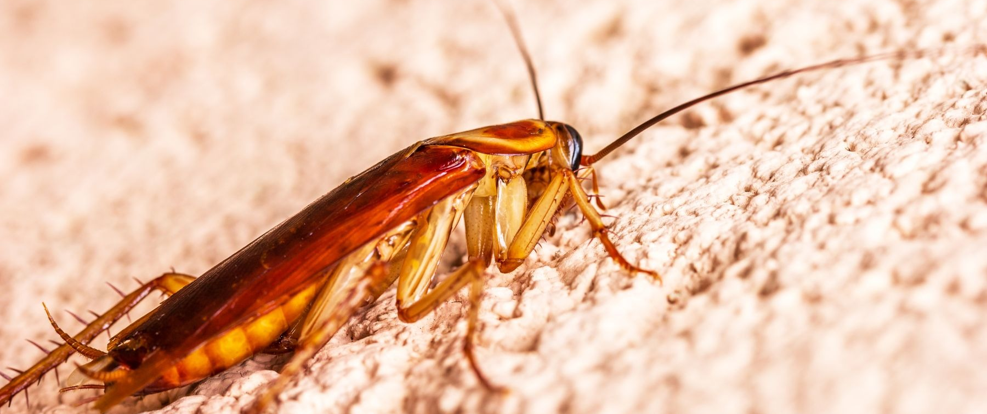
PEST CONTROL
Illustrative pest photograph / Jari Lobo, Pexels
SITE FINDINGS FIRST
Pest control services based on an assessment of the property and the pest
concerns reported by the client.
Assessment of pest activity
Treatment scope based on site findings
Service scheduling and contractor coordination
The treatment scope, service schedule and specialist requirements are confirmed
after assessment.
OCEANIDES
0917 671 6383
05
marketing@oceanidessepticandpest.com
Notes:
Logo: latest JPG supplied by Neil on 2026-10-01, canonical clients/oceanides/assets/logo.jpg.
Service scope, Oceanides coordination and intended audience: user briefing in this chat.
Phone, email and address: user-supplied Facebook Page screenshot 1000040025.jpg; phone also explicitly confirmed by Neil.
Legal company name: workflows/oceanides_business_model.md, existing company records.
Design reference: Metro Rod Services Explained brochure https://www.metrorod.co.uk/app/themes/metrorod-v2.0.1/assets/flipbook/newcastle/common/data/catalogue.pdf ; Oceanides colors from clients/oceanides/DESIGN.md.
No assertion of supplier accreditation, equipment ownership, licenses, project volume, treatment-system capability or maintenance-free operation.
Illustrative pest: Jari Lobo, Pexels https://www.pexels.com/photo/close-up-of-cockroach-19294665/ .

Slide 6
LET'S ASSESS
YOUR SITE.
Tell us the service, location and preferred inspection schedule.
0917 671 6383
GLOBE / marketing@oceanidessepticandpest.com
HOW THE WORK MOVES FORWARD
01
SITE ASSESSMENT
02
WRITTEN QUOTATION
Review the reported problem, work areas, site
Define the proposed work and pricing. Confirm
access and project requirements.
the scope with the client before scheduling.
03
COORDINATION
04
TURNOVER
Arrange the field team or specialist contractor
Review the agreed work with the client and
and coordinate access with the client.
coordinate any follow-up within the project
scope.
FOR MANAGEMENT & PROCUREMENT
Share your supplier-accreditation requirements with Oceanides. We can coordinate the company
documents and project information required for your review.
Tramo Street Corner Dandan, Pasay City, Philippines 1300
Oceanides Plumbing Siphoning & Pest Management Services OPC
Final scope, pricing and scheduling depend on the site assessment and the agreed quotation.
Notes:
Logo: latest JPG supplied by Neil on 2026-10-01, canonical clients/oceanides/assets/logo.jpg.
Service scope, Oceanides coordination and intended audience: user briefing in this chat.
Phone, email and address: user-supplied Facebook Page screenshot 1000040025.jpg; phone also explicitly confirmed by Neil.
Legal company name: workflows/oceanides_business_model.md, existing company records.
Design reference: Metro Rod Services Explained brochure https://www.metrorod.co.uk/app/themes/metrorod-v2.0.1/assets/flipbook/newcastle/common/data/catalogue.pdf ; Oceanides colors from clients/oceanides/DESIGN.md.
No assertion of supplier accreditation, equipment ownership, licenses, project volume, treatment-system capability or maintenance-free operation.

