Slide 1
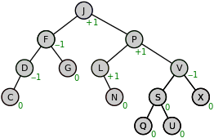
AVL Trees
Lab 11: AVL Trees

Slide 2
AVL Trees
In 1962 G.M. Adel'son-Vel'skiî and E.M. Landis developed a self-balancing tree. The tree is known by their initials: AVL.
The AVL tree algorithm keeps track of the difference in height of each subtree.
As items are added to or removed from a tree, the balance of each subtree from the insertion or removal point up to the root is updated.
BalanceFactor = height(right-subtree) – height(left-subtree)
The absolute difference between the left sub tree and right sub tree is never greater than 1.
If the balance gets out of the range -1 to +1, the tree is rotated to bring it back into range.

Slide 3


Slide 4
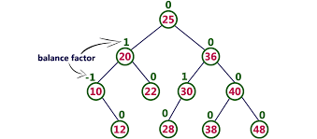
Lab 03 - Iterator

