Slide 1
Lab 06 – Railroad

Slide 2
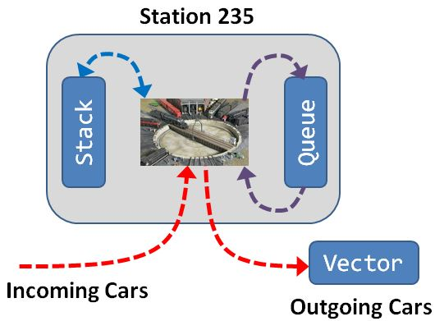

Lab 06 - Railroad
Create a railroad train station that uses a central turntable and roundhouses to store train cars as well as changes the order of cars entering and leaving the station.
Cars may enter the train station if the turntable is empty.
From the turntable cars can be moved to a "stack" roundhouse facility (LIFO) or a "queue" roundhouse facility (FIFO).
Train cars leave the train station by moving from the turntable to a "vector" of outbound cars.
What Objects?
How to describe them?
UML

Slide 3
Vector<T>
<<interface>>
DequeInterface<T>
-container__:Deque<T>
+Vector()
+~Vector()
+push_back(const T&):void
+pop_back():void
+back():T&
+size():size_t
+at(size_t):T&
+toString() const:string
+static const size_t
DEFAULT_CAPACITY = 4
+DequeInterface()
+~DequeInterface()
+push_front(const T&):void
+push_back(const T&):void
+pop_front():void
+pop_back():void
+front():T&
+back():T&
+size():size_t
+empty() const:bool
+at(size_t):T&
+toString() const:string
Station<T>
-train_:Vector<T>
-stack_:Stack<T>
-queue_:Queue<T>
-turnTableCar_:T
-empty:bool
+Station()
+~Station()
+addCar(const T&):string
+removeCar():string
+topCar():string
+addStack():string
+removeStack():string
+topStack():string
+sizeStack():string
+addQueue():string
+removeQueue():string
+topQueue():string
+sizeQueue():string
+find(T):string
+toString() const:string
Queue<T>
-container__:Deque<T>
+Queue()
+~Queue()
+push(const T&):string
+pop():void
+top():T&
+size():size_t
+at(size_t):T&
+toString() const:string
Deque<T>
-capacity:size_t
-num_items:size_t
-front_index:size_t
-rear_index:size_t
-the_data:T*
-reallocate():void
Stack<T>
+Deque()
+~Deque()
+push_front(const T&):void
+push_back(const T&):void
+pop_front():void
+pop_back():void
+front():T&
+back():T&
+size():size_t
+empty() const:bool
+at(size_t):T&
+toString() const:string
-container__:Deque<T>
+Stack()
+~Stack()
+push(const T&):string
+pop():void
+top():T&
+size():size_t
+at(size_t):T&
+toString() const:string

Slide 4
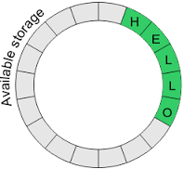
Circular Buffer
capacity = 16
num_items = 5
the_data
L | O |  |  |  |  |  |  |  |  |  |  |  | H | E | L
rear_index
front_index
front_index
the_data
rear_index

Slide 5
Specification of the Deque
Behavior | Member Function
Insert element at back | void push_back(item)
Insert element at front | void push_front(item)
Remove last element | void pop_back();
Remove first element | void pop_front();
Examine last element | item& back();
Examine first element | item& front();
Index | item& at(index);
Size | size_t size();
*Insert element | iterator insert(iterator, item);
*Remove all items | void remove(item);
*Index | item& []
*Iterator start | iterator begin();
*Iterator end | iterator end();
*Not Required for Lab 06 Deque

Slide 6
Wrapper Class
A wrapper class is a class that encapsulates or contains another class and uses its functionality to define the class' behavior.
#include "Deque.h"
template <typename T>
class Stack
{
private:
Deque<T> stack_;
public:
void push(T data)
{
stack_.push_back(data);
}
void pop(void)
{
return stack_.pop_back();
}
...
};
#include "Deque.h"
template <typename T>
class Queue
{
private:
Deque<T> queue_;
public:
void push(T data)
{
queue_.push_back(data);
}
void pop(void)
{
return queue_.pop_front();
}
...
};

Slide 7
Station Commands
COMMAND | DESCRIPTION | OUTPUT
Add:station <data> Add:queue <data> Add:stack <data> | Train car enters the station turntable. Train car is removed from the turntable and pushed to the Queue roundhouse. Train car is removed from the turntable and pushed to the Stack roundhouse. | OK Turntable occupied! Turntable empty!
Remove:station Remove:queue Remove:stack | A train car is removed from the turntable and pushed into the train vector. A train car is removed from Queue roundhouse and moved to the station turntable. A train car is removed from Stack roundhouse and moved to the station turntable. | OK Turntable empty! Turntable occupied! Queue empty! Stack empty!
Top:station Top:queue Top:stack | Display the current train car on station turntable, Display the train car at head of Queue roundhouse. Display the train car at head of Stack roundhouse. | <data> Turntable empty! Queue empty! Stack empty!
Size:queue Size:stack | Output number of train cars in Queue/Stack roundhouse. | Size of Queue/Stack
Find: <data> | Find and display the current location and position of a car in the station data structures (turntable, queue, stack, or vector). | Turntable Queue[<index>] Stack[<index>] Train[<index>] Not Found!
Train: | Output the contents of the train vector. | List of train cars leaving the station.

Slide 8
Lab Requirements
5 | argv[1] and argv[2] used for input / output streams respectively.
5 | A Deque template class is correctly implemented using a dynamic circular array and is derived from the abstract DequeInterface interface class.
5 | All station facility containers (stack, queue, vector) are separate classes that are implemented by "wrapping" your Deque template class.
5 | As train cars exit the station turntable, they are pushed on a Train vector template class that has-a Deque container and operates as described above (lab06_in_01.txt).
5 | The Stack roundhouse consists of a LIFO template class that has-a Deque container and operates as described above (lab06_in_02.txt).
5 | The Queue roundhouse consists of a FIFO template class that has-a Deque container and operates as described above (lab06_in_03.txt).
5 | All the station containers (Queue, Stack, Vector) resize correctly (lab06_in_04.txt).
(5) | BONUS: The Find command finds a train car in the Station data structures (queue or stack) or the train vector. If found, the name of the structure and the index within the structure is displayed (as described above.) (lab06_in_05.txt).
5 | VS_MEM_CHECK macro is included in main to detect memory leaks. No Memory leaks are reported.

Slide 9
