Slide 1
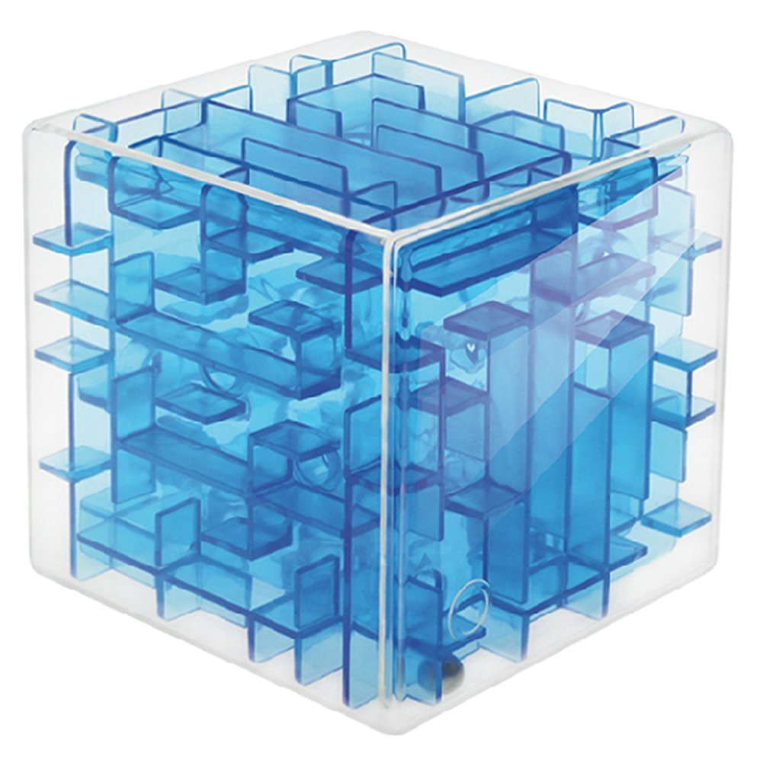
Lab 07 – 3D Maze

Slide 2
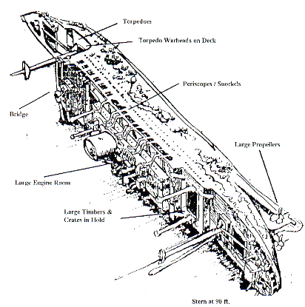
3D Maze
"Two SCUBA diving buddies have encountered a large, box-shaped storage facility inside the hull of the Heian Maru, a 512' submarine tender lying on the bottom of Truk Lagoon at 108'.
The storage facility is composed of cells, some of which can be entered and some which cannot. The only exterior walls that are missing are on the front of the storage facility in the upper left corner, and on the rear of the storage facility in the lower right corner.
The divers wish to determine a path through the storage facility. Use recursion to find a path through the maze or to prove that there is no path."

Slide 3
Finding a Path through a Maze
Problem
Use backtracking to find and display the path through a maze.
From each point in a maze you can move to the next cell in a horizontal or vertical direction if the cell is not blocked.
Analysis
The maze will consist of an array of cells.
The starting point is at the top left corner maze[0][0][0].
The exit point is at the bottom right corner, that is
maze[HEIGHT - 1][WIDTH - 1][LAYERS - 1].
All cells on the path will have a OPEN value.
All cells that represent barriers will have a BLOCKED value.
Cells that we have visited will have a TEMPORARY value.
If we find a path through the maze, the exit cell value will be EXIT and all cells on the path will have the PATH value.

Slide 4
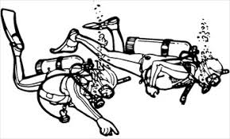
The Maze Layout
The maze size is defined by height x width x layer as specified on the first line of the test file.
Width
Left Right
START 0,0,0 | 0,1,0 | 0,2,0 | 0,3,0
1,0,0 | 1,1,0 | 1,2,0 | 1,3,0
2,0,0 | 2,1,0 | 2,2,0 | 2,3,0
3,0,0 | 3,1,0 | 3,2,0 | 3,3,0
Layer
Out IN
0,0,1 | 0,1,1 | 0,2,1 | 0,3,1
1,0,1 | 1,1,1 | 1,2,1 | 1,3,1
2,0,1 | 2,1,1 | 2,2,1 | 2,3,1
3,0,1 | 3,1,1 | 3,2,1 | 3,3,1
Height
Down Up
0,0,2 | 0,1,2 | 0,2,2 | 0,3,2
1,0,2 | 1,1,2 | 1,2,2 | 1,3,2
2,0,2 | 2,1,2 | 2,2,2 | 2,3,2
3,0,2 | 3,1,2 | 3,2,2 | 3,3,2
0,0,3 | 0,1,3 | 0,2,3 | 0,3,3
1,0,3 | 1,1,3 | 1,2,3 | 1,3,3
2,0,3 | 2,1,3 | 2,2,3 | 2,3,3
3,0,3 | 3,1,3 | 3,2,3 | EXIT 3,3,3

Slide 5
The Maze Layout
The maze size is defined by height x width x layer as specified on the first line of the test file.
Width
Left Right
0 (START) | 0 (Open) | 0 (Open) | 0 (Open)
0 (Open) | 1 (Blocked) | 1 (Blocked) | 1 (Blocked)
0 (Open) | 1 (Blocked) | 1 (Blocked) | 1 (Blocked)
0 (Open) | 1 (Blocked) | 1 (Blocked) | 1 (Blocked)
Layer
Out IN
0 (Open) | 0 (Open) | 0 (Open) | 1 (Blocked)
1 (Blocked) | 1 (Blocked) | 1 (Blocked) | 1 (Blocked)
1 (Blocked) | 1 (Blocked) | 1 (Blocked) | 1 (Blocked)
0 (Open) | 1 (Blocked) | 1 (Blocked) | 1 (Blocked)
Height
Down Up
0 (Open) | 0 (Open) | 1 (Blocked) | 0 (Open)
0 (Open) | 1 (Blocked) | 1 (Blocked) | 0 (Open)
0 (Open) | 1 (Blocked) | 1 (Blocked) | 1 (Blocked)
0 (Open) | 1 (Blocked) | 1 (Blocked) | 1 (Blocked)
1 (Blocked) | 0 (Open) | 1 (Blocked) | 1 (Blocked)
1 (Blocked) | 0 (Open) | 1 (Blocked) | 1 (Blocked)
1 (Blocked) | 0 (Open) | 1 (Blocked) | 1 (Blocked)
1 (Blocked) | 0 (Open) | 0 (Open) | 0 (Exit)

Slide 6
The Maze Layout (Bonus)
Maze values tell which way to proceed thru the maze ("L", "R", "U", "D", "I", or "O".)
Width
Left Right
R (Right) | R (Right) | I (In) | 0 (Open)
0 (Open) | 1 (Blocked) | 1 (Blocked) | 1 (Blocked)
0 (Open) | 1 (Blocked) | 1 (Blocked) | 1 (Blocked)
0 (Open) | 1 (Blocked) | 1 (Blocked) | 1 (Blocked)
Layer
Out IN
I (In) | L (Left) | L (Left) | 1 (Blocked)
1 (Blocked) | 1 (Blocked) | 1 (Blocked) | 1 (Blocked)
1 (Blocked) | 1 (Blocked) | 1 (Blocked) | 1 (Blocked)
0 (Open) | 1 (Blocked) | 1 (Blocked) | 1 (Blocked)
Height
Down Up
R (Right) | I (In) | 1 (Blocked) | 0 (Open)
0 (Open) | 1 (Blocked) | 1 (Blocked) | 0 (Open)
0 (Open) | 1 (Blocked) | 1 (Blocked) | 1 (Blocked)
0 (Open) | 1 (Blocked) | 1 (Blocked) | 1 (Blocked)
1 (Blocked) | D (Down) | 1 (Blocked) | 1 (Blocked)
1 (Blocked) | D (Down) | 1 (Blocked) | 1 (Blocked)
1 (Blocked) | D (Down) | 1 (Blocked) | 1 (Blocked)
1 (Blocked) | R (Right) | R (Right) | E (Exit)

Slide 7
Dynamic Arrays
A dynamic array is basically an array of pointers to arrays. A 2 dimensional dynamic array is created/deleted using a loop as follows:
int height = 10;
int width = 10;
int **myArray = new int*[height];
for(int i = 0; i < height; ++i)
{
myArray[i] = new int[width];
}
Constructor
for(int i = 0; i < height; ++i)
{
delete [] myArray[i];
}
delete [] myArray;
Destructor

Slide 8
The Maze Array
The 3D maze array is of data type "int***" - a pointer to a pointer to a pointer to an int.
int**
int*
int
int*** maze_
int maze[3][2][2]

Slide 9
2D Implementation
bool find_maze_path(int height, int width)
{
// check boundary (base case #1)
if ((height < 0) || (height >= HEIGHT) ||
(width < 0) || (width >= WIDTH)) return false;
if (maze_[height][width] != OPEN) return false; // blocked (base case #2)
if ((height == HEIGHT - 1) && (width == WIDTH - 1))
{
maze_[height][width] = EXIT; // Success! (base case #3)
return true;
}
maze_[height][width] = PATH; // Recursive case
if (find_maze_path(height - 1, width) ||
find_maze_path(height + 1, width) ||
find_maze_path(height, width - 1) ||
find_maze_path(height, width + 1)) return true;
maze_[height][width] = TEMPORARY;
return false;
}

Slide 10
Requirements
Points | Requirement (40 Points)
5 | argv[1] and argv[2] used for input / output streams respectively. No execution user interaction (i.e. system("pause"); or getchr();).
5 | A Maze class contains a dynamically sized 3-dimensional maze array as specified by the first line of the input file. The Maze class is derived from the abstract MazeInterface interface class.
5 | The Maze toString() function returns a formatted string of the maze (as described above.)
5 | Backtracking used to correctly solve a 4 x 4 x 4 maze (lab07_in_01.txt).
5 | Backtracking used to correctly solve a 5 x 5 x 5 maze (lab07_in_02.txt).
5 | Backtracking used to correctly solve a 5 x 10 x 6 maze (lab07_in_03.txt).
5 | Your Maze program uses backtracking to detect an unsolvable maze (lab07_in_04.txt).
5 | BONUS: Your maze program outputs the solution path using 'L' for move left, 'R' for move right, 'U' for move up on the same layer, 'D' for move down on the same layer, 'I' for move to the next layer (layer + 1), and 'O' for move to the previous layer (layer - 1). In addition, 'E' indicates the exit point. (lab07_in_05.txt).
5 | VS_MEM_CHECK macro is included in main to detect memory leaks. No Memory leaks are reported.

Slide 11


