Slide 1
Lab 08 - BST

Slide 2
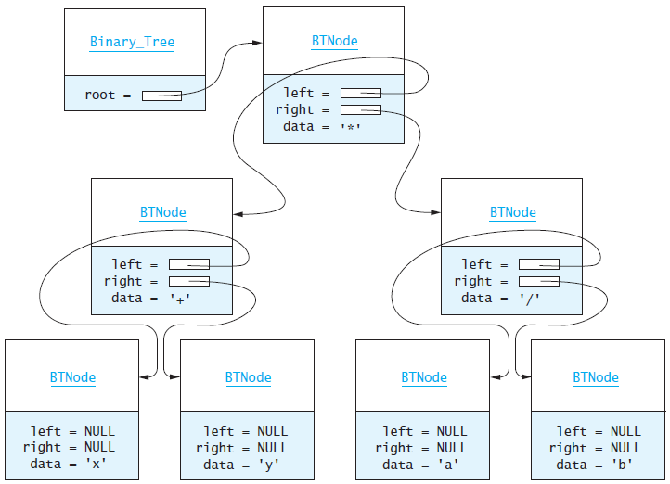
L08 – Binary Search Tree
"A binary search tree (BST), which may sometimes be called an ordered or sorted binary tree, is a node-based data structure where each node references a value, a left child, and a right child.
In a Binary Search Tree, the left subtree of a node contains only nodes with values less than the node's value, the right subtree of a node contains only nodes with values greater than the node's value, there are no duplicate nodes, and both left and right subtrees of a node must also be binary search trees."

Slide 3
Traversal
pre_order_traversal(node)
if node is NULL return
visit node
pre_order_traversal(node.left)
return pre_order_traversal(node.right)
Full tree
internal nodes w/2 children
Complete tree
unfilled nodes right on row h
Predecessor
left, right-most node
Successor
right, left-most node
in_order_traversal(node)
if node is NULL return
in_order_traversal(node.left)
visit node
return in_order_traversal(node.right)
8
4
12
post_order_traversal(node)
if node is NULL return
post_order_traversal(node.left)
post_order_traversal(node.right)
visit node
return
2
6
10
14
1
3
5
7
9
11
13
15

Slide 4
Search
bool search(node, value)
if node is NULL
return false
if node.value == value
return true
if value < node.value
return search(node.left, value)
if value > node.value
return search(node.right, value)
8
Find node 9
Go right
Go left
Go left
4
12
2
6
10
14
1
3
5
7
9
11
13
15

Slide 5
Insert
bool insert(Node*& node, const T& data)
if node is NULL
node = new Node(data)
return true
if data == node->data
return false
if data < node->data
return insert(node->left, data);
if data > node->data
return insert(node->right, data);
8
8
8
Insert node 6
Go left
Insert as 4's right child
4
4
4
12
12
12
2
2
2
6
6
10
10
10
14
14
14
Insert node 13
Go right, right
Insert as 14's leftchild
1
1
1
3
3
3
11
11
13
15
15
15

Slide 6
Delete
bool delete(Node*& node, const T& data)
if node is NULL, return false
if data < node->data, return delete(node->left, data)
if data > node->data, return delete(node->right, data)
if node has no children, parent = NULL, return true
if node has 1 child, parent = node->(left or right), return true
exchange node->data with in_order_predecessor->data
return delete(node->left, data)
8
8
8
8
8
8
8
Delete node 2
Find node (2)
Set parent (3) to child (1)
8
3
3
3
3
3
3
3
3
9
9
9
9
9
9
9
9
2
2
2
2
2
2
2
1
4
4
4
4
4
5
4
5
12
12
12
12
12
12
12
12
1
11
11
11
11
11
11
11
4
11
4

Slide 7
Delete
bool delete(Node*& node, const T& data)
if node is NULL, return false
if data < node->data, return delete(node->left, data)
if data > node->data, return delete(node->right, data)
if node has no children, parent = NULL, return true
if node has 1 child, parent = node->(left or right), return true
exchange node->data with in_order_predecessor->data
return delete(node->left, data)
5
8
8
8
8
8
8
8
Delete node 2
Find node (2)
Set parent (3) to child (1)
5
3
3
3
3
3
3
3
3
9
9
9
9
9
9
9
Swap data
9
Delete node 8
Find predecessor (5)
Exchange data only with node
Delete 8 from left tree
2
2
2
2
2
1
2
1
4
4
4
4
4
5
4
4
8
12
12
12
12
12
12
12
12
11
11
11
11
11
11
11
4
11

Slide 8
BST Commands
COMMAND | DESCRIPTION | OUTPUT
Add <data> | Add data node to BST. Return false if duplicate. | True False
Remove <data> | Remove node from BST. Return false if not found. | True False
Clear | Delete all nodes from the BST. | True
PrintBST | Print BST (using insertion operator) in level-order. | Level-order listing of BST.
Find <data> (Bonus) | Find and display node in BST. Return "Found" or "Not Found". | Found Not Found!
Tree (Bonus) | Output the contents of the BST using begin() and end() iterators in in-order. | In-order listing of BST.

Slide 9
Level-Order Traversal
/** Output nodes at a given level */
bool outLevel(Node<T>* root, int level, stringstream& out) const
{
if (root == NULL) return false;
if (level == 0)
{
out << " " << root->data;
if ((root->left != NULL) || (root->right != NULL)) return true;
return false;
}
if ((level == 1) && !root->left_ && root->right_) out << " _";
bool left = outLevel(root->left, level - 1, out);
bool right = outLevel(root->right, level - 1, out);
if ((level == 1) && root->left_ && !root->right_) out << " _";
return left || right;
} // end outLevel()
int level = -1;
do
{
out << endl << " " << ++level << ":";
} while (outLevel(root, level, out));
Add 2 True
Add 3 True
Add 4 True
PrintBST
0: 2
1: _ 3
2: _ 4

Slide 10
Requirements
Points | Requirement (35 Points)
5 | argv[1] and argv[2] used for input / output streams respectively. No execution user interaction (i.e. system("pause"); or getchr();).
5 | A BST class is derived from the abstract BSTInterface interface class. No STL container is used anywhere in your BST class.
5 | The BST class implements a public toString and friend insertion member function. The "PrintBST" command uses the insertion operator function to send the contents of the BST container (in level-order) to the output stream. If the BST is empty, report "Empty".
5 | Any number of Nodes are correctly added to the BST using the "Add" command. Attempt to add a duplicate node outputs false. (lab08_in_01.txt)
5 | Nodes are correctly removed from the BST using the "Remove" command. Attempt to remove a non-existant node outputs false. (lab08_in_02.txt)
5 | The "Clear" command removes every node from the tree. (lab08_in_03.txt)
5 | BONUS: The "Find" uses a BST iterator and reports "Found" if the value is in the BST and "Not Found" if not found. (lab08_in_04.txt)
5 | BONUS: The "Tree" command displays the tree in in-order using BST iterators. (lab07_in_04.txt)
5 | VS_MEM_CHECK macro is included in main to detect memory leaks. No Memory leaks are reported.

Slide 11
Steps 1 - 3 BST Class
#include "BSTInterface.h"
template<typename T>
class BST : public BSTInterface<T>
{
private:
struct Node
{
T data_;
Node* left_;
Node* right_;
Node(T d) : data_(d), left_(NULL), right_(NULL) { }
};
Node* root_;
public:
BST() { this->root_ = NULL; }
~BST() { clearTree(); }
/** Return true if node added to BST, else false */
virtual bool addNode(const T& data) { return insert(this->root_, data); }
/** Return true if node removed from BST, else false */
virtual bool removeNode(const T& data) { return remove(this->root_, data); }
/** Return true if BST cleared of all nodes, else false */
virtual bool clearTree() { return deleteTree(root_); }
/** Return a level order traversal of a BST as a string */
virtual string toString() const { ... }
/** Override insertion operator to insert BST string */
friend std::ostream& operator<< (ostream& os, const BST<T>& bst) { ... }
};
Class BST inherits from the interface template BSTInterface class.
structs are lightweight objects and often used in place of a class if the object's main responsibility is a type of data storage. A node represents a single value, is similar to a primitive type, is mutable, and relatively small, and hence a good candidate for a struct

Slide 12
Step 3 – Add an Iterator (Bonus)
#include "BSTInterface.h"
template<typename T>
class BST : public BSTInterface<T>
{
private:
struct Node { ... };
Node* root_;
public:
BST() { this->root_ = NULL; }
~BST() { clearTree(); }
/** BST iterator */
class Iterator
{
private:
mutable int index_;
Node* root_;
public:
Iterator(int index, Node* root) : index_(index), root_(root) {}
~Iterator() {}
virtual bool operator!=(const Iterator& rhs) const { ... }
virtual Iterator operator++(T) { ... }
virtual T operator*() const { ... }
};
virtual Iterator find(T& value) { ... }
virtual Iterator begin() { ... }
virtual Iterator end() { ... }
};
if (item1 == "Find")
{
out << endl << "Find " << data;
BST<int>::Iterator iter = bst.find(data);
BST<int>::Iterator end_iter = bst.end();
if (!(iter != end_iter)) out << " Not Found";
else out << " Found " << *iter;
}
else if (item1 == "Tree")
{
out << endl << "Tree ";
BST<int>::Iterator iter = bst.begin();
BST<int>::Iterator end_iter = bst.end();
if (iter == end_iter) out << " Empty";
for (; iter != end_iter; iter++)
out << " " << *iter;
}
BST
Iterator
Nested classes can access all members of the parent via a reference/pointer

Slide 13
Bonus: Iterator
BST<int>
Node* root_;
8
8
8
Iterator
int index_ = 0; Node* root_;
begin()
5
3
3
3
3
9
9
9
9
Iterator
int index_ = 7; Node* root_;
2
2
2
1
4
4
4
4
12
12
12
12
end()
11
11
11
11
BST<int>::Iterator iter = bst.begin();
BST<int>::Iterator end_iter = bst.end();
if (iter == end_iter) out << " Empty";
for (; iter != end_iter; iter++)
out << " " << *iter;
?

Slide 14


