Slide 1
ULK Academic Activity and Resource Management System
Advanced Database Management Project
Kigali Independent University (ULK)
ROLLNUMBER: 202311271

Slide 2
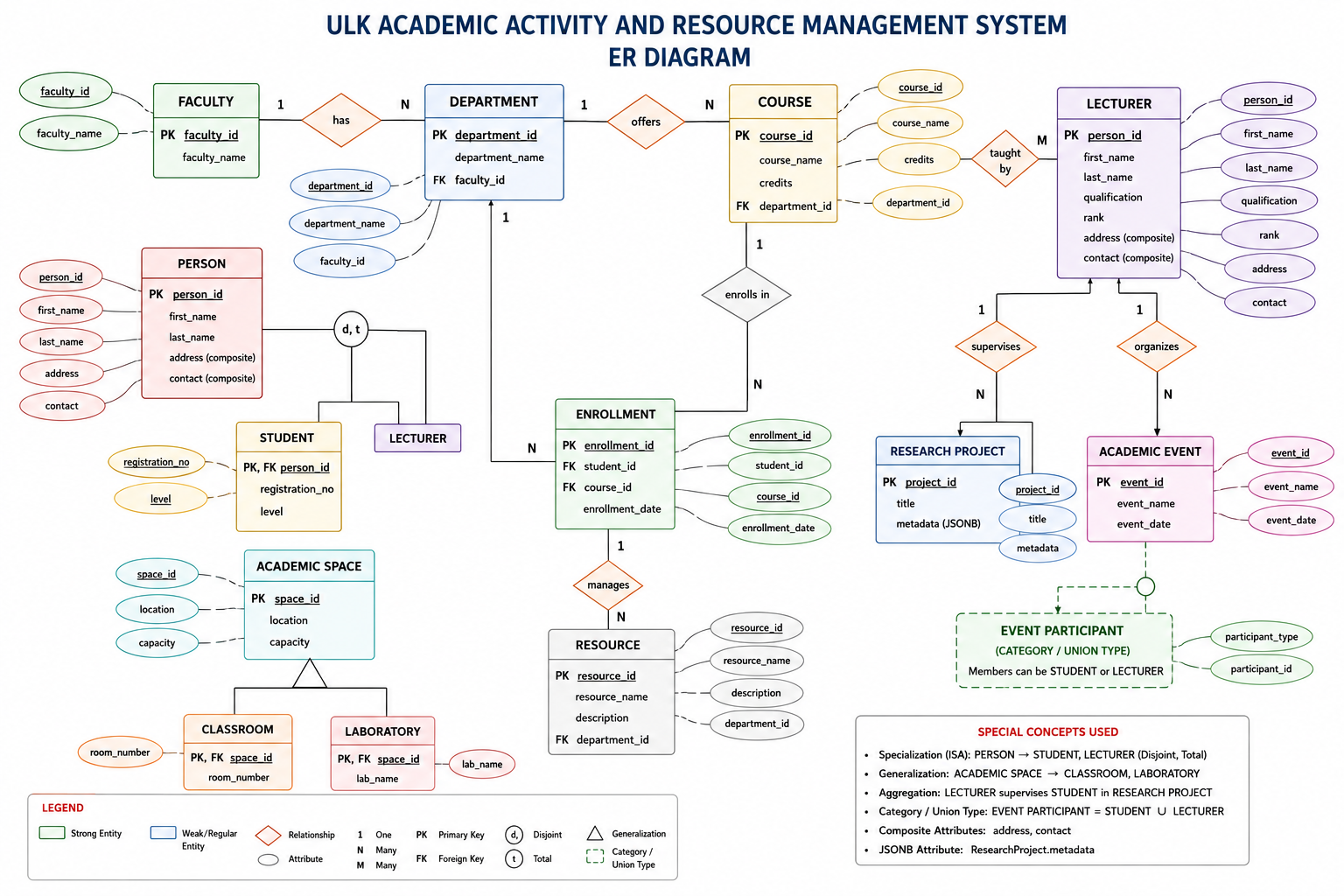
ER Diagram (Visual Drawing)

Slide 3
Introduction
Centralized PostgreSQL database integrating students, lecturers, courses, departments, laboratories, classrooms, research activities, and academic events.

Slide 4
Objectives
• Student registration and management
• Lecturer management
• Course allocation
• Enrollment management
• Resource tracking

Slide 5
Requirements Analysis
Functional and Non-Functional Requirements including integrity, scalability, security, and performance.

Slide 6
ER Model - Entities
Student, Lecturer, Department, Faculty, Course, Enrollment, Classroom, Laboratory, ResearchProject, AcademicEvent, Resource.

Slide 7
ER Model - Relationships
Student enrolls in Course, Department offers Course, Lecturer teaches Course, Lecturer supervises ResearchProject, etc.

Slide 8
ER Diagram Explanation
The ER diagram models academic operations. Students enroll in courses, departments belong to faculties, lecturers teach courses and supervise research projects. Enrollment resolves the many-to-many relationship between students and courses.

Slide 9
EER Model
Specialization: Person → Student, Lecturer
Generalization: AcademicSpace → Classroom, Laboratory
Category: EventParticipant = Student ∪ Lecturer

Slide 10
PostgreSQL Implementation
Inheritance, Composite Types, JSONB, User Defined Types, Constraints, and Relationships.

Slide 11
Data Population
100 Students, 20 Lecturers, 30 Courses, 100+ Enrollments, 300+ total records.

Slide 12
SQL Queries
15 SQL queries including joins, aggregations, grouping, subqueries, and reporting.

Slide 13
Indexing Analysis
Created index on Enrollment(student_id). Sequential Scan improved to Index Scan.

Slide 14
Storage Analysis
8KB pages, heap files, index files, and TOAST storage.

Slide 15
Buffer Management
Repeated execution showed cache usage and improved performance.

Slide 16
Conclusion & Recommendations
Centralized academic database with scalability, consistency, and efficient query processing.

