Slide 1
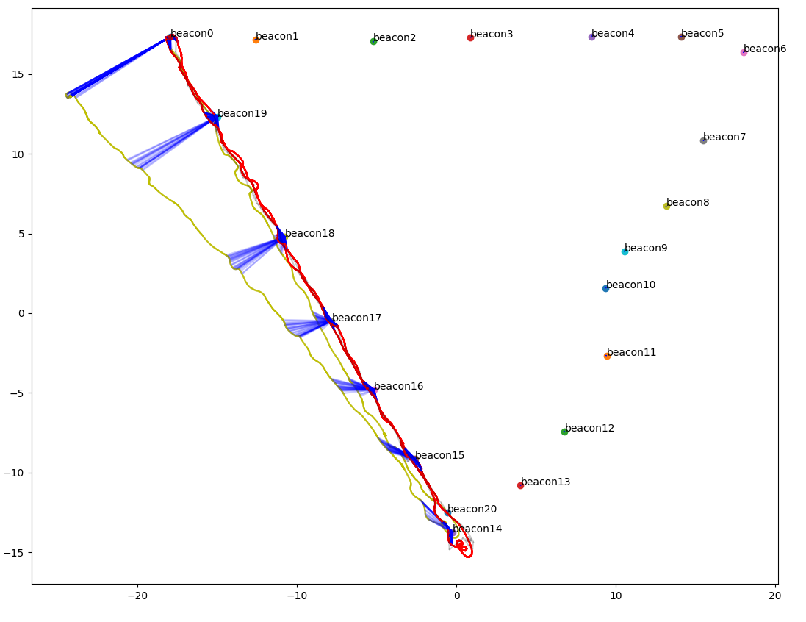
Pose Graph Optimization
For Trajectory Smoothing

Slide 2
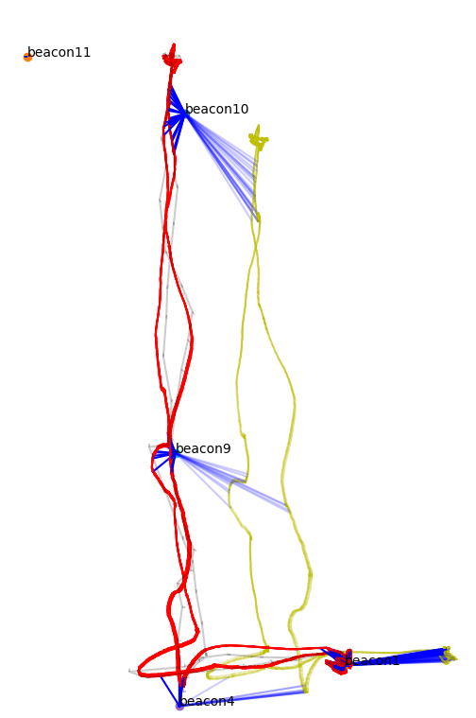
Can see that odometry is bad at the beginning,

Slide 3
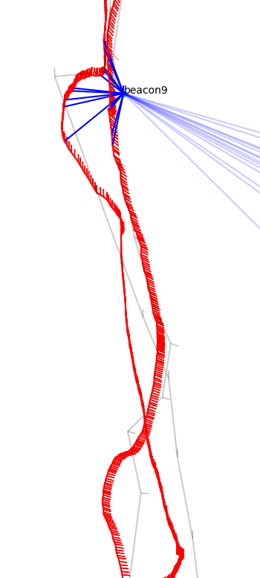
EKF includes jump before beacon

