Slide 1
CSD2183
Lab03 – Sort Algorithms
2026
Dr Chiew TK

Slide 2
Exercises
Quick Sort
  Implement Recursive Quick Sort
  Find Kth minimum element using Quick Sort method
Heap Sort
  Implement Heapify to build Min-Heap
  Implement Heap sort with Heapify
Bubble Sort
  Implement Bubble Sort (iteratively)
  Benchmark Bubble Sort

Slide 3
Data file format
Test.dat
11
9 0 3 8 7 2 6 4 1 10 5
7
Number of inputs, n
List of n integer inputs
Only in Ex1b, the k^{th} element

Slide 4
(1) Quick Sort

Slide 5
What is Quick Sort?
Quick Sort is an efficient divide-and-conquer algorithm used to sort elements in an array. It works by selecting a "pivot" element, partitioning the array into two sub-arrays around the pivot, and recursively sorting the sub-arrays.
How It Works
  Choose a Pivot – Select an element as the pivot. Common strategies include choosing the first, last, or a random element.
  Partition the Array – Rearrange the elements so that:
    All elements smaller than or equal to the pivot are on its left.
    All elements larger than the pivot are on its right.
Recursive Sorting – Recursively apply Quick Sort to the left and right sub-arrays until the sub-arrays have one or no elements (base case)
Note: pivots are always sorted first!

Slide 6
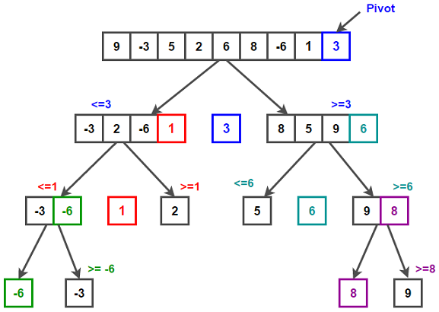
Pivots are placed in their correct locations

Slide 7
How to find 3rd smallest element in an array?
First run = use "3" as pivot
"3" correctly places → at 5 th position
Only need to perform quick-sort on left sub-array to find 3rd position.
Seond run = use 1 as pivot.
"1" correctly placed at 3rd position.
STOP: 3rd position found → its "1"
No need to do the rest.

Slide 8
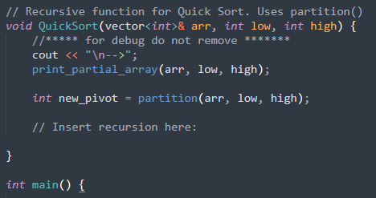
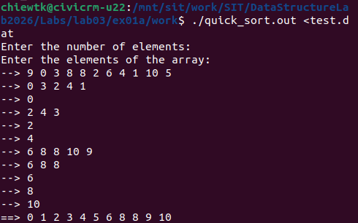
1.a) Implement Recursive Quick Sort
quick_sort.cpp
./quick_sort.out <test.dat
> make
Insert your codes to call QuickSort( ) recursively.
Run and generate output showing inputs to each recursive calls.
Do not remove these.
Upload modified quick_sort.cpp to gradescope.

Slide 9
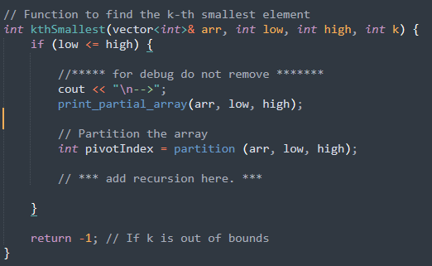
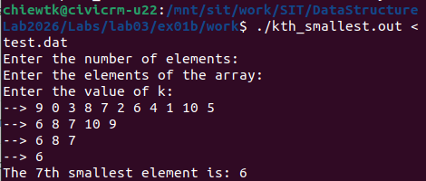
1.b) Find K^{th} minimum element using Quick Sort method
./ kthSmallest.out <test.dat
kthSmallest.cpp
> make
Run and generate output showing inputs to each recursive calls (Note: only partial sort is performed). K^{th} smallest element is output.
Insert your codes to call kthSmallest ( ) recursively.
Do not remove these.
Upload modified kthSmallest.cpp to gradescope.

Slide 10
(2) Heap Sort

Slide 11
What is Heap Sort?
Heap Sort is an efficient comparison-based sorting algorithm that uses a binary heap data structure. It organizes elements into a special tree-like structure (heap) and repeatedly extracts the smallest element to reverse-sort the array.
How It Works
  Build a Min-Heap:
    Rearrange the array into a min-heap, where the smallest element is at the root.
    A min-heap satisfies the property that every parent node is smallest than or equal to its child nodes.
  Extract the Smallest Element:
    Swap the root (largest element) with the last element in the array.
    Reduce the heap size and re-heapify to restore the min-heap property.
  Repeat:
    Continue extracting the root and heapifying until all elements are sorted.
    Result – a reversed sorted list.
Question : how do we sort the list smallest-to-largest? (Max-heap)

Slide 12
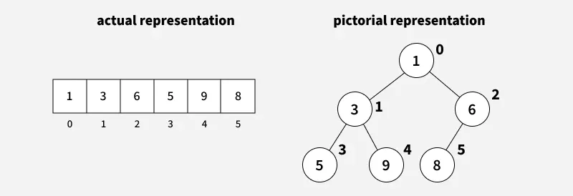
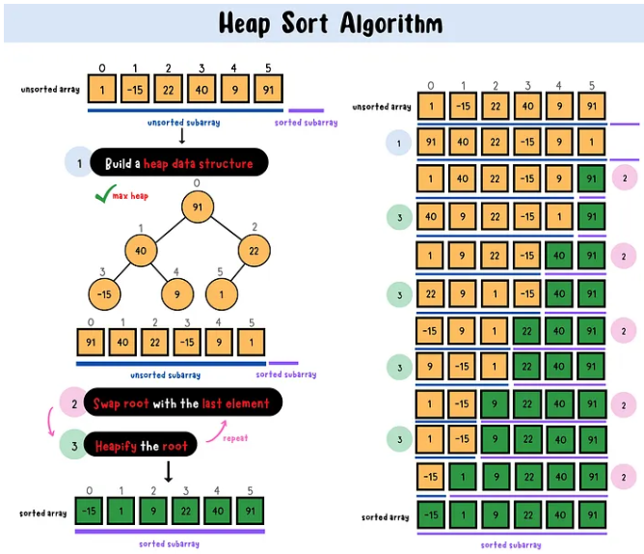
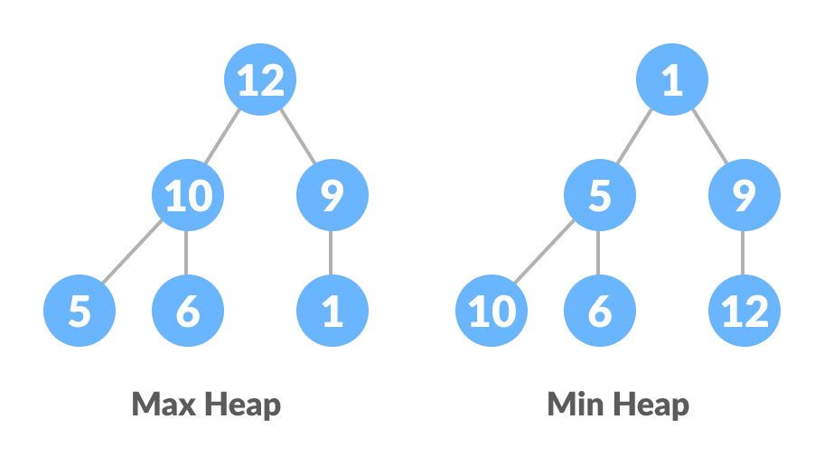
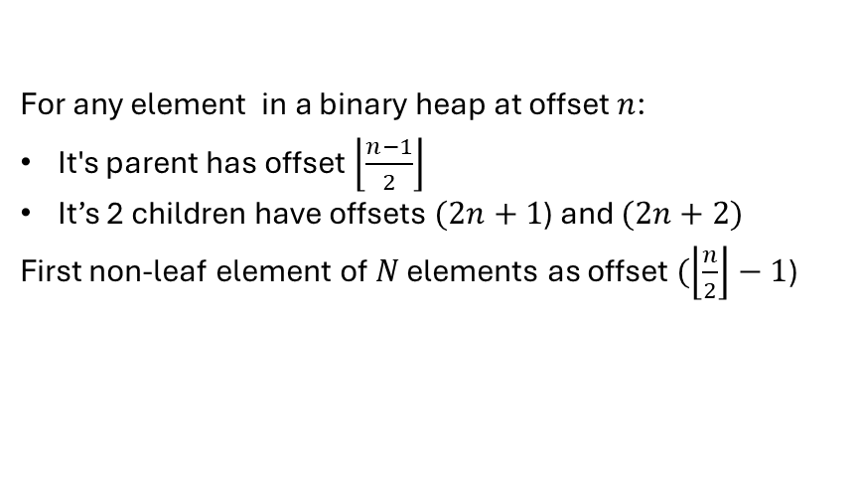
For any element in a binary heap at offset $n$:
It's parent has offset $\left\lfloor \left.\frac{n−1}{2}\right\rfloor \right.$
It’s 2 children have offsets $(2n+1$) and $(2n+2)$
First non-leaf element of $N$ elements as offset $(\left\lfloor \left.\frac{n}{2}\right\rfloor \right.−1$)
To form Max-heap/Min-heap, successively move larger/smaller child up to parent if it’s larger then parent, in reverse order – method is called max-heapify / min-heapify.

Slide 13
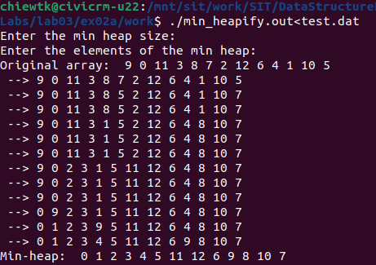
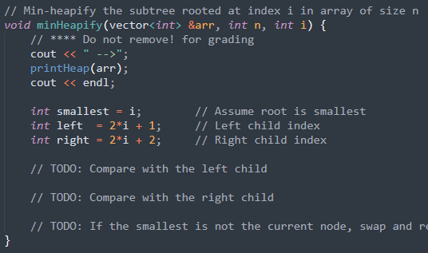
2.a) Implement Heapify to build Min-Heap
./ min_heapify.out < test.dat
min_heapify.cpp
> make
Add recursive minHeapify( ) codes
Run and generate output showing inputs to each recursive calls. Final result shows a min-heap with smallest element at the root of the tree.
Do not remove these.
Upload modified min_heapify.cpp to gradescope.

Slide 14
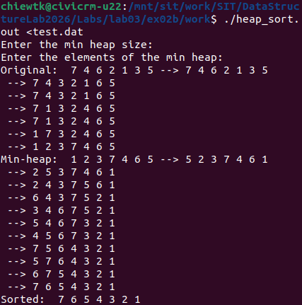
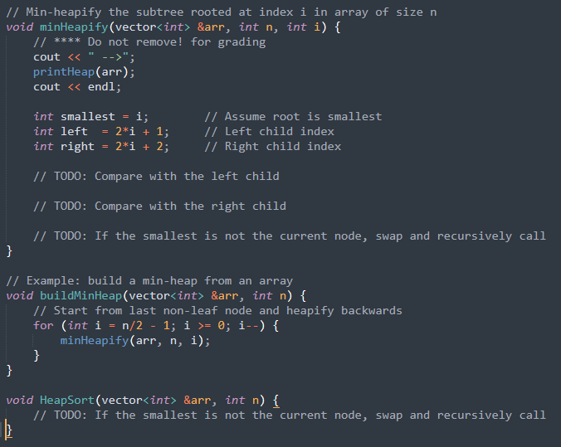
2.b) Implement Heap sort with Heapify
./ heap_sort.out < test.dat
heap_sort.cpp
> make
Call minHeapify iteratively on non-leaf nodes to do reverse sort.
Run to perform heap-sort (1) heapify (2) iteratively place root to heap end then heapify.
Copy codes from last exercise.
Do not remove these.
Upload modified heap_sort.cpp to gradescope.

Slide 15
(3) Bubble Sort

Slide 16
What is Bubble Sort?
Bubble Sort is a simple sorting algorithm that repeatedly compares adjacent elements in an array and swaps them if they are in the wrong order. This process "bubbles" the largest (or smallest) elements to their correct position in each iteration.
How It Works
  Compare Adjacent Elements:
    Starting from the first element, compare each pair of adjacent elements.
    If the first element is greater than the second (for ascending order), swap them.
  Repeat for the Remaining Elements:
    After each pass, the largest element is "bubbled" to its correct position at the end of the array.
    The next pass only processes the unsorted portion of the array.
  Stop When Sorted: If no swaps are made in a pass, the array is already sorted, and the algorithm terminates.
Note: bubble sort grows fastest when input is sorted in reverse order and slowest when input already is sorted (in what O(.)?)

Slide 17
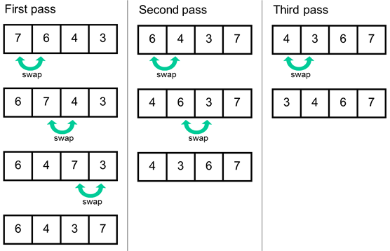

Slide 18
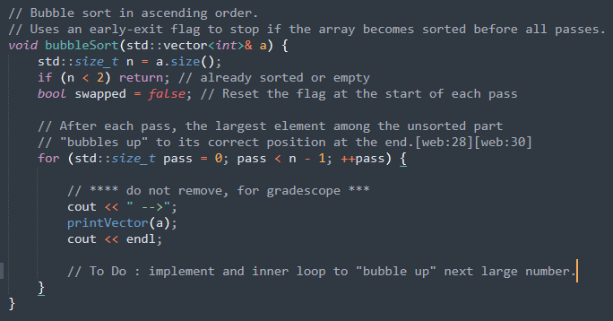
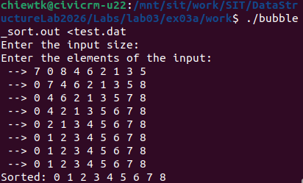
3.a) Bubble Sort Implementation
bubble_sort.cpp
./ bubble_sort.out < test.dat
> make
Add iterative bubble_sort( ) codes.
Note: to optimize sorting, implement an early exit feature.
Step-by-step bubble_sort output
Do not remove these.
Upload modified bubble_sort.cpp to gradescope.

Slide 19
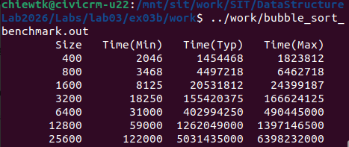
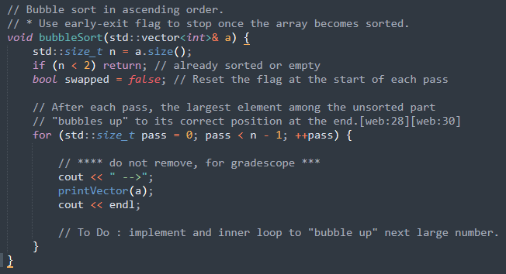
3.b) Bubble Sort Benchmark
./bubble_sort_benchmark.out
bubble_sort_benchmark.cpp
> make
May take a few minutes
Benchmarking output:
    (Min) – with already sorted input
    (Max) – with reversely sorted i/p
    (Typ) – with random array.
Individual readings may be different, trend should be the same
Replace with codes from previous exercise.

Slide 20
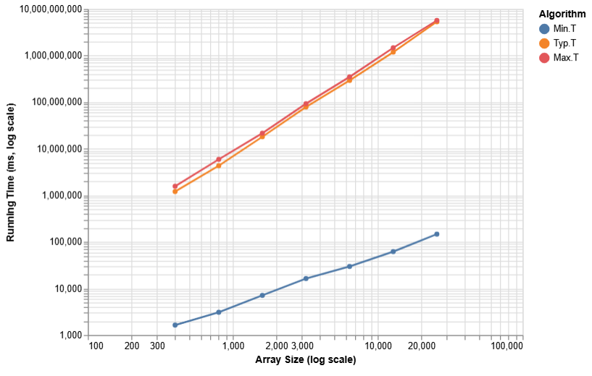
3.b) Bubble Sort Benchmark (cont …)
bubble_sort_timings.html
Upload to Xsite dropbox
Comment on the growth rate of Bubble sort at MinT, MaxT and TypT.

Slide 21
Fin.

