Slide 1
IC Design HW4 Tutorial
Tzi-Dar Chiueh
2018/12/14

Slide 2
Outline
Flow & Notification of HW4
Standard Cell Library
MAC example
Pipeline MAC example
Verification
Reminder

Slide 3
Flow
Correctness (50%)
The product of the minimum half cycle time and the number of transistors (20%)
First, design a circuit that can pass testbench
Second, decrease the HALF_CYCLE in testbench.v until it failed (CYCLE < critical path). The minimum half cycle time is the minimum HALF_CYCLE for successfully pass testbench.

Slide 4
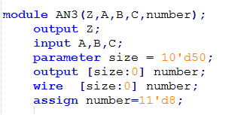
Flow
Third, Find the number of transistors in your design by hand.
Finally, modify you design the get better product of the minimum half cycle time and the number of transistors. Trade-off between them. Ex. Try different adders, carry-skip, carry-lookahead, etc.

Slide 5
Notification of HW4!!
In this HW, all the logic operation MUST consist of standard cell (defined in lib.v). You can NOT use logic operators.
wire a, b, c;
assign a = b & c;
wire a, b, c;
AN2 an(a, b, c);
Behavioral Modeling
Structural Modeling

Slide 6
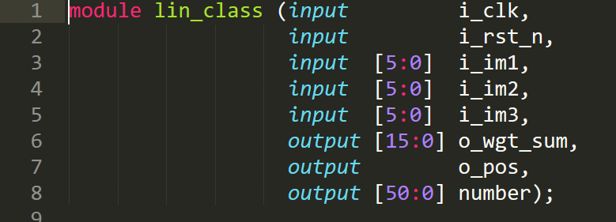
Notification of HW4!!
Do NOT change any module name and port name in lin_class.v, just modifiy the module description, otherwise you can’t pass testbench.
Use FD2 (positive edge) module for flip flop.
Don’t Change

Slide 7
Standard Cell Library
7

Slide 8
Standard Cell Library (lib.v)
Choose what you need
Compose your circuit according to I/O connections
IV // not
AN3
AN4
AN2
EN // xnor
EN3
EO // xor
EO3
FA1 // full adder
FD1 // negative edge DFF
FD2 // positive edge DFF
ND2 // nand
ND3
ND4
NR2 // nor
NR3
OR2 // or
OR3
OR4
HA1 // half adder
MUX21H // 2-to-1 MUX

Slide 9
Number of Transistors
module Reg3(Q,DD,CLK,RESET,Reg3_num);
output [2:0] Q;
input [2:0] DD;
input CLK,RESET;
output wire [50:0] Reg3_num;
wire [50:0] FD_num0,FD_num1,FD_num2;
assign Reg3_num=
FD_num0+FD_num1+FD_num2;
FD2 fd0(Q[0],DD[0],CLK,RESET,FD_num0);
FD2 fd1(Q[1],DD[1],CLK,RESET,FD_num1);
FD2 fd2(Q[2],DD[2],CLK,RESET,FD_num2);
endmodule
module DUT(clk,rst,
A,B,C,D);
input clk;
input rst;
input [3:0] A;
input [6:0] B;
input [5:0] C;
output [14:0]D;
wire [50:0] DUT_num;
wire [50:0] num0,num1;
assign DUT_num=num0+num1;
wire [2:0] A_reg,B_reg;
Reg3 rr0(A_reg,A[2:0],clk,rst,num0);
Reg3 rr1(B_reg,B[2:0],clk,rst,num1);
endmodule

Slide 10
MAC(multiplier–accumulator) Example
10

Slide 11
2-bit MAC Example (1/2)
A
R
C
B
D
W
Multiplier
a1
d3
w3
pp0
Partial Product Generator
Wallace
Tree
structure
d2
w2
a0
2
Adder
Register
b1
pp1
d1
w1
c3 ~ c0
b0
d0
w0
2
Reset
Clock

Slide 12
2-bit MAC Example (2/2)
a1
a0
b1
b0
CI
CO
pp0[1]
pp0[0]
A
FA
B
S
pp1[1]
pp1[0]
Multiplier
Adder
Register
0
pp1[1]
FA
d3
FA
R
a1
w3
c3
d2
a0
FA
R
0
w2
c2
pp1[0]
FA
d1
b1
pp0[1]
FA
R
w1
c1
b0
pp0[0]
0
FA
R
d0
w0
c0

Slide 13
Timing Path Calculation By Hand
CI
CO
0.54
Register delay time
0.441
A
CO
0.55
CI
CO
B
CO
0.55
Register setup time
0.581
A
FA
CI
S
0.43
B
S
Booth encoder delay
1.5 (assume)
A
S
0.61
B
S
0.54
0
d3
2.60
pp1[1]
FA
FA
3.82
R
a1
3.21
w3
c3
d2
2.66
2.05
FA
R
a0
0
2.66
3.27
w2
c2
pp1[0]
2.11
b1
FA
d1
R
pp0[1]
2.05
FA
2.72
w1
c1
b0
pp0[0]
0
FA
2.11
R
d0
w0
0.0
1.5
c0
0.441
Critical path = 3.82+0.581
0.441
0.441
0.441

Slide 14
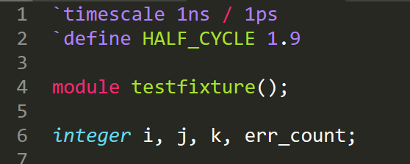
Timing Path Calculation By Simulation
Modify HALF_CYCLE in testfixture.v to test your critical path
First, loosen the clock cycle when you’re checking your circuit logic. Once the logic is correct, start to shorten the clock period to find the critical path.
14
Notes:
`timescale time units / precision units
14

Slide 15
Pipeline MAC Example
15

Slide 16
Pipelined Structure
pipeline
0
d3
pp1[1]
R
R
FA
FA
a1
0.441
w3
c3
d2
R
a0
FA
R
0
0.441
0.441
w2
c2
pp1[0]
FA
R
b1
pp0[1]
d1
FA
R
w1
c1
b0
pp0[0]
0
FA
R
R
d0
w0
0.441
c0
Clock

Slide 17
Verification
17

Slide 18
Test and Verify Your Circuit
By applying input patterns and observing output responses
Testbench
tb_*.v
*.v
*.fsdb / *.vcd / *.out
Test patterns
Design Under Test (DUT)
Output response

Slide 19
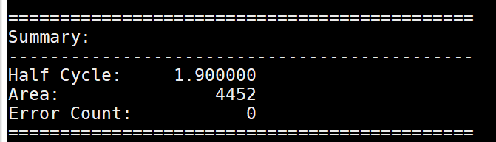
Compile and debug
Source
- source /usr/cadence/cshrc
source /usr/spring_soft/CIC/verdi.cshrc
Include the testbench & lib.v files to run simulation
ncverilog +access+r testfixture.v lin_class.v lib.v

Slide 20
Reminder (1/2)
Loosen the clock cycle when you’re checking your circuit logic.
Once the logic is correct, start to shorten the clock period to find the critical path.
Use basic gates provided in lib.v to design your circuit. No behavior level code will be accepted.

Slide 21
Reminder (2/2)
Due on 2019/01/04 13:20
For any further questions , contact TAs !
江子近 r06943159@ntu.edu.tw
王鈺凱 r06943124@ntu.edu.tw
To know more about Verilog, refer to
http://www.ece.umd.edu/courses/enee359a.S2008/verilog_tutorial.pdf

