Slide 1
Full Stack Web Development
Project Proposal
(20%)
Tu2tor
Geng Yue
2403880d
P02

Slide 2
Declaration of Originality
I am the originator of this work and I have appropriately acknowledged all other original sources used as my references for this work.
I understand that Plagiarism is the act of taking and using the whole or any part of another person’s work, including work generated by AI, and presenting it as my own.
I understand that Plagiarism is an academic offence
and if I am found to have committed or abetted the offence of plagiarism in relation to this submitted work, disciplinary action will be enforced.
Name and Signature of Student:
Geng Yue

Slide 3
Declaration on the use of Generative AI tools for assignments
Describe how you have used Generative AI tools such as ChatGPT or Dall.E-2 in your assignment.
Show snapshots of the conversations with the AI tool (i.e., the prompts you used and the response you get from the AI tool).

Slide 4
How do you indicate the reference?
The content generated by AI tools are not retrievable except by the user who generated them, so they are considered non-recoverable sources. Although non-recoverable data or quotations in APA Style papers are usually cited as personal communications, with ChatGPT-generated text there is no person communicating. Quoting text from ChatGPT chat is therefore more like sharing the output of an algorithm, with a reference list entry and the corresponding in-text citation.
According to the official APA Style site, ChatGPT references should be cited as:
E.g. OpenAI. (2023). ChatGPT (Sep 25 version) [Large language model].
https://chat.openai.com/chat
Important Note:
Do not copy answers produced by the AI tool in totality as it is considered as plagiarism.
Do not rely on any information produced by the AI tool blindly. You should always verify the answer with other sources. Do not assume that these answers provided by the AI tool are correct.
To achieve quality outputs from the AI tool, you should provide good prompt that is clear and specific. Be precise and provide context. Avoid asking open-ended questions.

Slide 5
Selected Use Case –
Highlight your selected use case below
Case Study Options (The problem statement serves as a starting point; you can use it as is or adapt it based on your users' specific needs.):
Campus Event Management System
Problem Statement: Students often miss out on campus events due to scattered announcements, lack of reminders, and complicated registration processes, leading to low participation and poor event visibility.
Library Book Finder & Reservation System
Problem Statement: Students waste time searching for books in the library without knowing their availability, resulting in frustration and missed opportunities to access learning resources.
Peer-to-Peer Learning / Tutor Finder
Problem Statement: Students often need academic help but struggle to find peers with the right expertise, leading to missed learning opportunities and uneven access to support.
Internship & Job Portal for Students
Problem Statement: Students often struggle to find internships and job opportunities relevant to their courses, as postings are scattered across multiple platforms with no campus-specific matching.

Slide 6
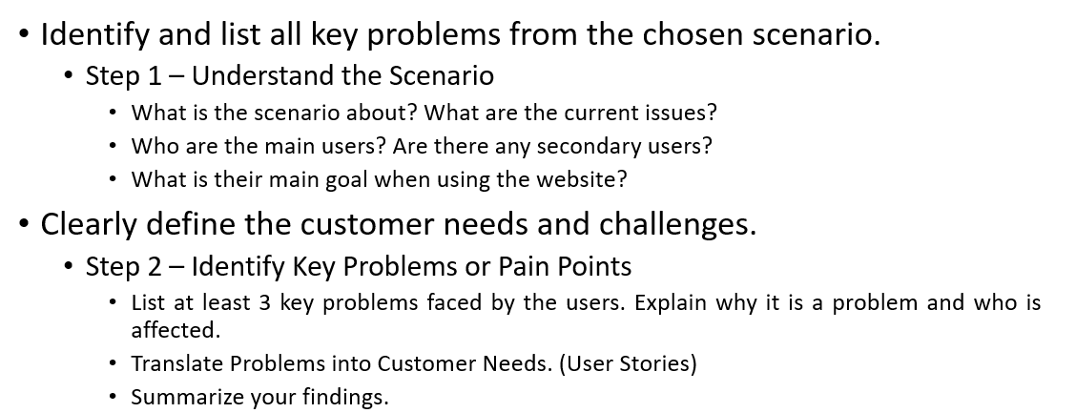
Problem Definition/Customer Needs (4%)

Slide 7
Problem Definition/Customer Needs (4%)
Problem Statement
Problem 1: Discovery Problem - Information Silos Prevent Finding Qualified Tutors. During the discovery stage, students cannot systematically find qualified peer tutors because communication happens organically through existing social circles like class groups, friends, casual networks. Rather than through purposeful channels designed for academic support. In instances where a student is struggling with one subject, asking classmates within their immediate network results in missing highly qualified peer tutors from other classes or cohorts who have proven expertise in that subject. This creates information silos whereby the talented peers remain invisible simply because they are not in the same social circle. There is no capacity to search for tutors by subject expertise, availability, or past performance. Students waste time asking around and are not assured of finding suitable help. Customer need: "As a student struggling with ADEV, I want to quickly find experienced tutors available this week with good ratings, so that I can get help before my exam."
Problem 2: Coordination Problem-Informal Channels Make Booking and Management Chaotic. When a student identifies a potential peervtutor, the coordination stage is challenging as it relies on informal channels such as Reddit, WhatsApp, or personal messaging. Lacking a unified platform, students and tutors are forced to coordinate schedules through back-and-forth messaging, which results in missed appointments, double booking, and confusion over session details. There is no centralized booking system, no calendar integration, and there is no systemized tracking of upcoming or past sessions. Each tutoring arrangement requires a different, manual coordination across various communication tools. In this respect, such a fragmented approach adds a lot of unnecessary friction to a rather seamless process from the customer's perspective, from the point of booking confirmation to session completion. Customer need: "As a tutor managing 5-10 sessions per week, I want a centralized booking system with automatic conflict detection and calendar integration, so that I can efficiently manage my tutoring schedule without chaotic messaging."

Slide 8
Problem Definition/Customer Needs (4%)
Problem Statement
Problem 3: Trust & Motivation Problem - No Quality Assurance and No Incentive for Good Students to Help. The problem with the present peer-learning system is two-fold. The first is that there is no mechanism for quality assurance. As a result, there is no review, feedback, or experience available to a student seeking tutoring services, making it impossible to gauge beforehand how much value they will derive. The second issue is more deeply ingrained. Better-performing students feel embarrassed to tutor other peers because there is no incentive system. Capable peers view tutoring others as a chore because they can't gain more value out of it. Tu2tor rectifies this situation by implementing a credit system whereby peers can reward each other to better themselves later on - peers can gain credits to tutor others, which they can redeem later to gain tutorage assistance themselves. This break-through mechanism indicates that better-performing peers are essentially rewarding themselves because they will gain because peers tutor each other. Customer need : “As a high-performing student, I want to gain credits to reward other peers, such that when I personally need tutorage assistance in other subjects I am no better at, I gain access to quality tutorage assistance, which is essentially rewarding myself because I am helping myself at a later date.”
Problem 4: Matching Problem - Manual Browsing Without AI-Driven Recommendations. Students must manually browse dozens of peer's profiles, leading to decision fatigue and inefficiency. Without intelligent matching based on learning history, they struggle to identify the best fit for their needs. Customer need : " As a student with previous ADEV and DBAV tutoring, I want AI recommendations based on my history so that I can quickly find the best match.."

Slide 9
Problem Definition/Customer Needs (4%)
Tutee’s user story
Finding Qualified Tutors Quickly
I'm a Year 1 IT student struggling with DBAV, and my exam is next week. I need to find a tutor who really knows this subject and has helped other students successfully before. I don't have time to ask around in multiple WhatsApp groups or wait for responses. I want a system where I can search by subject, see who's available this week, and check their ratings from previous students. This would make the website personalized for me and get me the right help before it's too late.
Making Informed Decisions with Reviews
I want to book a tutor for React.js, but I'm worried about wasting my credits on someone who might not be helpful. Before I commit, I need to see what other students have said about this tutor. Were they clear in their explanations? Did they actually help improve grades? I feel students should have some transparency about the quality of tutors through a review system so I can make confident decisions about who to learn from.
Seamless Video Sessions
When I am booking an online tutoring session, I don't want to be bothered with several applications and lost Zoom links. It would be simpler to plan if the video meeting was integrated right into the platform. I should click "Join Session" and directly start learning without copying links, downloading apps, and troubleshooting. The system should remember about my upcoming sessions and let me join in with one click.
Personal AI recommendations
I have already taken tutoring for ADEV and JavaScript; now I need help with React. The modules I want to learn need not be confined to what I'm currently studying—perhaps I'd like to explore other IT frameworks or even design principles. I want an authentication system so that the platform remembers my learning history and recommends tutors who match my progression. Instead of browsing hundreds of profiles, the AI should suggest the best tutors based on what I've learned before.

Slide 10
Problem Definition/Customer Needs (4%)
Tutor’s user story
Credit System - Helping Others Means Helping My Future Self
I'm strong in Full stack development but struggle with IOT. I've never been motivated to tutor because it takes time from my studies and free time. With Tu2tor's credit system, when I tutor DBAV now, I earn credits to use for IOT help this semester. Helping my peers today is actually investing in my own future learning. This makes me want to actively share my knowledge, knowing that when I need help later, I'll have credits to access quality tutoring. It's helping others while helping my future self.
Managing My Tutoring Schedule
I'm helping 3 students every week, and I want to make it easy for potential students to know when I'm available without constant messaging. I should be able to set my available time slots once in my profile—for example, Mondays 2-5pm and Wednesdays 10am-4pm—and students can view these slots directly when they visit my profile. When a student books a slot, the system should automatically mark it as unavailable for others, preventing double-booking. This way, I don't have to manually coordinate schedules through WhatsApp, and students can immediately see when they can book me.
Building My Reputation
I specialize in web development subjects like ADEV and DBAV and I've helped many students improve their grades. When I apply for internships or jobs, I want to include this tutoring experience on my resume, but I need verifiable evidence. This platform can serve as proof, my profile displays the real cases of students I've helped, their actual reviews and ratings, and specific comments about how I improved their understanding. Employers and schools can verify this directly through the platform. Having documented student feedback and quantifiable results (like "helped 25 students improve by average 1 grade") makes my resume stand out and demonstrates my teaching abilities with real evidence, not just claims.

Slide 11
Problem Definition/Customer Needs (4%)
Acceptance Criteria
From these user stories and problem definitions, I can derive clear success metrics for Tu2tor:
Finding Qualified Tutors Quickly:
-Students can search by subject, rating, and availability without asking around in multiple group chats
-Search results surface peer tutors beyond students' immediate social circles
-Students feel confident they've found the right help before exam deadlines
Making Informed Decisions:
-Students can read authentic reviews from peers who've worked with the peer tutor
-Review content helps students assess whether the tutor is clear, patient, and knowledgeable
-Students trust they're spending credits wisely on quality tutoring
Seamless Session Experience:
-Students join video sessions with one click, no copying Zoom links or downloading apps
-Tutors can manage their schedule through centralized calendar without WhatsApp chaos
-Both parties can multitask with floating video while browsing the platform

Slide 12
Problem Definition/Customer Needs (4%)
Acceptance Criteria
From these user stories and problem definitions, I can derive clear success metrics for Tu2tor:
Credit System Motivation:
- Strong students see tutoring as "helping their future self for another subject" rather than just a favor
- Students who excel in one subject earn credits to get help in subjects they struggle with
- The ecosystem sustains itself through mutual benefit rather than relying on altruism
AI-Powered Personalization:
- Students receive tutor recommendations based on their learning history
- The platform remembers past subjects studied and suggests appropriate next steps
- Browsing time decreases significantly compared to manually scrolling through profiles
Building Tutor Reputation:
- Tutors can showcase their expertise through verified reviews and session counts
- Tutor profiles serve as credible evidence for resumes and job applications
- Students prefer tutors with documented track records over unknown peers
Real-Time Collaborative Learning:
- Programming tutoring sessions include live code editing where both can type simultaneously
- Students learn by doing alongside tutors, not just watching explanations
- Code collaboration makes debugging and understanding concepts more effective

Slide 13
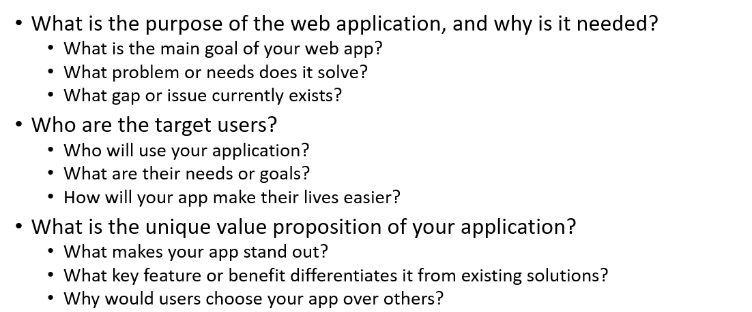
Project Objectives (3%)

Slide 14
Project Objectives (3%)
What is the purpose of Tu2tor, and why is it needed?
Tu2tor is a campus-based peer tutoring platform designed to connect Temasek Polytechnic students who need academic help with fellow students who can provide quality tutoring.
Why peer tutoring matters: A meta-analysis conducted in 2024 of 27 studies showed that peer tutoring programs have a moderate highly positive effect (g = 0.480) on the academic achievement of college students. Regarding STEM subjects, the results of the meta-analysis conducted in 2025 showed that the strong significant effect of peer tutoring programs on these subjects’ academic achievement; this implies that peer tutoring greatly improves university academic performance. Notably, there were significantly higher effects in Asian countries. This implies that peer tutoring programs suit the education system that prevails in Singapore.
The current problem: While students have vast knowledge resources within their own community, there's no efficient way to connect those who need help with those who can provide it. The informal system—relying on WhatsApp groups, word-of-mouth, and bulletin boards—creates inefficiencies, information gaps, and trust barriers. Research on WhatsApp use in education highlights major coordination challenges including information overload in large group chats, 24/7 availability expectations, and messages getting lost in the noise.

Slide 15
Project Objectives (3%)
Source: https://link.springer.com/article/10.1007/s40299-024-00960-0
https://www.sciencedirect.com/science/article/pii/S2666374025000123
https://www.mdpi.com/2071-1050/14/19/12304

Slide 16
Project Objectives (3%)
What is the main goal of the web app?
The main goal is to create a seamless, trustworthy, and efficient marketplace for peer-to-peer learning within the TP IIT community.
Tu2tor transforms scattered informal arrangements into a structured, scalable peer learning ecosystem by:
Centralizing tutor discovery: Students find qualified tutors through structured search instead of asking around in multiple WhatsApp groups
Streamlining booking management: Automated scheduling prevents the chaos of coordinating through messaging apps
Building trust through quality assurance: Reviews and ratings help students make informed decisions before committing credits
Rewarding knowledge sharing: Credit system motivates talented students to help peers, knowing they're investing in their own future learning
Digital-first approach: In 2024, 60% of institutions observed that online classes tend to fill first, and 50% noted that online program enrollment is increasing faster than on-campus enrollment, showing strong student preference for digital solutions.
Tu2tor meets this expectation by integrating video sessions, AI recommendations, and centralized booking—no more juggling multiple platforms.

Slide 17
Project Objectives (3%)
Source: https://research.com/education/online-education-statistics

Slide 18
Project Objectives (3%)
What problems or needs does it solve?
Tu2tor tackles five overlapping issues based on the research:
Discovery Problem: The issue of discovering qualified tutors outside of the immediate friend group faces the students. Though WhatsApp offers very high engagement rates (98% open rate), the informal communication platform prevents the students from tapping into qualified tutors other than their friend group. Studies reveal that more qualified tutor discovery occurs with an official tutor-seeking platform than with group chat forums.
Coordination Problem: By using WhatsApp as the platform of booking an appointment creates coordination problems. Some of the major issues that emerge according to research include information overlap during group bookings on messaging platforms such as WhatsApp. There’s the issue of being on call 24/7 with the student wanting access at any point. There’s the problem of getting the message through the noise.

Slide 19
Project Objectives (3%)
What problems or needs does it solve?
Trust & Motivation Problem: There are no quality assurance mechanisms—the students cannot evaluate the tutor’s performance prior to appointment. Current literature indicates that successful students frequently lack the motivation to tutor until adequate incentive schemes are put into place. Current academic literature validates that incentive reward schemes (addressing credit-based rewards and gamification) significantly improve student participation and engagement.
Problem of Integration: Most of the students expect integrated functionalities while interacting with technology; therefore, the complexity of interacting with different platforms like zoom and WhatsApp might affect the efficiency of the system.
Personalization Problem: Surfing dozens of profiles manually results in decision fatigue without the intelligent matchmaking based on the learning experience and the success of peers.

Slide 20
Project Objectives (3%)
Source:
https://sleekflow.io/blog/whatsapp-education
https://www.mdpi.com/2071-1050/14/19/12304
https://www.nature.com/articles/s41599-025-04860-6

Slide 21
Project Objectives (3%)
What gap or issue currently exists?
The tutoring paradox: Singapore has one of the world's strongest tutoring cultures. Families spent S$1.8 billion on private tutoring in 2023 (up almost 30% from 2018), with average household spending reaching S$104.80 per month in 2023 compared to S$88.40 in 2018. But this massive market focuses almost entirely on primary and secondary students through commercial agencies.
The polytechnic gap: No centralized platform exists for student-to-student tutoring at the tertiary level. This gap is especially problematic for polytechnic students who benefit most from peer learning due to the practical, project-based nature of their curricula. As demonstrated by research, peer tutoring has larger effect sizes in Asia, making it particularly suitable for Singapore's education context. Learning DBAV from someone who just completed the same assignment last semester is far more relevant than generic tutoring content.
Wasted potential: Current informal methods (WhatsApp, word-of-mouth, bulletin boards) waste time, create uncertainty, and severely underutilize the vast knowledge resources within the student body. Talented tutors remain invisible, struggling students can't find help, and everyone loses.

Slide 22
Project Objectives (3%)
Source:
https://smiletutor.sg/singapore-families-spent-1-8b-on-private-tuition-in-2023-heres-what-that-means-for-2025/
https://www.malaymail.com/news/singapore/2025/01/20/singapore-families-spent-s18-billion-on-private-tuition-in-2023-with-the-richest-spending-over-s162-per-month/163937
https://link.springer.com/article/10.1007/s40299-024-00960-0

Slide 23
Project Objectives (3%)
Who are the target users and what are their needs?
Tu2tor caters to the following user groups within the Temasek Polytechnic community:
Students (Tutees) - TP students of various years and classes who require academic support whether studying for an examination, projects, or just require an explanation of complicated matters. This group of learners requires the following:
-Quick access to qualified tutors of specific subjects
-Transparency Through Reviews For Informed Decisions
-Online booking with automated schedules
-Seamless integrated video meeting sessions
-Personalized suggestions based on the learning path
Student Tutors: TP students who excel at certain subjects and want to tutor other students while obtaining credits and improving their reputation. They have the following requirements:
-Visibility to Show Expertise and Availability
-A centralized calendar system that organizes sessions with no overlapping timelines
-Feedback procedures aimed at improving the quality of teaching

Slide 24
Project Objectives (3%)
How will Tu2tor make their lives easier?
For students seeking assistance:
Speed of discovery: Discover the right tutor in minutes, not days spent searching across various group chats.
Smart decisions: Check out genuine reviews so that credits are spent effectively instead of being wasted on inept tutoring.
Seamless sessions: Join online tutoring sessions with just one click—without the hassle of copying links or downloading an app
Smarter match: AI-powered matches examine the user’s study progression and offer recommendators that fit their study pattern with higher efficiency and increased learner satisfaction.
For Tutors:
Effortless visibility: Profiles offer expertise, topics of expertise, availability, and ratings without the need of incessantly promoting oneself
No Scheduling Chaos: The centralized calendar system automatically detects clashes and avoids double bookings so that there’s an end to the endless WhatsApp group messaging on bookings
Constructing reputation through Reviews and Badges: Excellence made visible; Verifiable evidence of experience on Resume and Job Apps. Always remain in control with the request-based booking system that enables the tutor to choose the requests that fit their timetable and specialisms.
Both:
A credit system makes an altruistic activity of peer tutoring a mutually beneficial activity because the act of improving others inherently improves yourself too.

Slide 25
Project Objectives (3%)
What is the unique value proposition?
Tu2tor provides "Trusted Peer Learning, Seamlessly Integrated", encompassing four distinctive aspects that set this platform apart from other generic tutoring websites:
1. Campus-Exclusive Community - Peer-Level Learning That Works
TP only email verification (@student.tp.edu.sg) builds an exclusive community of trusted users who are all Temasek Polytechnic students. This exclusivity ensures:
True peer-to-peer matching: Tutors recently completed the same courses (ADEV, DBAV, etc.) and understand TP's specific curriculum, assignment requirements, and teaching style
Shared context: Both tutors and students speak the same language—they know the same lecturers, use the same course materials, and face identical project challenges
Campus safety: Unlike open marketplaces where anyone can register, TP-only verification prevents external scammers and ensures accountability through student IDs
Network effects: As more TP students join, the platform becomes increasingly valuable—students can find tutors for even niche subjects like specific electives or specialized modules

Slide 26
Project Objectives (3%)
What is the unique value proposition?
Tu2tor provides "Trusted Peer Learning, Seamlessly Integrated", encompassing four distinctive aspects that set this platform apart from other generic tutoring websites:
2. Complete Integration - One Platform, Zero Friction
End-to-end functionality eliminates the need to juggle multiple apps throughout the tutoring journey:
Discovery: Advanced search with filters (subject, rating, price, availability) plus AI-powered recommendations in one interface
Booking: Integrated calendar shows tutor availability in real-time, request-based system lets tutors review and accept bookings, automatic conflict detection prevents double-booking
Communication: Built-in messaging system for session coordination (currently 30% implemented)
Video Sessions: One-click Meet integration, no copying Zoom links, no downloading apps, no "can you send the link again?" messages. Unique floating video window lets students browse other pages while staying in the session
Credit “Payment”: Internal credit system eliminates awkward cash transactions, PayNow transfers, or payment disputes—credits automatically transfer upon session completion
Quality Assurance: Post-session review prompts ensure feedback collection, reviews directly impact tutor rankings and visibility
This seamless flow means students go from "I need help with DBAV" to "I'm in a video session with a qualified tutor" without leaving the platform.

Slide 27
Project Objectives (3%)
What is the unique value proposition?
Tu2tor provides "Trusted Peer Learning, Seamlessly Integrated", encompassing four distinctive aspects that set this platform apart from other generic tutoring websites:
3. AI-Powered Personalization - Smarter Than Manual Browsing
LLM engine analyzes individual learning patterns to deliver intelligent recommendations:
Learning history tracking: System remembers subjects studied (e.g., "Previously took ADEV tutoring, now searching for IOT help") and suggests tutors who specialize in natural progression paths
Success pattern matching: AI identifies which tutors have successfully helped students with similar backgrounds and learning goals
Context-aware chat assistant: Students can ask natural language questions like "I'm struggling with database normalization in DBAV, who can help?" and receive personalized tutor recommendations with reasoning
Dynamic ranking: Search results adapt based on student priorities—AI Priority Slider lets users weight "highest rating" vs "most available" to match their urgency
Continuous learning: As more sessions complete and reviews accumulate, recommendations improve through feedback loops
This moves beyond simple keyword matching to understanding what makes a good tutor-student fit, dramatically reducing browsing time and improving satisfaction.

Slide 28
Project Objectives (3%)
What is the unique value proposition?
Tu2tor provides "Trusted Peer Learning, Seamlessly Integrated", encompassing four distinctive aspects that set this platform apart from other generic tutoring websites:
4. Quality Assurance Built-In - Trust Through Transparency
This multi-layered approach confirms that students place credits with qualified tutors.
Authentic booking experience: Customer reviews only come after completion of the sessions, not reviews generated by friends or competitors as might happen with other business listings on the platform.
All-around rating system: ratings on a scale of 1-5 stars + comments + applicable keywords (Clear, Patient, Knowledgeable) reveal multi-faceted qualities
Response of the tutor: Tutors should react appropriately to the reviews provided by demonstrating their accountability and expressing their gratitude to the students. This helps them gain
Performance badges: Given automatically based on certain criteria after every performance (Newbie-0-5 sessions; Rising Star-10+ sessions with a rating of 4.5+; Expert-30+ sessions with rating of 4.7+; TopTutor-50+ sessions with a rating of at least 4.8+)
Real-Time Statistics: All tutor profiles show the numbers of overall sessions conducted, average rating given, response rate, and completion rate without any hidden numbers.
Optional anonymous reviews : Feedback may remain completely anonymous while still being linked with genuine bookings. Contrary to the unofficial WhatsApp system used by students who gamble on tutors that they do not know, the quality assurance of Tu2tor allows the students to make informed decisions based on transparent data.

Slide 29
Project Objectives (3%)
Why would users choose Tu2tor over alternatives?
vs. WhatsApp/Informal Methods:
- Centralized discovery vs. scattered group chats
- Quality assurance through reviews vs. unknown quality
- Automated scheduling vs. manual coordination
- Integrated video vs. lost Zoom links
vs. Commercial Tutoring Platforms:
- Peer-to-peer learning (equally effective, lower cost) vs. expensive professional tutors
- Campus-exclusive community vs. generic marketplace
- Credit system vs. cash payments
- Subject relevance (tutors who recently passed courses) vs. generic content
vs. LMS/Learning Platforms:
- Live 1-on-1 tutoring vs. static resources
- Personalized AI recommendations vs. course catalogs
- Social learning community vs. isolated studying
- Practical project help vs. theoretical content
The Tu2tor Advantage: The only platform designed specifically for TP peer tutoring that combines trusted matchmaking, seamless booking, integrated video, AI personalization, and quality assurance in one complete solution.

Slide 30
Proposed Features (3%)
Feature Name | Description / Purpose | User Actions / What It Does | Expected Outcome / Display | Notes / Future Plans
Tutor Profile Creation | Enable students to register as tutors by creating comprehensive profiles showcasing their expertise | Users fill profile with bio, subjects, hourly rate, available time slots, preferred locations, and upload profile picture | Complete tutor profile displayed in search results with ratings, badges, and availability status | May add video introductions and teaching methodology descriptions
Advanced Search & Filters | Help students quickly find tutors matching specific criteria using multi-dimensional filtering | Users enter subject, select price range, minimum rating, availability days, and online/offline preference | Filtered list of tutors ranked by relevance; results update in real-time as filters change | Future: Add experience level filter and response time metrics
Tutor Detail View | Provide comprehensive information about a tutor before booking | Users click on tutor card to view full profile, read reviews, check detailed availability calendar, see statistics | Full-screen profile showing bio, subjects, ratings breakdown, student reviews with tags, completed sessions count, response rate | May add "Ask Question" feature for pre-booking inquiries
Booking Request System | Enable request-based pairing where students send booking requests and tutors accept/decline | Students select date, time slot, duration (30min-3hrs), location, add notes about learning goals; submit request to tutor | Booking created in "pending" status; tutor receives notification and can accept/decline; upon acceptance, status changes to "confirmed" | May add instant booking option for tutors who enable auto-accept
Calendar Integration | Display personalized calendar showing upcoming, active, and completed sessions | Users view calendar with color-coded sessions; click session for details | Calendar view with upcoming sessions highlighted; shows date, time, tutor/student name, subject, location; prevents double-booking | May sync with Google Calendar and send reminder notifications

Slide 31
Proposed Features (3%)
Feature Name | Description / Purpose | User Actions / What It Does | Expected Outcome / Display | Notes / Future Plans
Credit Management | Manage internal credit system for booking payments without real money transactions | Users start with 500 credits; booking deducts credits based on (hourly_rate × duration); completed sessions transfer credits to tutor | Dashboard displays current credit balance; transaction history shows debits and credits; low balance warning | May add credit purchase system or earning credits through referrals
Video Session Room | Provide integrated Jitsi Meet video conferencing for online tutoring sessions | Students click "Join Session Now" button (available ±15 minutes from scheduled time); enters almost-fullscreen video room | Jitsi video interface occupies calc(100vh-180px); session info bar below with subject, tutor name, time; unlimited re-entry during time window | Session recordings may be added for review purposes
Review & Rating System | Enable quality assurance through student reviews of completed sessions | After session completion, students rate 1-5 stars, write comment (10-1000 chars), select tags (Clear, Patient, Knowledgeable), choose anonymous option | Review posted on tutor profile; tutor's average rating updates automatically via Mongoose middleware; reviews display with helpful count and tutor response | May add photo uploads and form field feedback later on
Tutor Response to Reviews | Allow tutors to respond to student reviews professionally | Tutors view reviews on their profile and can write responses to address feedback | Response appears below student review; shows tutor's perspective; builds trust through transparency | May add review flagging system for inappropriate content
AI Recommendation Engine | Provide intelligent tutor suggestions using LLM based on learning history | Students open AI chat assistant; ask questions like "I need help with React hooks" or "Recommend an ADEV tutor" | AI analyzes student's previous bookings, subjects studied, review patterns; responds with personalized tutor recommendations with reasoning; supports multi-turn conversation | May expand to recommend study schedules, learning paths, and study groups

Slide 32
Proposed Features (3%)
Feature Name | Description / Purpose | User Actions / What It Does | Expected Outcome / Display | Notes / Future Plans
AI Chat Interface | Offer conversational AI support for study help and platform guidance | Users type questions in chat interface; AI responds with context-aware answers; code snippets display with syntax highlighting | Real-time responses with markdown formatting; chat history saved to user account; can reference previous conversations | May add voice input and integration with course materials
Dashboard Analytics | Visualize personal statistics and activity using Recharts | Users view dashboard with stats cards and charts showing sessions completed, average rating (for tutors), credits earned/spent, upcoming sessions | Recharts visualizations: radial bar charts for profile completion, area charts for activity trends, calendar heatmap for session frequency | May add comparative analytics showing performance vs. peers
Booking Management | Centralized view of all bookings with status filtering | Users view bookings page filtered by status: Pending (awaiting confirmation), Confirmed (upcoming sessions), Completed (past sessions), Cancelled | Each booking card shows subject, date, time, tutor/student name, cost, status badge; click to view details or take actions (cancel, reschedule, review) | May add bulk actions and export to CSV
Session Completion | Automatically mark sessions as completed after scheduled end time | System checks booking end time; automatically updates status from "confirmed" to "completed" 15 minutes after scheduled end | Booking status changes; triggers review request notification to student; credits transfer to tutor account | Session archiving may be implemented for algorithmic improvements
Real-time Collaborative Code Editor | Enable multi-party live coding during tutoring sessions using embedded Monaco Editor (VSCode core) | Students and tutors access split-screen view with video on left, code editor on right; both can type simultaneously; select programming language; run code with integrated compiler | Real-time synchronized editing with multi-cursor display (different colors per user); syntax highlighting for 20+ languages; IntelliSense code completion; instant code execution results; chat overlay for code-specific discussions | Uses Yjs CRDT + WebSocket for conflict-free synchronization; Judge0 API for code execution; saves code snapshots per session; particularly valuable for coding courses

Slide 33
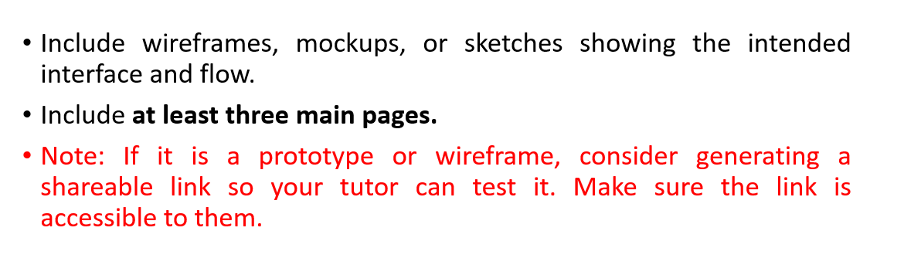
Wireframe (5%)
Screenshots link if pictures not clear enough
https://github.com/YoRHa16608/Fullstack_screenshots/tree/main/screenshots

Slide 34
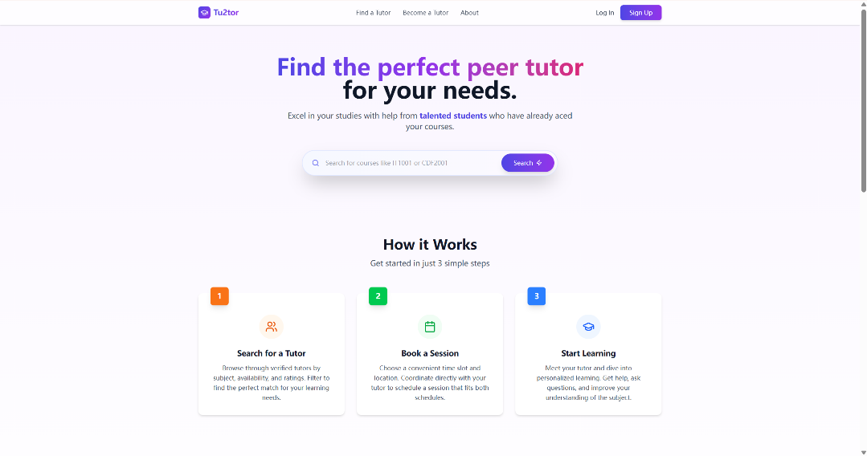
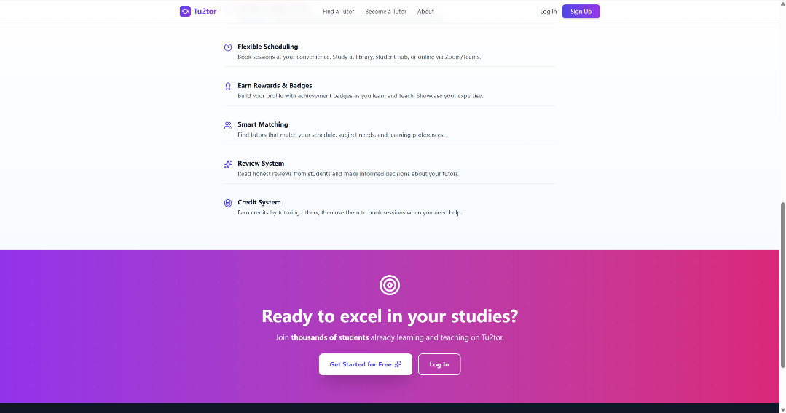
Wireframe (5%)
Main Page
The landing page features a clean hero section with the tagline "Find the perfect peer tutor for your needs" in gradient purple typography. A search bar enables course code lookup while navigation includes "Find a Tutor," "Become a Tutor," and "About" links with "Log In" and "Sign Up" buttons.

Slide 35
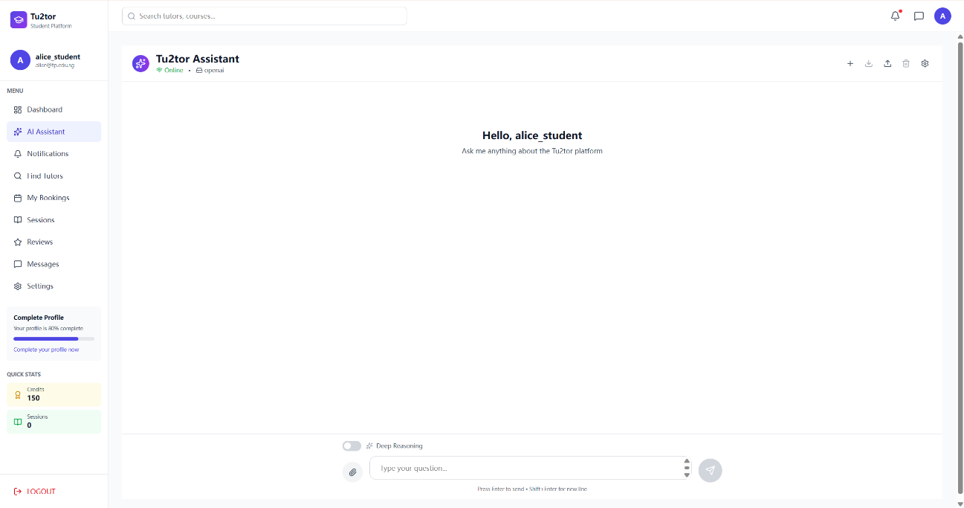
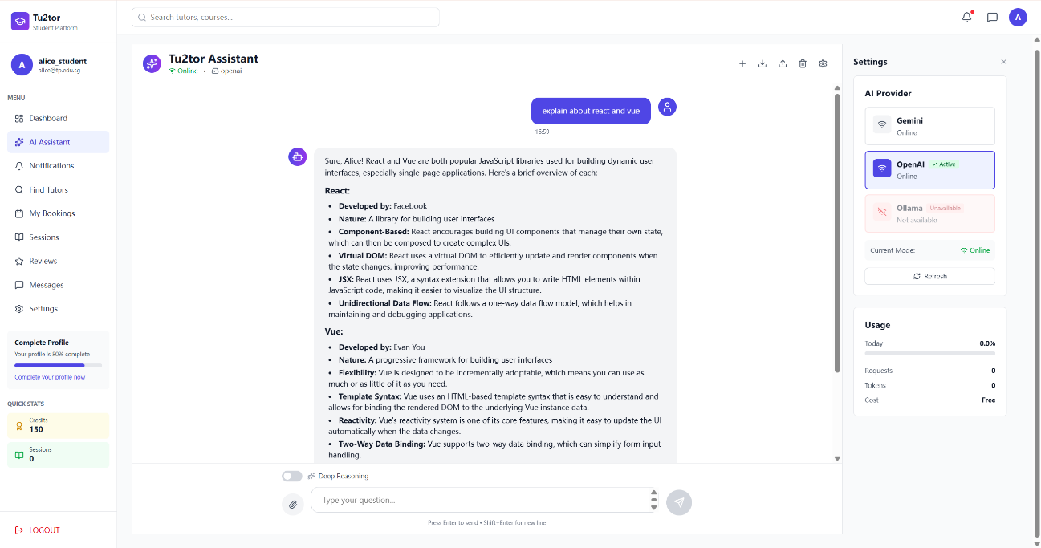
Wireframe (5%)
AI Assistant Page
The Tu2tor Assistant is an intelligent chatbot showing "Online" status with LLM provider. The sidebar displays profile completion, credits, and sessions . The interface greets "Hello, alice_student" with prompt "Ask me anything about the Tu2tor platform," featuring Deep Reasoning toggle and file attachment options. The Settings panel shows AI providers with usage state.

Slide 36
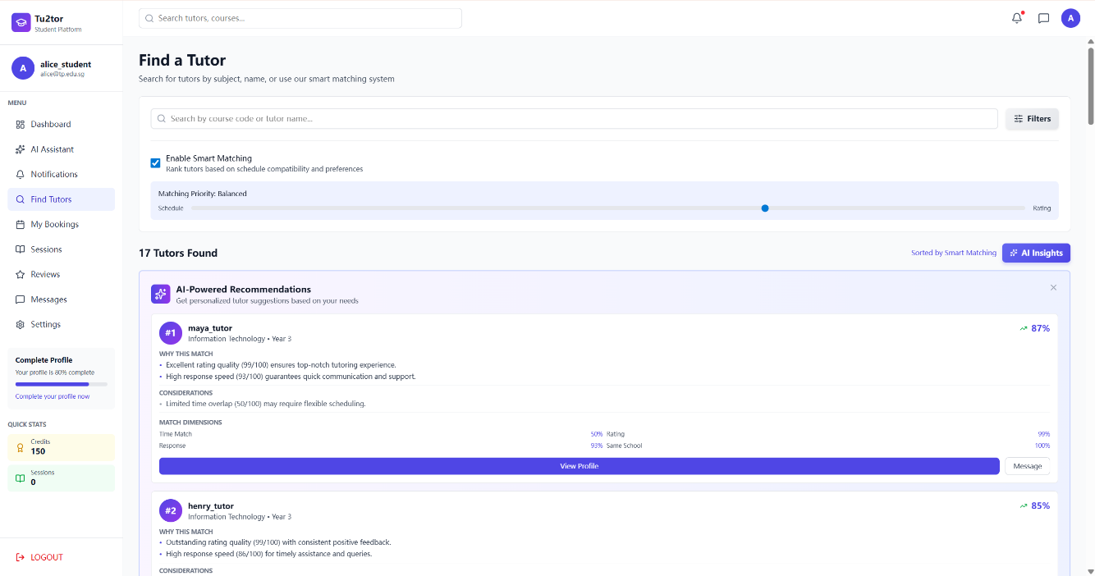
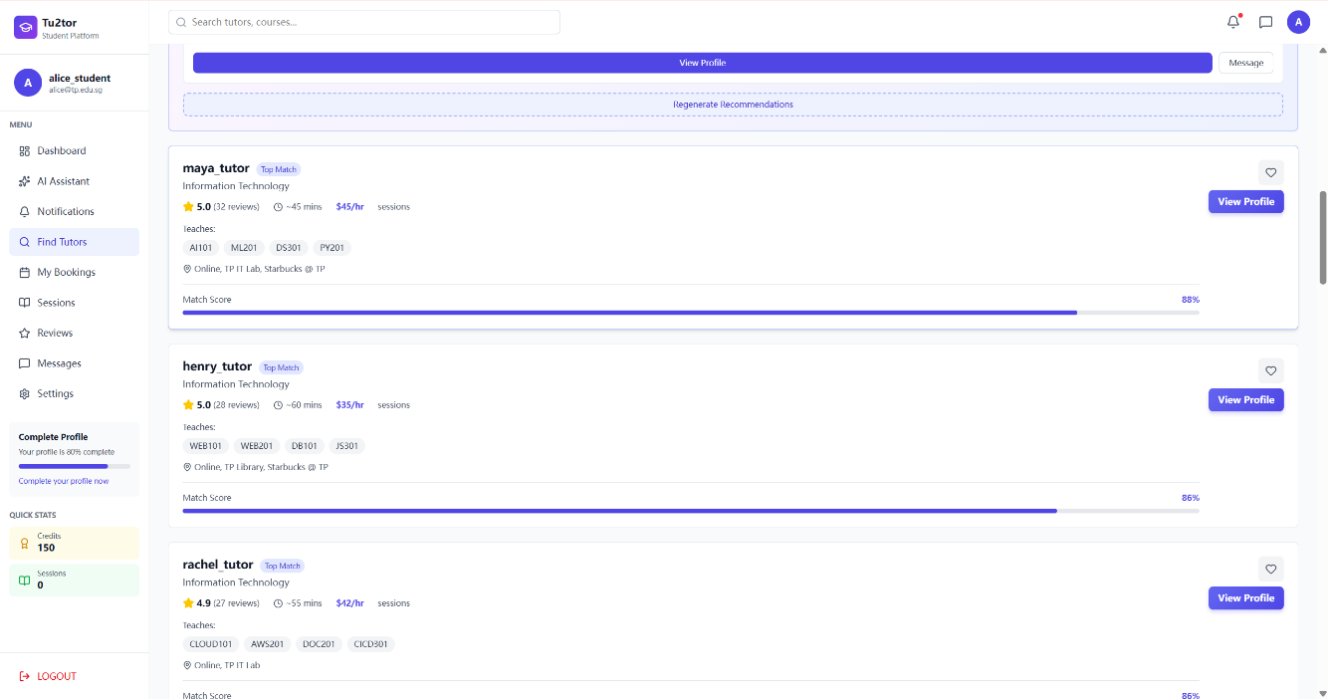
Wireframe (5%)
Matching Page
Tu2tor's AI matching system ranks tutors with "Enable Smart Matching" toggle and "Matching Priority: Balanced" slider between Schedule and Rating. Displays "17 Tutors Found" with personalized match percentages (maya_tutor 87%, henry_tutor 85%). Each recommendation shows "WHY THIS MATCH," "CONSIDERATIONS," and "MATCH DIMENSIONS" metrics.

Slide 37
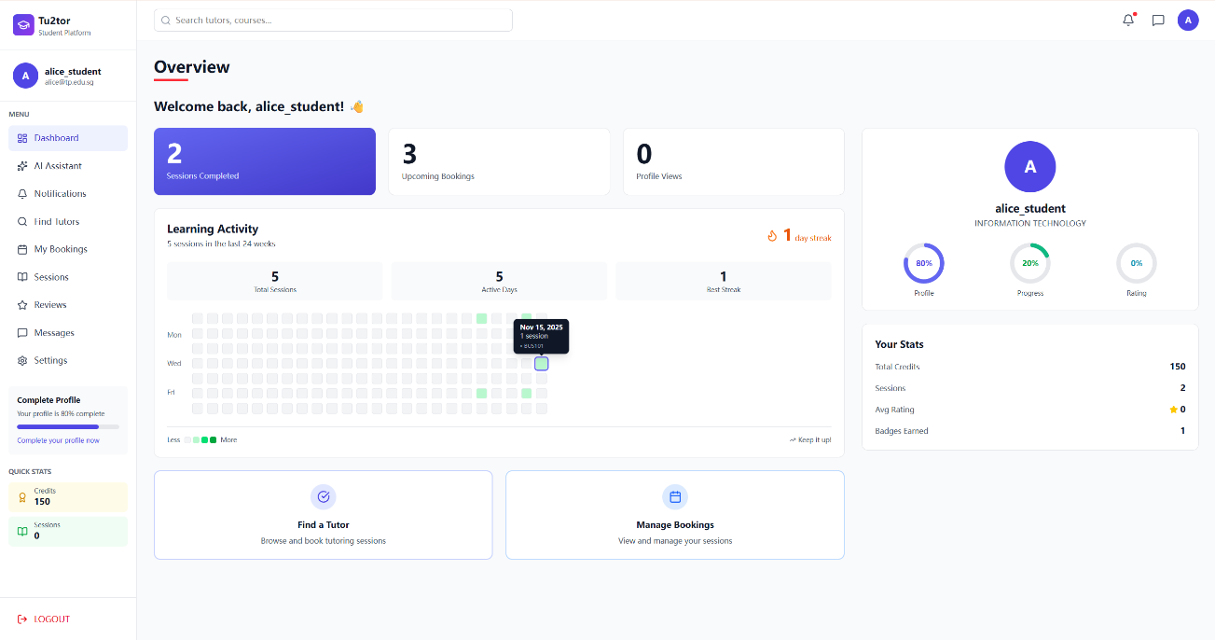
Wireframe (5%)
User Dashboard Page
The dashboard shows student's key metrics: Sessions Completed, Upcoming Bookings, Profile Views, day streak. A GitHub-style heatmap tracks 5 sessions over 24 weeks. Profile completion at 80%, Quick Stats show 150 credits, 2 sessions, 0 avg rating, 1 badge. Action buttons include "Find a Tutor" and "Manage Bookings."

Slide 38
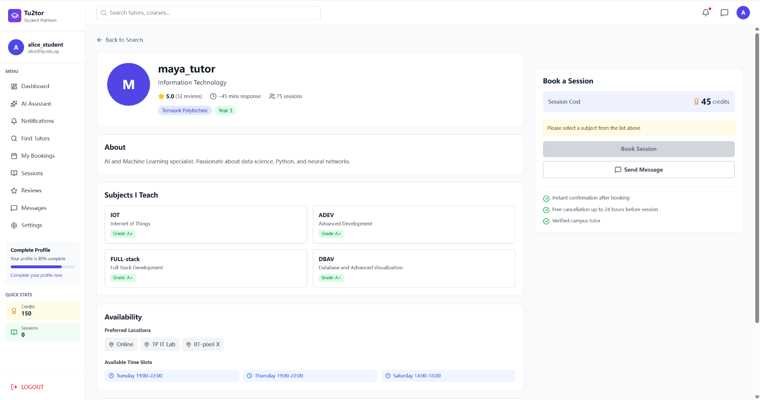
Wireframe (5%)
Tutor Profile Page
Tutor's profile shows rating, reviews, min response, sessions, Temasek Polytechnic Year 3, advanced subjected and available time and locations. Booking sidebar shows credits, instant confirmation, free 24hr cancellation, verified tutor badge.

Slide 39
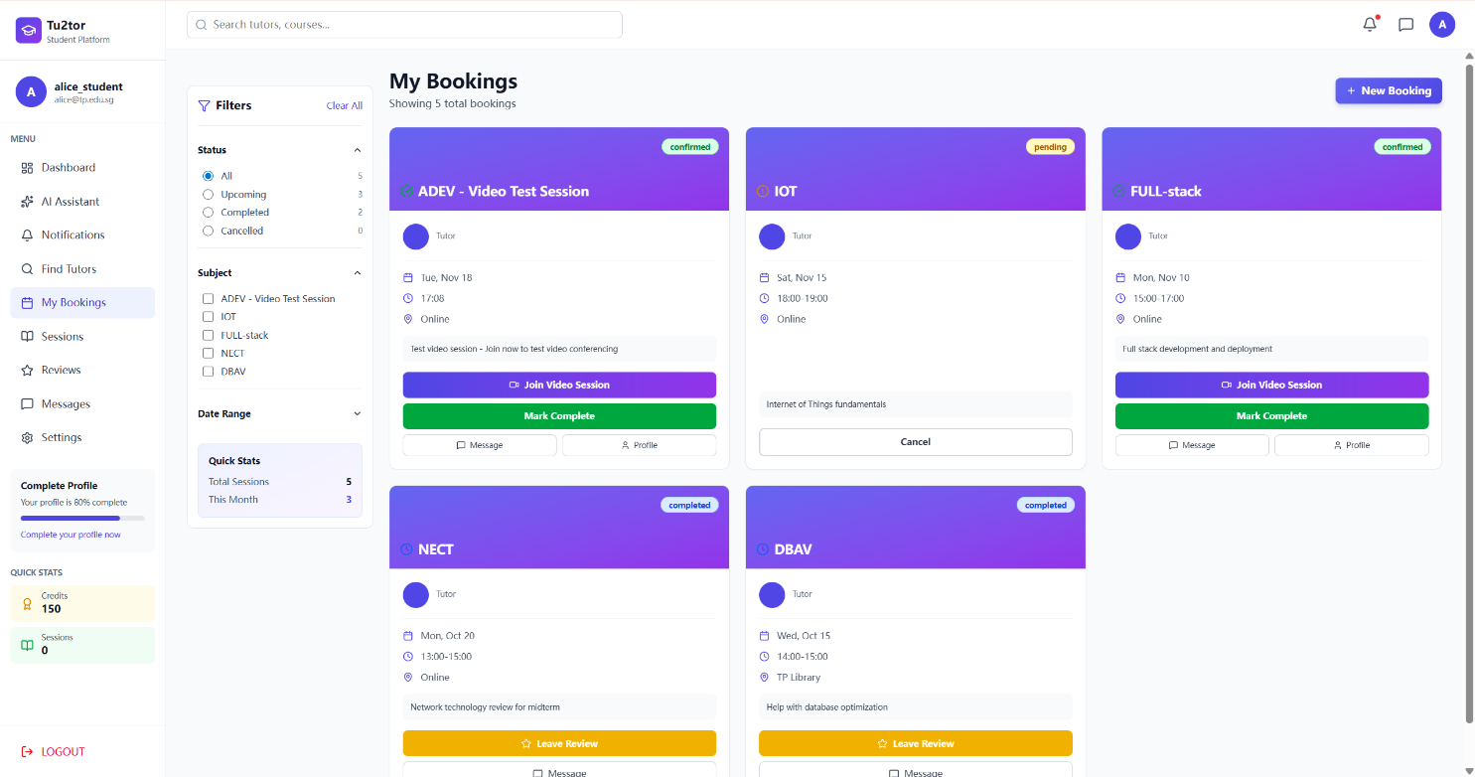
Wireframe (5%)
Booking Page
Shows student's bookings with Status/Subject filters and active bookings and completed bookings with booking history

Slide 40
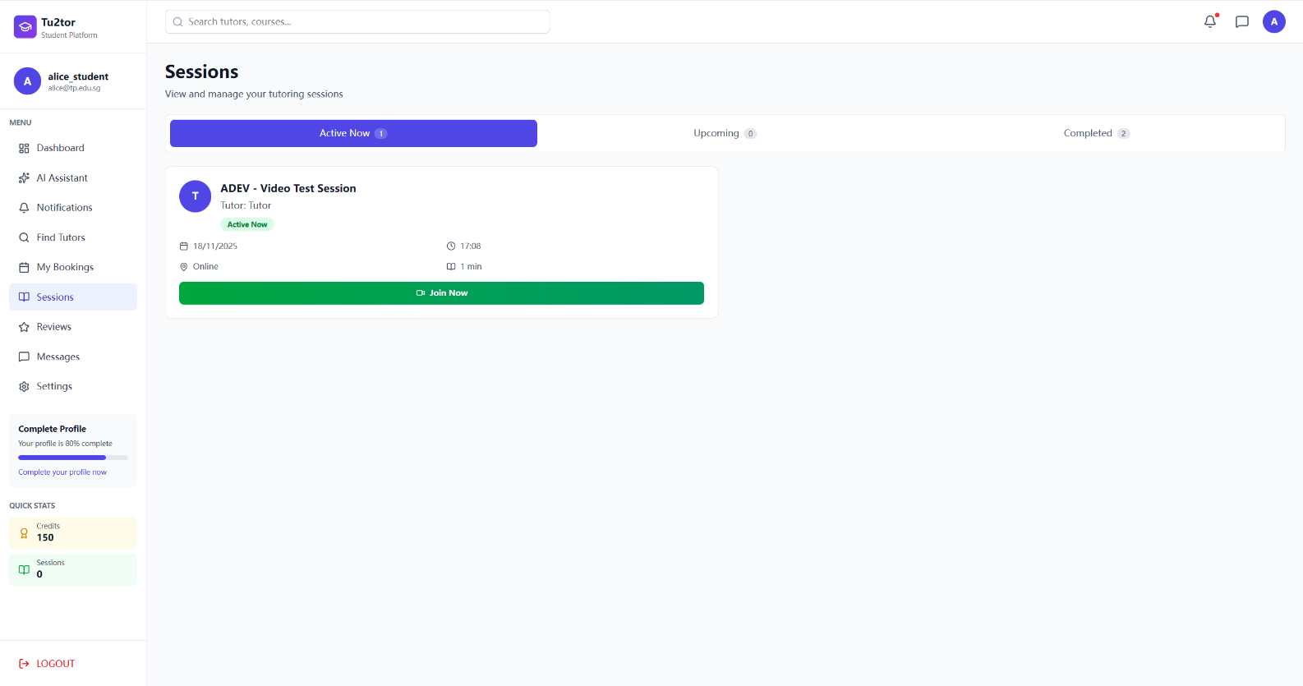
Wireframe (5%)
Session Page
Sessions page with three tabs: "Active Now", "Upcoming", "Completed" . Active session shows "ADEV - Video Test Session" with green "Active Now" badge, date, time, location, duration. Prominent green "Join Now" button enables immediate video session access for time-sensitive learning.

Slide 41
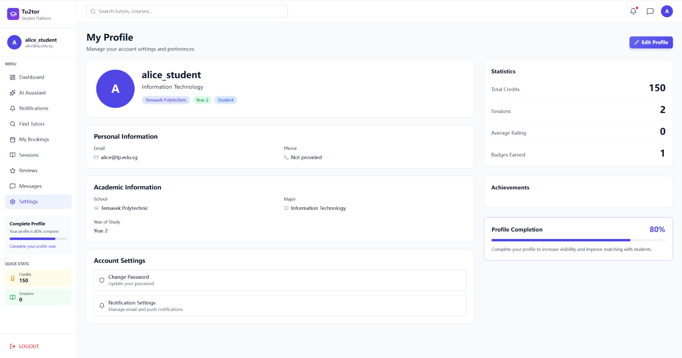
Wireframe (5%)
User Profile Page
My Profile page for student shows Information Technology, school and year of study. It also shows the credit system and session history

Slide 42
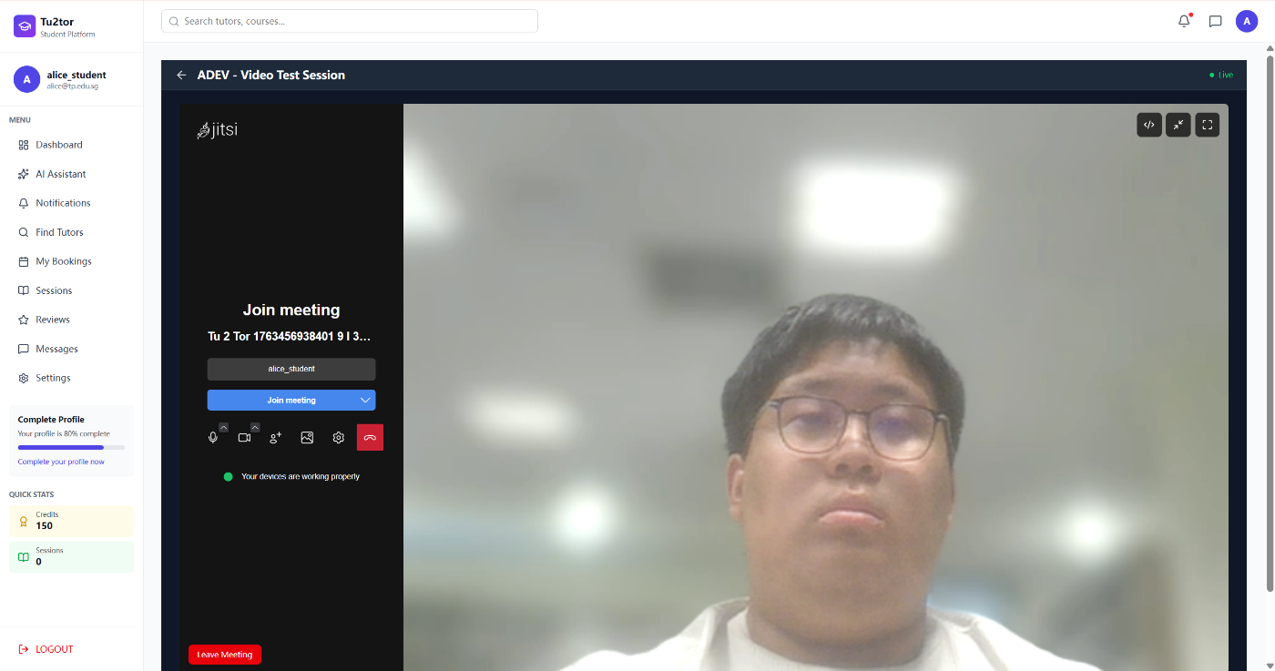
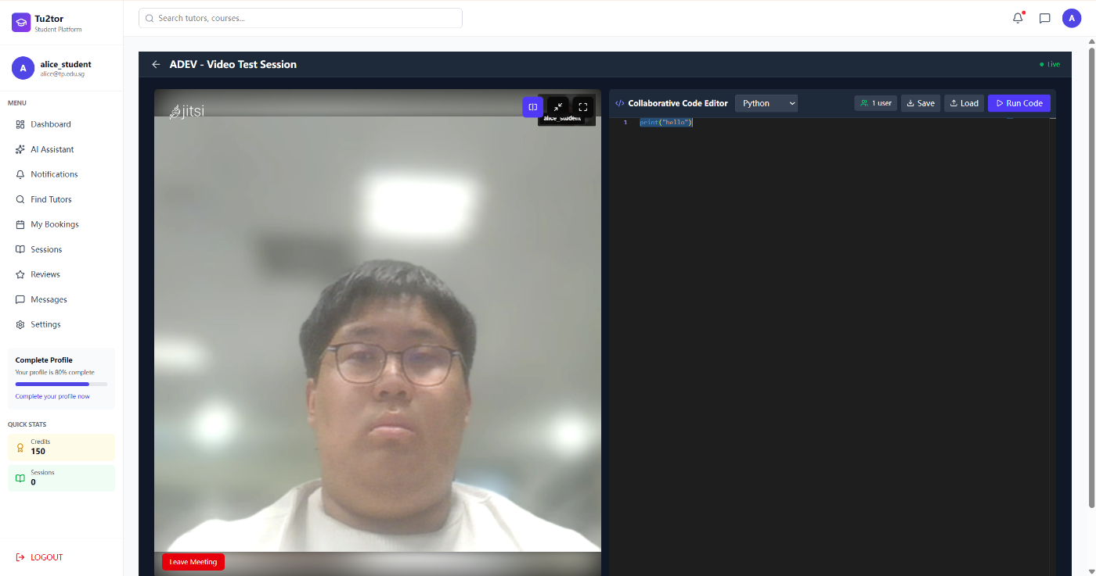
Wireframe (5%)
User Profile Page
It shows a live “Video Test Session” inside the same platform. On the left is a video call with the student’s camera feed, and on the right there is a collaborative code editor set to Python, with options to save, load and run code in real time.

Slide 43
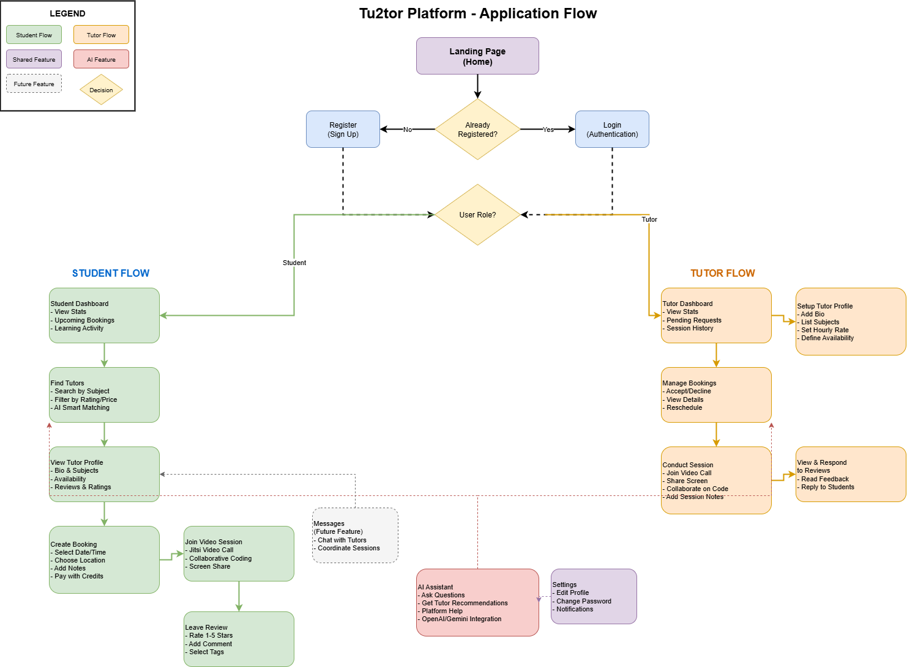
User Flow

Slide 44
Data Modeling (5%)
Initial identification of entities in your application.
Include at least four key data models and provide sample attributes for each model.
Note: Refer to the sample table in the next slide

Slide 45
Data Modeling - User
Table: User | Description: Stores fundamental user information for authentication and profile management. Serves as the base model for all platform users. Usage in App: Handles user registration, login authentication, profile display, and role management. Used throughout the platform to identify students and tutors, track credits, and manage account settings.
Attribute | Type | Sample Value | Description
_id | ObjectId | user_001 | Unique identifier for each user, automatically generated by MongoDB.
username | String | alice_student | Display name shown on profile, bookings, and reviews. Required field.
email | String | alice@student.tp.edu.sg | Temasek Polytechnic email address used for authentication and notifications. Must be unique.
password | String | $2b$10$... | Bcrypt hashed password for secure authentication. Never stored in plain text.
role | Array[String] | ['student', 'tutor'] | User roles allowing multi-role support. Users can be both student and tutor simultaneously.
school | String | Temasek Polytechnic | Educational institution name, used for campus-specific filtering.

Slide 46
Data Modeling - User
Table: User | Description: Stores fundamental user information for authentication and profile management. Serves as the base model for all platform users. Usage in App: Handles user registration, login authentication, profile display, and role management. Used throughout the platform to identify students and tutors, track credits, and manage account settings.
Attribute | Type | Sample Value | Description
course | String | Information Technology | Major or diploma program, displayed on profile and used for matching.
yearOfStudy | Number | 2 | Academic year (1, 2, or 3), helps match students with appropriate tutors.
credits | Number | 150 | Platform currency for booking sessions. Default: 500 credits upon registration.
badges | Array[String] | ['First Session', 'Top Reviewer'] | Achievement badges earned through platform activities, displayed on profile.
profilePicture | String | /uploads/avatar123.jpg | URL path to user's profile image. Optional field.
profileCompletion | Number | 80 | Percentage (0-100) indicating how complete the profile is. Encourages full profile setup.

Slide 47
Data Modeling - User
Table: User | Description: Stores fundamental user information for authentication and profile management. Serves as the base model for all platform users. Usage in App: Handles user registration, login authentication, profile display, and role management. Used throughout the platform to identify students and tutors, track credits, and manage account settings.
Attribute | Type | Sample Value | Description
createdAt | Date | 2025-10-01T10:30:00Z | Timestamp of account creation, auto-generated.
updatedAt | Date | 2025-11-15T14:20:00Z | Timestamp of last profile update, auto-updated.
Relationships:
One-to-One with Tutor (if user has tutor role)
One-to-Many with Booking (as student or tutor)
One-to-Many with Review (as student or tutor)

Slide 48
Data Modeling - Tutor
Table: Tutor | Description: Profile for users offering tutoring services. Contains specialized information about teaching capabilities, availability, and performance metrics. Usage in App: Manages tutor-specific data displayed on tutor profiles, search results, and AI matching system. Tracks session statistics and ratings for quality assurance.
Attribute | Type | Sample Value | Description
_id | ObjectId | tutor_001 | Unique identifier for tutor profile.
userId | ObjectId (ref: 'User') | user_010 | Reference to associated User model. Enables one-to-one relationship.
bio | String | AI and Machine Learning specialist. Passionate about data science... | Personal introduction displayed on tutor profile. Maximum 500 characters.
subjects | Array[Object] | [{code: 'IOT', name: 'Internet of Things', grade: 'A'}] | Array of subjects the tutor can teach with their achieved grades.
hourlyRate | Number | 45 | Credits charged per hour of tutoring. Range: 20-60 credits.
availableSlots | Array[Object] | [{day: 'Tuesday', startTime: '19:00', endTime: '22:00'}] | Weekly availability schedule for booking matching and filtering.

Slide 49
Data Modeling - Tutor
Table: Tutor | Description: Profile for users offering tutoring services. Contains specialized information about teaching capabilities, availability, and performance metrics. Usage in App: Manages tutor-specific data displayed on tutor profiles, search results, and AI matching system. Tracks session statistics and ratings for quality assurance.
Attribute | Type | Sample Value | Description
preferredLocations | Array[String] | ['Online', 'TP IT Lab', 'IIT-pixel X'] | Locations where tutor is willing to conduct sessions.
totalSessions | Number | 75 | Lifetime count of all sessions (completed and ongoing).
completedSessions | Number | 73 | Number of successfully completed sessions, used for reliability metrics.
averageRating | Number | 4.95 | Calculated average from all reviews (1-5 scale). Auto-updated via middleware.
totalReviews | Number | 32 | Count of reviews received, displayed alongside rating.
responseTime | Number | 45 | Average minutes to respond to booking requests. Lower is better.

Slide 50
Data Modeling - Tutor
Table: Tutor | Description: Profile for users offering tutoring services. Contains specialized information about teaching capabilities, availability, and performance metrics. Usage in App: Manages tutor-specific data displayed on tutor profiles, search results, and AI matching system. Tracks session statistics and ratings for quality assurance.
Attribute | Type | Sample Value | Description
isAvailable | Boolean | true | Whether tutor is currently accepting new bookings.
createdAt | Date | 2025-09-15T08:00:00Z | Timestamp when tutor profile was created.
updatedAt | Date | 2025-11-18T16:45:00Z | Timestamp of last tutor profile update.
Relationships:
One-to-One with User (via userId)
One-to-Many with Booking
One-to-Many with Review
Logics:
averageRating auto-calculated via Mongoose middleware when new reviews added
totalSessions increments when booking status changes to 'completed'

Slide 51
Data Modeling - Booking
Table: Booking | Description: Manages tutoring session requests, schedules, and status tracking throughout the booking lifecycle from creation to completion. Usage in App: Central model for booking workflow. Handles session creation, confirmation, scheduling, video room generation, and status management. Displayed in My Bookings, Sessions, and Dashboard.
Attribute | Type | Sample Value | Description
_id | ObjectId | booking_001 | Unique identifier for each booking.
studentId | ObjectId (ref: 'User') | user_001 | Reference to User model of the student making the booking.
tutorId | ObjectId (ref: 'Tutor') | tutor_001 | Reference to Tutor model of the tutor being booked.
subject | String | DBAV | Course code or subject name for the session. Required field.
date | Date | 2025-11-15T14:00:00Z | Session start date and time. Used for scheduling and reminders.
timeSlot | String | 14:00-15:00 | Human-readable time range displayed in booking cards.
duration | Number | 1 | Session length in hours (0.5, 1, 1.5, 2, or 3).

Slide 52
Data Modeling - Booking
Table: Booking | Description: Manages tutoring session requests, schedules, and status tracking throughout the booking lifecycle from creation to completion. Usage in App: Central model for booking workflow. Handles session creation, confirmation, scheduling, video room generation, and status management. Displayed in My Bookings, Sessions, and Dashboard.
Attribute | Type | Sample Value | Description
location | String | TP Library | Venue for session. Can be 'Online' or physical location.
sessionType | String | online | Type of session: 'online' or 'offline'. Determines if video room is created.
meetingRoomId | String | tutoring-booking001-1699438401913 | Auto-generated Jitsi room ID for online sessions. Format: tutoring-{bookingId}-{timestamp}.
status | String | confirmed | Booking state: 'pending', 'confirmed', 'completed', or 'cancelled'.
cost | Number | 45 | Total credits charged. Calculated as: hourlyRate × duration.
notes | String | Help with database optimization | Student's learning goals or specific questions for the session.
hasReview | Boolean | true | Quick flag indicating if student has left a review. Used for filtering.

Slide 53
Data Modeling - Booking
Table: Booking | Description: Manages tutoring session requests, schedules, and status tracking throughout the booking lifecycle from creation to completion. Usage in App: Central model for booking workflow. Handles session creation, confirmation, scheduling, video room generation, and status management. Displayed in My Bookings, Sessions, and Dashboard.
Attribute | Type | Sample Value | Description
cancellationReason | String | Schedule conflict | Reason provided if booking is cancelled. Optional field.
createdAt | Date | 2025-11-10T10:00:00Z | Timestamp when booking was created.
updatedAt | Date | 2025-11-15T15:30:00Z | Timestamp of last booking update (status change, etc.).
Relationships:
Many-to-One with User (student)
Many-to-One with Tutor
One-to-One with Review

Slide 54
Data Modeling - Review
Table: Review | Description: Enables quality assurance through student feedback on completed tutoring sessions. Supports rating, comments, tags, and tutor responses. Usage in App: Displayed on tutor profiles, review pages, and influences averageRating calculations. Verified reviews build trust and help students make informed decisions.
Attribute | Type | Sample Value | Description
_id | ObjectId | review_001 | Unique identifier for each review.
bookingId | ObjectId (ref: 'Booking') | booking_001 | Reference to the booking being reviewed. Ensures one review per booking (unique index).
tutorId | ObjectId (ref: 'User') | user_002 | Reference to the tutor being reviewed. Used for aggregating tutor ratings.
studentId | ObjectId (ref: 'User') | user_001 | Reference to the student who wrote the review.
rating | Number | 5 | Star rating from 1 to 5. Required field.
comment | String | Excellent tutor! Bob explained database optimization concepts very clearly... | Written feedback. Length: 10-1000 characters.
tags | Array[String] | ['Clear Explanations', 'Patient', 'Knowledgeable'] | Predefined tags describing teaching style and strengths.

Slide 55
Data Modeling - Review
Table: Review | Description: Enables quality assurance through student feedback on completed tutoring sessions. Supports rating, comments, tags, and tutor responses. Usage in App: Displayed on tutor profiles, review pages, and influences averageRating calculations. Verified reviews build trust and help students make informed decisions.
Attribute | Type | Sample Value | Description
isAnonymous | Boolean | false | If true, student identity is hidden on public review display.
isVerified | Boolean | true | True if booking exists and is completed. Verified badge shows on reviews.
helpfulCount | Number | 3 | Number of upvotes from other students finding the review helpful.
tutorResponse | String | Thank you Alice! It was great working with you... | Tutor's reply to the review. Optional field.
tutorResponseDate | Date | 2025-10-21T10:00:00Z | Timestamp when tutor responded to review.
createdAt | Date | 2025-10-15T16:00:00Z | Timestamp when review was submitted.
updatedAt | Date | 2025-10-21T10:05:00Z | Timestamp of last review update (e.g., tutor response added).

Slide 56
Data Modeling - Review
Relationships:
One-to-One with Booking (via bookingId)
Many-to-One with User as tutor
Many-to-One with User as student
Logics:
A review can only be created if booking.status === "completed".
isVerified becomes true when the booking exists and is completed.
Creating a review triggers Tutor averageRating recalculation through middleware.

Slide 57
Data Modeling - Subject
Table: Subject | Description: Centralized catalog of available subjects for tutoring with metadata for categorization, prerequisites, and demand tracking. Usage in App: Referenced by Tutor profiles (subjects taught) and Bookings (session subject). Used in search filters, AI matching, and analytics to track popular subjects.
Attribute | Type | Sample Value | Description
_id | ObjectId | subject_001 | Unique identifier for each subject.
code | String | DBAV | Short course code. Must be unique. Used in bookings and tutor profiles.
name | String | Database and Advanced Visualization | Full subject name displayed in UI.
category | String | Information Technology | Subject category for filtering: 'IT', 'Business', 'Engineering', etc.
yearLevel | Number | 2 | Academic year level (1, 2, or 3). Helps match students with appropriate tutors.
description | String | Learn database design, SQL optimization... | Brief subject overview displayed in search and subject details.
prerequisites | Array[String] | ['Intro to Databases'] | List of prerequisite subjects. Helps students understand learning path.

Slide 58
Data Modeling - Subject
Table: Subject | Description: Centralized catalog of available subjects for tutoring with metadata for categorization, prerequisites, and demand tracking. Usage in App: Referenced by Tutor profiles (subjects taught) and Bookings (session subject). Used in search filters, AI matching, and analytics to track popular subjects.
Attribute | Type | Sample Value | Description
isActive | Boolean | true | Whether subject is currently offered. Inactive subjects hidden from search.
tutorCount | Number | 8 | Number of tutors teaching this subject. Updated when tutors add/remove subjects.
demandScore | Number | 87 | Popularity metric based on recent booking frequency. Updated weekly for AI recommendations.
createdAt | Date | 2025-09-01T00:00:00Z | Timestamp when subject was added to catalog.
updatedAt | Date | 2025-11-18T12:00:00Z | Timestamp of last subject information update.
isActive | Boolean | true | Whether subject is currently offered. Inactive subjects hidden from search.
tutorCount | Number | 8 | Number of tutors teaching this subject. Updated when tutors add/remove subjects.

Slide 59
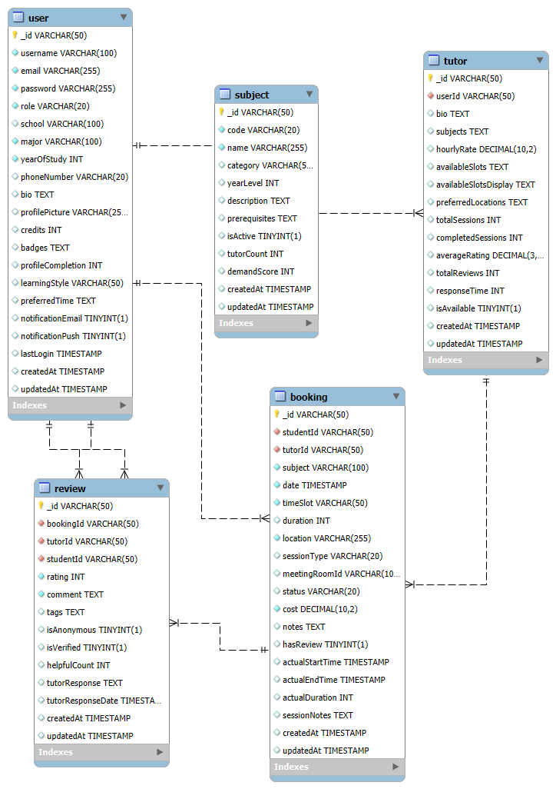
Data Modeling
ERD Diagram

Slide 60
The End

