Slide 1
Mestrado em Informática Aplicada
Embedded and Real-Time Systems
The RODOS Operating System
Francisco Afonso
2011/2012

Slide 2
The RODOS operating system
RODOS is a real-time embedded operating system designed for applications demanding high dependability.
Simplicity as a means to achieve dependability.
Object-oriented ( C++ )
Priority-based preemptive scheduling
Round-robin for same priority threads (last activated runs)
Communication middleware based on publish-subscribe protocol
Ethernet (TCP/IP) and CAN communication
Ports: arm-v4, arm-cortex, leon2, ppc-405, on-top-of Linux, and others

Slide 3
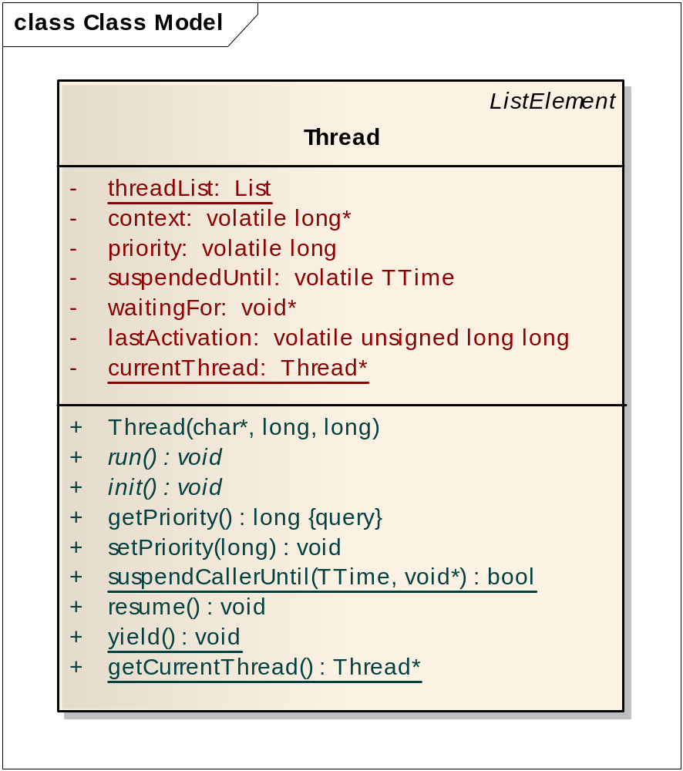
The Thread class
Priorities range from 1 to 4G (recom. 1000)
(default = 100; 0 is idleThread)
When it will be ready to run
What this thread is waiting for (e.g. a semaphore)
Last time it started running
Code executed by thread
Initialization code if needed (runs before starting any thread)
Suspends until this time
Resumes thread
Calls scheduler (may stop running)

Slide 4
Time in RODOS
Time in RODOS is defined as a long long variable (64 bits):
  typedef long long TTime;
It represents the number of nanoseconds elapsed since startup. It can measure time up to 292 years.
The following macros are defined in timemodel.h:
  #define END_OF_TIME 0x7FFFFFFFFFFFFFFFLL
  #define NANOSECONDS 1LL
  #define MICROSECONDS (1000LL * NANOSECONDS)
  #define MILLISECONDS (1000LL * MICROSECONDS)
  #define SECONDS (1000LL * MILLISECONDS)
  #define MINUTES (60LL * SECONDS)
  #define HOURS (60LL * MINUTES)
  #define DAYS (24LL * HOURS)
  #define WEEKS (7LL * DAYS)
  #define NOW() TimeModel::getNanoseconds()

Slide 5
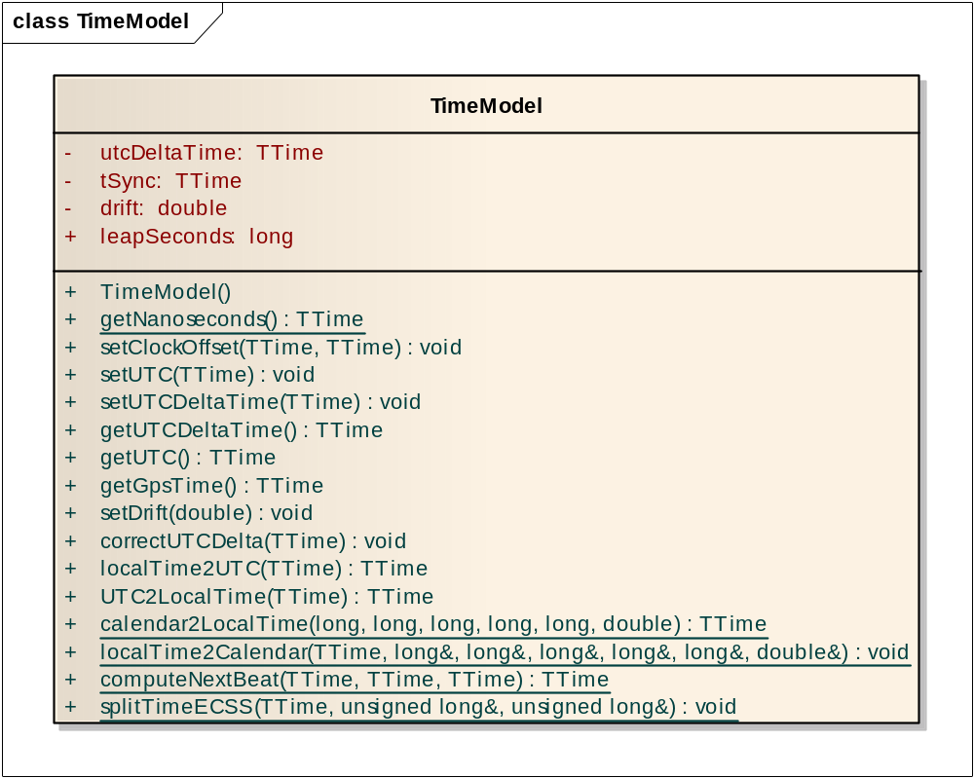
The TimeModel class
The TimeModel class stores the current time and can return it in several forms, as in nanoseconds since startup and UTC. It also has methods to convert the time from UTC to local time and vice-versa.
Returns current time

Slide 6
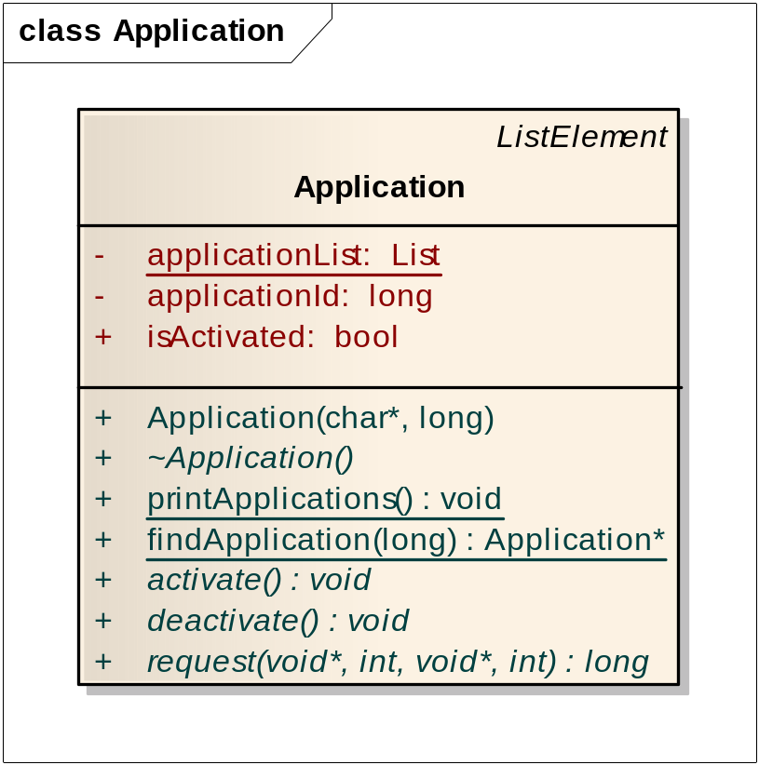
The Application class
The Application class stores and retrieves information about application modules that are part of the system. In each application module, the programmer can create an Application object that defines an application name and an identification number.
Each application has a name and an identification number (default: 1000)
All applications are printed at startup

Slide 7
A simple thread example
#include "rodos.h“
static Application module01("TestTime“, 1234);
class TestTime : public Thread {
public:
TestTime() : Thread("waitfor") { }
void run(){
int cnt=0;
long long t0;
while(1){
cnt++;
suspendCallerUntil(NOW() + 2*SECONDS);
t0 = NOW();
PRINTF(“Time now: %lld – cnt: %d\n“, t0, cnt);
}
}
void init() { PRINTF("Waiting 2 seconds");}
};
static TestTime testTime;

Slide 8
A simple thread example (program execution)
RODOS RODOS-85.0 OS Version RODOS-65-linux-8
Loaded Applications:
1234 -> 'TestTime'
10 -> 'Topics & Middleware'
Calling Initiators
Distribute Subscribers to Topics
List of Middleware Topics:
SigTermInterrupt Id = 16716 len = 4. -- Subscribers:
UartInterrupt Id = 15678 len = 4. -- Subscribers:
TimerInterrupt Id = 25697 len = 4. -- Subscribers:
gatewayTopic Id = 0 len = 4. -- Subscribers:
Event servers:
Threads in System:
Prio = 100 Stack = 32000 waitfor: Waiting 2 seconds
Prio = 0 Stack = 32000 IdleThread: yields all the time
Default internal MAIN
--------------- application running ------------
time now: 2000134018 - cnt: 1
time now: 4000166219 - cnt: 2
time now: 6000197483 - cnt: 3
time now: 8000225394 - cnt: 4
time now: 10000262779 - cnt: 5

Slide 9
Thread priorities and preemption (part 1)
#include "rodos.h"
static Application module01("PreemptiveTest", 2000);
class HighPriorityThread: public Thread{
public:
HighPriorityThread() : Thread("HiPriority", 25) {
}
void init() {
xprintf(" hipri = '*'");
}
void run() {
while(1) {
PRINTF("*");
FFLUSH();
suspendCallerUntil(NOW() + 1*SECONDS);
}
}
};

Slide 10
Thread priorities and preemption (part 2)
class LowPriorityThread: public Thread {
public:
LowPriorityThread() : Thread("LowPriority", 10) {
}
void init() {
xprintf(" lopri = '.'");
}
void run(){
long long cnt = 0;
while(1) {
cnt++;
if (cnt % 10000000 == 0) {
PRINTF(".");
FFLUSH();
}
}
}
};
HighPriorityThread highPriorityThread;
LowPriorityThread lowPriorityThread;

Slide 11
Thread priorities and preemption (program execution)
RODOS RODOS-85.0 OS Version RODOS-65-linux-8
Loaded Applications:
2000 -> 'PreemptiveTest'
10 -> 'Topics & Middleware'
Calling Initiators
Distribute Subscribers to Topics
List of Middleware Topics:
SigTermInterrupt Id = 16716 len = 4. -- Subscribers:
UartInterrupt Id = 15678 len = 4. -- Subscribers:
TimerInterrupt Id = 25697 len = 4. -- Subscribers:
gatewayTopic Id = 0 len = 4. -- Subscribers:
Event servers:
Threads in System:
Prio = 10 Stack = 32000 LowPriority: lopri = '.'
Prio = 25 Stack = 32000 HiPriority: hipri = '*'
Prio = 0 Stack = 32000 IdleThread: yields all the time
Default internal MAIN
--------------- application running ------------
*...........*...........*............*...........*............*.........
..*...........*...........*............*...........*...........*........
....*...........*...........*...........*...........*...........*......

Slide 12
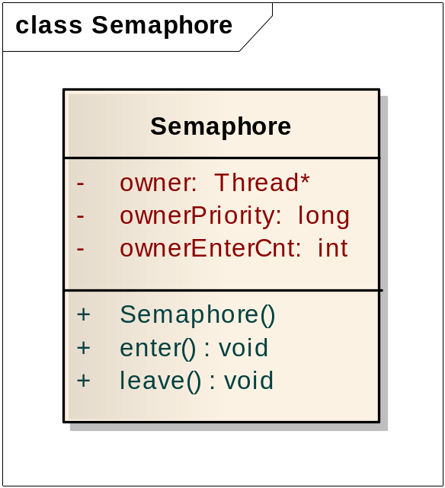
The Semaphore class
The Semaphore class implements a mutex semaphore.
It can be used for mutual exclusion between threads.
Semaphores have ownership and allow recursive locking.
The owner is the thread that acquired the semaphore. Only the owner can release it.
.
Acquires the semaphore. The owner can call enter several times. Each time increments the ownerEnterCnt attribute.
Decrements ownerEnterCnt and releases the semaphore if ownerEnterCounter reaches the initial value (zero).

Slide 13
Semaphore application example (part 1)
#include "rodos.h“
static Application module("semaphoretest");
Semaphore protector;
class TestThread : public Thread {
public:
TestThread(const char *name): Thread(name) { }
void run(){
PRINTF("%s: I have started and will yield\n",getName());
yield();
PRINTF("%s: I will try to acquire semaphore\n",getName());
// critical section
protector.enter();
PRINTF("%s: I have acquired the semaphore\n",getName());
yield();
PRINTF("%s: Now other threads cannot run this code\n",getName());
yield();
PRINTF("%s: while I do not release it\n",getName());
yield();
PRINTF("%s: ok. I will release it\n",getName());
protector.leave();

Slide 14
Semaphore application example (part 2)
yield();
xprintf("%s: bye\n",getName());
suspendCallerUntil(END_OF_TIME);
}
};
TestThread t1("thread_A");
TestThread t2("thread_B");
TestThread t3("thread_C");

Slide 15
Semaphore application example (program execution 1/2)
RODOS RODOS-85.0 OS Version RODOS-65-linux-8
Loaded Applications:
1000 -> 'semaphoretest'
10 -> 'Topics & Middleware'
Calling Initiators
Distribute Subscribers to Topics
List of Middleware Topics:
SigTermInterrupt Id = 16716 len = 4. -- Subscribers:
UartInterrupt Id = 15678 len = 4. -- Subscribers:
TimerInterrupt Id = 25697 len = 4. -- Subscribers:
gatewayTopic Id = 0 len = 4. -- Subscribers:
Event servers:
Threads in System:
Prio = 100 Stack = 32000 thread_C:
Prio = 100 Stack = 32000 thread_B:
Prio = 100 Stack = 32000 thread_A:
Prio = 0 Stack = 32000 IdleThread: yields all the time
Default internal MAIN
These threads have the same priority (default: 100)

Slide 16
Semaphore application example (program execution 2/2)
--------------- application running ------------
thread_C: I have started and will yield
thread_B: I have started and will yield
thread_A: I have started and will yield
thread_C: I will try to acquire semaphore
thread_C: I have acquired the semaphore
thread_B: I will try to acquire semaphore
thread_A: I will try to acquire semaphore
thread_C: Now other threads cannot run this code
thread_C: while I do not release it
thread_C: ok. I will release it
thread_B: I have acquired the semaphore
thread_B: Now other threads cannot run this code
thread_C: bye
thread_B: while I do not release it
thread_B: ok. I will release it
thread_A: I have acquired the semaphore
thread_A: Now other threads cannot run this code
thread_B: bye
thread_A: while I do not release it
thread_A: ok. I will release it
thread_A: bye

Slide 17
The PRINTF function
The printf function in RODOS is called xprintf (see yprintf.cpp).
This function formats and prints data to the UART or terminal (Linux).
It must be protected by a semaphore if more than one thread may call it simultaneously.
The PRINTF function uses a semaphore to protect the calling to xprintf.
If scheduling is still disabled, PRINTF calls xprintf without previously acquiring any semaphore (see debug.cpp).
PRINTF should not be called by an ISR, as ISRs must not try to acquire a mutex semaphore (they are not supposed to block).

Slide 18
Preemption locking
Preemption locking consist in disabling the dispatch mechanism. The application of this mechanism makes the scheduler non-preemptive as a lower priority thread will no more be preempted by a higher priority thread.
Preemptive locking in RODOS is not provided by disabling the dispatch. Instead, a mechanism of increasing the thread priority to a maximum is used to provide mutual exclusion between threads. This mechanism is implemented using the macro PRIORITY_CEILING.
#define MAX_THREAD_PRIORITY 1000
#define NETWORKREADER_PRIORITY (MAX_THREAD_PRIORITY + 2)
#define CEILING_PRIORITY (NETWORKREADER_PRIORITY + 1)
#define PRIORITY_CEILING \
for(long _previusPriority = Thread::setPrioCurrentRunner(CEILING_PRIORITY)+1;\
_previusPriority; \
Thread::setPrioCurrentRunner(_previusPriority-1), _previusPriority = 0)
.

Slide 19
A mutual exclusion problem
#include "rodos.h“
static Application module("prio_ceiling");
volatile long counter = 0;
long max = 100000000;
class TestThread: public Thread {
public:
TestThread(): Thread("test_ceiling") {
}
void run() {
suspendCallerUntil(1*SECONDS);
PRINTF("at %ld,%09ld: thread started\n", SPLIT_SEC_NS(NOW()) ) ;
for(long i=0; i < max; i++){
counter++;
}
PRINTF("at %ld,%09ld: counter= %ld\n", SPLIT_SEC_NS(NOW()), counter);
suspendCallerUntil(END_OF_TIME);
}
};
TestThread t1, t2;

Slide 20
A mutual exclusion problem (program execution)
RODOS RODOS-85.0 OS Version RODOS-65-linux-8
Loaded Applications:
1000 -> 'prio_ceiling'
10 -> 'Topics & Middleware'
Calling Initiators
Distribute Subscribers to Topics
List of Middleware Topics:
SigTermInterrupt Id = 16716 len = 4. -- Subscribers:
UartInterrupt Id = 15678 len = 4. -- Subscribers:
TimerInterrupt Id = 25697 len = 4. -- Subscribers:
gatewayTopic Id = 0 len = 4. -- Subscribers:
Event servers:
Threads in System:
Prio = 100 Stack = 32000 test_ceiling:
Prio = 100 Stack = 32000 test_ceiling:
Prio = 0 Stack = 32000 IdleThread: yields all the time
Default internal MAIN.
--------------- application running ------------
at 1,000003031: thread started
at 1,100019813: thread started
at 1,416739101: counter= 144971067
at 1,433254408: counter= 144538039
nok!

Slide 21
A solution using the priority ceiling macro
#include "rodos.h“
static Application module("prio_ceiling");
volatile long counter = 0;
long max = 100000000;
class TestThread: public Thread {
public:
TestThread(): Thread("test_ceiling") {
}
void run() {
suspendCallerUntil(1*SECONDS);
PRINTF("at %ld,%09ld: thread started\n", SPLIT_SEC_NS(NOW()) ) ;
for(long i=0; i < max; i++){
PRIORITY_CEILING {
counter++;
}
}
PRINTF("at %ld,%09ld: counter= %ld\n", SPLIT_SEC_NS(NOW()), counter);
suspendCallerUntil(END_OF_TIME);
}
};
TestThread t1, t2;

Slide 22
A solution using the priority ceiling macro (program execution)
RODOS RODOS-85.0 OS Version RODOS-65-linux-8
Loaded Applications:
1000 -> 'prio_ceiling'
10 -> 'Topics & Middleware'
Calling Initiators
Distribute Subscribers to Topics
List of Middleware Topics:
SigTermInterrupt Id = 16716 len = 4. -- Subscribers:
UartInterrupt Id = 15678 len = 4. -- Subscribers:
TimerInterrupt Id = 25697 len = 4. -- Subscribers:
gatewayTopic Id = 0 len = 4. -- Subscribers:
Event servers:
Threads in System:
Prio = 100 Stack = 32000 test_ceiling:
Prio = 100 Stack = 32000 test_ceiling:
Prio = 0 Stack = 32000 IdleThread: yields all the time
Default internal MAIN
--------------- application running ------------
at 1,000001805: thread started
at 1,500034944: thread started
at 4,729601700: counter= 184150612
at 5,042200977: counter= 200000000
ok!

Slide 23
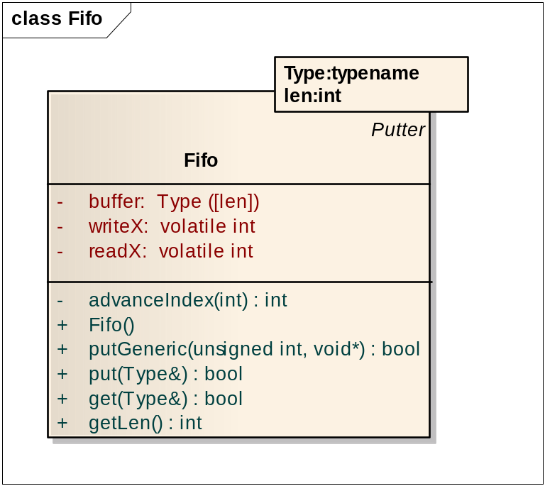
The Fifo class
The Fifo class implements a queue (first in, first out) of defined type. One thread can write to the SyncFifo object while other can read from it.
The data is copied twice: first when writing and then when reading from it.
Writes and reads do not block the thread if the queue is full or empty. In that situations, these operations return immediately with return status equals false.
If more than one thread needs to write or read to/from a Fifo, additional mutual exclusion mechanisms, such as mutex semaphores, must be applied.
Writes to Fifo
Reads from Fifo

Slide 24
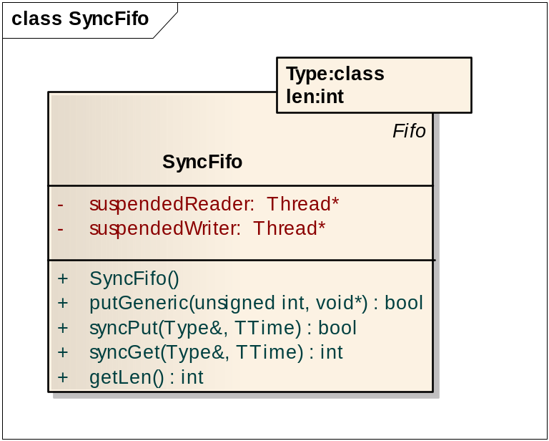
The SyncFifo class
The SyncFifo class inherits from the Fifo class and implements the same functionality, but with a synchronous behaviour.
Writes and reads can block the thread if the queue is full or empty, respectively. A timeout to abort the operation can be defined.
SyncFifo is able to block only one writer and one reader. If more than one thread needs to write or read to/from it, additional semaphores must be applied (one for each operation).
Writes to SyncFifo
Reads from SyncFifo

Slide 25
SyncFifo application example (part 1)
#include "rodos.h"
SyncFifo<int, 5> fifo;
class Sender : public Thread {
void run () {
int cnt = 0;
while(1) {
cnt++;
fifo.syncPut(cnt);
PRINTF("sent %d at %lld\n", cnt, NOW());
if ((cnt % 5) == 0) {
PRINTF("Sender will wait 2 seconds\n");
suspendCallerUntil(NOW() + 2*SECONDS);
}
}
}
};

Slide 26
SyncFifo application example (part 2)
class Receiver : public Thread {
void run () {
int cntIn = 0;
suspendCallerUntil(NOW() + 3*SECONDS);
PRINTF("Receiver started\n");
while (1) {
fifo.syncGet(cntIn);
PRINTF("read %d at %lld\n", cntIn, NOW());
}
}
};
Sender sender;
Receiver receiver;

Slide 27
SyncFifo application example (program execution)
--------------- application running ------------
sent 1 at 119888
sent 2 at 126705
sent 3 at 132483
sent 4 at 138134
Receiver started
read 1 at 3000127966
read 2 at 3000131076
read 3 at 3000133640
read 4 at 3000136192
sent 5 at 3000140501
Sender will wait 2 seconds
read 5 at 3000147247
sent 6 at 5000147927
sent 7 at 5000159724
sent 8 at 5000162548
sent 9 at 5000165090
read 6 at 5000169659
read 7 at 5000172541
read 8 at 5000175156
read 9 at 5000177697
sent 10 at 5000181666
Sender will wait 2 seconds
read 10 at 5000188064
...

Slide 28
Bibliography
Sergio Montenegro and John Richardson , “RODOS operating system for Network Centric Core Avionics”, Conference on Advances in Satellite and Space Communications, July 20-25, 2009 - Colmar, France.
RODOS information page at German Space Agency (DLR):
  http://www.dlr.de/irs/en/desktopdefault.aspx/tabid-5976/9736_read-19576/
  http://www.dlr.de/sc/en/desktopdefault.aspx/tabid-5276/8847_read-15871/
RODOS version 86

