Slide 1
R1
family inet
R3
R4
family l3vpn
RT = X
R2
inet.0
inet.0
R5
Imported based on
matching route target.
Routes sent with RD and RT
R3
VRF.inet.0
VRF.inet.0
R6

Slide 2
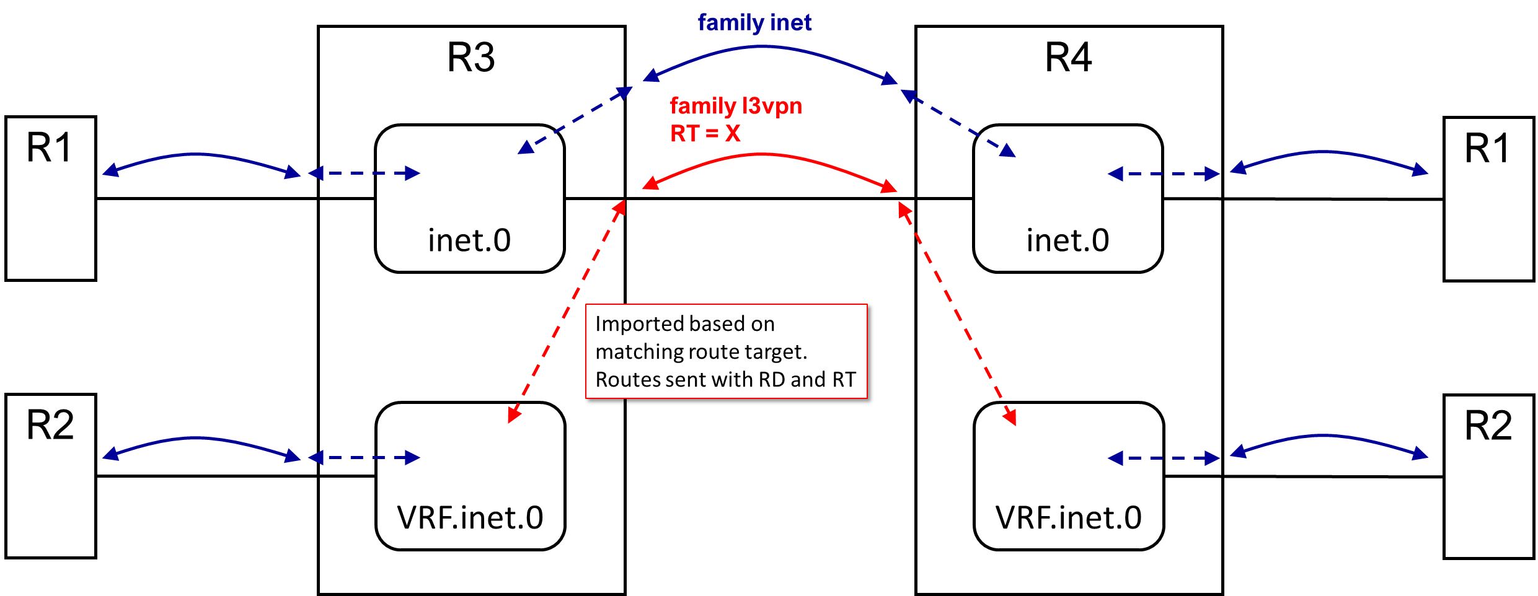
EBGP
IBGP
EBGP

Slide 3
R1
10.1/16
family inet
RA
RB
10.1/16
family l3vpn RD1 RT1
10.1/16
10.1/16
R2
inet.0
family l3vpn RD2 RT2
inet.0
R5
Imported based on
matching route target.
Routes sent with RD and RT
R3
VRF1.inet.0
VRF1.inet.0
R6
R4
VRF2.inet.0
VRF2.inet.0
R7
EBGP
IBGP
EBGP

Slide 4
R1
10.1/16
family inet
RA
RB
10.1/16
10.1/16
10.1/16
R2
inet.0
inet.0
R5
R3
VRF1.inet.0
VRF1.inet.0
R6
R4
VRF2.inet.0
VRF2.inet.0
R7
EBGP
IBGP
EBGP

Slide 5
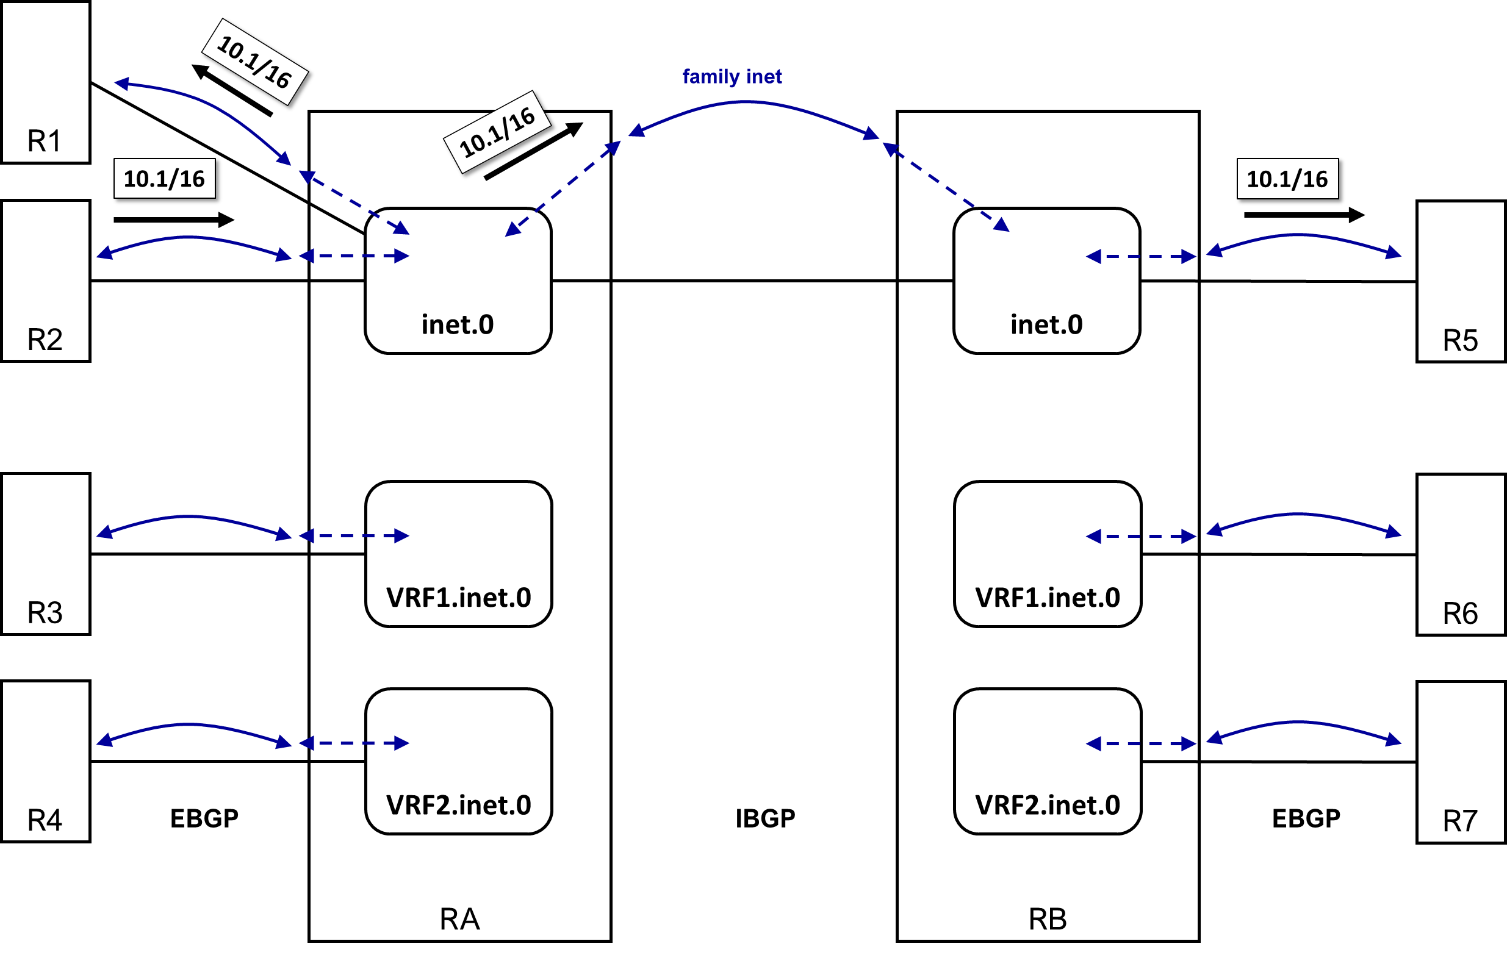

Slide 6
R1
RD1:10.1/16 RT1
RA
RB
family l3vpn
SAME BGP SESSION
R2
inet.0
family l3vpn
inet.0
R5
RD2:10.1/16 RT2
Imported based on
matching route target.
10.1/16
10.1/16
R3
VRF1.inet.0
RD1, RT1
VRF1.inet.0
RD1, RT1
R6
10.1/16
Imported based on
matching route target.
10.1/16
R4
VRF2.inet.0
RD2, RT2
VRF2.inet.0
RD2, RT2
R7
EBGP
IBGP
EBGP

Slide 7
