Slide 1
Sprint 1 Delivery WAtch2Gether Clone

Slide 2
Sprint Goals
Research Plan
Project Plan
Portfolio Setup
Functional Requirements
Architecture Diagram

Slide 3
Sprint 1 Achievements

Slide 4
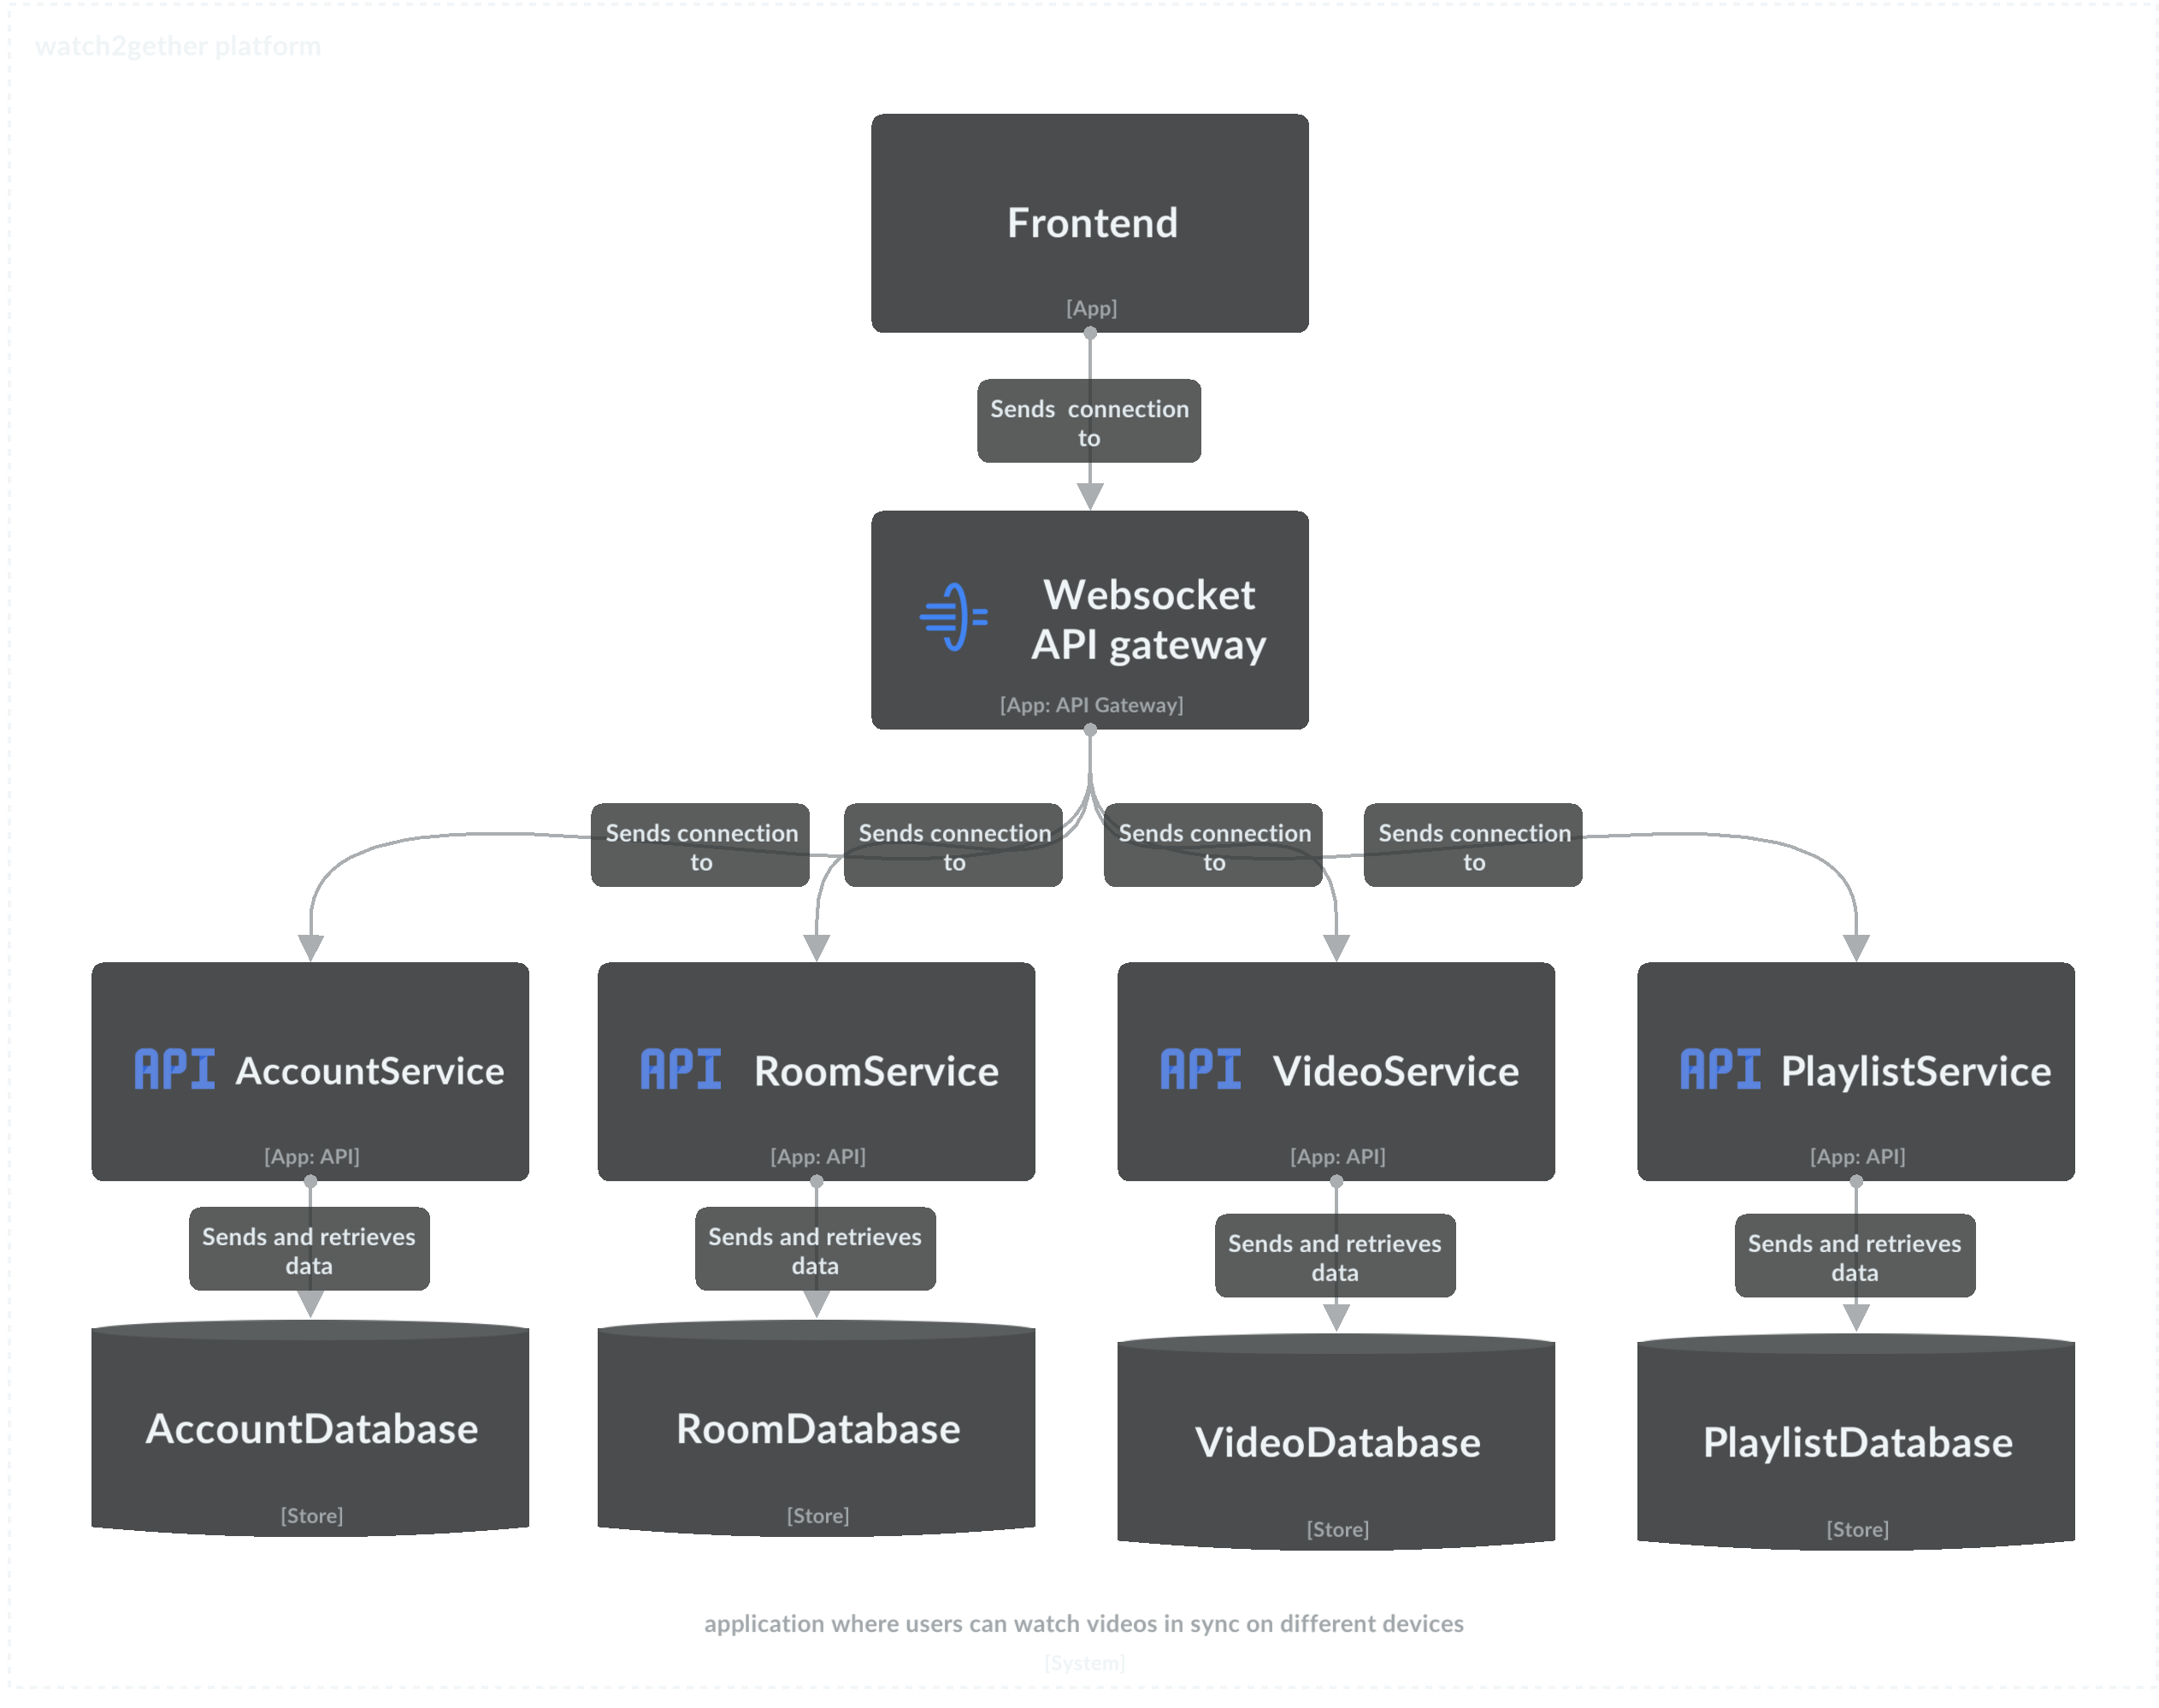
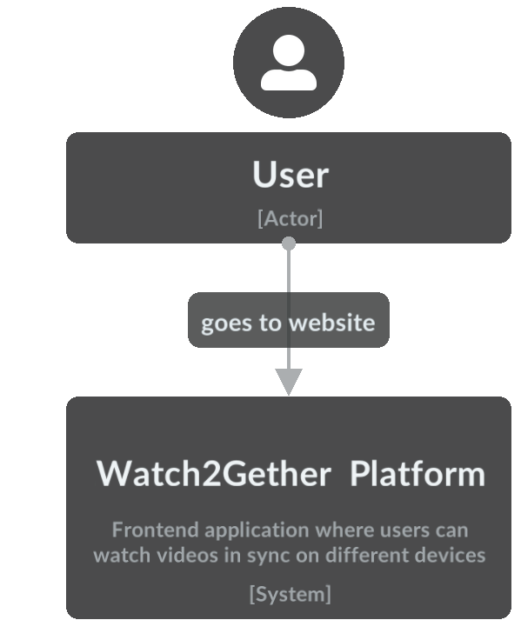
C1 & C2 Diagram

Slide 5
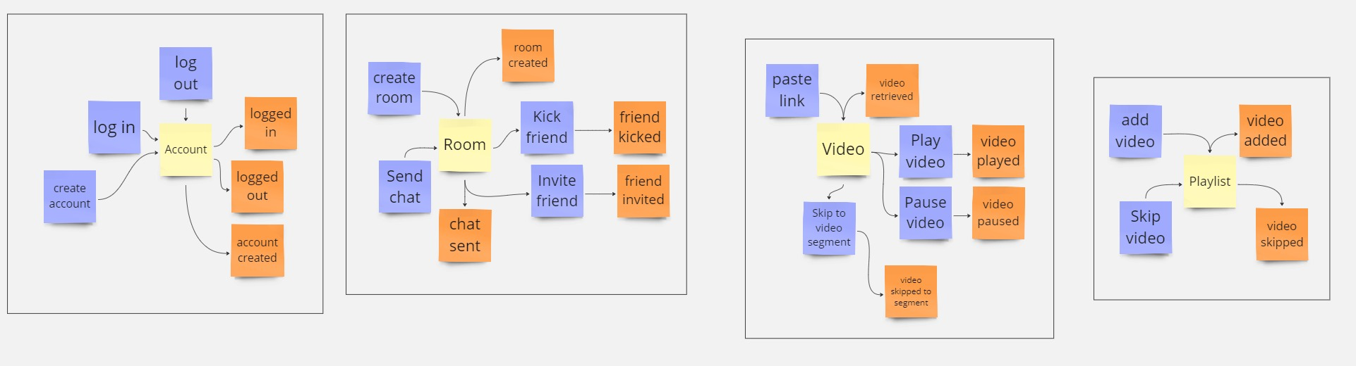
Event Storming

Slide 6
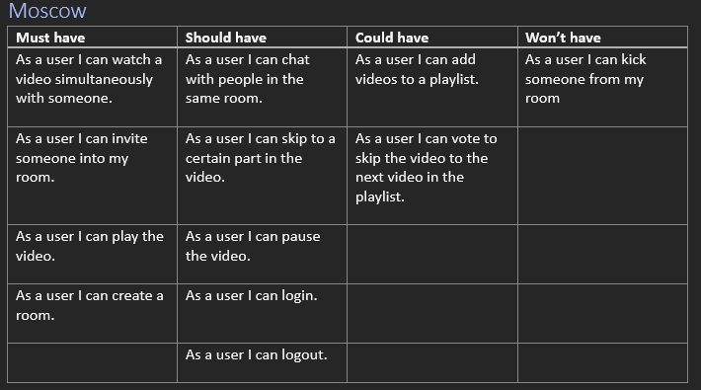
Requirements

Slide 7
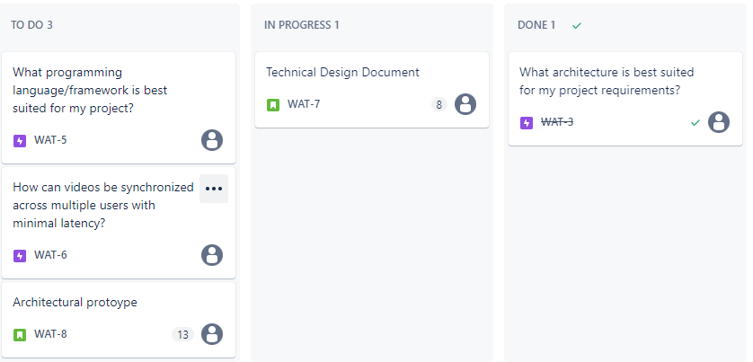
Sprint Planning

Slide 8

Thank you
Any Questions?

