Slide 1
Mid Term Presentation
Yordi Kremer
Mabs 4.0

Slide 2

Contents
Problem/Opportunity
Assignment
Current Results
Next Sprint

Slide 3
Problem/Opportunity
Move4Vitality
Mabs 4.0
Health Platform
Coach & Client
Exercises & pain level
Garmin
Independent from activity trackers

Slide 4
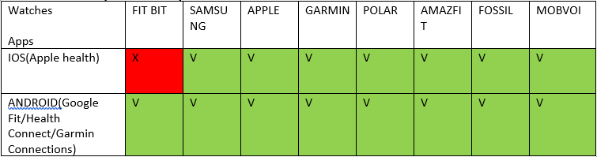
Assignment
React Native App
C# Web Application
C# Rest Web API
Health Connect
Apple Health
Google fit

Slide 5
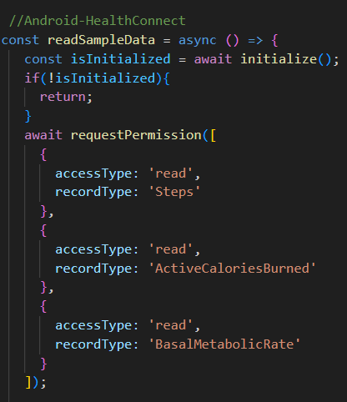
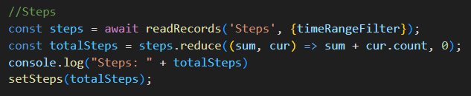
Current Results
Health Connect
Steps
Basal Metabolic Rate
Burned Calories
Permissions
Packages

Slide 6
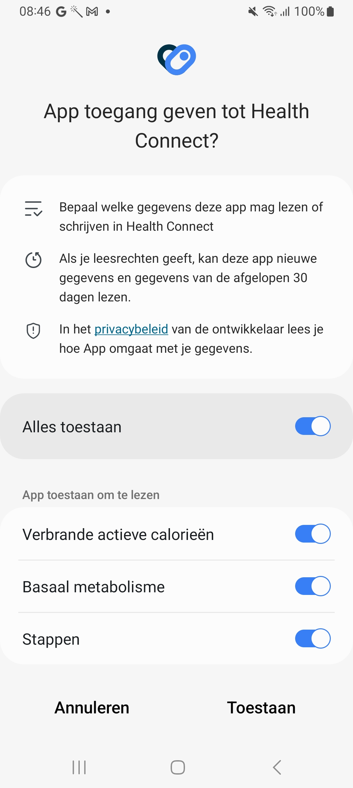
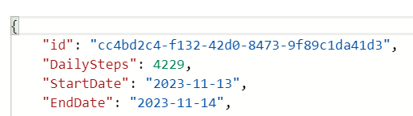
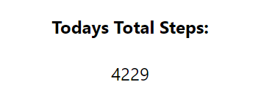

Slide 7
Next Sprint
3 weeks
4 december
Implement my Backend code
Implement React Native code
Change my code to standard

