Slide 1
YORKSTEAD SYSTEMS
BUSINESS WEBSITES
Your website should help a buyer decide—and help you act.
SOFTWARE THAT
KEEPS REAL-WORLD
WORK MOVING.
Clear positioning, credible proof, useful intake, and a direct path from interest to qualified work.
Brandon York • hello@yorkstead.com • yorkstead.com
Notes:
[Sources]
- Yorkstead Systems brand positioning: repository lib/brand.ts
[/Sources]

Slide 2
BUSINESS WEBSITES
The expensive part is the handoff nobody owns.
01
Generic copy makes every business sound interchangeable.
02
Project proof is buried or shown without the operational context buyers need.
03
Contact forms collect messages—not enough information to take the next step.
YORKSTEAD SYSTEMS
02
Notes:
[Sources]
- Buyer problems synthesized from Yorkstead project workflows; no external quantitative claim.
[/Sources]

Slide 3
BUSINESS WEBSITES
A customer journey that explains the work, proves capability, and creates a useful handoff.
SHARED
CONTEXT
→
CLEAR
NEXT STEP
The useful system is not the one with the most features. It is the one that keeps context attached as work moves between people, decisions, and tools.
YORKSTEAD SYSTEMS
03
Notes:
[Sources]
- Yorkstead Systems positioning and repository case-study narratives.
[/Sources]

Slide 4
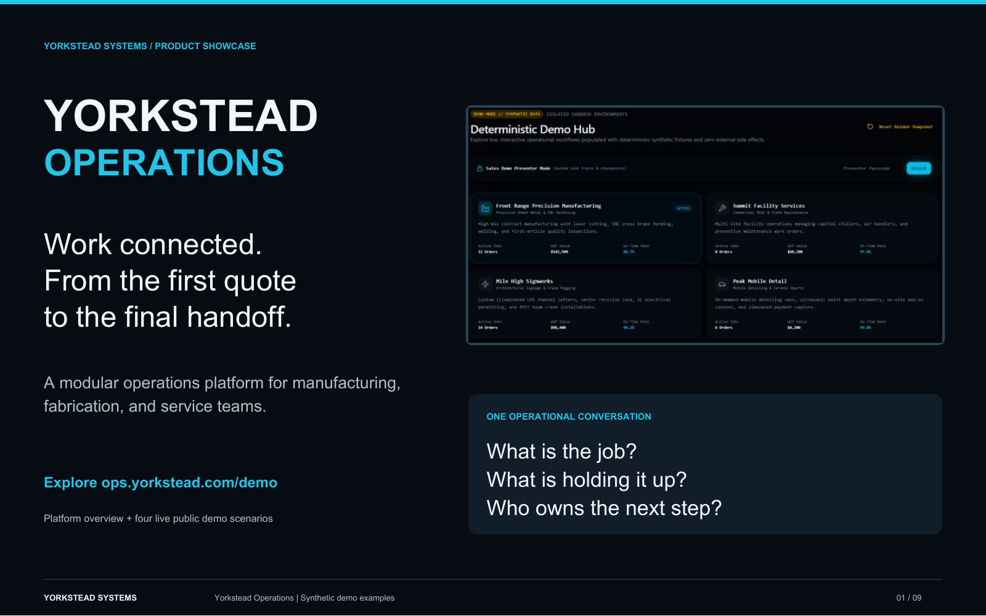
BUSINESS WEBSITES
Yorkstead.com is built as a working sales and operations surface.
The public site connects positioning, services, project evidence, workflow audits, consultation paths, and an owner Command Center. Its case studies use authentic system screens and explicit limitations instead of inflated results.
Operational product story
YORKSTEAD SYSTEMS
04
Notes:
[Sources]
- C:\Users\4twen\dev\yorkstead-website\public\media\yorkstead-ops\pages\operations-1.png
- Repository project documentation and case-study limitations.
[/Sources]

Slide 5
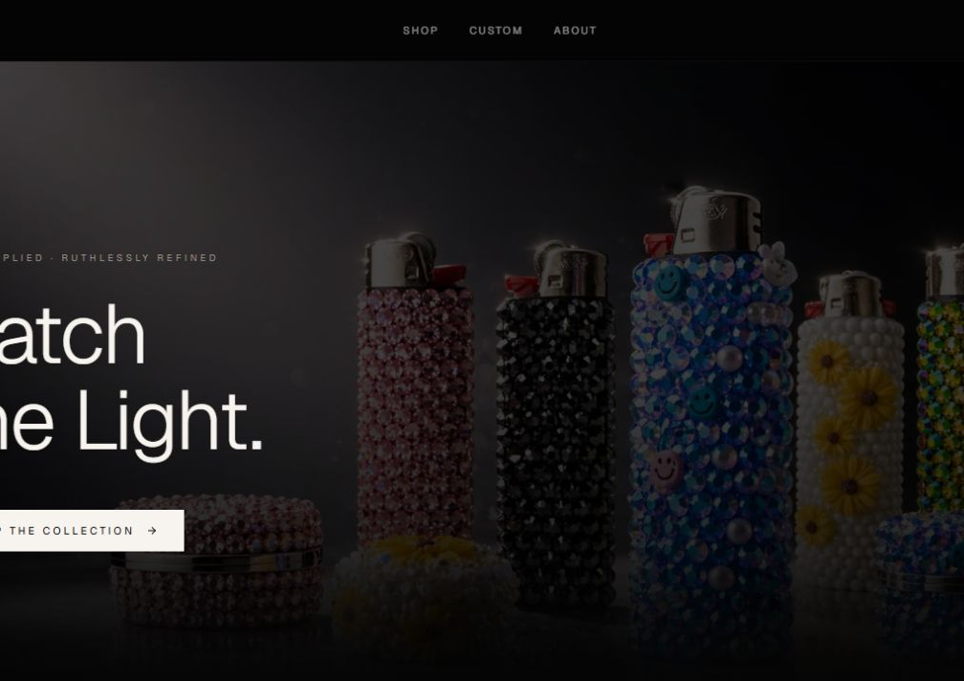
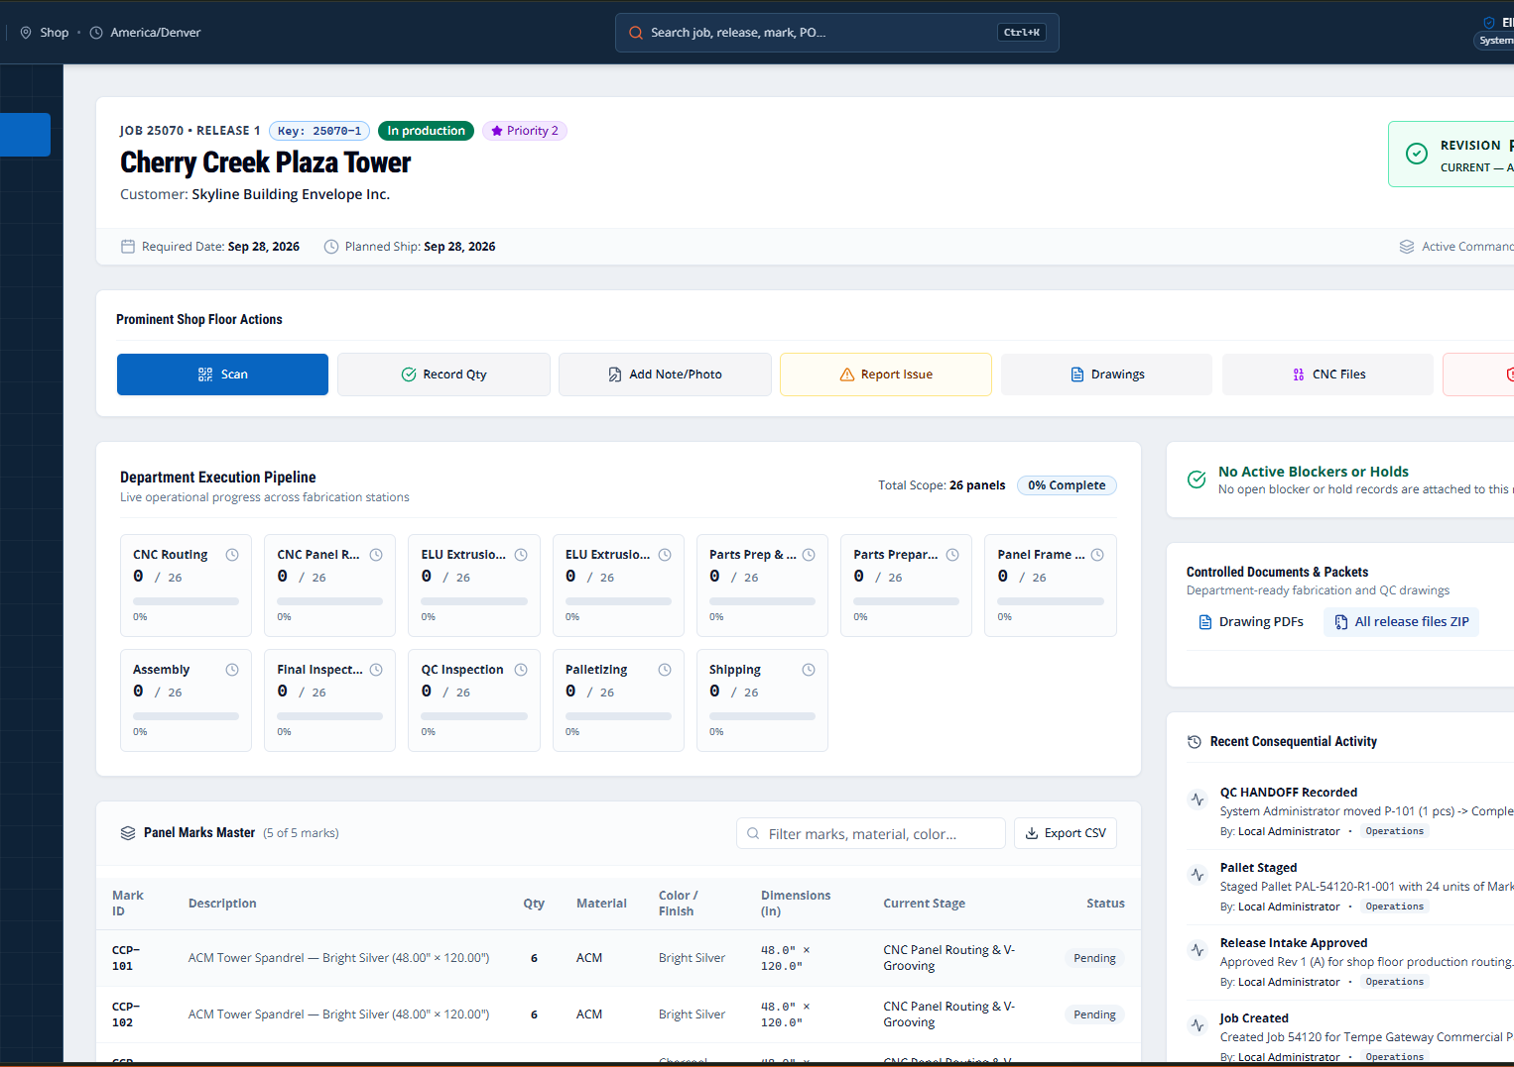
BUSINESS WEBSITES
Proof you can point to—not promises you have to explain.
Operational product story
Distinctive customer experience
Proof from the working system
These are working interfaces and documented prototypes. Where outcomes have not been measured, the deck says so.
YORKSTEAD SYSTEMS
05
Notes:
[Sources]
- C:\Users\4twen\dev\yorkstead-website\public\media\yorkstead-ops\pages\operations-1.png
- C:\Users\4twen\dev\yorkstead-website\public\media\jwld\screenshots\home.png
- C:\Users\4twen\dev\yorkstead-website\public\media\ellwood\active-release.png
[/Sources]

Slide 6
BUSINESS WEBSITES
A focused first engagement creates momentum without a blank check.
Pick one buyer and one decision. Build the shortest credible path from their problem to a qualified conversation.
AUDIT
PRIORITIZE
BUILD
VERIFY
HAND OFF
Positioning & information design
01
Conversion-focused build
02
Case studies & proof
03
Qualified intake
04
Measurement & iteration
05
YORKSTEAD SYSTEMS
06
Notes:
[Sources]
- Engagement framing from yorkstead.com services, packages, and workflow-audit content.
[/Sources]

Slide 7
YORKSTEAD SYSTEMS
Do not launch another brochure.
Build the beginning of the sales process.
Bring one broken workflow. We’ll identify the first useful system and the shortest path to shipping it.
hello@yorkstead.com • yorkstead.com
Notes:
[Sources]
- Yorkstead Systems contact and engagement positioning.
[/Sources]

