Slide 1
YORKSTEAD SYSTEMS
MANUFACTURING
Keep production moving when the work changes.
SOFTWARE THAT
KEEPS REAL-WORLD
WORK MOVING.
Practical software for release control, shop-floor execution, inventory, quality, and the handoffs between them.
Brandon York • hello@yorkstead.com • yorkstead.com
Notes:
[Sources]
- Yorkstead Systems brand positioning: repository lib/brand.ts
[/Sources]

Slide 2
MANUFACTURING
The expensive part is the handoff nobody owns.
01
Critical context lives across inboxes, folders, spreadsheets, and paper travelers.
02
Revision changes reach the floor late—or without a clear owner.
03
Managers reconstruct status after the delay has already cost time.
YORKSTEAD SYSTEMS
02
Notes:
[Sources]
- Buyer problems synthesized from Yorkstead project workflows; no external quantitative claim.
[/Sources]

Slide 3
MANUFACTURING
One controlled operating path from release intake to shipment.
SHARED
CONTEXT
→
CLEAR
NEXT STEP
The useful system is not the one with the most features. It is the one that keeps context attached as work moves between people, decisions, and tools.
YORKSTEAD SYSTEMS
03
Notes:
[Sources]
- Yorkstead Systems positioning and repository case-study narratives.
[/Sources]

Slide 4
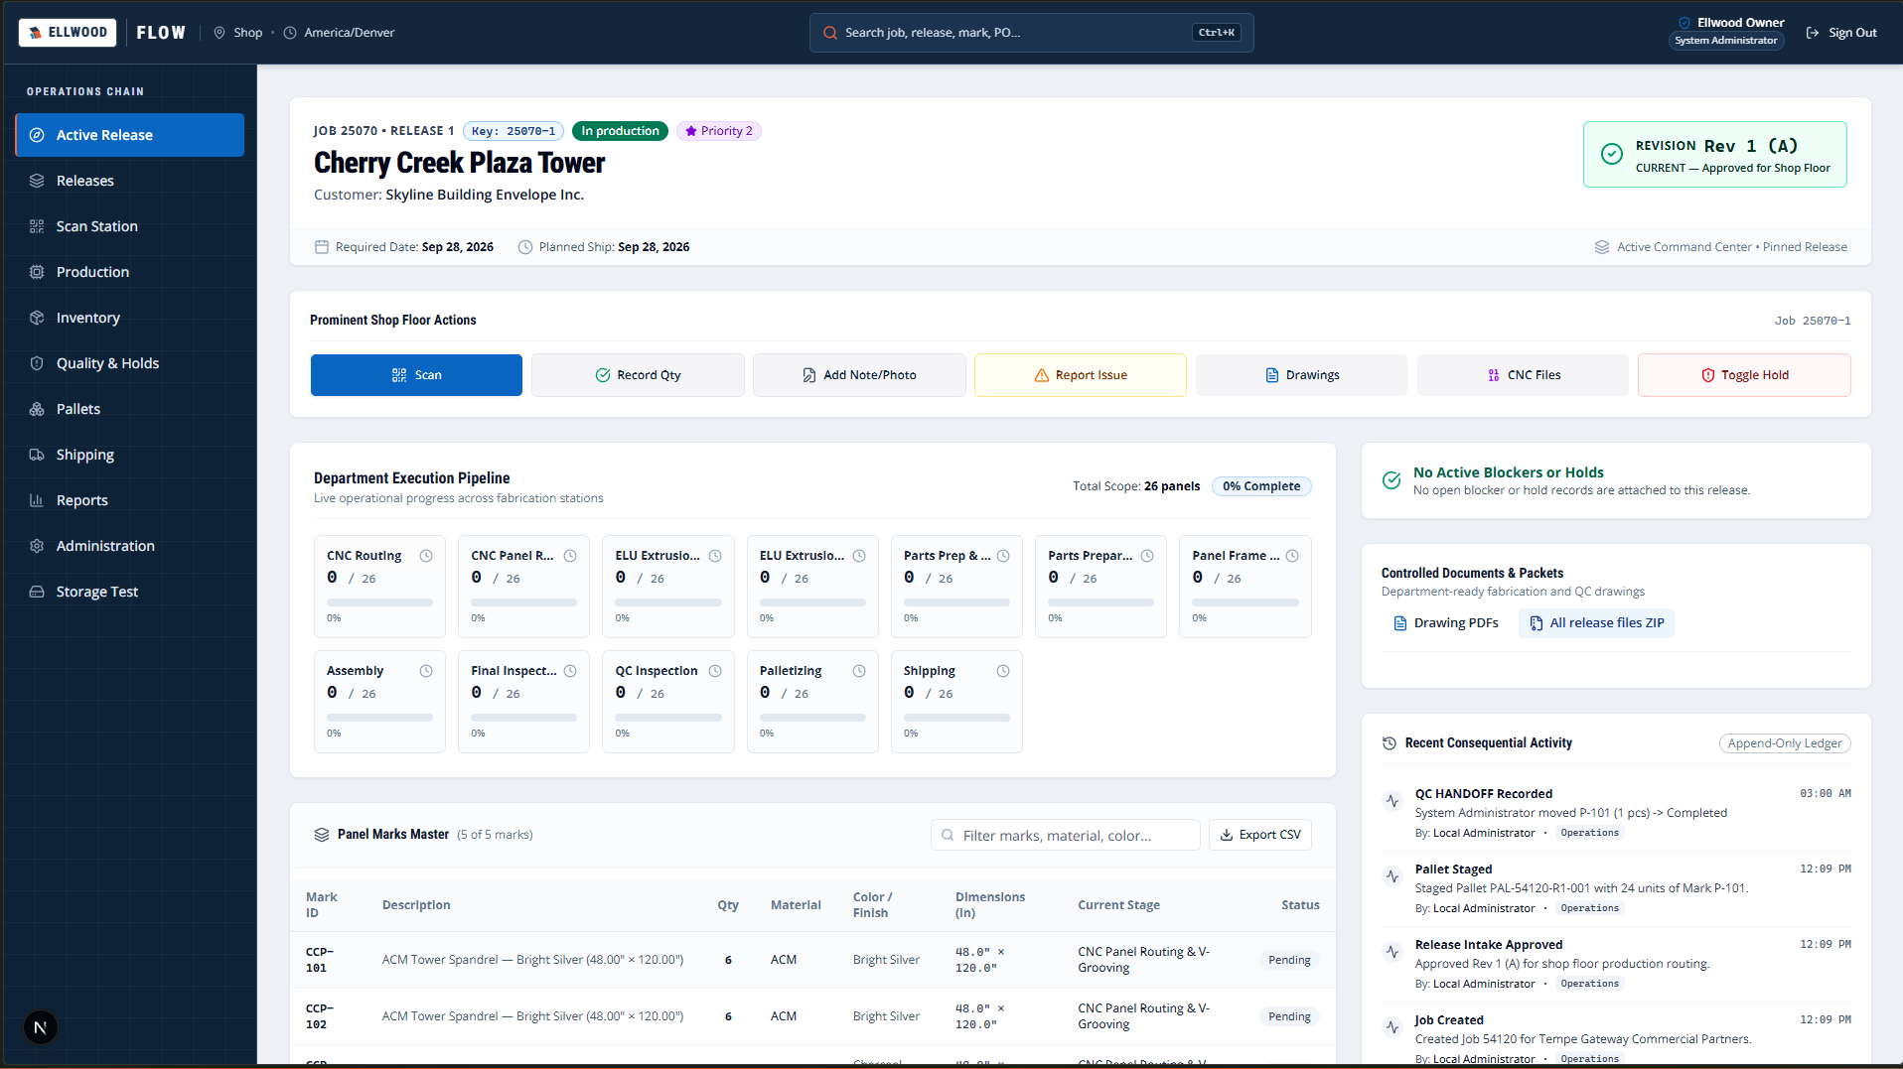
MANUFACTURING
Built around real manufacturing work—not generic task management.
Ellwood Flow connects release intake, controlled documents, production dispatch, inventory, QC, palletization, shipping, reports, and audit history. Yorkstead Operations shows how the same thinking adapts across manufacturing and fabrication workflows.
Active release workspace
YORKSTEAD SYSTEMS
04
Notes:
[Sources]
- C:\Users\4twen\dev\yorkstead-website\public\media\ellwood\active-release.png
- Repository project documentation and case-study limitations.
[/Sources]

Slide 5
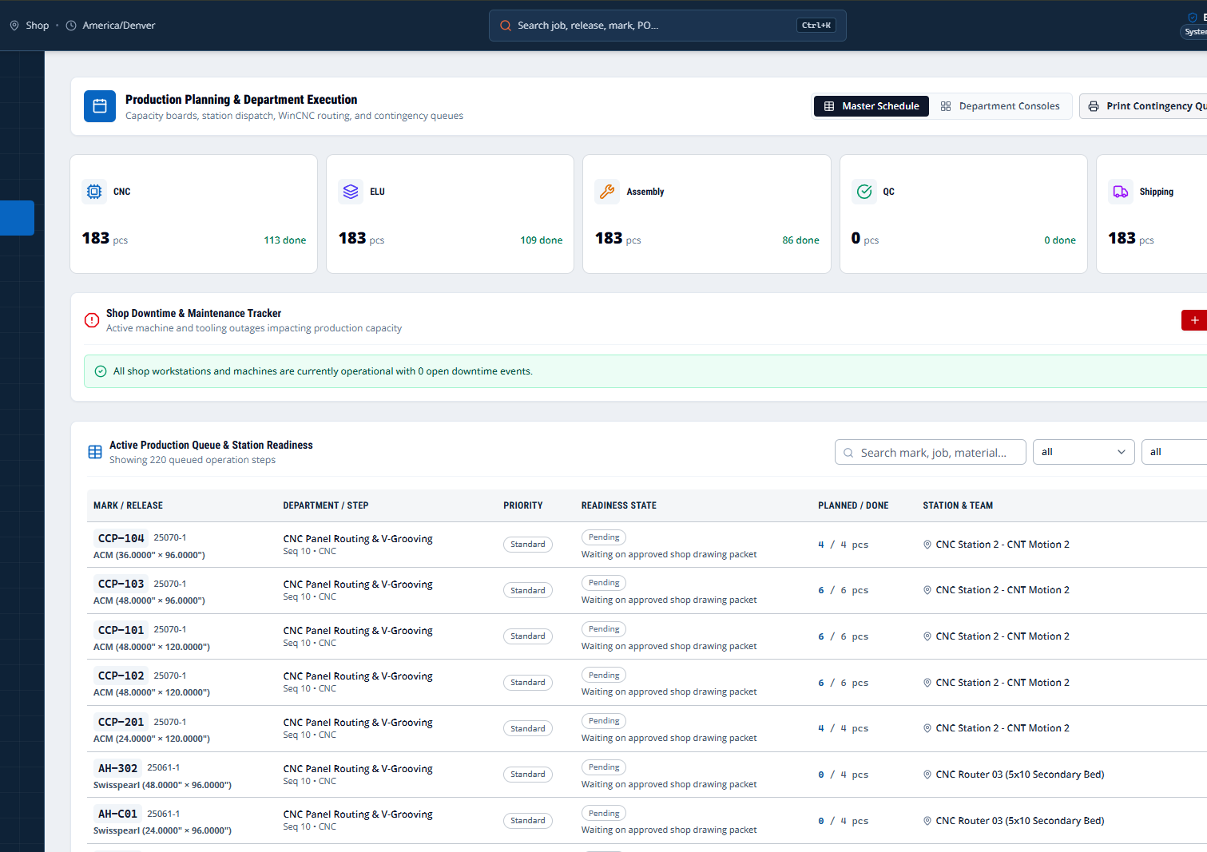
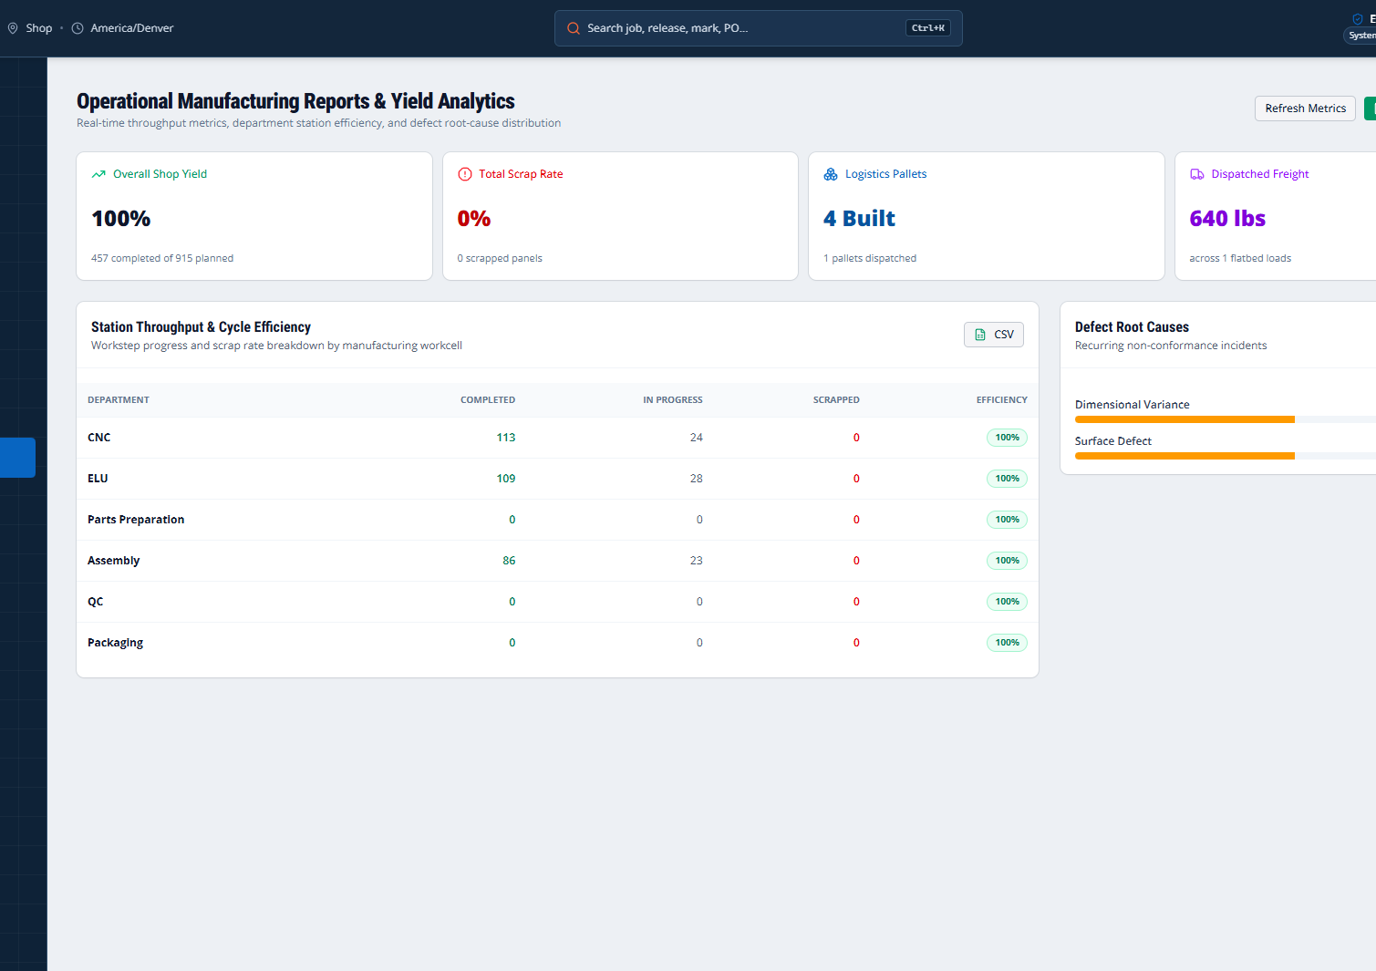
MANUFACTURING
Proof you can point to—not promises you have to explain.
Active release workspace
Production dispatch
Operational reporting
These are working interfaces and documented prototypes. Where outcomes have not been measured, the deck says so.
YORKSTEAD SYSTEMS
05
Notes:
[Sources]
- C:\Users\4twen\dev\yorkstead-website\public\media\ellwood\active-release.png
- C:\Users\4twen\dev\yorkstead-website\public\media\ellwood\production.png
- C:\Users\4twen\dev\yorkstead-website\public\media\ellwood\reports.png
[/Sources]

Slide 6
MANUFACTURING
A focused first engagement creates momentum without a blank check.
Start with one costly handoff: map it, measure it, and ship a focused working system.
AUDIT
PRIORITIZE
BUILD
VERIFY
HAND OFF
Release & document control
01
Digital travelers & scanning
02
Inventory & purchasing
03
Quality & traceability
04
Production dashboards
05
YORKSTEAD SYSTEMS
06
Notes:
[Sources]
- Engagement framing from yorkstead.com services, packages, and workflow-audit content.
[/Sources]

Slide 7
YORKSTEAD SYSTEMS
Your operation does not need more software.
It needs fewer broken handoffs.
Bring one broken workflow. We’ll identify the first useful system and the shortest path to shipping it.
hello@yorkstead.com • yorkstead.com
Notes:
[Sources]
- Yorkstead Systems contact and engagement positioning.
[/Sources]

