Slide 1
YORKSTEAD SYSTEMS
RESTAURANTS + POS
One live table. Everyone sees what they need.
SOFTWARE THAT
KEEPS REAL-WORLD
WORK MOVING.
A restaurant operating system concept that connects guests, servers, kitchen stations, expo, managers, and service analytics.
Brandon York • hello@yorkstead.com • yorkstead.com
Notes:
[Sources]
- Yorkstead Systems brand positioning: repository lib/brand.ts
[/Sources]

Slide 2
RESTAURANTS + POS
The expensive part is the handoff nobody owns.
01
Servers carry requests, coursing, handoffs, and split checks in their heads.
02
Guest, kitchen, and manager tools see fragments of the same meal.
03
Operators learn why service slipped only after the shift.
YORKSTEAD SYSTEMS
02
Notes:
[Sources]
- Buyer problems synthesized from Yorkstead project workflows; no external quantitative claim.
[/Sources]

Slide 3
RESTAURANTS + POS
A shared table session becomes the source of truth for the entire service.
SHARED
CONTEXT
→
CLEAR
NEXT STEP
The useful system is not the one with the most features. It is the one that keeps context attached as work moves between people, decisions, and tools.
YORKSTEAD SYSTEMS
03
Notes:
[Sources]
- Yorkstead Systems positioning and repository case-study narratives.
[/Sources]

Slide 4
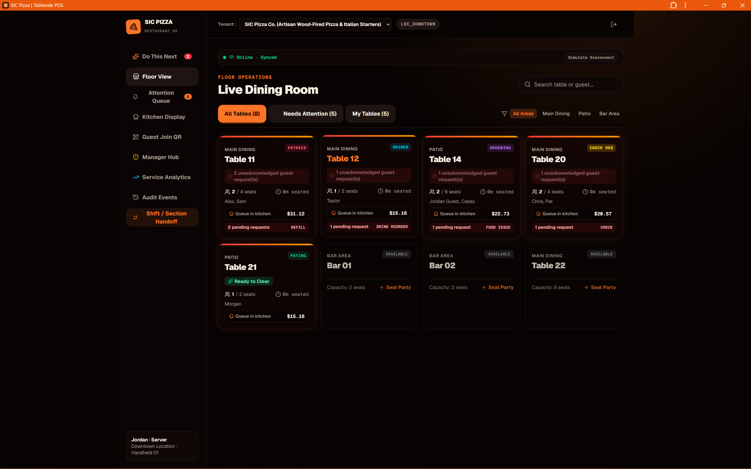
RESTAURANTS + POS
Designed around hospitality roles, not a single checkout screen.
SIC Pizza demonstrates phone-first floor management, guest QR participation, station-specific kitchen queues, handoffs, manager interventions, and service analytics. Payment and production integrations remain implementation work—not simulated success claims.
Live dining room
YORKSTEAD SYSTEMS
04
Notes:
[Sources]
- C:\Users\4twen\dev\yorkstead-website\public\media\sic\floor.png
- Repository project documentation and case-study limitations.
[/Sources]

Slide 5
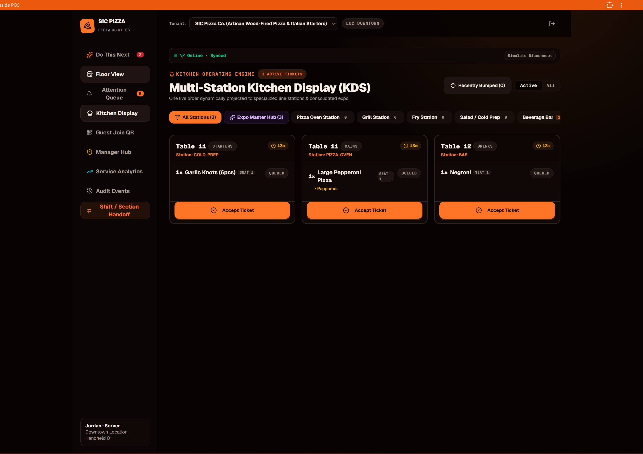
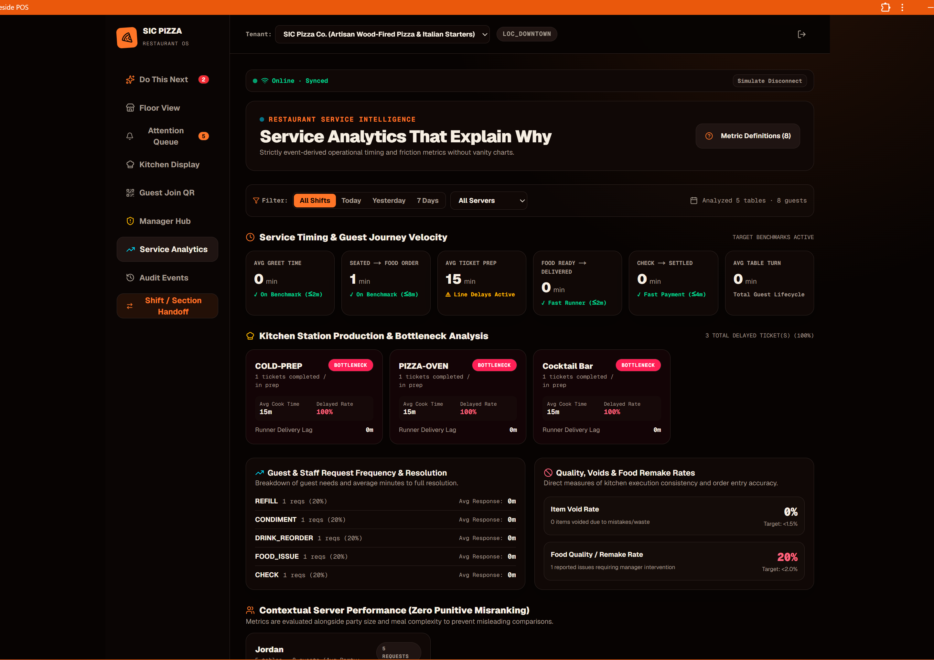
RESTAURANTS + POS
Proof you can point to—not promises you have to explain.
Live dining room
Multi-station KDS
Service analytics
These are working interfaces and documented prototypes. Where outcomes have not been measured, the deck says so.
YORKSTEAD SYSTEMS
05
Notes:
[Sources]
- C:\Users\4twen\dev\yorkstead-website\public\media\sic\floor.png
- C:\Users\4twen\dev\yorkstead-website\public\media\sic\kitchen.png
- C:\Users\4twen\dev\yorkstead-website\public\media\sic\analytics.png
[/Sources]

Slide 6
RESTAURANTS + POS
A focused first engagement creates momentum without a blank check.
Choose one service bottleneck—requests, kitchen flow, split checks, or handoff—and prove the workflow before replacing everything.
AUDIT
PRIORITIZE
BUILD
VERIFY
HAND OFF
Mobile server workflow
01
Guest QR ordering
02
Kitchen display systems
03
Shift handoffs
04
Service metrics
05
YORKSTEAD SYSTEMS
06
Notes:
[Sources]
- Engagement framing from yorkstead.com services, packages, and workflow-audit content.
[/Sources]

Slide 7
YORKSTEAD SYSTEMS
Do not add another screen to the restaurant.
Connect the service.
Bring one broken workflow. We’ll identify the first useful system and the shortest path to shipping it.
hello@yorkstead.com • yorkstead.com
Notes:
[Sources]
- Yorkstead Systems contact and engagement positioning.
[/Sources]

