Slide 1
YORKSTEAD SYSTEMS
RETAIL + E-COMMERCE
Make the product feel valuable before the customer touches it.
SOFTWARE THAT
KEEPS REAL-WORLD
WORK MOVING.
Distinctive storefronts, product storytelling, custom-order intake, and the operational pieces behind a confident purchase.
Brandon York • hello@yorkstead.com • yorkstead.com
Notes:
[Sources]
- Yorkstead Systems brand positioning: repository lib/brand.ts
[/Sources]

Slide 2
RETAIL + E-COMMERCE
The expensive part is the handoff nobody owns.
01
Template storefronts flatten what makes the product worth buying.
02
Custom requests arrive without the details needed to quote or fulfill them.
03
Marketing, catalog, checkout, and fulfillment feel like separate businesses.
YORKSTEAD SYSTEMS
02
Notes:
[Sources]
- Buyer problems synthesized from Yorkstead project workflows; no external quantitative claim.
[/Sources]

Slide 3
RETAIL + E-COMMERCE
A storefront that sells the product—and hands clean work to the operator.
SHARED
CONTEXT
→
CLEAR
NEXT STEP
The useful system is not the one with the most features. It is the one that keeps context attached as work moves between people, decisions, and tools.
YORKSTEAD SYSTEMS
03
Notes:
[Sources]
- Yorkstead Systems positioning and repository case-study narratives.
[/Sources]

Slide 4
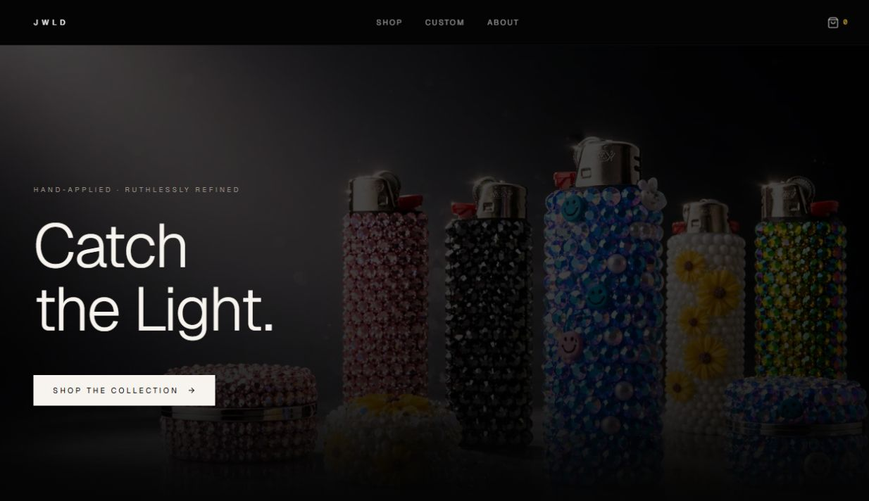
RETAIL + E-COMMERCE
JWLD turns a hand-finished product into a coherent buying experience.
The project combines art direction, a focused catalog, product detail, custom commission intake, cart behavior, and a premium visual system. The live storefront is evidence of the customer-facing experience; commercial outcomes are not yet quantified.
Brand-led storefront
YORKSTEAD SYSTEMS
04
Notes:
[Sources]
- C:\Users\4twen\dev\yorkstead-website\public\media\jwld\screenshots\home.png
- Repository project documentation and case-study limitations.
[/Sources]

Slide 5
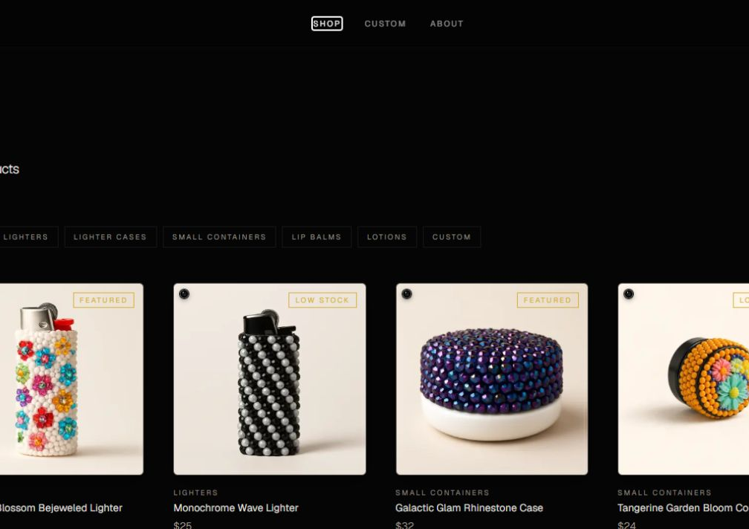
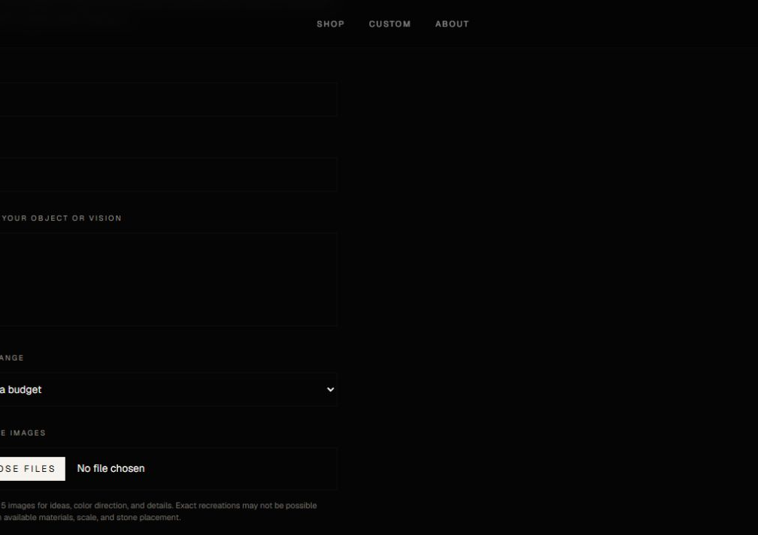
RETAIL + E-COMMERCE
Proof you can point to—not promises you have to explain.
Brand-led storefront
Focused catalog
Custom commission intake
These are working interfaces and documented prototypes. Where outcomes have not been measured, the deck says so.
YORKSTEAD SYSTEMS
05
Notes:
[Sources]
- C:\Users\4twen\dev\yorkstead-website\public\media\jwld\screenshots\home.png
- C:\Users\4twen\dev\yorkstead-website\public\media\jwld\screenshots\catalog.png
- C:\Users\4twen\dev\yorkstead-website\public\media\jwld\screenshots\custom-form.png
[/Sources]

Slide 6
RETAIL + E-COMMERCE
A focused first engagement creates momentum without a blank check.
Start with the buying path that matters most: discover, trust, choose, purchase—or request something custom.
AUDIT
PRIORITIZE
BUILD
VERIFY
HAND OFF
Storefront strategy
01
Product & collection pages
02
Custom order intake
03
Checkout & fulfillment flow
04
Launch measurement
05
YORKSTEAD SYSTEMS
06
Notes:
[Sources]
- Engagement framing from yorkstead.com services, packages, and workflow-audit content.
[/Sources]

Slide 7
YORKSTEAD SYSTEMS
A beautiful store gets attention.
A connected store gets the order right.
Bring one broken workflow. We’ll identify the first useful system and the shortest path to shipping it.
hello@yorkstead.com • yorkstead.com
Notes:
[Sources]
- Yorkstead Systems contact and engagement positioning.
[/Sources]

