Slide 1
YORKSTEAD SYSTEMS
WORKFLOW + DATA
Turn scattered activity into visible, actionable work.
SOFTWARE THAT
KEEPS REAL-WORLD
WORK MOVING.
Workflow automation, operational dashboards, and focused internal tools for owner-led teams.
Brandon York • hello@yorkstead.com • yorkstead.com
Notes:
[Sources]
- Yorkstead Systems brand positioning: repository lib/brand.ts
[/Sources]

Slide 2
WORKFLOW + DATA
The expensive part is the handoff nobody owns.
01
People re-enter the same information across forms, spreadsheets, inboxes, and systems.
02
Dashboards report history but do not show the next action or owner.
03
Automation fails when it ignores exceptions, approvals, and human judgment.
YORKSTEAD SYSTEMS
02
Notes:
[Sources]
- Buyer problems synthesized from Yorkstead project workflows; no external quantitative claim.
[/Sources]

Slide 3
WORKFLOW + DATA
Connect the handoff, preserve the decision, and surface what needs attention now.
SHARED
CONTEXT
→
CLEAR
NEXT STEP
The useful system is not the one with the most features. It is the one that keeps context attached as work moves between people, decisions, and tools.
YORKSTEAD SYSTEMS
03
Notes:
[Sources]
- Yorkstead Systems positioning and repository case-study narratives.
[/Sources]

Slide 4
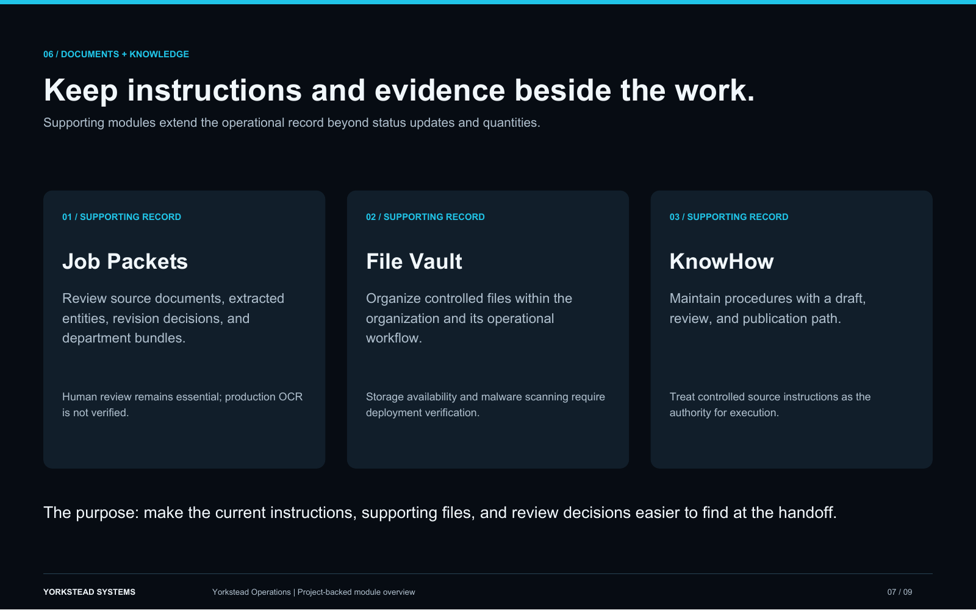
WORKFLOW + DATA
The work spans intake, execution, exceptions, and measurement.
Yorkstead systems combine structured intake, shared records, explicit workflow state, dashboards, audit trails, and operational reporting. The implementation can sit beside existing tools or become a focused system where spreadsheets have reached their limit.
Connected records and handoffs
YORKSTEAD SYSTEMS
04
Notes:
[Sources]
- C:\Users\4twen\dev\yorkstead-website\public\media\yorkstead-ops\pages\operations-7.png
- Repository project documentation and case-study limitations.
[/Sources]

Slide 5
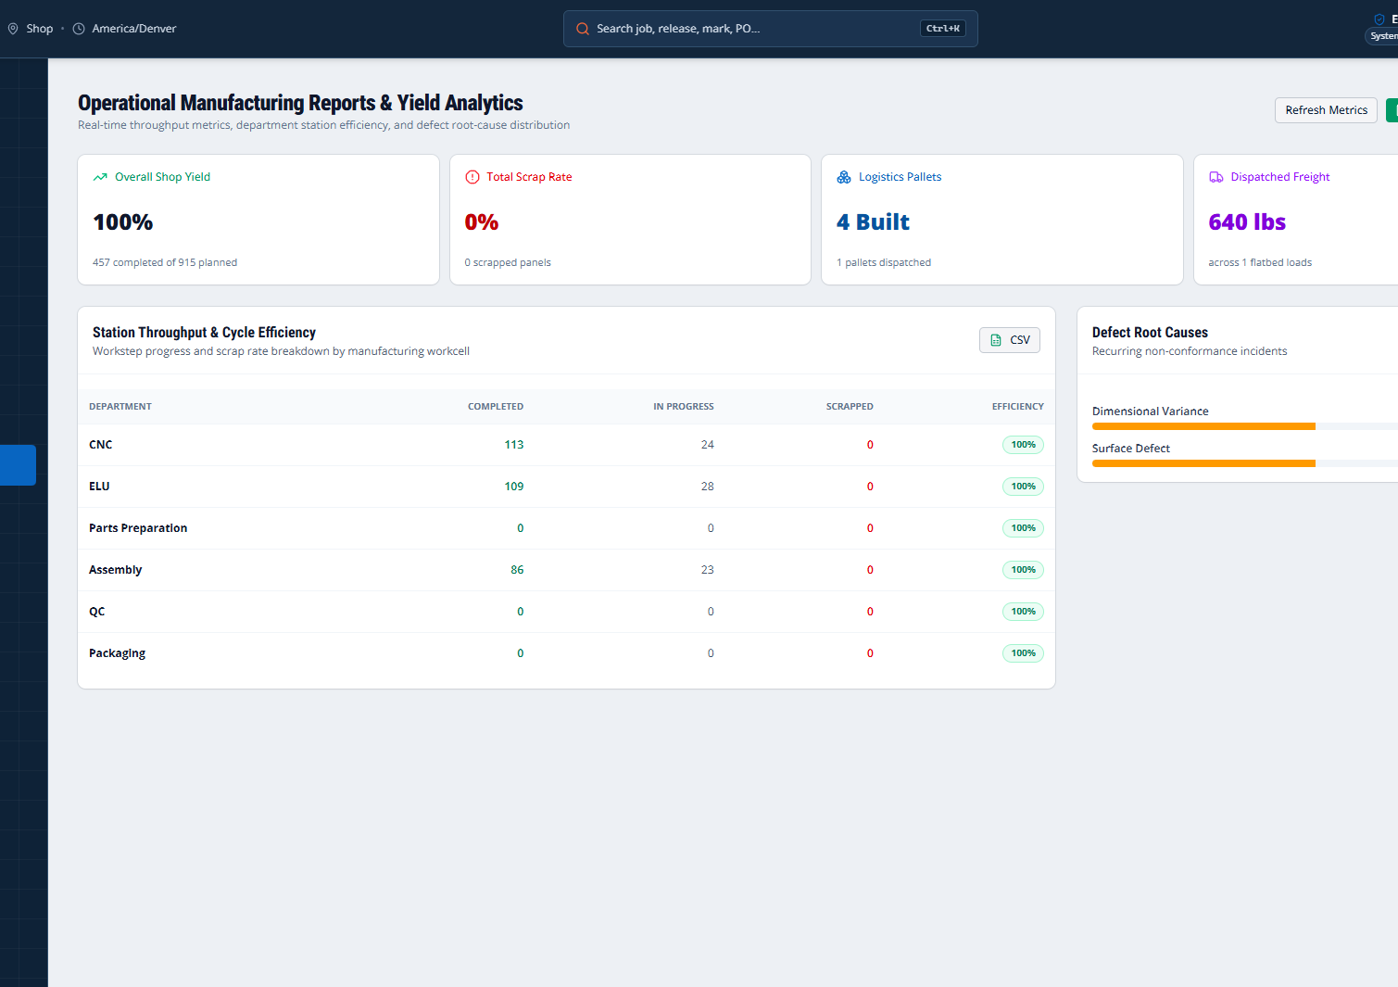
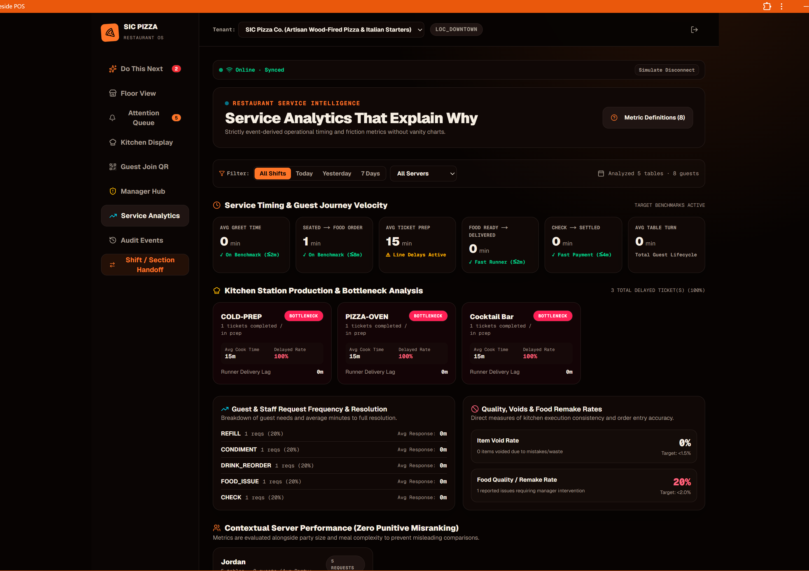
WORKFLOW + DATA
Proof you can point to—not promises you have to explain.
Connected records and handoffs
Manufacturing metrics
Service telemetry
These are working interfaces and documented prototypes. Where outcomes have not been measured, the deck says so.
YORKSTEAD SYSTEMS
05
Notes:
[Sources]
- C:\Users\4twen\dev\yorkstead-website\public\media\yorkstead-ops\pages\operations-7.png
- C:\Users\4twen\dev\yorkstead-website\public\media\ellwood\reports.png
- C:\Users\4twen\dev\yorkstead-website\public\media\sic\analytics.png
[/Sources]

Slide 6
WORKFLOW + DATA
A focused first engagement creates momentum without a blank check.
Begin with the repeated handoff that consumes attention every week. Make it visible, measurable, and easier to complete.
AUDIT
PRIORITIZE
BUILD
VERIFY
HAND OFF
Workflow audit
01
Forms & intake automation
02
Operations dashboards
03
Approvals & exception handling
04
System integration
05
YORKSTEAD SYSTEMS
06
Notes:
[Sources]
- Engagement framing from yorkstead.com services, packages, and workflow-audit content.
[/Sources]

Slide 7
YORKSTEAD SYSTEMS
The goal is not more automation.
The goal is less operational drag.
Bring one broken workflow. We’ll identify the first useful system and the shortest path to shipping it.
hello@yorkstead.com • yorkstead.com
Notes:
[Sources]
- Yorkstead Systems contact and engagement positioning.
[/Sources]

