Slide 1
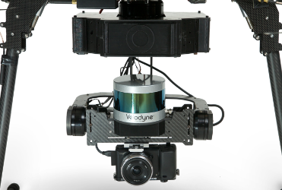
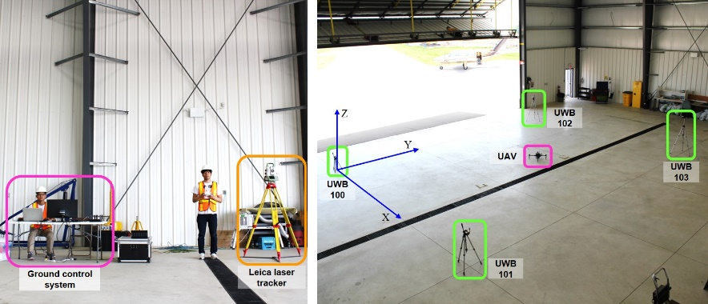
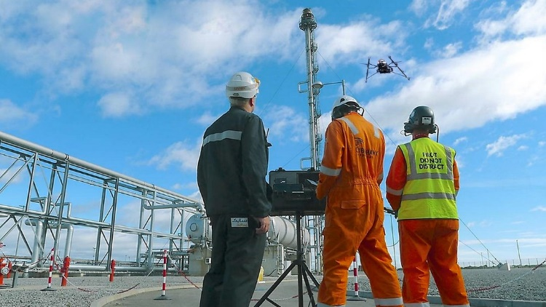
QDrone: UAV Navigation for Infrastructure Inspection
*QDrone: Quality-driven Drone
Introduction
Progress & Future Work
■ Our team members & collaborators
• Jungwon, Zahra, Kunwoo
• U of Calgary
■ Objectives
Developing a high-performance UAV-photogrammetry system adapted to metric inspection of infrastructures • UWB-aided localization
• Semantic mapping
• Quality-driven automatic navigation
■ Period
• Sept 2016 – Sept 2019
■ Progress
• Item purchase
- DJI M100, M600
- ZED stereo, FLIR Duo R, Sony A7III
- Velodyne LiDAR
• UWB-aided localization
- Filtering & smoothing
- Oshawa experiment (May 2018)
• Corrosion segmentation
■ Future Works • Building integrated sensor system
• Semantic SLAM
• Simple navigation / Quality-driven navigation
Oshawa experiment (May 2018)

