Slide 1




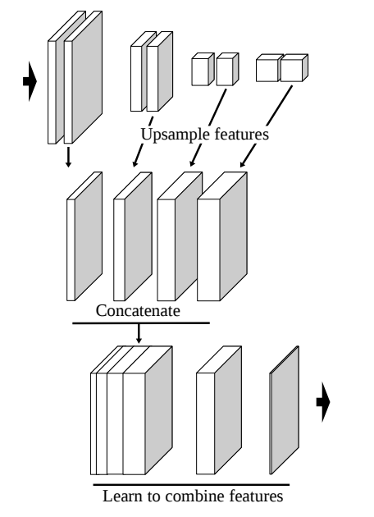
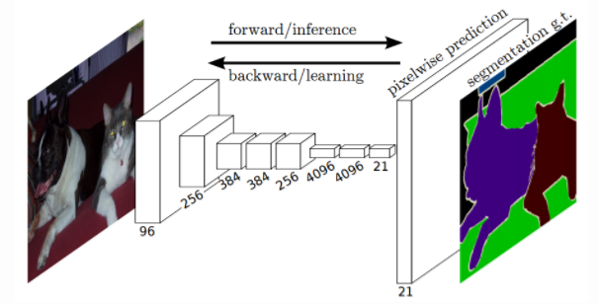
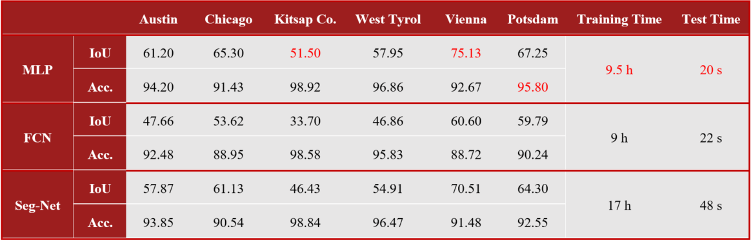
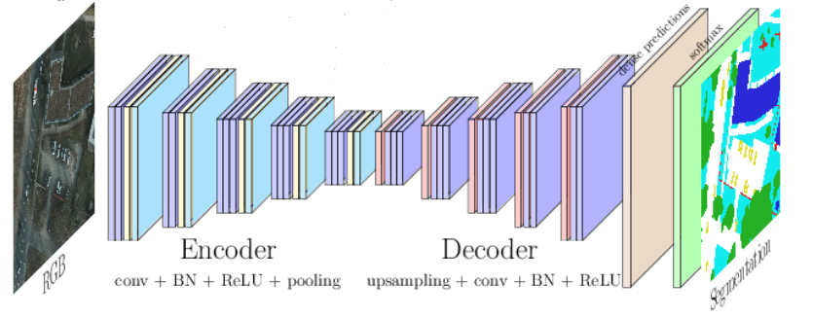
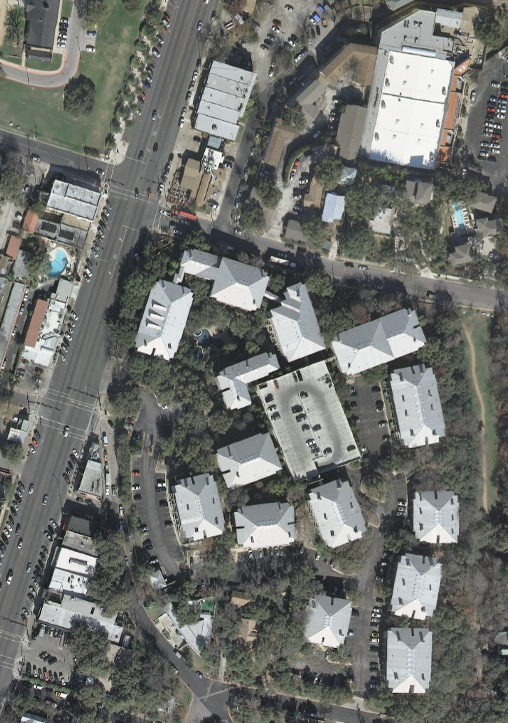
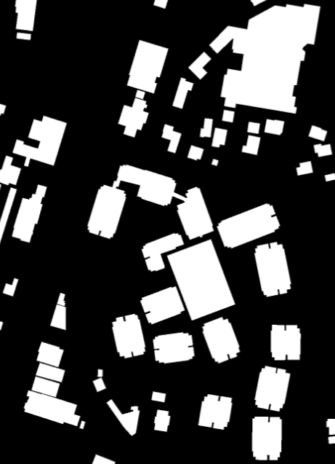
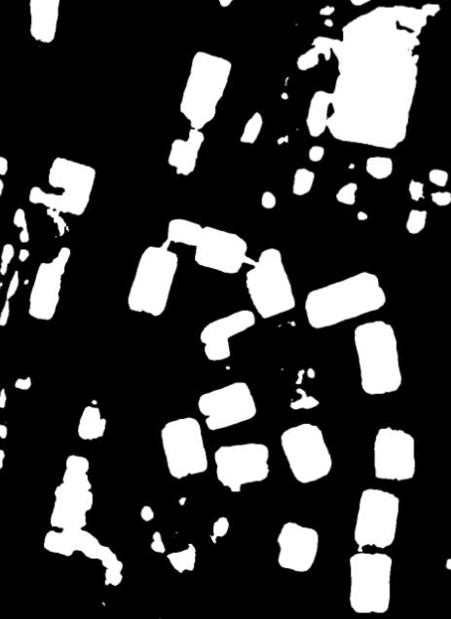
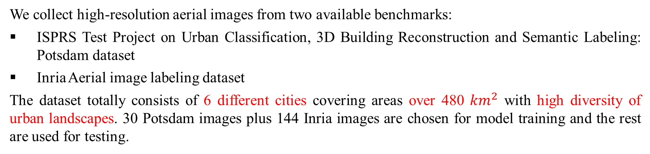
Automatic Building Segmentation from Aerial Images
based on Deep Neural Network
Kang Zhao, Jungwon Kang, Gunho Sohn
Department of Earth and Space Science Engineering
York University
Introduction
Methods
Results
The increasing availability of aerial images provides abundant global and local remote sensing information about the structure on the surface of our planet, benefiting applications in a wide range of areas including urban planning, crop and forest management, disaster relief, climate modeling and so on. However, it also raises new challenges for the problems like semantic segmentation, which consists in the assignment of a class label information to every pixel in an image. At present, much of the information extraction is still performed by human experts, making the process slow, costly, and error prone. While deep neural networks have achieved significant advances in the semantic segmentation of high-resolution images, we introduce the use of deep learning methods to produce automatic, efficient and accurate aerial image labeling result, particularly for the building extraction. We show how deep neural networks implemented on modern GPUs can be used to efficiently learn highly discriminative image features and evaluate our architecture on large building detection datasets and indicate that it works reliably under a wide variety of conditions.
A
B
Challenges
The pixel-level classification accuracy (Acc.) and intersection over union (IoU) are adopted to present how good the segmentation can be(both are percentages). From the table above, methods based on deep learning get unified and stable performance over 6 various cities. Specially MLP produces the finest outcomes while FCN gets the most fuzzy results.
The segmentation efficiency is evaluated by training time for the model and testing time per image. Seg-net has the lowest speed due to its complex architecture while FCN and MLP achieves much higher efficiency.
The figures below show an example of RGB satellite image (left), ground truth (middle) and MLP prediction result (right). The building area is white in the dark background.
C
Conventional image segmentation methods find huge difficulties in processing large amount of high-resolution images.
Diversity of urban landscapes cause plenty of confusion to image understanding work like building extraction.
Recognition and localization trade-off: it is hard to preserve the spatial resolution while extracting high level features.
Deep learning methods with complicated architecture requires large computation power.
Data Preparation
We collect high-resolution aerial images from two available benchmarks:
ISPRS Test Project on Urban Classification, 3D Building Reconstruction and Semantic Labeling: Potsdam dataset
Inria Aerial image labeling dataset
The dataset totally consists of 6 different cities covering areas over 480 ${km}^{2}$ with high diversity of urban landscapes. 30 Potsdam images plus 144 Inria images are chosen for model training and the rest are used for testing.
An artificial neural network is a system of interconnected neurons that pass messages to each other. As a special form of artificial neural network, convolutional neural networks (CNNs), is playing huge and significant role in the image analysis community. For our segmentation purpose, especially to solve the aforementioned recognition and localization trade-off, 3 CNN architectures are investigated (in the figures above):
A. Multi-layer Perceptron (MLP): Intermediate features are extracted from the network and treated equally, creating a pool of features that emanate from different resolutions.
A neural network learns how to combine features from different scales to give the final classification verdict. The proposed technique is intended to learn how to combine information at different resolutions, not how to upsample a low-resolution classification.
We can think of the MLP with one hidden layer and a non-linear activation function as a minimal system to learn how to combine the pool of features.
Flexible and small structure leads high computational efficiency.
Region | Resolution | Size | Amount (image tiles) | Coordinate Frame | Source
Potsdam | 1m | 1500*1500 | 36 | NAD27 | ISPRS Semantic Labeling Benchmark
Austin, Chicago, Vienna, etc | 0.3m | 5000*5000 | 180 | WGS84 | Inria Aerial Image Labeling Dataset
B. Fully Convolutional Network (FCN): It contains only convolutional layers without fully connected layers.
It can be applied to images with various sizes.
At the last layer, it upsamples the feature map to the original resolution of the input image to maintain the localization accuracy and output resolution.
A reduced computational complexity.
we can efficiently train on input patches that are larger than the receptive fields, and in turn produce larger classified patches, with more than a single pixel.
Conclusion &Future Work
Conclusions:
Deep learning based methods can effectively learn features of building footprints from different urban landscapes of high-resolution aerial images and automatically produce reliable building segmentation outcomes.
Multi-layer Perceptron (MLP) is capable of dealing with large image dataset. Its simple architecture assures computational efficiency while maintaining segmentation outcomes of high accuracy compared to other deep learning methods.
Future Work:
Create new deep learning model to handle image noises.
Boundary Regularization for the segmentation results in pixel level.
Image to vector transformation: from the segmented images to automatically produce object vectors.
Hardware &Software
C. Seg-Net: The most hassle-free way is to simply “reflect” an existent FCN, with the same number of layers and kernel sizes, to perform the upsampling.
Instead of naively upsampling the classification score maps with one deconvolutional layer, a more advanced approach is to attach a multi-layer network to learn a complex upsampling function.
This concept can be thought of as an “encoder–decoder”, where the middle layer is seen as a common representation to images and classification maps, while the “encoder” and “decoder” ensure the translation between this representation and the two modalities.
The interleaved outputs are directly compared to individual pixels in the ground truth one by one, producing better upsampling accuracy.
Double size as FCN results in much more parameters and higher difficulty to optimize, thus more computation required.
Hardware:
CPU: Intel Core i7-8700 @3.2GHz
GPU: GEFORCE GTX 1080 Ti Provided by NVIDIA
Software:
Ubuntu 16.04 TS, Linux Operating System
Caffe, a deep learning framework provided by UC Barkley
Python 3.5 for programming

