Slide 1





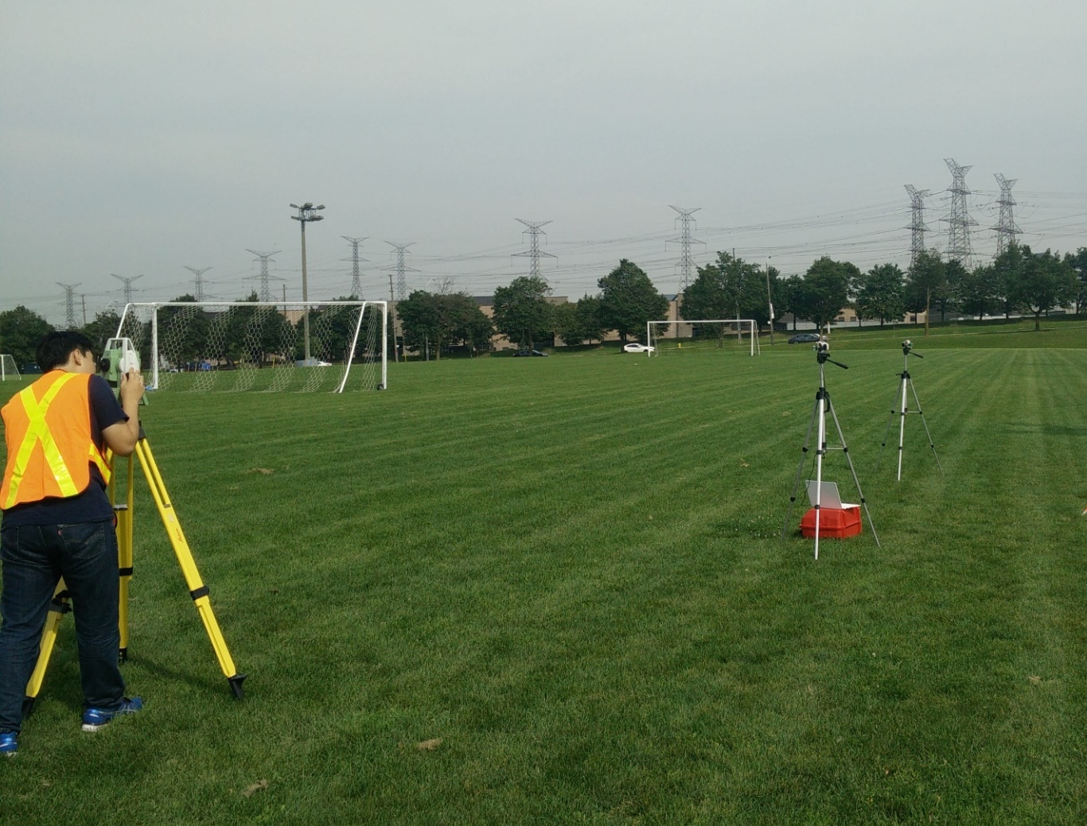
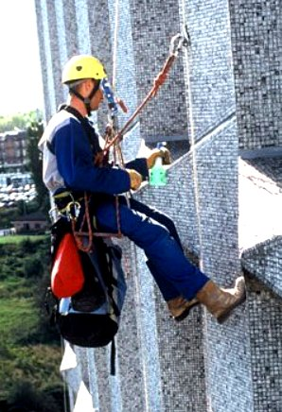
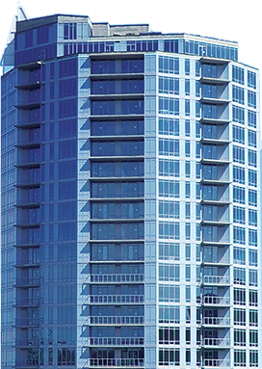
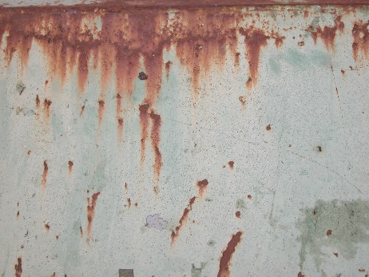
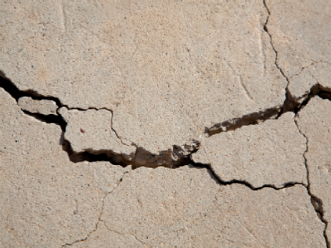


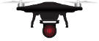
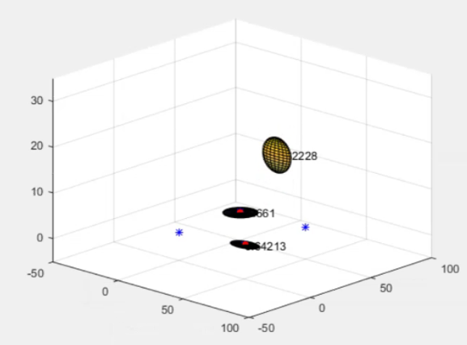
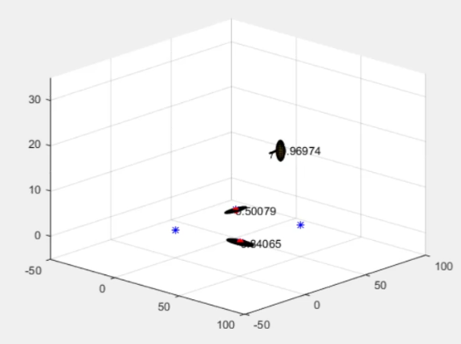
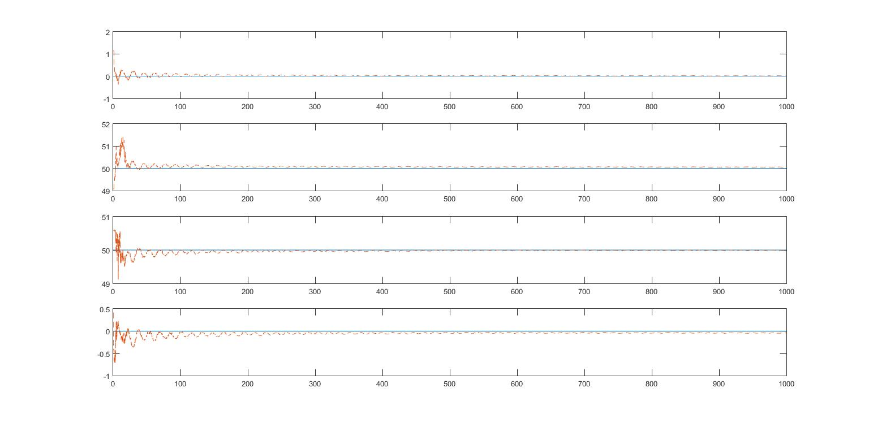
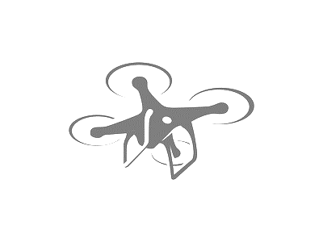

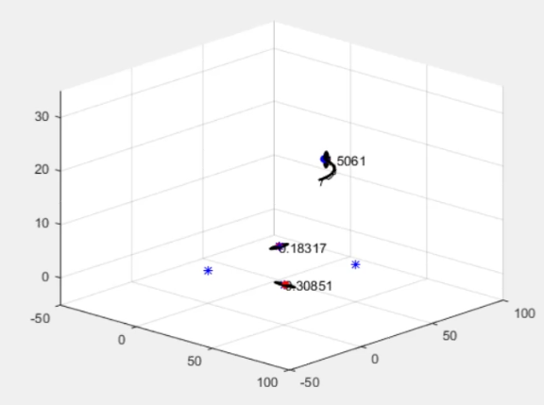
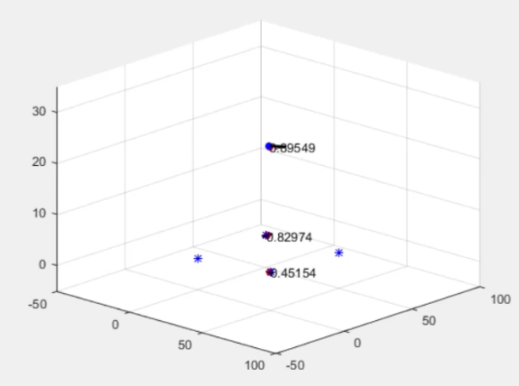
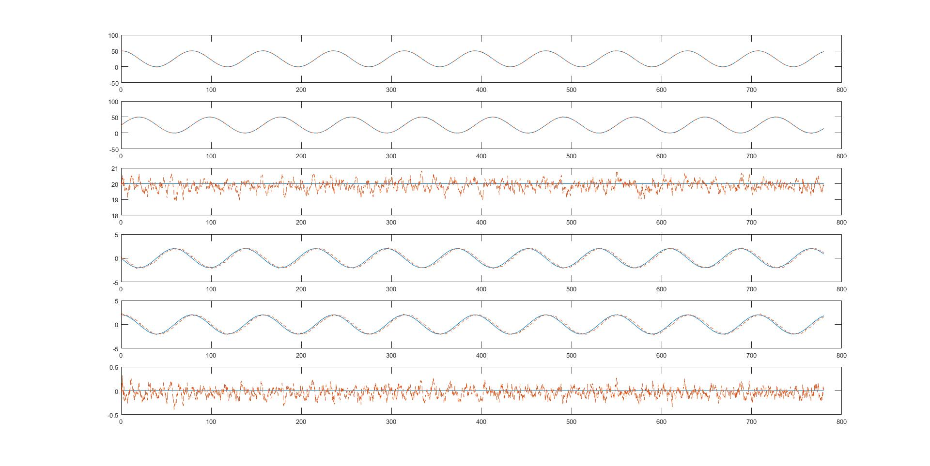




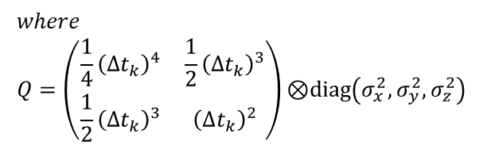




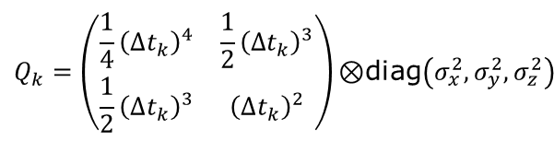


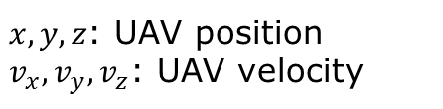























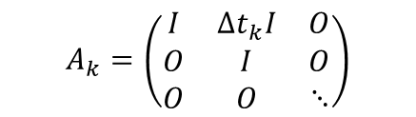




ULTRA-WIDEBAND-BASED RANGE-ONLY SLAM FOR UAV LOCALIZATION IN OUTDOOR ENVIRONMEMT
K. Park, J. Kang, G. Sohn
Dept. of Earth & Space Science & Engineering, York University Toronto, M3J1P3 Canada - (kunwoo7, jkang99 ,gsohn)@yorku.ca
Background
UWB Ranging Calibration
Range Only SLAM
A precision monitoring of the status of critical infrastructure on a timely manner is critical for public safety and economics. Today’s practice for inspecting critical infrastructure mainly rely on human forces, which is time-consuming, prone to errors and often put inspectors in dangerous situations. To address these issues, Unmanned Aerial Vehicle (UAV) is recently attracting large amount of attentions as an alternative solution to human-centric labors.
Reference(x) | UWB(y) | Difference (UWB-REF)
5046.88 | 5024.31 | -22.57
10019.61 | 9998.18 | -21.43
14987.38 | 14963.76 | -23.62
20030.77 | 20007.35 | -23.41
25012.76 | 24991.89 | -20.87
29969.53 | 29952.38 | -17.15
34949.02 | 34965.31 | 16.29
40072.37 | 40049.80 | -22.56
45059.26 | 45037.82 | -21.43
50031.28 | 50002.44 | -28.83
UAV position: $P$= $\left\{p_{x},p_{y},p_{z}\right\}$ ,UAV velocity:$V$= $\left\{v_{x},v_{y},v_{z}\right\}$
Unknown Anchor position :$P_{a2}$=$\left\{p_{x_a2},p_{y_a2} \right\}$, $P_{a4}$=$\left\{p_{x_a4},p_{y_a4} \right\}$
(height(z) of each anchor is assumed be known)
$$where \\ Q=\left(\begin{matrix}\frac{1}{4}{\left(∆t_{k}\right)}^{4} & \frac{1}{2}{\left(∆t_{k}\right)}^{3} \\ \frac{1}{2}{\left(∆t_{k}\right)}^{3} & {\left(∆t_{k}\right)}^{2}\end{matrix}\right)\text{⊗}\text{diag}\left(σ_{x}^{2},σ_{y}^{2},σ_{z}^{2}\right)$$
$$X=\left(\begin{aligned}P \\ V \\ P_{a2} \\ P_{a4}\end{aligned}\right)$$
$$A_{k}=\left(\begin{matrix}I & ∆t_{k}I & O \\ O & I & O \\ O & O & ⋱\end{matrix}\right)$$
$$Q_{k}=\left(\begin{matrix}Q & O & … \\ O & O & … \\ ⋮ & ⋮ & ⋱\end{matrix}\right)$$
unit: mm
anchor 1
UWB sensor measured about 21 mm longer than reference in average. This calibrated range is used for localization and SLAM algorithm.
$$\frac{1}{{\hat{d}}_{k}}\left[{\left({\hat{p}}_{k}^{−}−p^{1}\right)}^{T} 0 0 0 0 0 0 0\right]$$
Prediction
Correction
$${\hat{x}}_{k}^{−}=A{\hat{x}}_{k−1}$$
$${\hat{d}}_{k}=\left\|{\hat{p}}_{k}^{−}−p^{a}\right\|$$
Localization Simulation Setup
anchor 2
$$\frac{1}{{\hat{d}}_{k}}\left[{\left({\hat{p}}_{k}^{−}−p^{2}\right)}^{T} 0 0 0{ −\left({\hat{p}}_{k}^{−}−p^{2}\right)}^{T} 0 0\right]$$
$$P_{k}^{−}=AP_{k−1}A^{T}+Q$$
$$K_{k}=P_{k}^{−}H_{k}^{T}{\left(H_{k}P_{k}^{−}H_{k}^{T}+R\right)}^{−1}$$
However, UAV mainly relies on consumer-grade lower-quality of positioning systems and has critical drawback to operate in downtown core areas where high-rise buildings often interfere signals from Global Navigation Satellite System (GNSS).
0 ,50,1.25
50,50,2
$$H_{k}=$$
anchor 3
Install UWB anchors at different heights
at each vertex of 50m by 50m square.
$$\frac{1}{{\hat{d}}_{k}}\left[{\left({\hat{p}}_{k}^{−}−p^{3}\right)}^{T} 0 0 0 0 0 0 0 \right]$$
$${\hat{X}}_{k}={\hat{X}}_{k}^{−}+K_{k}\left(d_{k}−{\hat{d}}_{k}\right)$$
anchor 4
$$P_{k}=\left(I−K_{k}H_{k}\right)P_{k}^{−}$$
Initial location
50,25,20
Initial velocity
0,2,0
The UAV moves along a circle with radius of 25m
at a height of 20m, at an uniform linear velocity 2m/s.
$$\frac{1}{{\hat{d}}_{k}}\left[{\left({\hat{p}}_{k}^{−}−p^{4}\right)}^{T} 0 0 0{ 0 0−\left({\hat{p}}_{k}^{−}−p^{4}\right)}^{T} \right]$$
Ultra-Wideband(UWB) Based Localization
Results of Range Only SLAM
Thus, there is high demand to increase UAV localization accuracy in GNSS-denial environments. One emerging solution is Ultra-Wideband (UWB) based localization due to its robustness to multipath and cm-level ranging error.
0,0,1
50,0,2.5
The distance from an anchor measured every 1/10s.
$x_{p_a2}$, $y_{p_a2}$, $x_{p_a4}$, $y_{p_a4}$: Anchor coordinates
EKF Model for Localization
$$x_{p_a2}$$
D
Dynamic model
Prediction
Correction
$$y_{p_a2}$$
$$X_{k+1}=A_{k}X_{k}+ε_{k}$$
$$E\left(ε_{k}ε_{k}^{T}\right)= Q_{k}$$
$${\hat{x}}_{k}^{−}=A{\hat{x}}_{k−1}$$
$${\hat{d}}_{k}=\left\|{\hat{p}}_{k}^{−}−p^{a}\right\|$$
Z_{W}
Z_{S}
$$d_{k}=\left\|p_{k}−p_{a}\right\|+η_{k}$$
$$E\left(η_{k}η_{k}^{T}\right)=R$$
$$P_{k}^{−}=AP_{k−1}A^{T}+Q$$
$$H_{k}=\frac{1}{{\hat{d}}_{k}}\left[{\left({\hat{p}}_{k}^{−}−p^{a}\right)}^{T} 0 0 0\right]$$
$$x_{p_a4}$$
where
$$A_{k}=\left(\begin{matrix}I & ∆t_{k}I \\ 0 & I\end{matrix}\right)$$
Y_{W}
W
X_{W}
Y_{S}
S
X_{S}
UWB anchors
$X=\left(\begin{aligned}P \\ V\end{aligned}\right)$
$$K_{k}=P_{k}^{−}H_{k}^{T}{\left(H_{k}P_{k}^{−}H_{k}^{T}+R\right)}^{−1}$$
$$y_{p_a4}$$
Nevertheless, fixed UWB modules (anchors) have to be precisely installed to achieve localization by additional surveying work which hinders quick and easy use of the UWB based localization.
$$Q_{k}=\left(\begin{matrix}\frac{1}{4}{\left(∆t_{k}\right)}^{4} & \frac{1}{2}{\left(∆t_{k}\right)}^{3} \\ \frac{1}{2}{\left(∆t_{k}\right)}^{3} & {\left(∆t_{k}\right)}^{2}\end{matrix}\right)\text{⊗}\text{diag}\left(σ_{x}^{2},σ_{y}^{2},σ_{z}^{2}\right)$$
$${\hat{X}}_{k}={\hat{X}}_{k}^{−}+K_{k}\left(d_{k}−{\hat{d}}_{k}\right)$$
$$P_{k}=\left(I−K_{k}H_{k}\right)P_{k}^{−}$$
Ground truth value
Estimated value
Guo, K., Qiu, Z., Miao, C., Zaini, A. H., Chen, C. L., Meng, W., & Xie, L. (2016). Ultra-wideband-based localization for quadcopter navigation. Unmanned Systems, 4(01), 23-34.
Conclusion
Results of Localization
$x, y,z$: UAV position
$v_{x},v_{y},v_{z}$: UAV velocity
Ground truth value
Range-Only SLAM for UAV Localization
Estimated value
UWB ranging and EKF can be used to perform UAV localization within 1 meter.
Range Only SLAM can be used to accurately estimate the position of anchor and localization of UAV.
In this poster, we present UWB based Range Only Simultaneous Localization and Mapping (RO-SLAM) to facilitate quick installation of anchors and achieve UAV localization simultaneously. Approximate location of the UWB anchors and the UAV are continually updated based on the Extended Kalman Filter (EKF) using distance measurements. As a result, the coordinates of the UWB anchors converge within a certain amount of error and UAV localization is performed based on the distance measurement from the anchors.
$x$(m)
$$y\text{(}\text{m}\text{)}$$
$z$ (m)
$$v_{x}\text{(}\text{m}\text{/}\text{s}\text{)}$$
Acknowledgements
This project is partially supported by an NSERC (Natural Sciences and Engineering Research Council of Canada) grant in collaboration with ISW and CGQ.
$$v_{y}\text{(}\text{m}\text{/}\text{s}\text{)}$$
$v_{z}$ $\text{(}\text{m}\text{/}\text{s}\text{)}$
(X axis unit: 0.1s)

