Slide 1




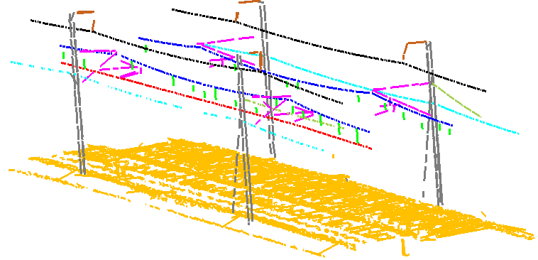
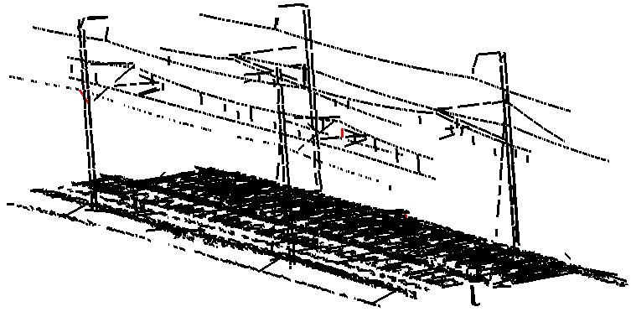
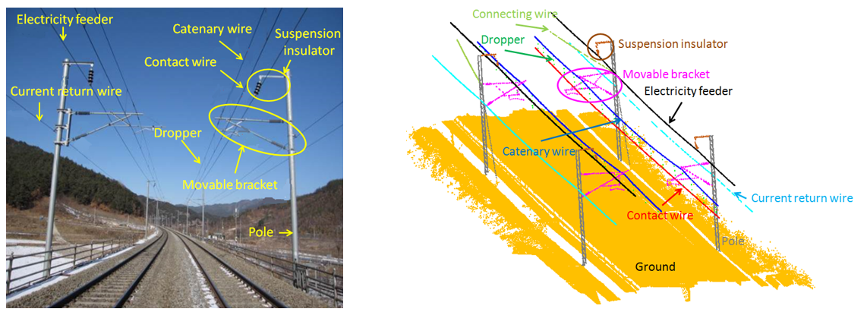
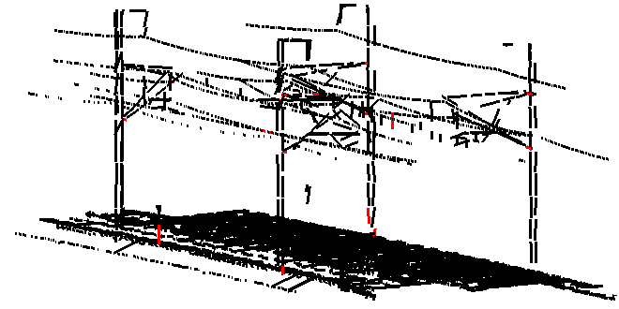
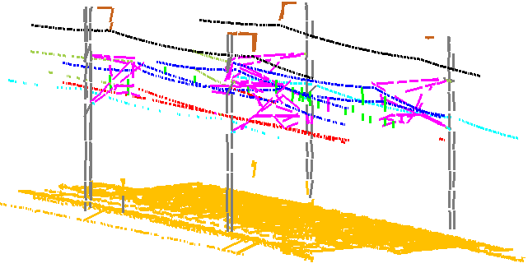
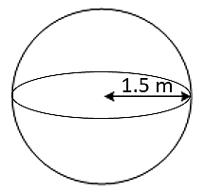
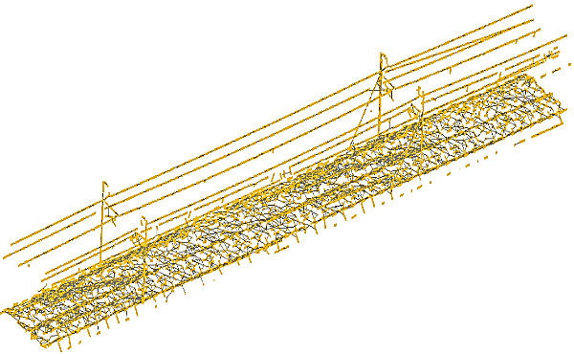
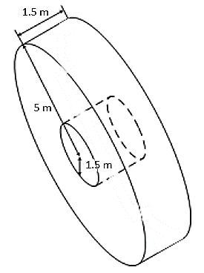
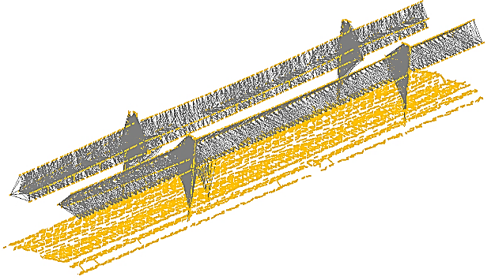
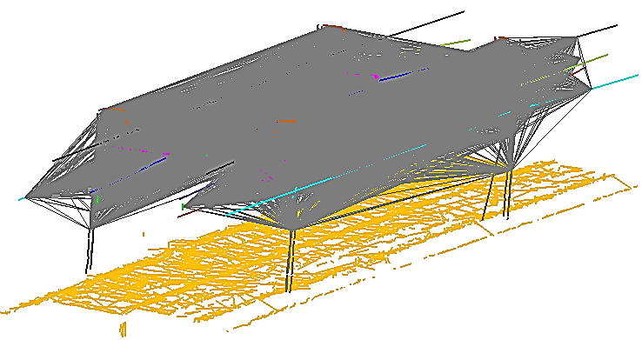
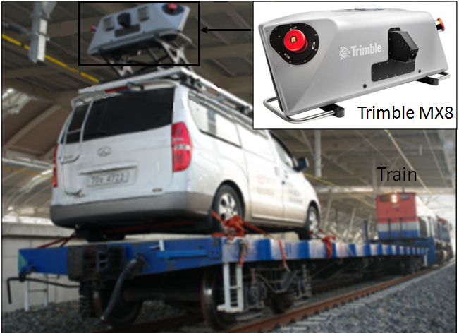
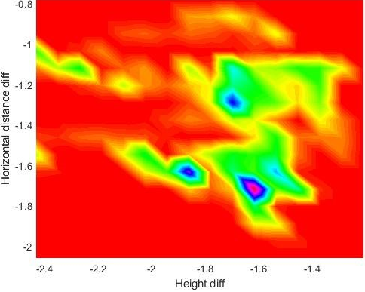
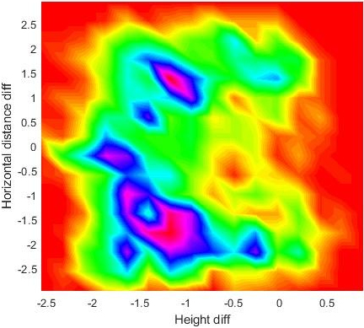
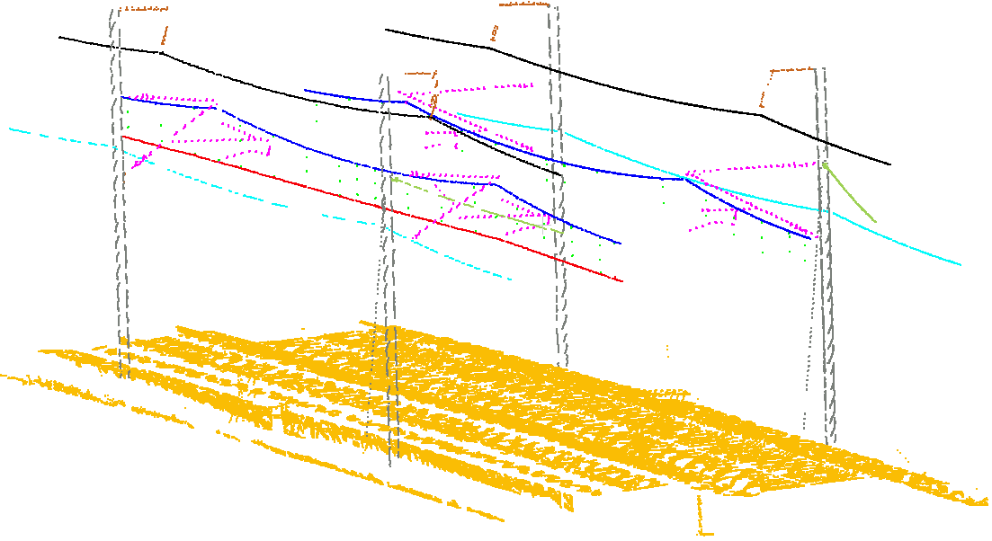
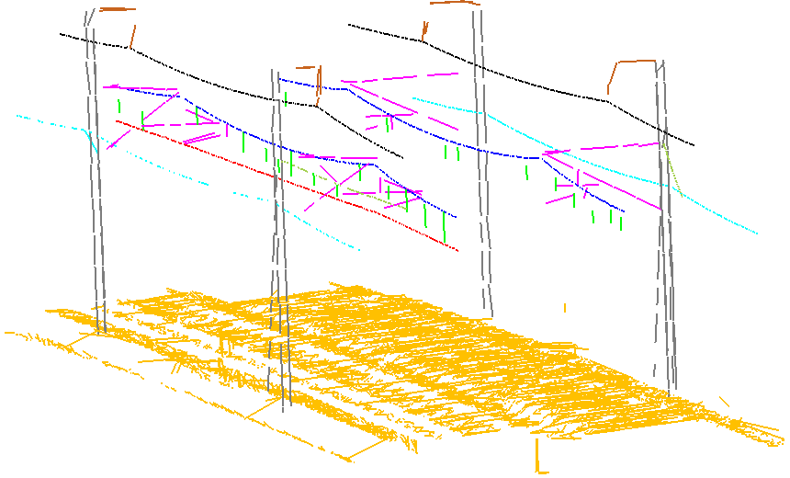
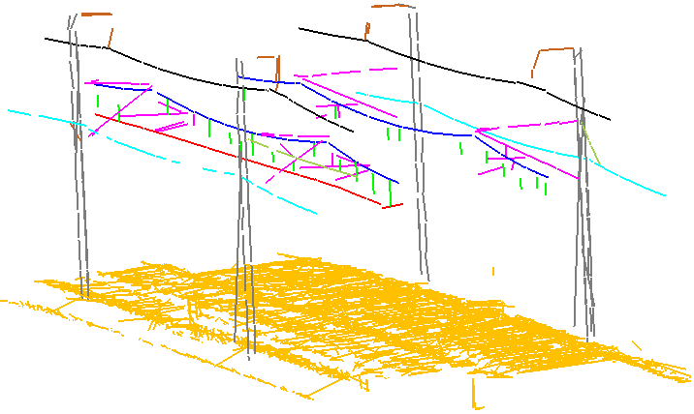
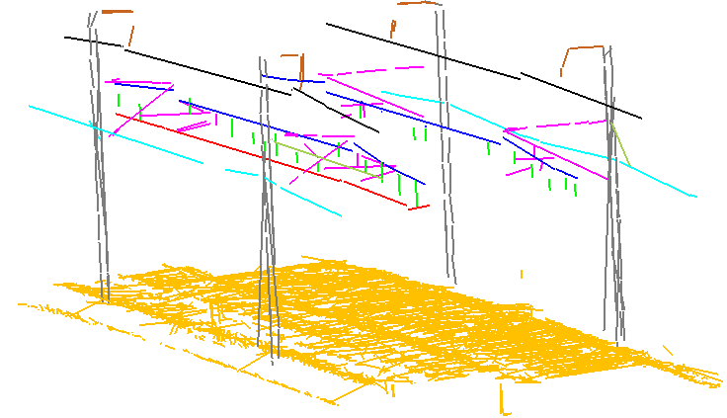
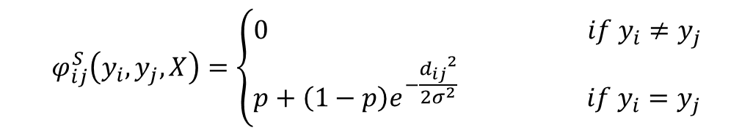
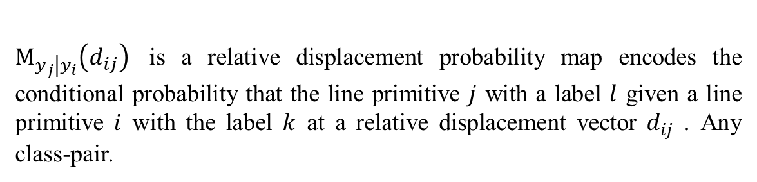
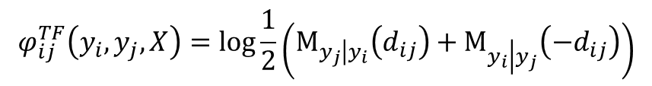
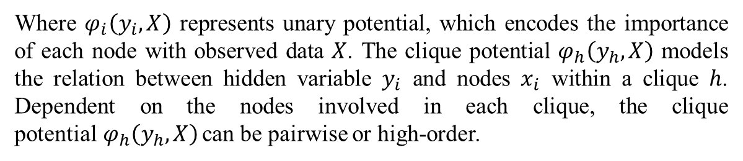
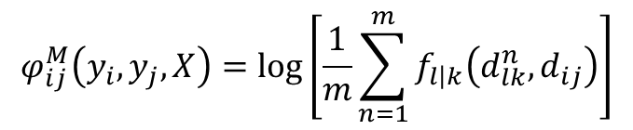
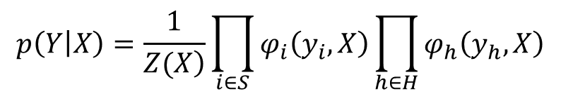
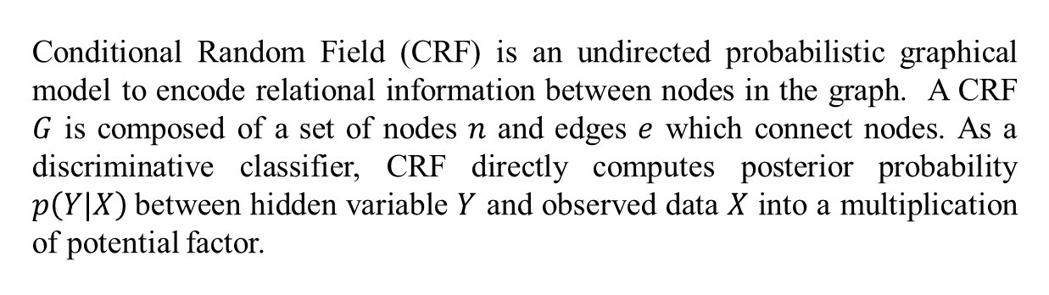
Railway electrification system classification from mobile laser scanning data using hierarchical CRF
Leihan Chen, Jaewook Jung, Gunho Sohn
Geomatics Engineering, Depart. Of ESSE, York University,
4700 Keele St., North York, ON M3J 1P3 - {leihan, jwjung, gsohn}@yorku.ca
Introduction
Hierarchical Conditional Random Field
Experiment Result
Railways have been used as one of the most crucial means of transportation in public mobility and economic development. The electrification system in the railway infrastructure is an essential facility for stable train operation. Due to its important role, the electrification system needs to be rigorously and regularly inspected and managed.
Visualization of the best and the worst subsets classification result
(a)
(b)
(c)
(d)
Fig. 7 (a),(c) is the classification result of subset 1 and 5. (b),(d) shows corresponding correct and misclassification.
Fig .1 Electrification system configuration and object class definition
Fig. 4 Hierarchical CRF graph structure
Quantitative classification result of proposed model and standard SVM
We present a supervised learning method to classify Mobile Laser Scanning (MLS) data into ten target classes representing overhead wires, movable brackets and poles, which are key objects in the electrification system. The method focuses on learning multi-scale relative spatial regularities under a probabilistic graph framework. Both local smoothness, relative object location and relative displacement are learnt in both short range, middle range and full range respectively.
 | SVM (Without context) |  |  | HiCRF (With context)
 | Comp.[%] | Corr.[%] | Qual.[%] | Comp.[%] | Corr.[%] | Qual.[%]
EF CAW COW CRW CNW SI MB Dro Pole Gro | 99.84 | 100.00 | 99.84 | 100 (+0.16) | 100.00 (0.00) | 100.00 (+0.16)
 | 99.63 | 99.42 | 99.06 | 99.56 (-0.07) | 99.34 (-0.08) | 98.91 (-0.15)
 | 99.42 | 100.00 | 99.42 | 99.71 (+0.29) | 100.00 (0.00) | 99.71 (+0.29)
 | 99.90 | 99.28 | 99.18 | 99.90 (0.00) | 99.18 (-0.10) | 99.08 (-0.10)
 | 93.97 | 96.14 | 90.56 | 96.73 (+2.76) | 96.73 (+0.59) | 93.67 (+3.11)
 | 64.86 | 79.12 | 55.38 | 95.50 (+30.64) | 96.36 (+17.24) | 92.17 (+36.79)
 | 89.71 | 91.24 | 82.60 | 96.89 (+7.18) | 97.36 (+6.12) | 94.41 (+11.81)
 | 92.36 | 92.36 | 85.81 | 97.90 (+5.54) | 97.90 (+5.54) | 95.89 (+10.08)
 | 90.65 | 87.30 | 80.09 | 97.31 (+6.66) | 96.08 (+8.78) | 93.60 (+13.51)
 | 99.69 | 99.68 | 99.38 | 99.88 (+0.19) | 99.96 (+0.28) | 99.85 (+0.47)
OA (%) | 98.99 |  |  | 99.67 (+0.68)
Kappa (%) | 97.52 |  |  | 99.18 (+0.60)
Dataset
Conditional Random Field
Fig. 5 Graph structure for short range, middle range and full range respectively.
Middle Range Relative Location
The MLS data for experiment was taken at the Honam high-speed railway in South Korea. The MLS data were acquired in 2014 using the Trimble MX8 system, which was mounted on an inspection train with a speed of 50 km/h to 70 km/h. The average density varies on the position of the laser scanner ranging from 100 points/m² to 800 points/m². The whole railway length is approximately 1 km and is divided into six subsets.
1
3
Conditional Random Field (CRF) is an undirected probabilistic graphical model to encode relational information between nodes in the graph. A CRF $G$ is composed of a set of nodes $n$ and edges $e$ which connect nodes. As a discriminative classifier, CRF directly computes posterior probability $p\left(Y|X\right)$between hidden variable $Y$ and observed data $X$ into a multiplication of potential factor.
Relative location prior is a two-dimensional vector in which the first element is the height difference of line primitives while the second element is the difference of line primitives’ horizontal distance to its corresponding railway track.
Conclusions
We proposed a new hierarchical CRF model to classify railway electrification scenes, which can consider both local smoothness and object spatial regularities. This spatial regularities are learnt at multi-scales in the whole scene.
The results showed that the can effectively classify individual railway elements, representing an average recall of 98.34% and an average precision of 98.29% for all classes.
Learning spatial regularities at multi-scales caused classification difference for individual objects and full-range displacement learning can significantly improved classification result.
Table.1 Specification of Trimble MX8
$$p\left(Y | X\right)=\frac{1}{\left.Z(X\right)}\prod_{i∈S}{φ_{i}\left(y_{i},X\right)\prod_{h∈H}{φ_{h}\left(y_{h},X\right)}}$$
(1)
Fig. 2 Trimble MX8 mounted on a train.
Where $φ_{i}\left(y_{i},X\right)$ represents unary potential, which encodes the importance of each node with observed data $X$. The clique potential $φ_{h}\left(y_{h},X\right)$ models the relation between hidden variable $y_{i}$ and nodes $x_{i}$ within a clique $h$. Dependent on the nodes involved in each clique, the clique potential$φ_{h}\left(y_{h},X\right)$ can be pairwise or high-order.
Fig. 6 Example of relative displacement prior.
Multi-Scale Line Extraction
$$φ_{ij}^{M}\left(y_{i},y_{j},X\right)=\log\left[\frac{1}{m}\sum_{n=1}^{m}{f_{l\left|k\right.}\left(d_{lk}^{n},d_{ij}\right)}\right]$$
(3)
MLS points are converted into a set of line segments to which the labeling process is applied to gain computational efficiency. A seed filling based line merging algorithm was applied to merge line primitives' according to their geometry similarities, which includes two adjacent line’s distance, angle and height.
Short Range Smoothness
Full Range Displacement
Reference
2
4
Local smoothness assumes that neighboring entities such as pixel or individual point prefer to belong with same object. A contrast-sensitive Potts model was introduced to compromise between data feature and smoothness degree dependent on the Euclidean distance difference.
Full connected CRF graph can learn contextual relation between any two nodes in the whole graph, which is adoptable to learn relative spatial displacement of any two line primitives.
J. Domke, “Learning graphical model parameters with approximate marginal inference,” IEEE transactions on pattern analysis and machine intelligence, vol. 35, no. 10, pp. 2454-2467, 2013.
Y. Jwa, and G. Sohn, “Kalman filter based railway tracking from mobile Lidar data,” Proceedings of the ISPRS Annals of the Photogrammetry, Remote Sensing and Spatial Information Sciences, La Grande Motte, France, vol. 28, 2015.
J. Niemeyera, F. Rottensteinera, U. Soergelb et al., “Hierarchical Higher Order Crf for the Classification of Airborne LIDAR Point Clouds in Urban Areas,” ISPRS-International Archives of the Photogrammetry, Remote Sensing and Spatial Information Sciences, pp. 655-662, 2016.
$$φ_{ij}^{TF}\left(y_{i},y_{j},X\right)=\log{\frac{1}{2}}\left(Μ_{y_{j}\left|y_{i}\right.}\left(d_{ij}\right)+Μ_{y_{i}\left|y_{j}\right.}\left(−d_{ij}\right)\right)$$
(4)
$$φ_{ij}^{S}\left(y_{i},y_{j},X\right)=\left\{\begin{aligned}&0 if y_{i}≠y_{j} \\ &p+\left(1−p\right)e^{−\frac{{d_{ij}}^{2}}{2σ^{2}}} if y_{i}=y_{j}\end{aligned}\right.$$
(2)
$Μ_{y_{j}\left|y_{i}\right.}\left(d_{ij}\right)$ is a relative displacement probability map encodes the conditional probability that the line primitive $j$ with a label $l$ given a line primitive $i$ with the label $k$ at a relative displacement vector $d_{ij}$ . Any class-pair.
Fig .3 Three-scale line representation of original MLS data,

