Slide 1
Plan for Scanning-Day (Mar 16 2018)
Initially drafted by Jungwon & Kunwoo
Mar 15 2018

Slide 2
Overview
Schedule on Mar 16 (Fri) 2018
8:40 AM : Gathering at PSE Lobby
8:40 - 12:00 : Arrangement & Scanning
12:00 - 14:00 : Joining in Bruce's farewell party
14:00 - 16:00 : Scanning
Participants
ISSUM members: Pio, Yi-Chen, Afnan, Kang
Indoor modeling expert: Kivanc
Supporters: Jungwon, Kunwoo
Plan for Scanning
Total 9 sets

Slide 3
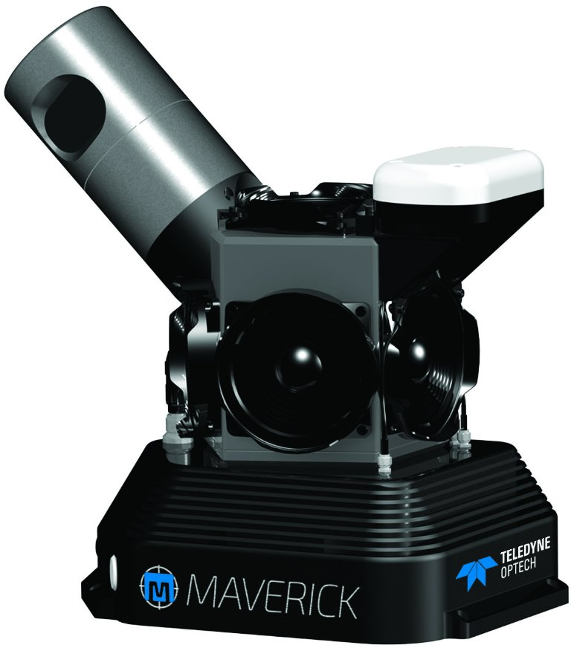
Scanning System
Optech Maverick Mobile Mapping System
http://www.teledyneoptech.com/index.php/product/maverick/

Slide 4
Comments ^{(1/2)}
Pio's comment on 'Set 7: Campus Walk'
Some buildings (e.g. York lanes - Student Centre, Student Centre - Vari Hall) have short indoor paths connecting them. These are important for us.
Kivanc's comment for open space movement
To make a turn from the area between chemistry and life science buildings might be preferred to capture a little pedestrian square to model the open space movements.

Slide 5
Comments ^{(2/2)}
Kivanc's comment on scanning priority
Scan Set 3, 4, 5, 6, and 7 could be set as priority, and then 8, 9 sample floors, and 1, 2 if time is tight.
Kivanc's comment on processing & file format
Asking for preprocessing ? postprocessing?
.las file?

Slide 6
Plan for Scanning Set
Set Number | Place | Type
1 | York Blvd Outdoor Loop | All Outdoor Path
2 | South York Blvd Building Corridor Loop | Indoor + Outdoor Path
3 | Student Centre | Indoor + Outdoor Path
4 | York Lane | Indoor + Outdoor Path
5 | Vari Hall | All Indoor Path
6 | Ross Building | All Indoor Path
7 | Campus Walk | All Outdoor Path
8 | PSE Building | All Indoor Path
9 | Chemistry Building | All Indoor Path

Slide 7
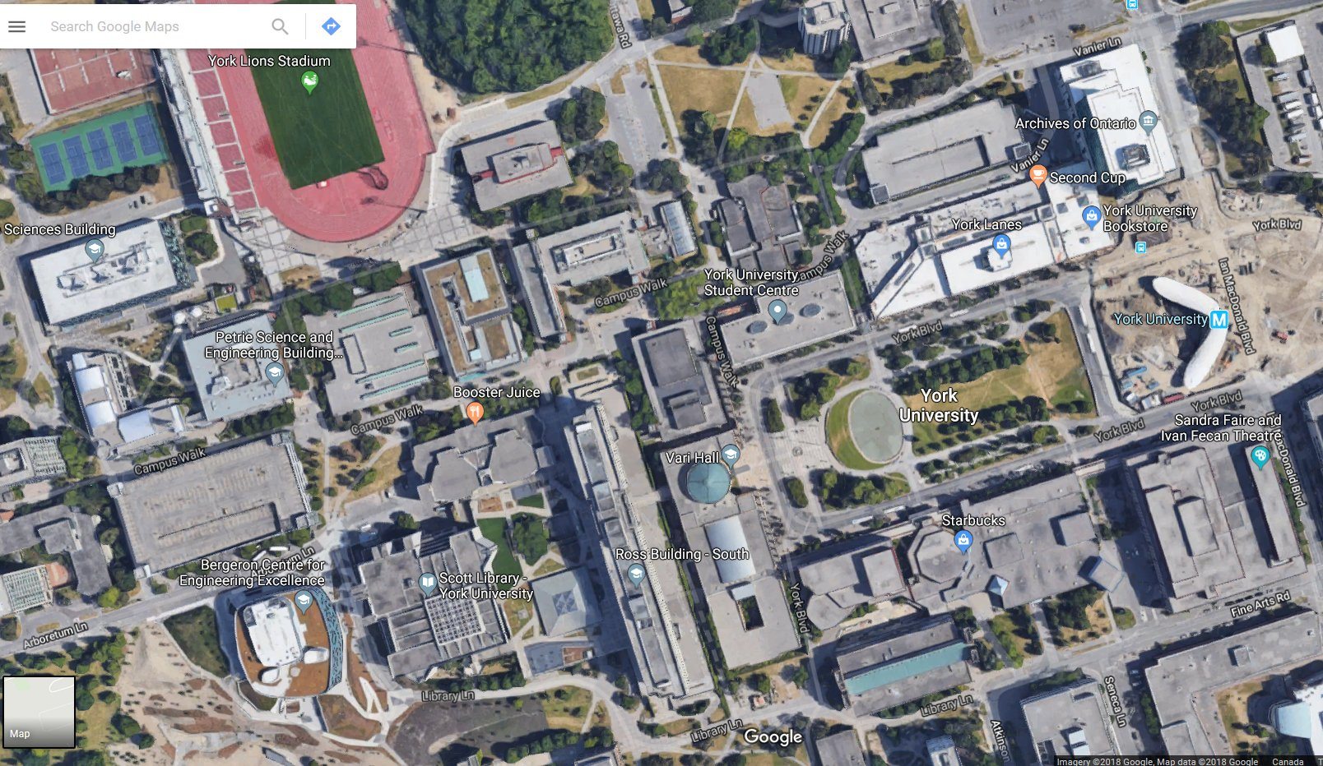
Set 1: York Blvd Outdoor Loop
Starting point
All Outdoor Path
Scanning the building wall outside.
Outdoor path
Indoor path

Slide 8
Set 2: South York Blvd Building Corridor Loop
Indoor + Outdoor Path

Slide 9
Set 3: Student Centre
Indoor + Outdoor Path
Including a corridor basically, and indoor space if possible

Slide 10
Set 4: York Lane
Indoor + Outdoor Path
Including all the corridors

Slide 11
Set 5: Vari Hall
All Indoor Path
Path: Not determined yet

Slide 12
Set 6: Ross Building
All Indoor Path
Path: Not determined yet

Slide 13
Set 7: Campus Walk
All Outdoor Path

Slide 14
Set 8: PSE Building
All Indoor Path
Scanning all floors (B, G, 2, 3, 4)

Slide 15
Set 9: Chemistry Building
All Indoor Path
Scanning all floors (G, 2, 3, 4)

Slide 16
Further Discussion
Issues for 8:40 AM (Mar 16) Meeting
Priority & sequence for scanning
Indoor Path for 'Set 5: Vari Hall', 'Set 6: Ross Building', 'Set 8: PSE Building', and 'Set 9: Chemistry Building'
Principal accompanying people
Originally plan - 8:40 AM: Kivanc, 10 AM: Pio, 11 AM: Kang, 2 PM: Yi-Chen, 3 PM: Afnan
However, it should be changed as Afnan has to join in the Thales meeting (~ 3 PM or late).

