Slide 1

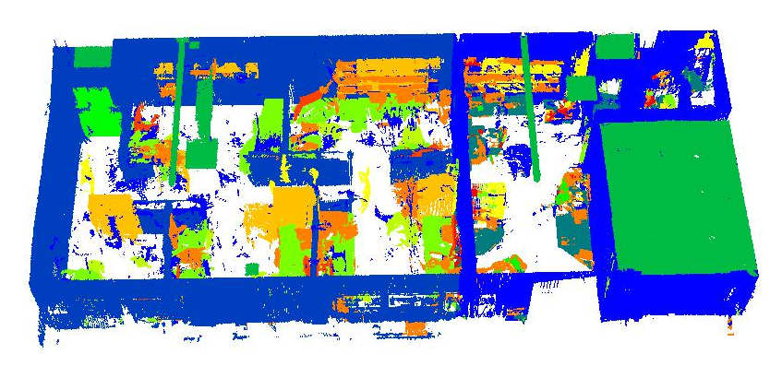

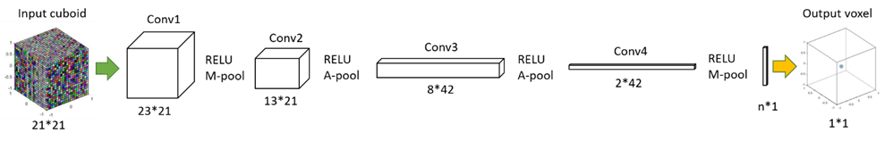
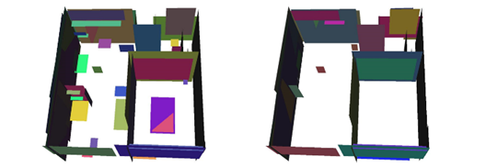
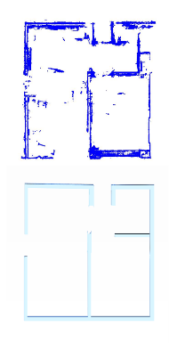
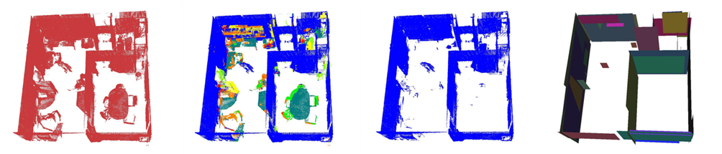
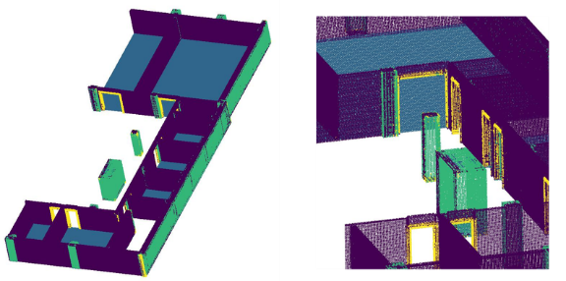
CONTAINED PLANAR EXTRACTION IN CLUTTERED INDOOR ENVIRONMENTS USING DEEP LEARNING
REPLACE THIS BOX WITH YOUR ORGANIZATION’S
HIGH RESOLUTION LOGO
K. Babacan, L. Chen, G. Sohn
Dept. of Earth & Space Science & Engineering, York University Toronto, M3J1P3 Canada –
(babacan, leihan, gsohn)@yorku.ca
Abstract
Method & Results
Discussion
As-built indoor modelling from point clouds highly relies on well extracted planar primitives in the first place. Although there are several recent works on established methods such as RANSAC and Hough Transform to improve their performance in the indoor environment, they easily brittle due to clutter and cannot generalize well in large and complex scenes.
Instead of working out towards another even more sophisticated planar extraction method, we propose to bring forward recent deep learning techniques to facilitate the processing of the existing methods. In particular, a convolutional neural network is trained on the scene to classify the point cloud into both its specific architectural elements such as wall, ceiling, door, and other furnished items like desk, chair, monitor, and so forth (Fig. 2b/3, Tab.1/2)
This approach enables to constrain the planar extraction problem only to the relevant semantic segments within the point cloud, hence improves the performance of existing extractors. We demonstrate some preliminary results both on real and synthetic point clouds and make a comparison to a baseline RANSAC implementation.
Deep Learning in 3D
y = f(x; θ, w) = φ(x; θ)^{T} ω (1)
f(x) = f^{(n)}(f^{(n-1)}….(f⁽³⁾(f⁽²⁾(f⁽¹⁾(x))) (2)
φ is the feature set learned through optimizing the parameters θ.
ω maps the feature set to the output.
Our motivation is the fact that planar extraction could become extremely challenging in indoor environments, especially in the presence of high clutter and occlusion (Fig.4a). We previously have circumscribed this problem by means of favourable slice selection (Babacan et al, 2016). However, this solution necessarily limits the information content into a narrow 3D, even convert the problem into 2D line extraction. Here, we present an alternative that could effectively be employed directly in 3D.
Figure 1. Our Convolutional Neural Network (CNN) has four main blocs, each having their respective convolution-pooling and activation layers. Input cube is fed into the network and the result of the soft-max layer is assigned to the centre voxel. n is the variable for the number of categories.
The architecture could be represented as;
C(w_{c1}; h_{c1}; d_{c1} ;f _{c1}) - P(w_{p1}; h_{p1}) –
C(w_{c2}; h_{c2}; d_{c2}; f _{c2}) - P(w_{p2}; h_{p2}) –
C(w_{c3}; h_{c3}; d_{c3} ;f _{c3}) - P(w_{p3}; h_{p3}) –
C(w_{c4}; h_{c4}; d_{c4} ;f _{c4}) - P(w_{p4}; h_{p4}) –
FC(n) - LR(n); (3)
where;
w, h, d, denotes width, height, depth of the layers.
f denotes the number feature maps.
FC(n) is the fully-connected layer with input size n,
LR(n) is the softmax layer with input size n.
Flowchart.
Figure 4. RANSAC planar extraction results; a) applied to the raw point cloud; b) applied to wall points detected by CNN. It can clearly be seen that the number of irrelevant planes is reduced c) CAD model digitized from the point cloud for quick reference.
Conclusions
Contained Planar Extraction
In this research we propose a viable method to extract semantic information for indoor modelling. A convolutional neural network is designed for 3D data to obtain semantic segmentation of indoor point clouds. Experimental results demonstrate that the methodology can adapt to different kind of datasets, both real and synthetic at various densities with categorical assortment. A simple example of how this semantic information can be deployed to mitigate the challenge of geometry modelling is given.
Contributions
Large-scale indoor point cloud classification:
We have acquired and prepared suitable datasets both real and synthetic, and 3D input–output relationships compatible with a simple, fast CNN architecture (Fig.1), and tuned our algorithm to train and run over a high number of points, and a floor size indoor space. (Fig.3)
Effective clutter removal based on semantics:
We have tackled the problem of clutter in indoor modelling by reframing it as a simple semantic filtering.(Fig.2c)
Demonstration of enhanced planar extraction:
Finally we demonstrate how geometry reconstruction can benefit from semantic segmentation with a case study of planar extraction enhancement in particular. (Fig.2d)
Figure 2. The input and outputs of the method; a) raw point cloud of the cluttered indoor environment; b) direct application of previously trained CNN classifier to the test site; c) selection of the wall points determined by the CNN; d) the result of the planar extraction, applied only to the corresponding wall points
Outlook
Table 1. Classification results for the real office point cloud
Table 2. Classification results for the large-scale synthetic data
class | wall | floor | beam | door
prec. | 94.68 | 93.97 | 42.12 | 76.58
recall | 85.61 | 99.74 | 67.74 | 55.61
First, the inherent class ambiguity issue should be tackled. This problem is closely related to dataset size and variations, hence indoor modelling research community needs to give emphasis on producing large datasets with diverse categories. Present datasets are mainly for small scenes and / or object oriented; the relation between the real environments deprived of prior segmentation information should be established. Finally, we advocate that a geometry modelling could benefit immensely by considering semantics, which we strive to further in future study.
confusion | wall | desk | chair | human | shelf | object | monitor | recall
wall | 1339110 | 8523 | 126 | 12714 | 28887 | 15105 | 2068 | 0.95
desk | 4593 | 72624 | 5122 | 49 | 276 | 11778 | 1246 | 0.76
chair | 1026 | 9045 | 22692 | 1627 | 685 | 12150 | 942 | 0.47
human | 6657 | 145 | 478 | 8602 | 496 | 4348 | 0 | 0.42
shelf | 104133 | 2030 | 10 | 2518 | 21983 | 7643 | 1192 | 0.16
object | 28655 | 18165 | 3934 | 4584 | 9608 | 37335 | 4858 | 0.35
monitor | 18919 | 2137 | 41 | 1 | 94 | 6532 | 4004 | 0.13
precision | 0.89 | 0.64 | 0.70 | 0.29 | 0.35 | 0.39 | 0.28 | Acc./ 0.81
Large-Scale
Semantic Segmentation
Figure 3. a) the result of the semantic segmentation, among a great majority of correctly labelled points, a façade wall is misclassified as a long beam; b) a close-up to the results, the door frames are recognized well.
Contact Information
References
Acknowledgements
Dr. Gunho Sohn
ESSE, York University
gsohn@yorku.ca
http://www.yorku.ca/gsohn/
Babacan, K., Chen, L., and Sohn, G.: Semantic Segmentation Of Indoor Point Clouds Using Convolutional Neural Network, ISPRS Ann. Photogramm. Remote Sens. Spatial Inf. Sci., IV-4/W4, 101-108, https://doi.org/10.5194/isprs-annals-IV-4-W4-101-2017, 2017.
Babacan, K., Jung, J., Wichmann, A., Jahromi, B. A., Shahbazi, M., Sohn, G., Kada, M. (2016). Towards Object Driven Floor Plan Extraction From Laser Point Cloud. International Archives of the Photogrammetry, Remote Sensing & Spatial Information Sciences, 41.
We wish to thank Applanix Company for providing the TIMMS mobile scanning, and pre-processing the point cloud. We are also grateful to Dr. Jungwon Kang for sharing the CAD model that enabled us to generate the synthetic data.

