Slide 1
Plan for Scanning-Day (Mar 16 2018)
Initially drafted by Jungwon & Kunwoo
Mar 14 2018

Slide 2
Overview
Schedule on Mar 16 (Fri) 2018
8:40 AM : Gathering at PSE Lobby
8:40 - 12:00 : Arrangement & Scanning
12:00 - 14:00 : Joining in Bruce's farewell party
14:00 - 16:00 : Scanning
Participants
ISSUM members: Pio, Yi-Chen, Afnan, Kang
Indoor modeling expert: Kivanc
Supporters: Jungwon, Kunwoo
Plan for Scanning
Total 9 sets

Slide 3
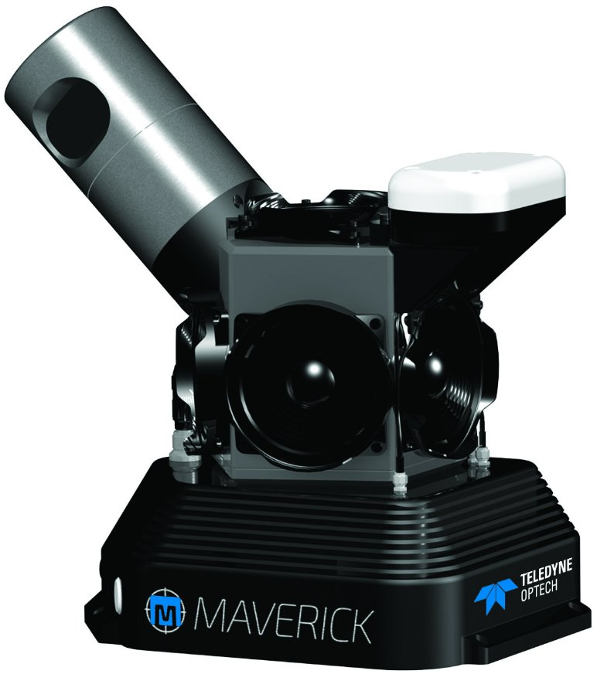
Scanning System
Optech Maverick Mobile Mapping System
http://www.teledyneoptech.com/index.php/product/maverick/

Slide 4
Plan for Scanning Set
Set Number | Place | Type
1 | York Blvd Outdoor Loop | All Outdoor Path
2 | South York Blvd Building Corridor Loop | Indoor + Outdoor Path
3 | Student Centre | Indoor + Outdoor Path
4 | York Lane | Indoor + Outdoor Path
5 | Vari Hall | All Indoor Path
6 | Ross Building | All Indoor Path
7 | Campus Walk | All Outdoor Path
8 | PSE Building | All Indoor Path
9 | Chemistry Building | All Indoor Path

Slide 5
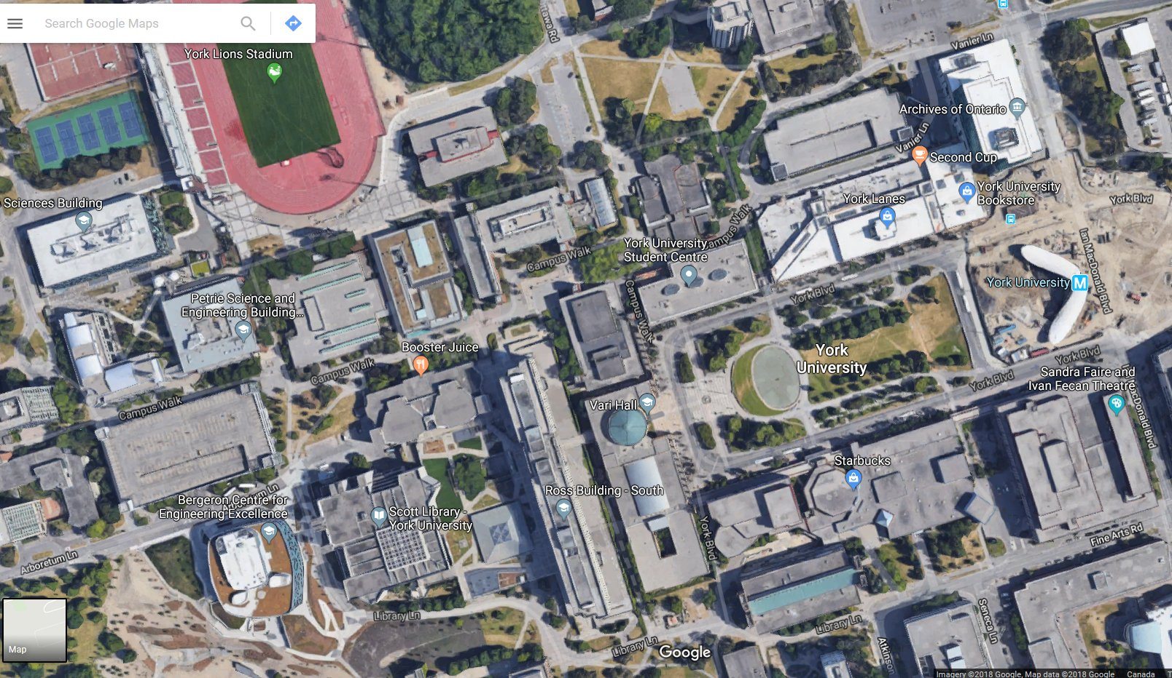
Set 1: York Blvd Outdoor Loop
Starting point
All Outdoor Path
Scanning the building wall outside.
Outdoor path
Indoor path

Slide 6
Set 2: South York Blvd Building Corridor Loop
Indoor + Outdoor Path

Slide 7
Set 3: Student Centre
Indoor + Outdoor Path
Including a corridor basically, and indoor space if possible

Slide 8
Set 4: York Lane
Indoor + Outdoor Path
Including all the corridors

Slide 9
Set 5: Vari Hall
All Indoor Path
Path: Not determined yet

Slide 10
Set 6: Ross Building
All Indoor Path
Path: Not determined yet

Slide 11
Set 7: Campus Walk
All Outdoor Path

Slide 12
Set 8: PSE Building
All Indoor Path
Scanning all floors (B, G, 2, 3, 4)

Slide 13
Set 9: Chemistry Building
All Indoor Path
Scanning all floors (G, 2, 3, 4)

