Slide 1
Weekly Lab Meeting
07TH FEBRUARY,2019

Slide 2
Agenda
CRD demo
Graduate Development Fund Application
Scholarships
Website
Suggestion on Lab Interiors and Space for New Members

Slide 3
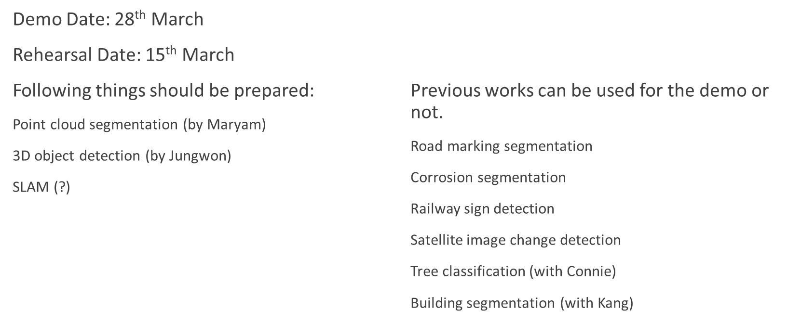
CRD Demo

Slide 4
Graduate Development Fund
Application Deadline is 28th Feburary, 2019
Apply in case you are publishing paper at some conference and have received acceptance.
Following link has all details:
http://gradstudies.yorku.ca/current-students/student-finances/funding-awards/graduate-development-fund/

Slide 5
Scholarships
Dr. Ralph Nicholls Graduate Scholarship (Deadline 15th February)
Enbridge Graduate Student Awards (Deadline 15th February)
Elia Scholars Program (Deadline 15th February)
Mamdouh and Susan Shoukri Graduate Award (Deadline 15th Feburary)
Graduate Fellowship for Academic Distinction (GFAD) (Deadline 18th March)

Slide 6
Linked in Photo booth
11th February, 2019 for Professional Photograph
Mini workshop 12:30

Slide 7
Lab’s website
Separate Website for our research group
Separate sections for subgroups
Frequent Updates
Content Ideas

Slide 8
Suggestion on Lab Interiors and Space for New Members
Desk space for New Members
Options: PSE 312 – Kaneff Tower – Schulich Basement

