Slide 1






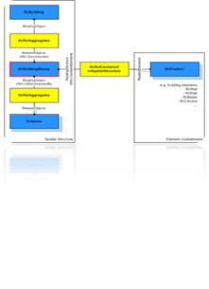
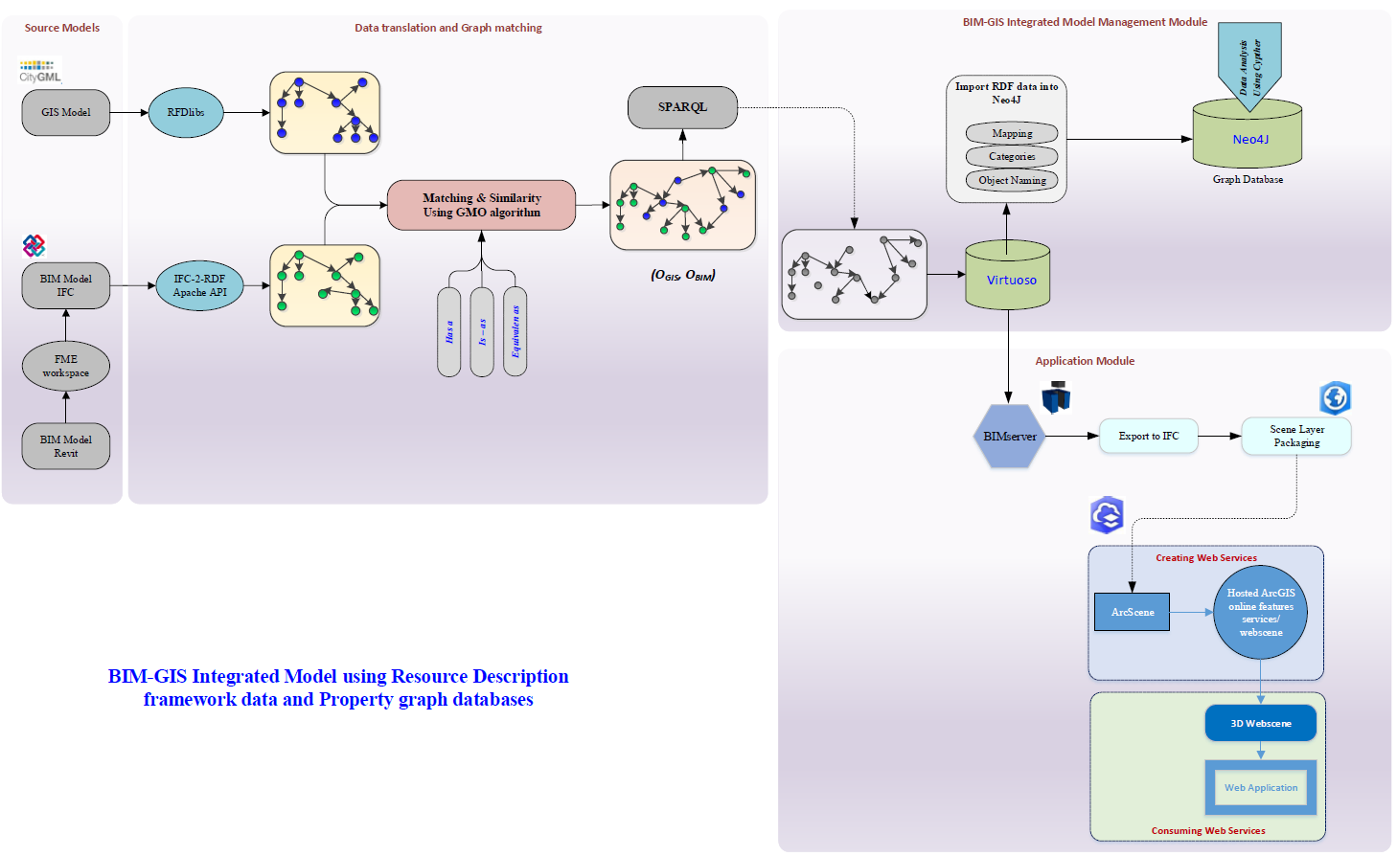

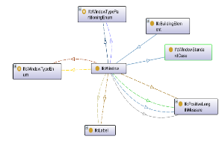
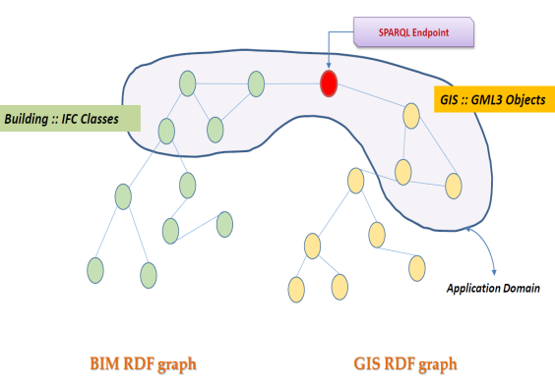
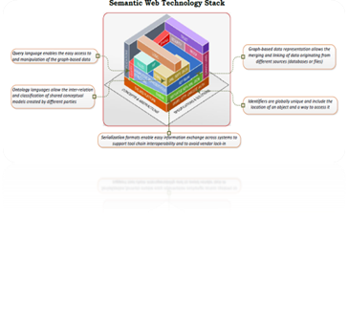

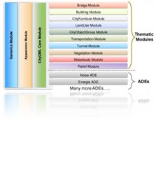


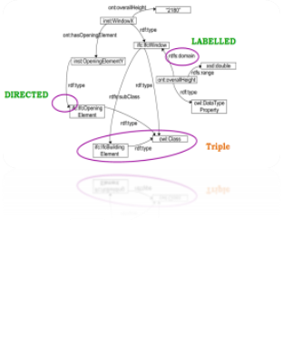

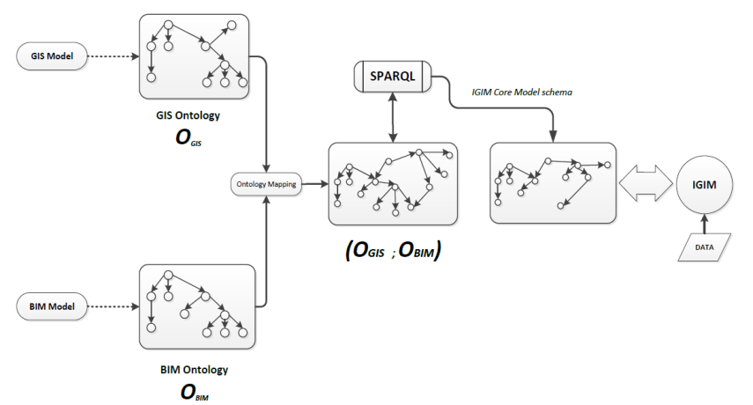
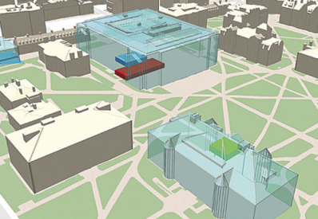

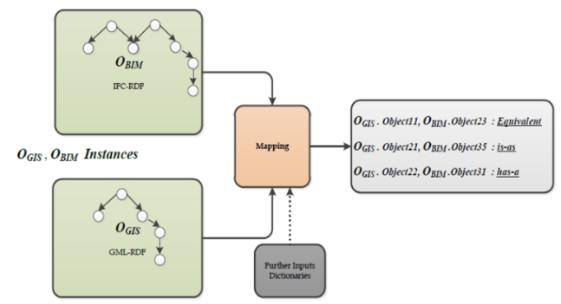




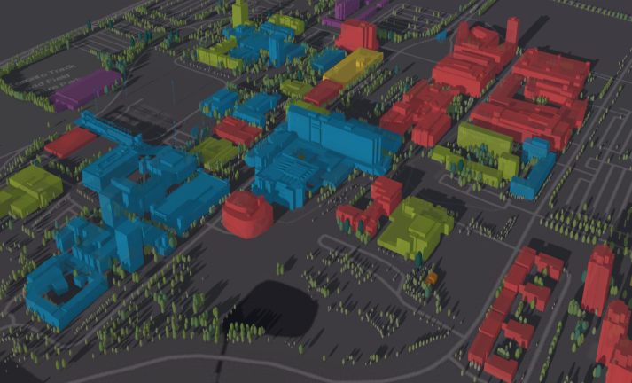
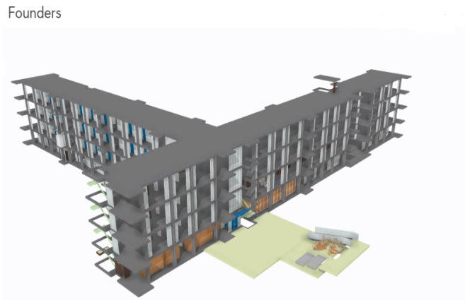
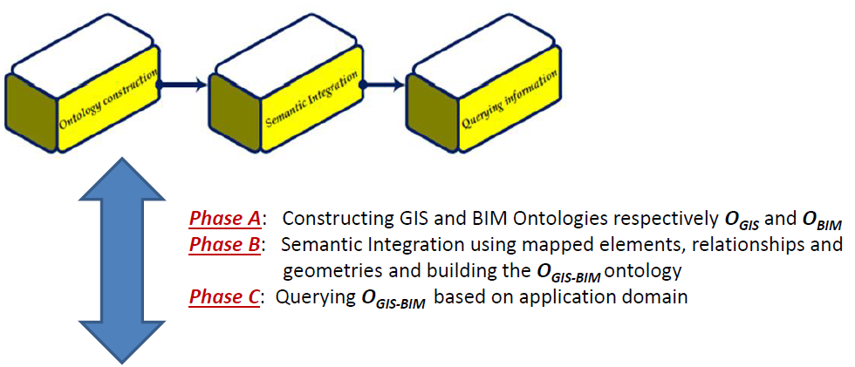
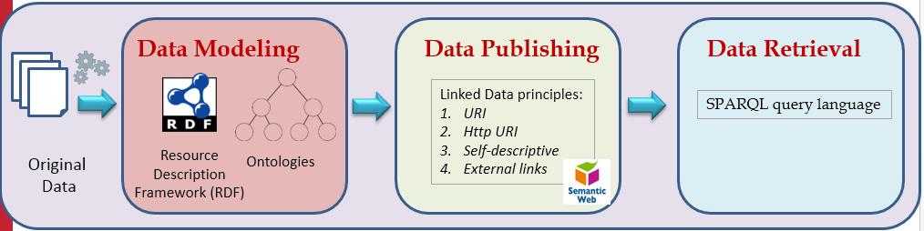
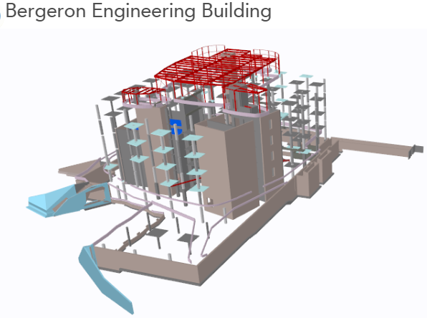
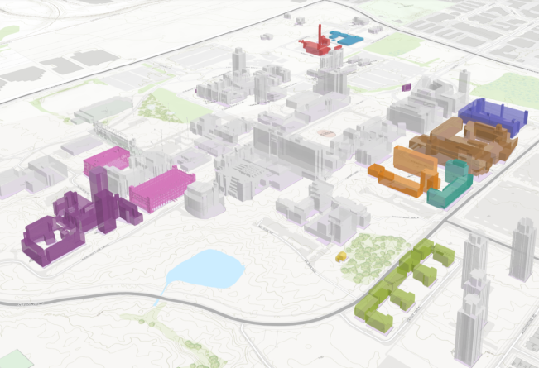

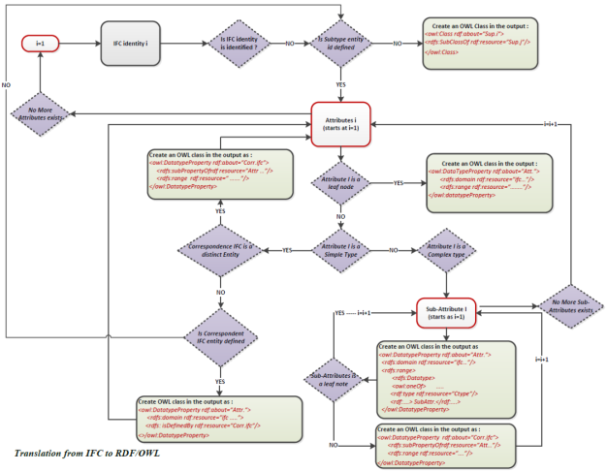
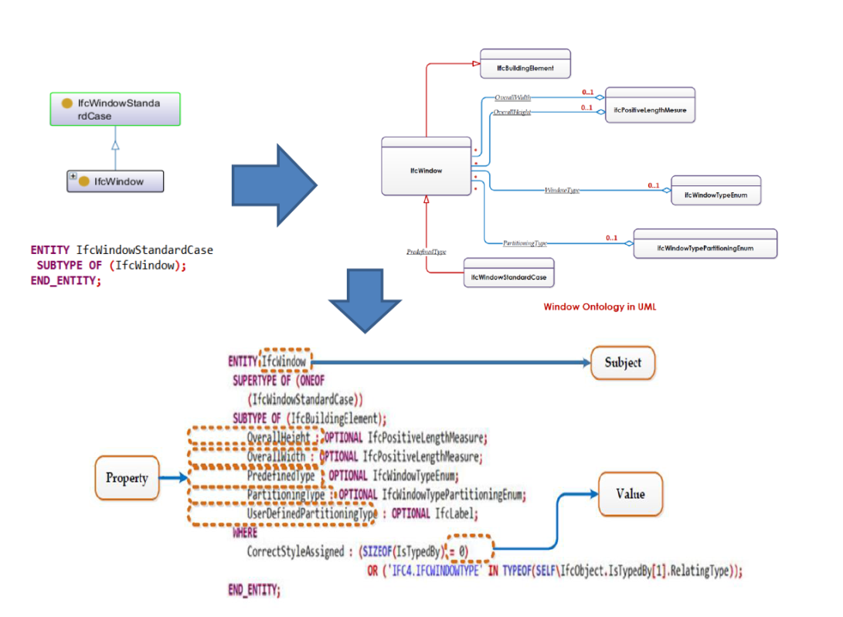

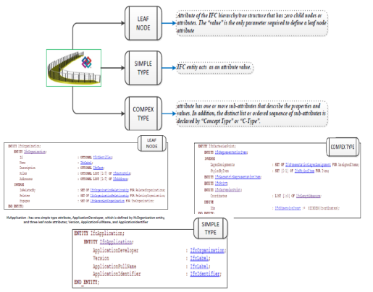

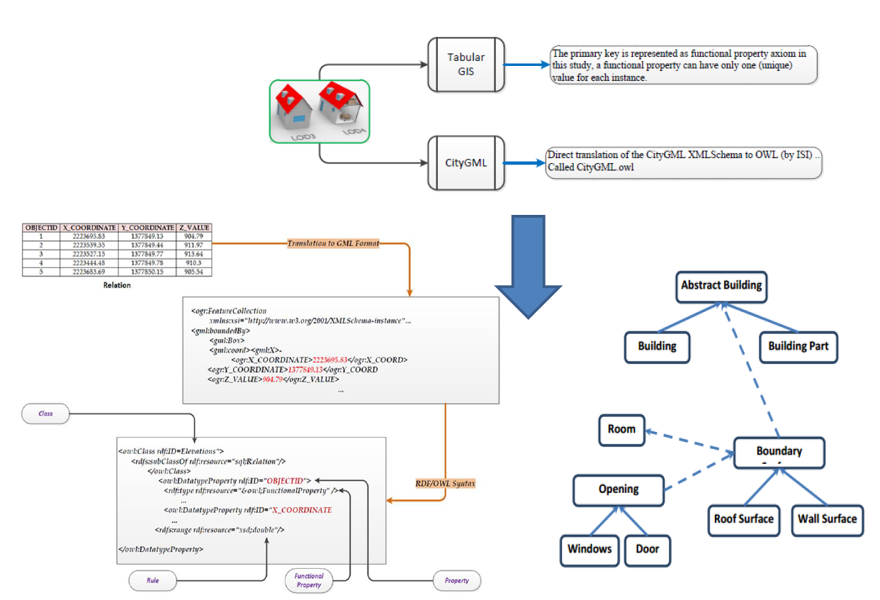

Integrating BIM and GIS models using semantic web technologies and RDF graph databases
A.El-Hadi Hor, Gunho Sohn
Geomatics Engineering, Depart. Of ESSE, York University,
4700 Keele St., North York, ON M3J 1P3 - {elhadi, gsohn}@yorku.ca
Association of Ontario
Land Surveyors
Abstract
3D virtual indoor/outdoor urban modelling becomes a key spatial information framework for many civil, and military engineering applications and decision support systems (DSS) such as evacuation planning, emergency and facility management, to accomplish such sophisticated decision tasks, a large demands for buildings multi-scale and multi-sourced 3D urban models, and building information model (BIM) and geographical information systems (GIS) are used as modelling sources. However, data sharing, exchanging and integration of information between these two domain models is still a huge challenge, this research is proposing a new approach for integrating BIM and GIS using semantic web methodologies and resources description framework (RDF) graphs, the new integrated Geospatial information Model (IGIM) will consist of three modules a RDF_{BIM} , RDF_{GIS} graphs as well as the Semantic web technologies.
The IGIM generates queries from both the BIM and GIS graphs resulting a semantically integrated model with entities representing both BIM classes and GIS feature objects with respect to the target-client application. The linkage between BIM-RDF and GIS-RDF is achieved through SPARQL endpoints and defined by a query using set of datasets and entity classes with complementary properties, relationships and geometries. To validate the proposed approach and its performance, a case study was also tested using IGIM system design.
1
3
Introduction
BIM-GIS Integrated Information Model – End-to-End System Architecture
IFC to RDF
Ontology Engineering for a BIM-GIS integration
Triples Selection :
Equivalent : Object A (from GIS) is Equivalent to Object B (from BIM).
An object A is taken into a resulting ontology as-is to avoid redundancy or because of As-is richness of its semantics.
Object A has a attributes needed by object B.
classification rules:
Discarding of triples from either BIM
if : redundant or semantically worthless
Merging: entities in the RDF bipartite graph as semantically equivalent or same.
Inference: to help structural comparison i.e. a transitive statement using inverseOf and rdfs:domain that can be added to one unique triple.
Experimental Results
4
Accurate of building models
2
A Facility management application has been studied to evaluate the integration Model using BIM models of Buildings and the 3D datasets (including trees) from York University Keele Campus
Ontological integration Model Construction
Modeling Workflow
As study site, classrooms, corridors, exit doors, and stairwells are stored as IFC objects. The outdoor objects such as road pedestrian paths, vegetation area, etc. are extracted as CityGML objects.
The components of IFCSpace and IFCStairs are retrieved from BIM data and the rest are extracted from GIS data, calculating the evacuee’s path to evacuee’s building
IFC Ontology Representation
5
Conclusion
This research presented a highest level of integration between BIM and GIS data by introducing a new way of formatting and processing data using semantic web technologies and RDF graphs. The novelty of the proposed solution refers to the benefits of both BIM and GIS technologies together into one integrated model, called, IGIM.
Using the GMO mapping algorithm with well-established classification rules, the IGIM offers the flexibility to access and process datasets from GIS and BIM through RDF directed graph, while there is no need to establish direct links between various terminologies that are represented in objects and classes only by cruising between them. IFC and CityGML were translated into IFC-RDF and GIS-RDF graphs, while the integration of both graphs was done at semantic level and data is managed using Neo4J graph database.
GIS Ontology Representation
6
Acknowledgements
…
A special thanks to CSBO department of York University for providing BIM data, to the Geospatial data centre at York university for providing the GIS data, and to members at GeoICT Lab for their help and support.

