Slide 1

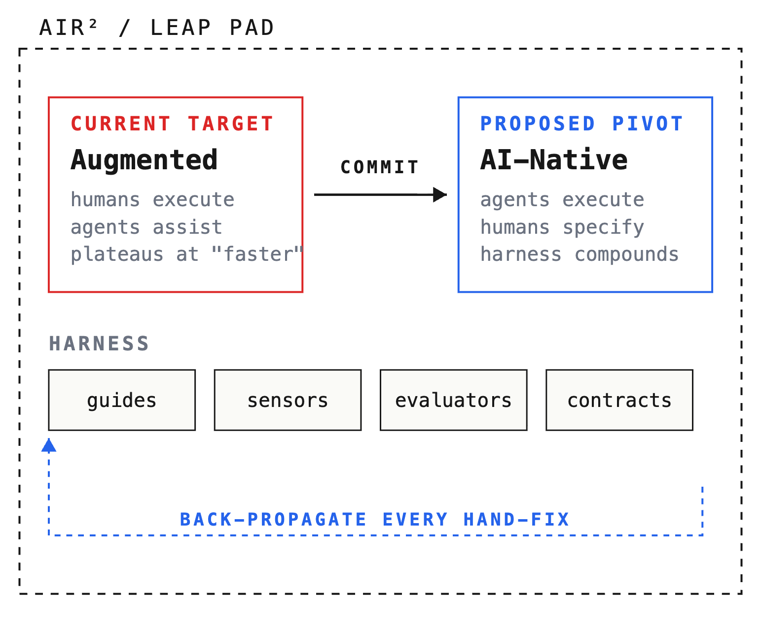
FIG. 00 — PROPOSAL SCHEMATIC
APRIL 2026
PROPOSAL 01 / AIR²
The AI-native jump.
Why AIR² is the where the first fully AI-native team at Payoneer should live.
YONATAN ORPELI
RUNTIME / ~18 MIN
01 / 08

Slide 2
/ AI-NATIVE PROPOSAL
§01 — THE PRIMITIVE IS WRONG
02 / 08
THE ARGUMENT
Stop sizing teams by headcount. Start sizing by value unit.
The value unit is the smallest autonomous cell that delivers a measurable business outcome end-to-end, on an ongoing basis. Size follows. Shape follows.
CURRENT PRIMITIVE
PROPOSED PRIMITIVE
Headcount
Value unit
PLAN BY
PLAN BY
the smallest number of humans we can put in a team
the shape that delivers the outcome, on an ongoing basis
ASSUMES
ASSUMES
the shape of the team is fixed in advance
size and shape are outputs of the work, not inputs

Slide 3
/ AI-NATIVE PROPOSAL
§02 — SKIP AUGMENTED, GO NATIVE
03 / 08
THE ARGUMENT
To lead, we skip Augmented and go AI-Native.
A
B
C
WHERE WE ARE
THE TEMPTING MIDDLE STEP
WHERE WE'RE GOING
Manual
Augmented
AI-Native
WHO EXECUTES
humans
WHO EXECUTES
humans (agents assist)
WHO EXECUTES
agents (humans specify)
AGENTS
not in the loop
AGENTS
copilots, drafts, snippets
AGENTS
planner · generator · evaluator
CEILING
human throughput
CEILING
"faster" — same shape
CEILING
compounds with every ship
Today's default. Status quo, not a strategy.
Faster today. Same roles, same handoffs. No compounding.
Different shape. Every ship compounds.

Slide 4
/ AI-NATIVE PROPOSAL
§03 — THE COMMITMENT
04 / 08
TARGET STATE
100% machine-owned execution.
Humans still decide. They stop producing the output.
MACHINES OWN
HUMANS OWN
code
produce PRs, refactor, migrate
intent
specify what "done" looks like
tests
generate, extend, harden
evaluators
tune criteria, override when wrong
documentation
write, update, cross-reference
decisions
review at go/no-go points
bug triage
triage, identify, fix, deploy
human contract
relationships, careers, culture
operations
deploys, routine remediation, on-call runbooks
NORTH-STAR METRIC
% hand-authored code — trending ↓ week over week

Slide 5
/ AI-NATIVE PROPOSAL
§04 — THE FORCING FUNCTION
05 / 08
WHY 100%, NOT "MOSTLY"
The 100% target is a forcing function, not a purity test.
OPTION A — HAND-FIX
OPTION B — BACK-PROPAGATE
Faster today
Cheaper tomorrow
Wins every individual task
Add a guide, sensor, or evaluator
Cheaper on that one task
Next failure of that class is caught
Never compounds
Every ship accumulates
Without the commitment, engineers type code when it's faster and the team drifts back to augmented. The hard commit is what forces us to find exactly where the agent falls short, and invest there.

Slide 6
/ AI-NATIVE PROPOSAL
§05 — THE FRONTIER HAS MOVED
06 / 08
EXTERNAL SIGNAL
Three serious organizations. Converging vocabulary. An 8-week window.
PRODUCT
PATTERNS
VOCABULARY
OpenAI
Anthropic
Thoughtworks
0 1
~1M lines of code
0 1
planner agent
0 1
guides (prevent)
0 2
5 months · 3 engineers (now 7)
0 2
generator agent
0 2
sensors (detect)
0 3
evaluator agent
0 3
runtime constraints
0 3
zero hand-written code
sprint contracts
harness
0 4
0 4
0 4
~1,500 PRs shipped
strip complexity as models improve
next-gen service template
0 5
0 5
0 5
3.5 PRs / engineer / day
CONVERGES ON
planner · generator · evaluator · guides · sensors · harness
PATTERN · NOT HYPE

Slide 7
/ AI-NATIVE PROPOSAL
§06 — WHY AIR² IS THE LEAP PAD
07 / 08
THE HOST
AIR²'s charter removes the three things that force teams back to augmented.
0 1
0 2
0 3
LEGACY
BLAST RADIUS
SHIPPING
No Payoneer-stack dependency
Bounded by charter
Real production, real cycles
Fast Keep/Toss cycles tolerate the unavoidable agent-led mistakes.
Agents can redesign the environment without blockers.
The forcing function only bites if code actually ships.

Slide 8
/ AI-NATIVE PROPOSAL
§07 — WHAT IS ALSO TRUE
08 / 08
HONEST DISCLOSURE
This is a bet. AIR² is the cheapest place to run it.
THE STRUCTURE OF THE BET
CAVEAT — THE EVIDENCE IS FROM LABS
Frontier signal comes from AI labs building AI products. Payoneer is neither. The pattern may not transfer cleanly to a regulated payments domain.
Cheapest
experiments would have run anyway
Safest
no legacy coupling, bounded blast radius
Fastest feedback
Keep/Toss cycle tells us quickly
OUR COMMITMENT
If the pattern breaks on a real Payoneer domain, we revise the thesis and say so — publicly.
Reversible
if it breaks, we revise and say so
— END OF PROPOSAL —
YONATAN ORPELI · APRIL 2026

