Slide 1

Thermal radiative properties of alternating-layer topological insulators: Bi2Se3 and Bi2Te3
Metamaterials are artificially created materials that exhibit unorthodox electromagnetic properties.
In the recent years, stratified nano-structures based on the topological insulators (TI) have attracted a lot of attention and have been heavily studied due to their unique characteristics – behaving as insulator in the bulk, while being conductors on the surfaces and edges. Such topological insulators as Bismuth Selenide (Bi2Se3) and Bismuth Telluride (Bi2Te3) can be of a great interest in thermoelectrics, nanomedicine, energy harvesting, spintronics and quantum computers.
The presentation will bring better understanding on how morphology of the nano-structures can govern the choice of the approximation methodology and serve as tool to simulate Fresnel coefficients of the topological insulators for the scientific community.

Slide 2
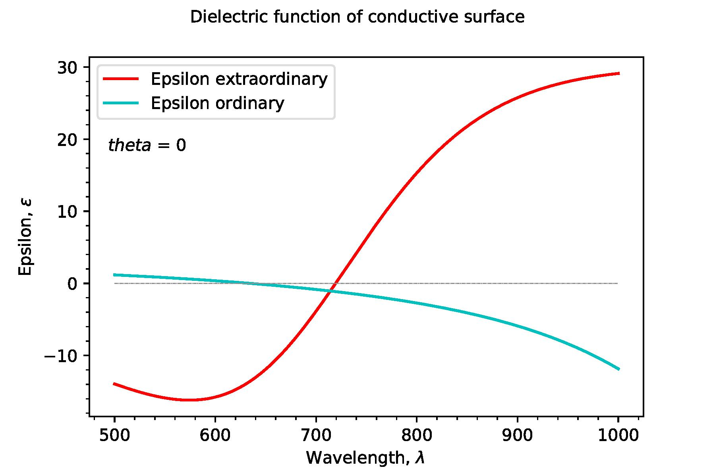
TMM results 1
(Epsilon_E and Epsilon_O of conducting surface)

Slide 3
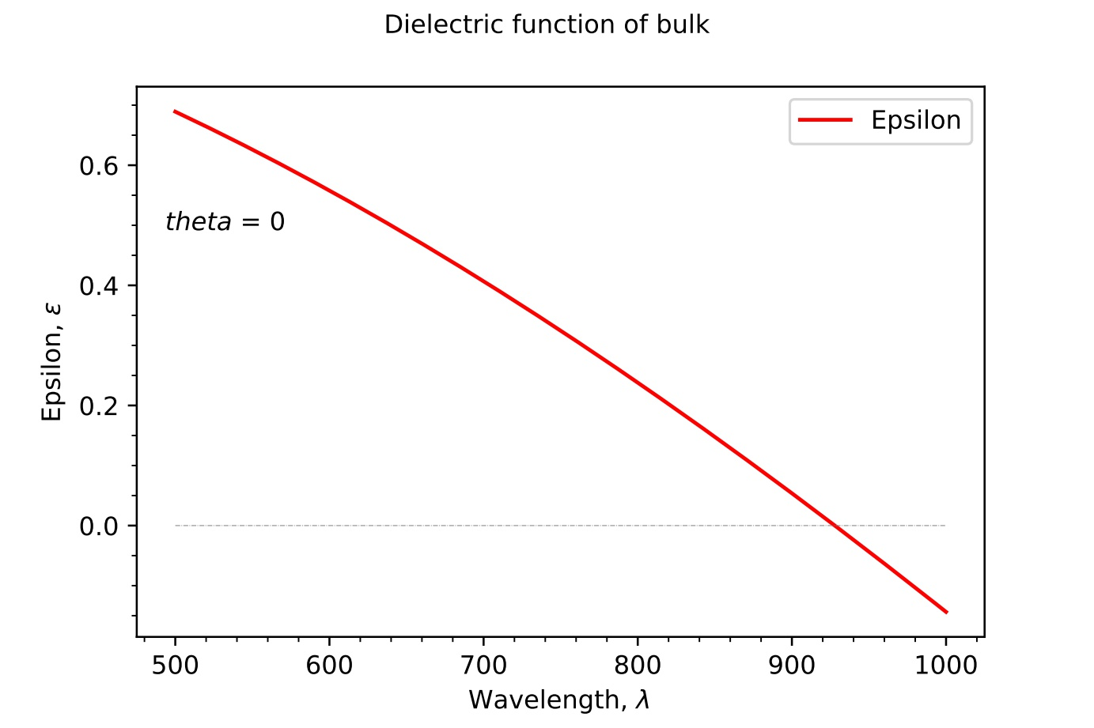
TMM results 2
(Epsilon of bulk part using 3-mode Lorentz-Drude oscillator)

Slide 4
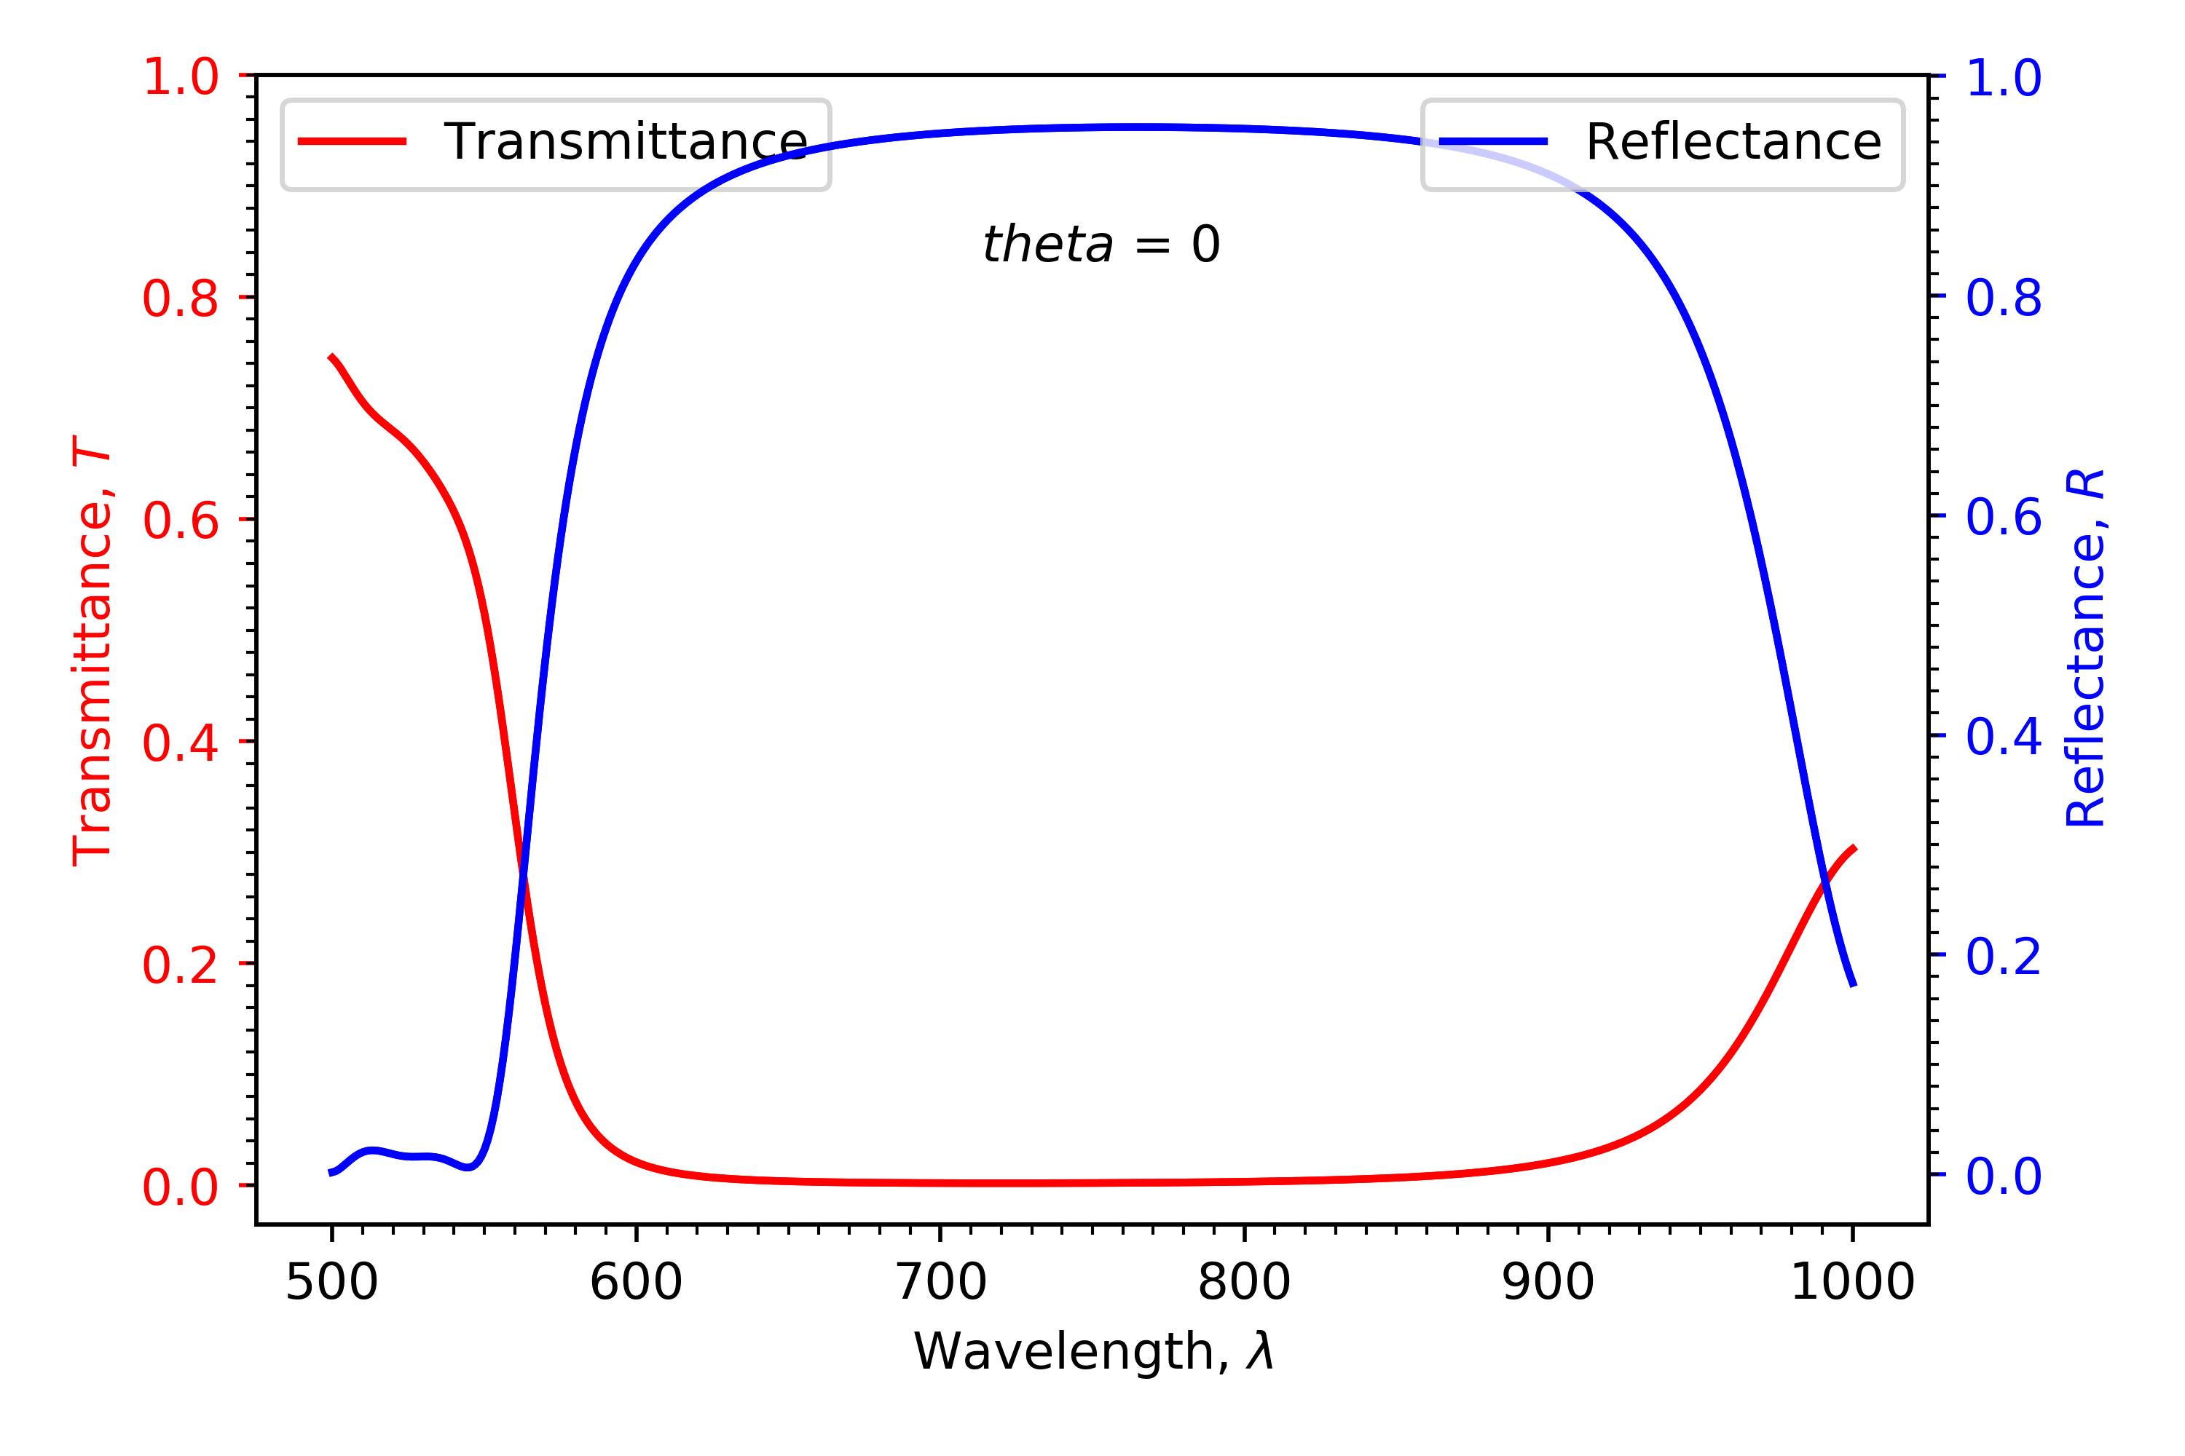
TMM results 3
(Plot of reflectance and transmittance over a range of wavelengths)

Slide 5
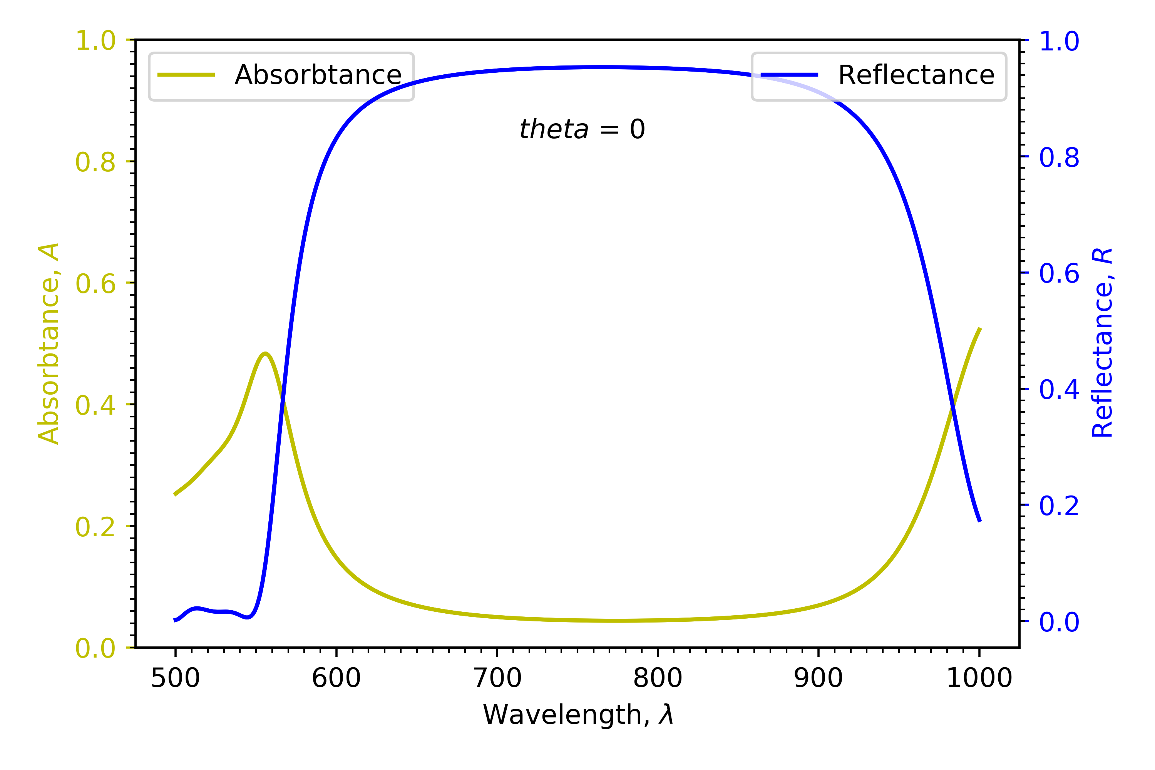
TMM results 4
(Plot of reflectance and absorbtance over a range of wavelengths)

Slide 6
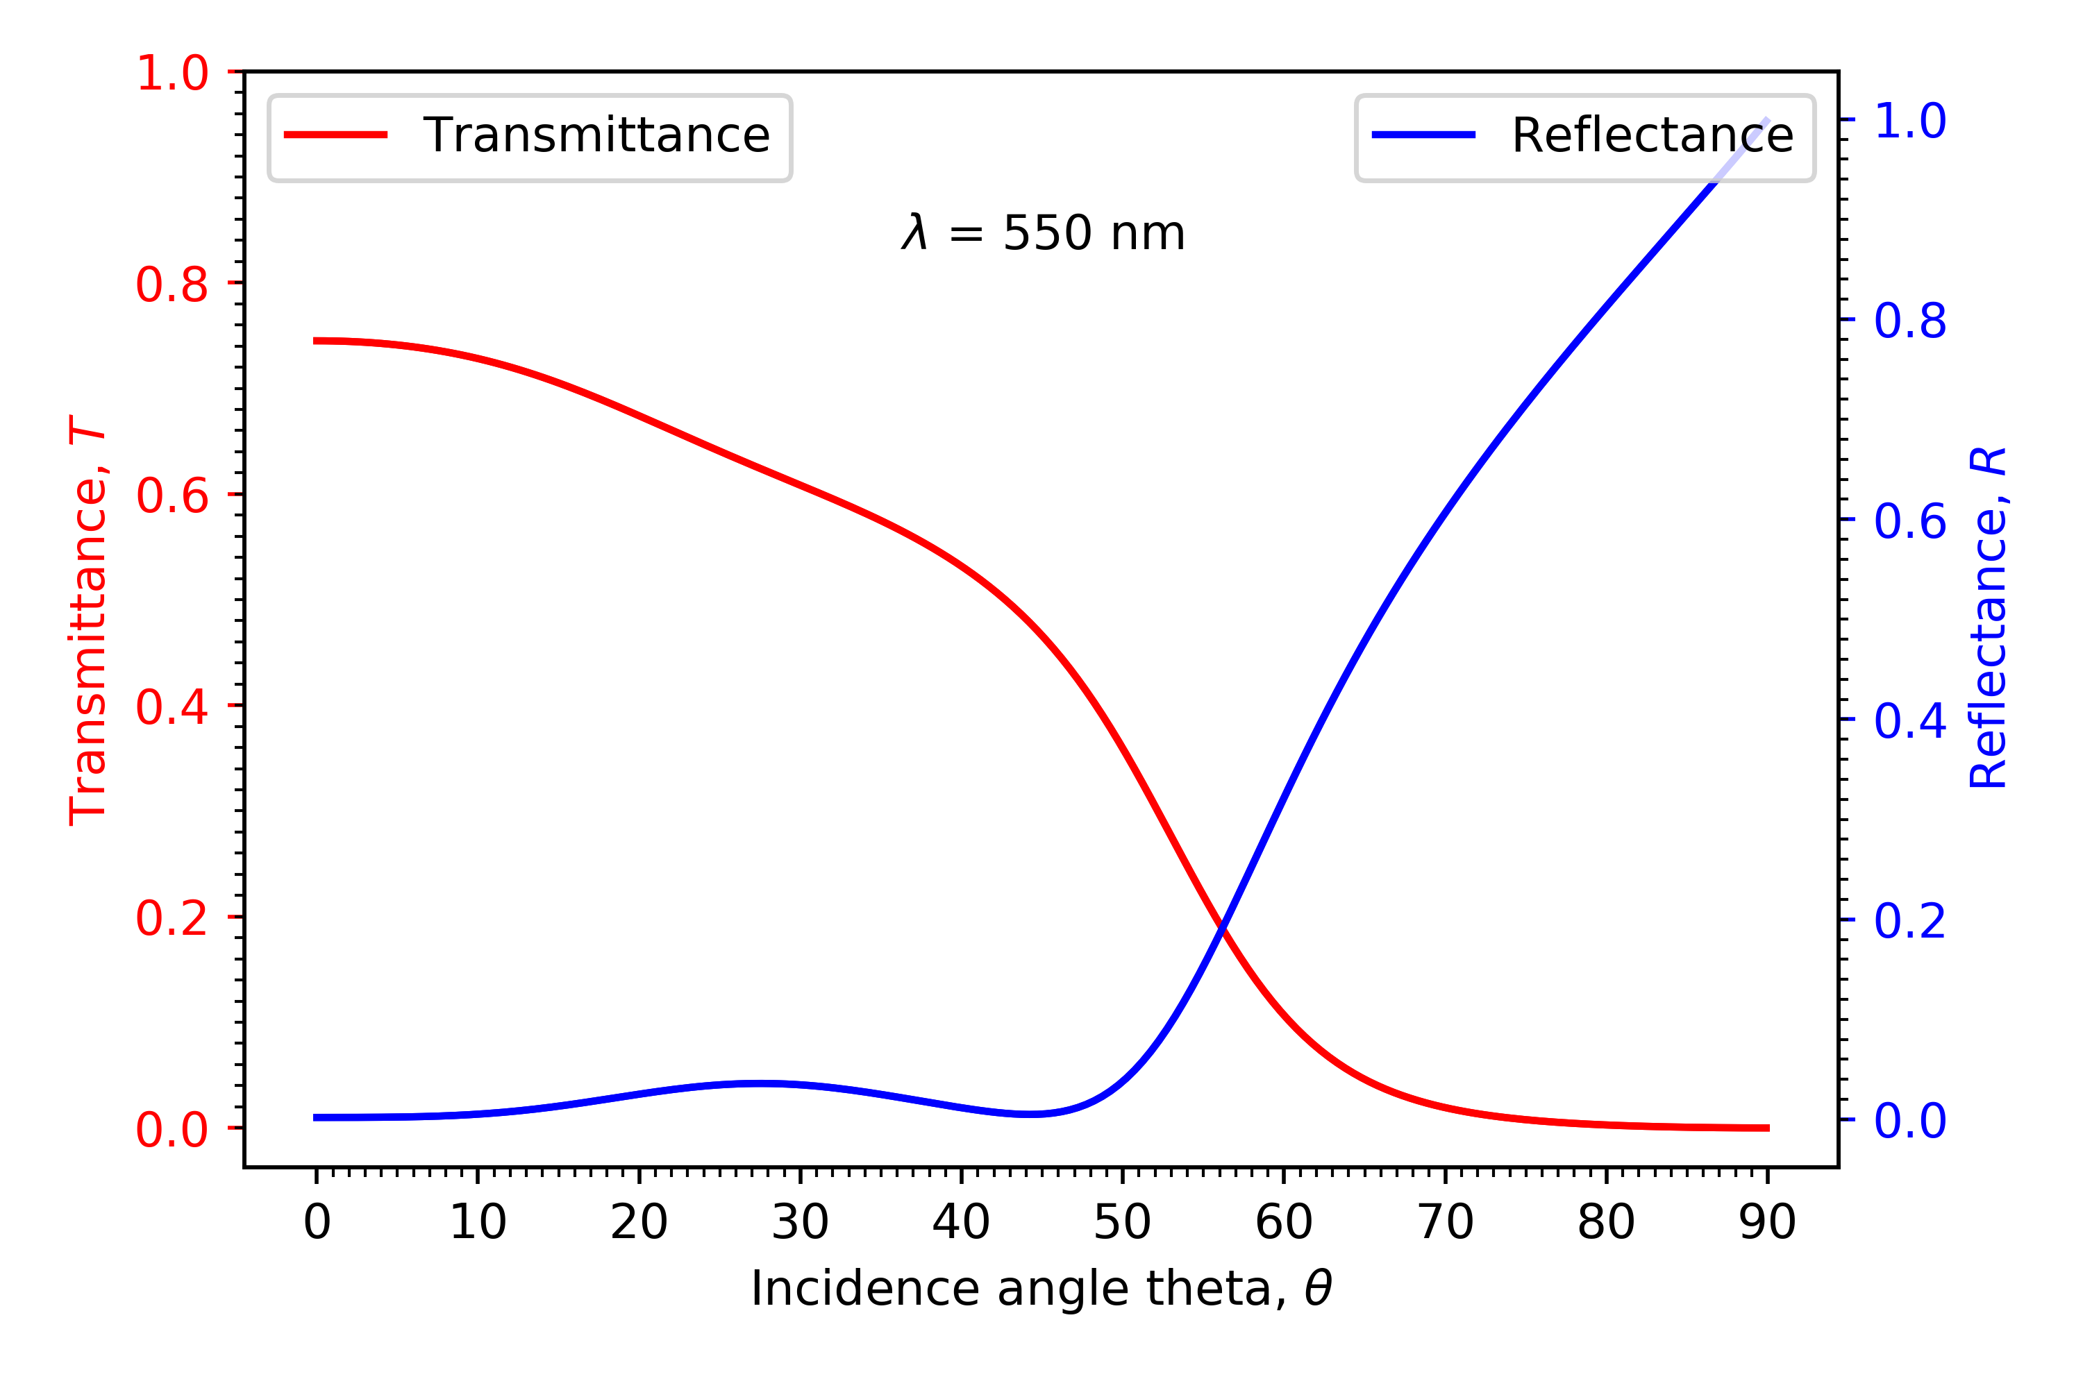
TMM results 5
(Plot of reflectance and transmittance for a range of incidence angles)

Slide 7
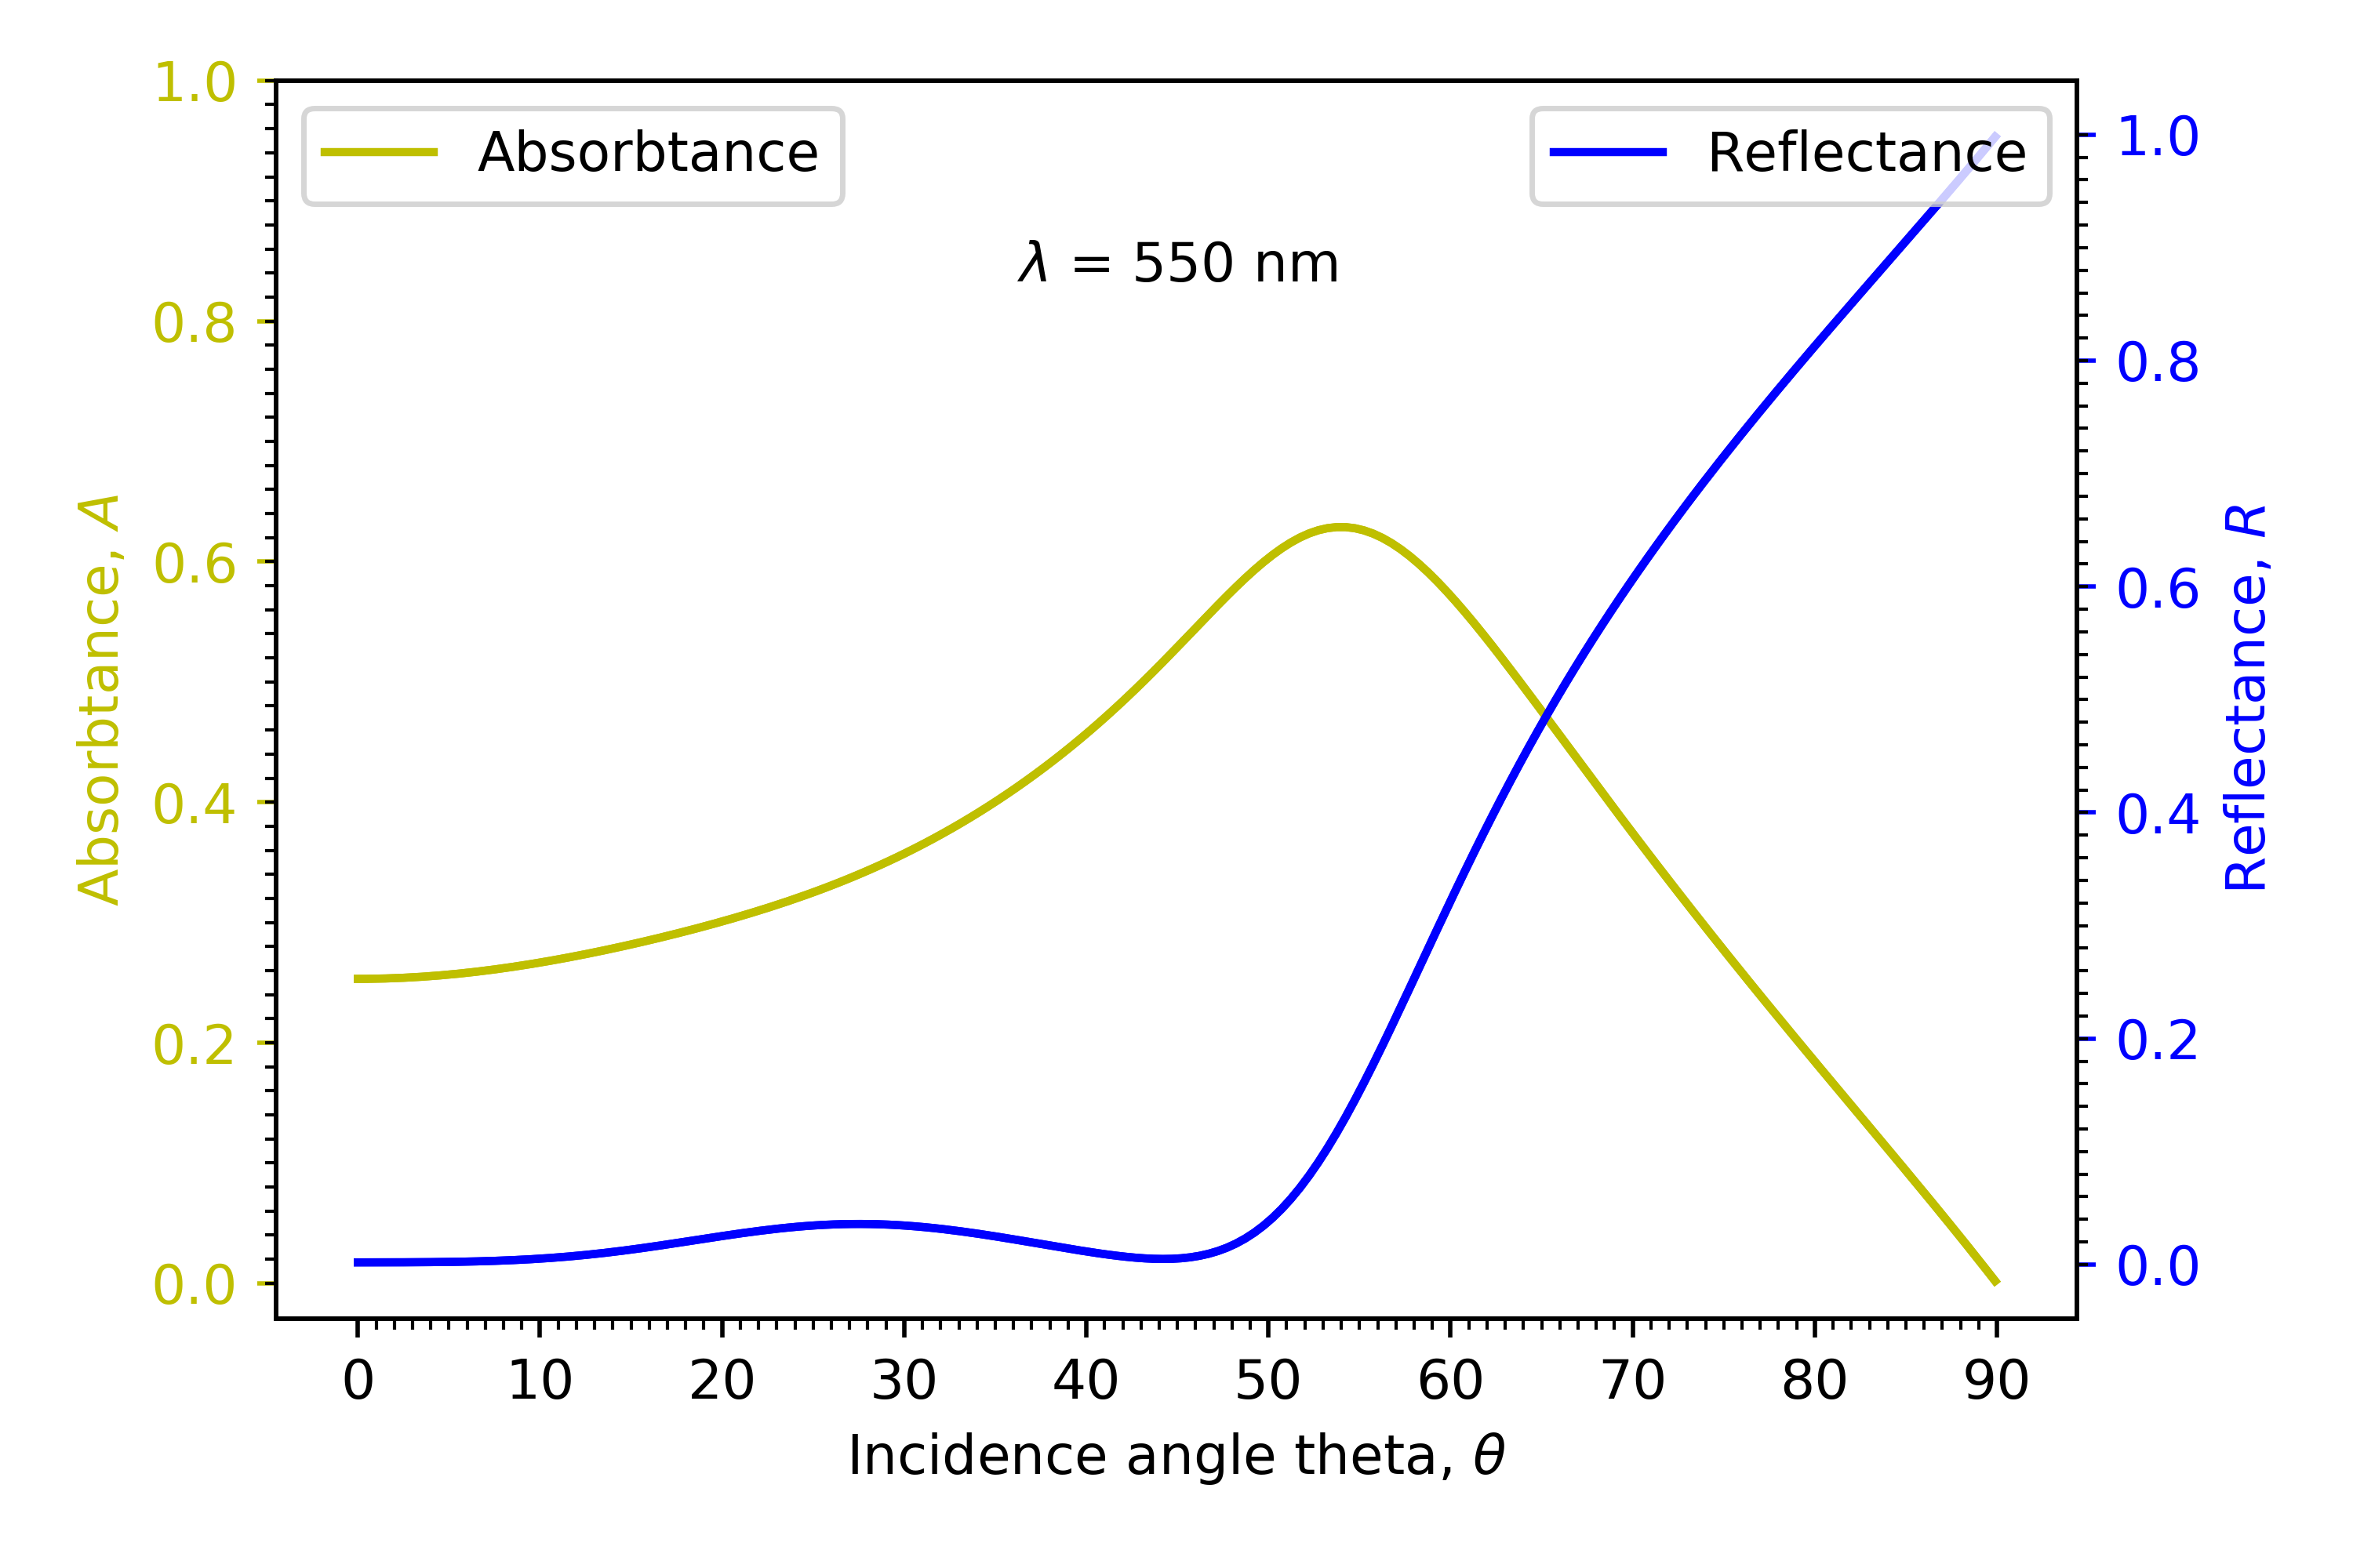
TMM results 6
(Plot of reflectance and absorbtance for a range of incidence angles)

