Slide 1

Thermal radiative properties of alternating-layer topological insulators: Bi2Se3 and Bi2Te3
Metamaterials are artificially created materials that exhibit unorthodox electromagnetic properties.
In the recent years, stratified nano-structures based on the topological insulators (TI) have attracted a lot of attention and have been heavily studied due to their unique characteristics – behaving as insulator in the bulk, while being conductors on the surfaces and edges. Such topological insulators as Bismuth Selenide (Bi2Se3) and Bismuth Telluride (Bi2Te3) can be of a great interest in thermoelectrics, nanomedicine, energy harvesting, spintronics and quantum computers.
The presentation will bring better understanding on how morphology of the nano-structures can govern the choice of the approximation methodology and serve as tool to simulate Fresnel coefficients of the topological insulators for the scientific community.

Slide 2
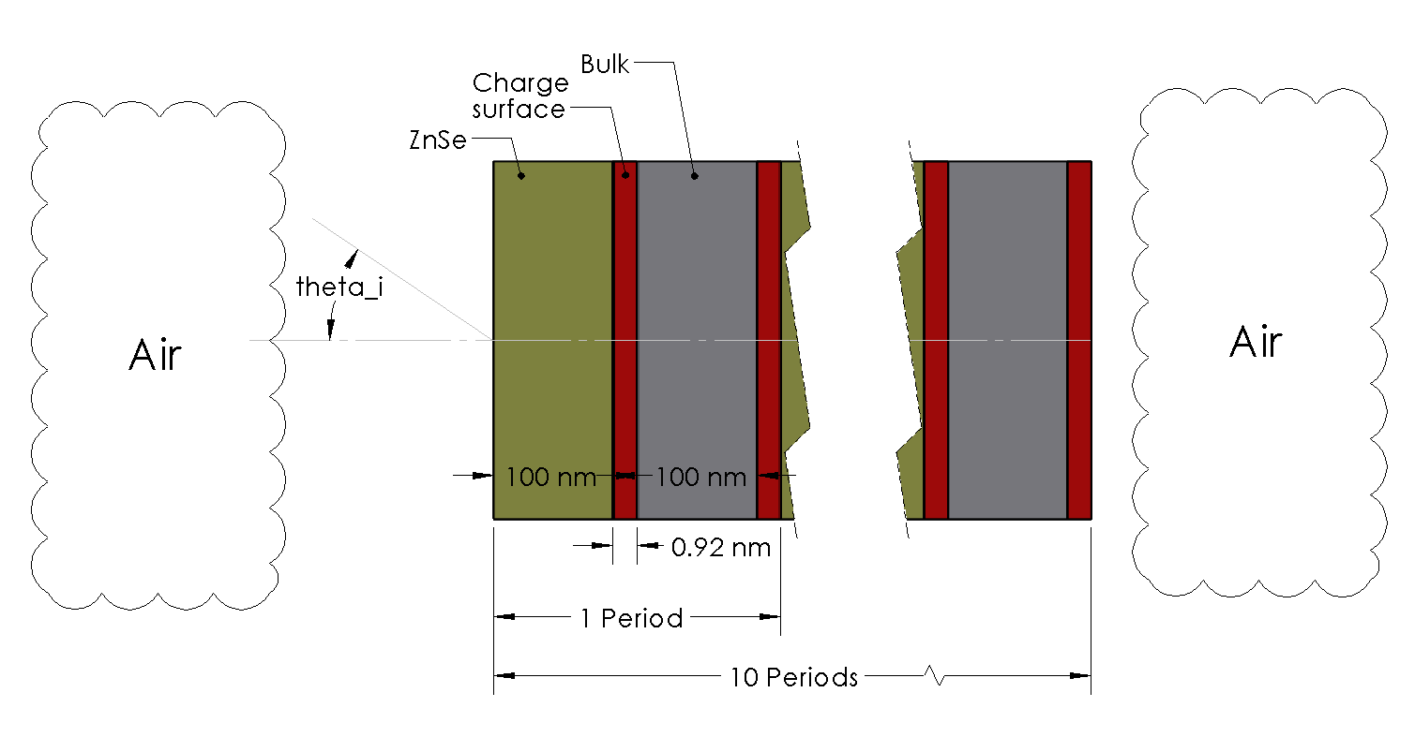
Schematic of Nano Structure

Slide 3
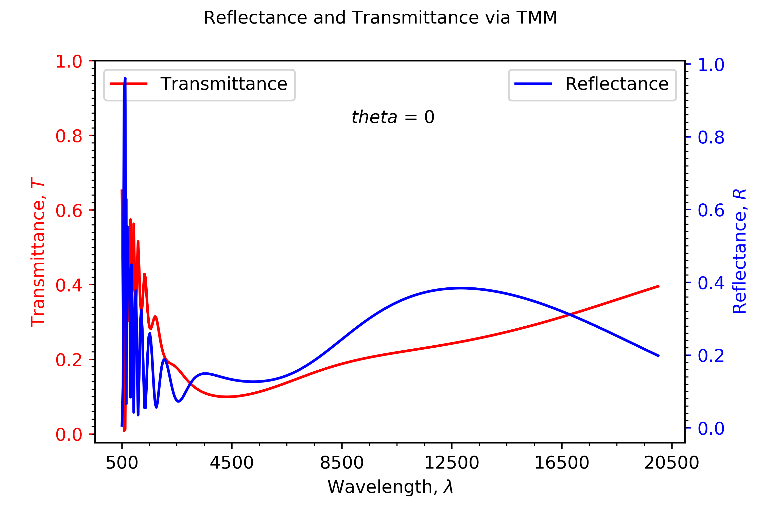
TMM results1
(Plot of reflectance and transmittance over a range of wavelengths)

Slide 4
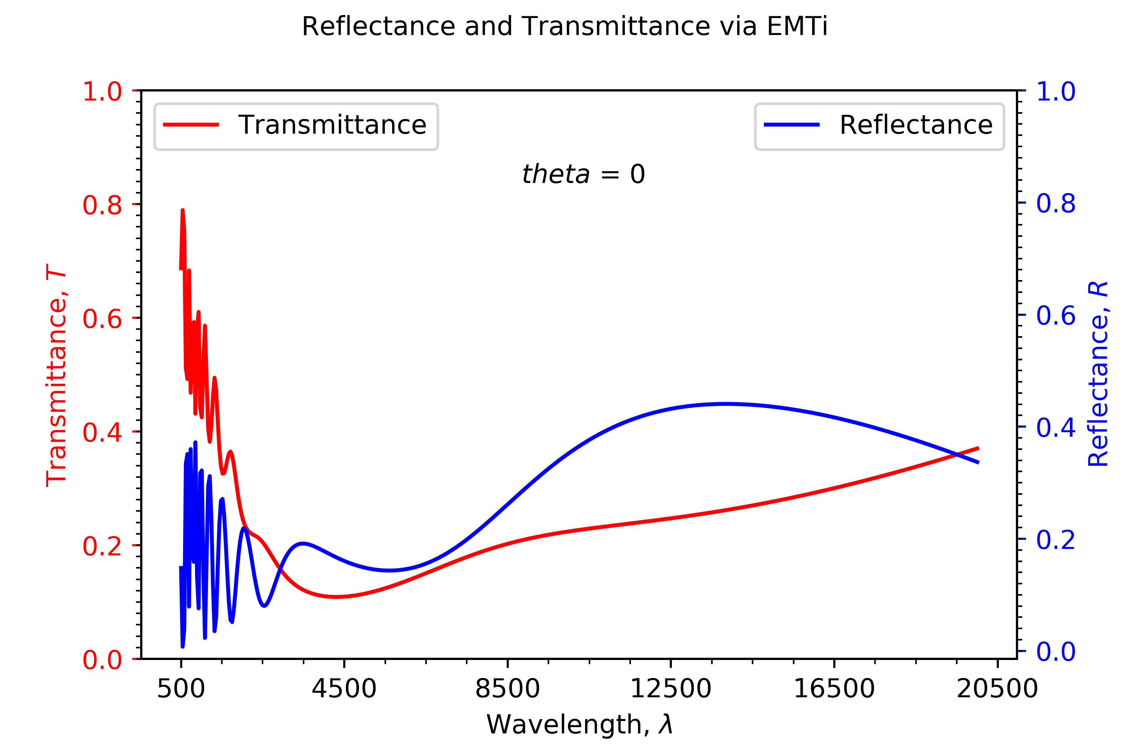
EMT results
(Plot of reflectance and transmittance over a range of wavelengths calculated via EMTi)

Slide 5
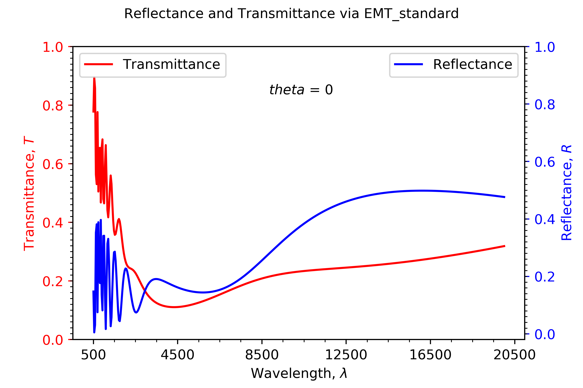
EMT results
(Plot of reflectance and transmittance over a range of wavelengths calculated via EMTst)

Slide 6
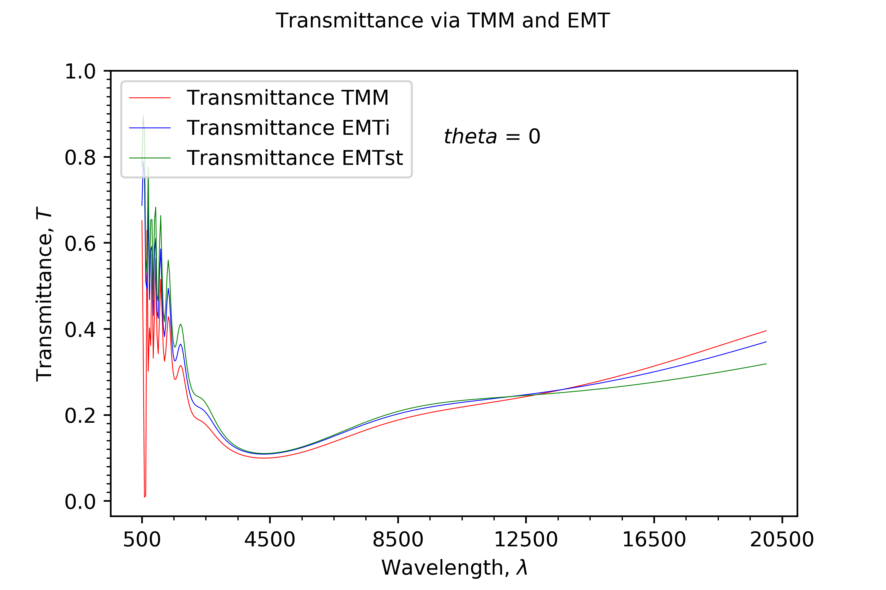
TMM vs EMTi vs EMTst
(Plot of transmittance over a long range of wavelengths calculated via TMM, EMTi and EMTst)

Slide 7
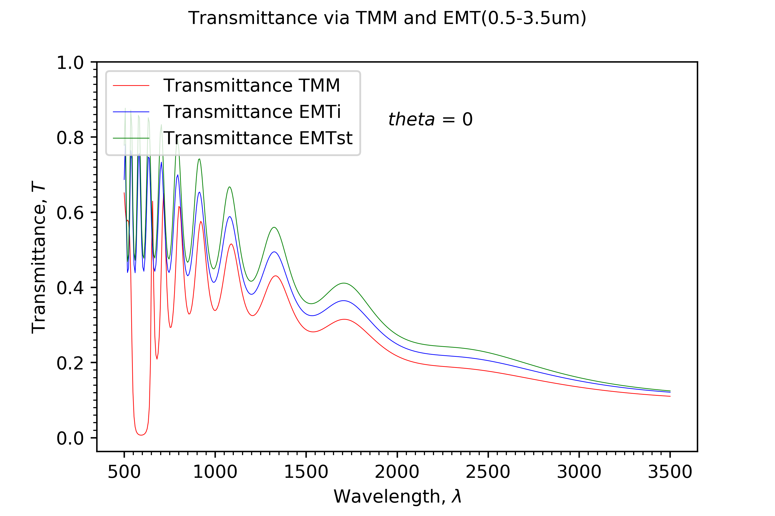
TMM vs EMTi vs EMTst
(Plot of transmittance over a short range of wavelengths calculated via TMM, EMTi and EMTst)

Slide 8
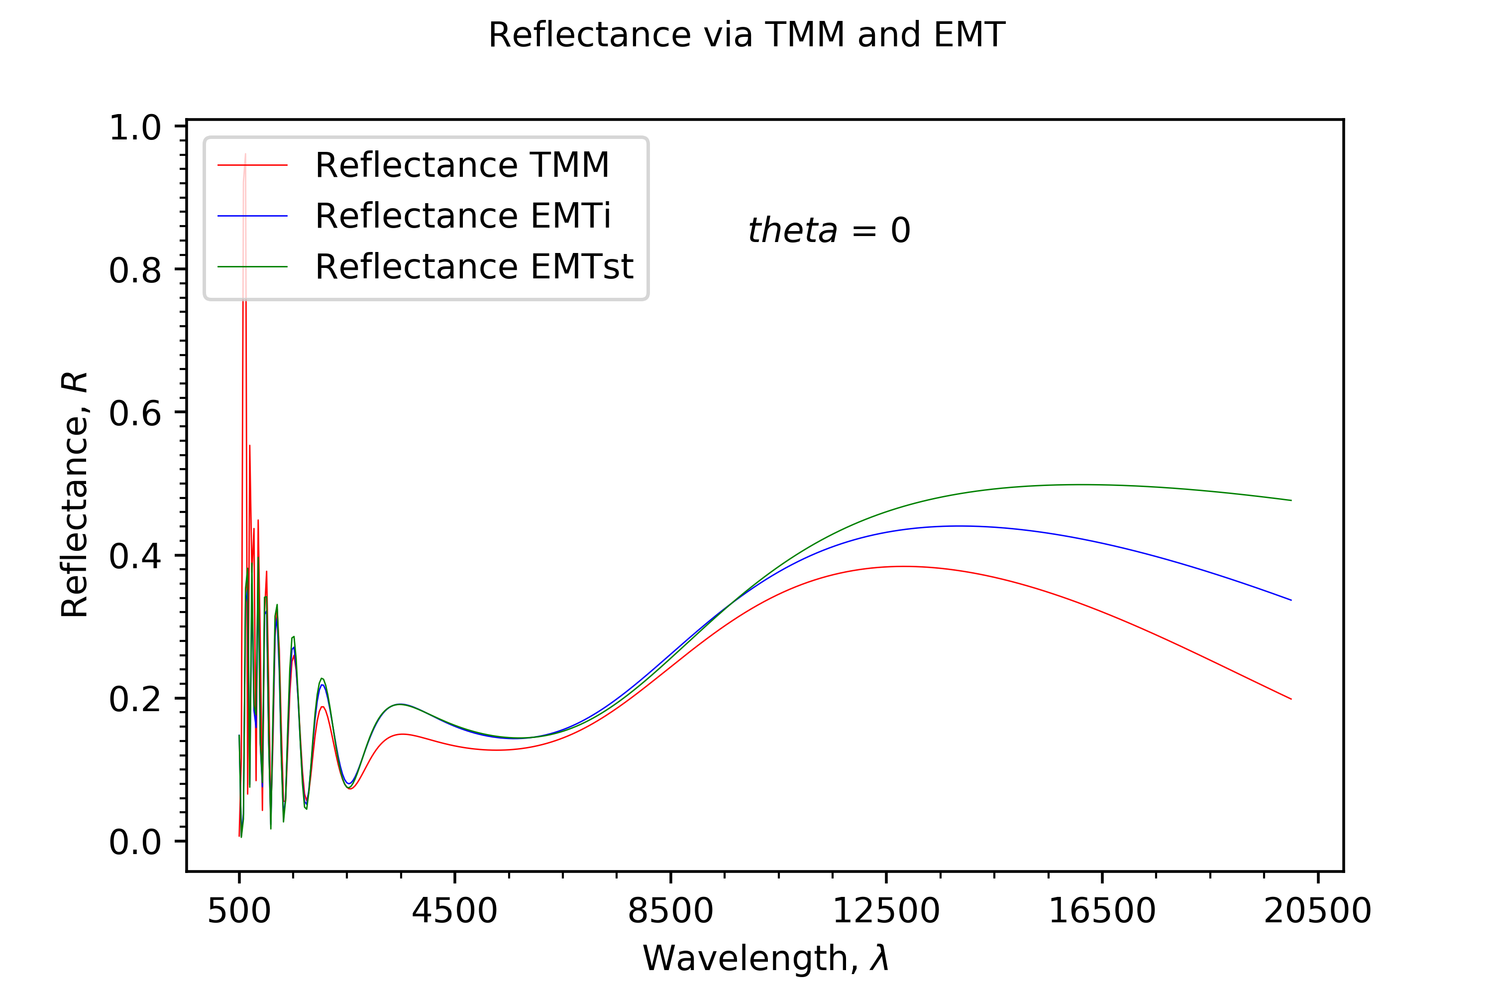
TMM vs EMTi vs EMTst
(Plot of reflectance over a long range of wavelengths calculated via TMM, EMTi and EMTst)

Slide 9
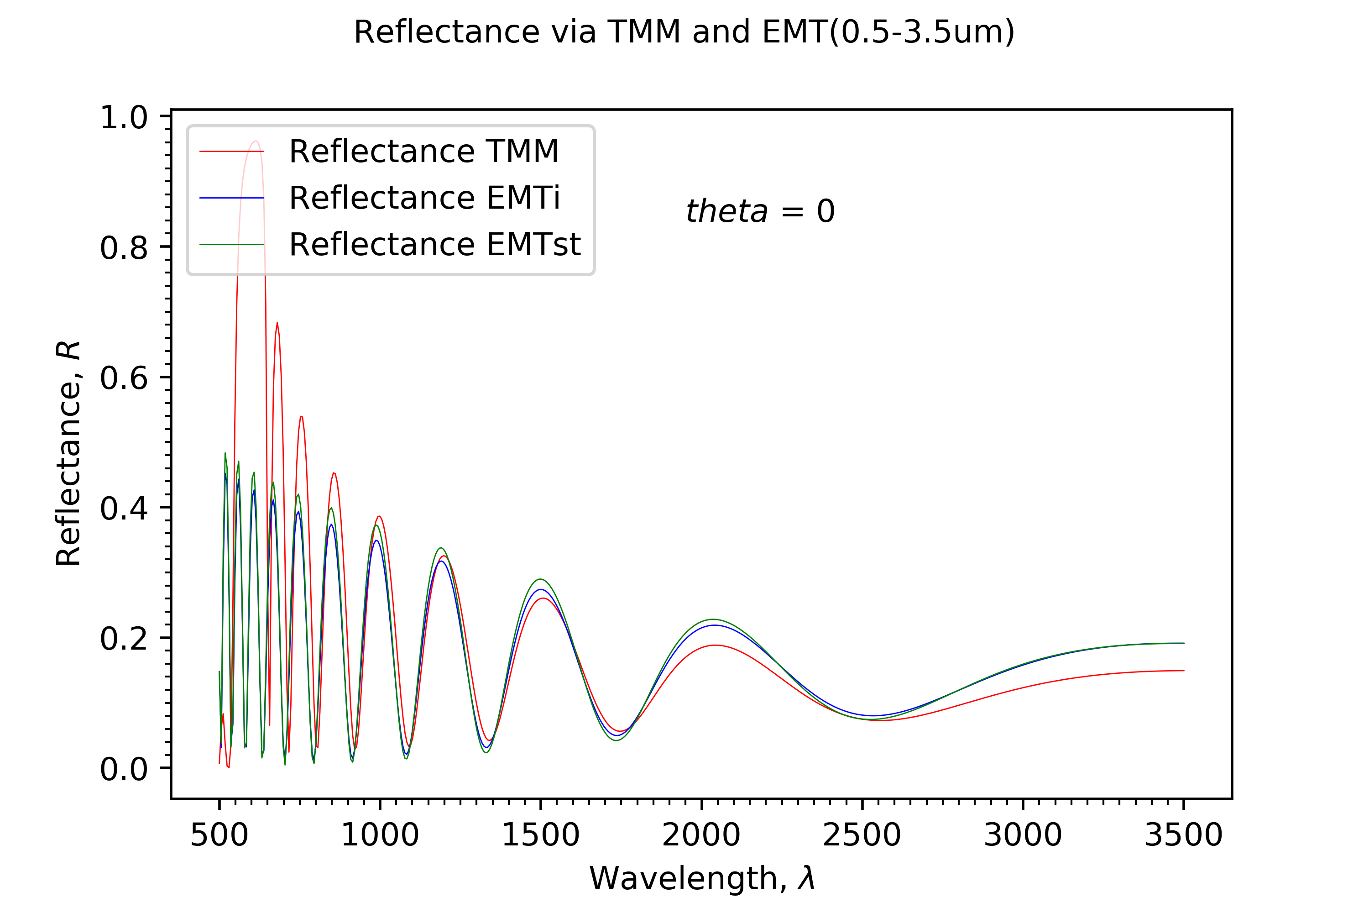
TMM vs EMTi vs EMTst
(Plot of reflectance over a short range of wavelengths calculated via TMM, EMTi and EMTst)

