Slide 1
Git & WorkFlow Practice
wangyaodi@gmail.com
2011/08/30
Lightning Talk @ RailsWed
http://groups.google.com/group/railswed

Slide 2
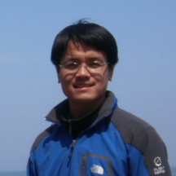
About Me
a.k.a. - yorzi
Details - about.me/wangyaodi
Senior Engineer at Intridea Inc.
More Links:
http://tech.wangyaodi.com
http://github.com/yorzi
http://twitter.com/yorzi
http://more-other-sites/yorzi
王要弟
Andy Wang

Slide 3


Slide 4
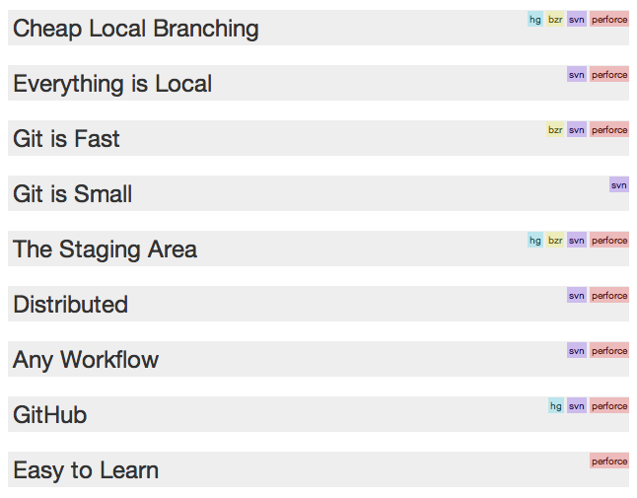
http://zh-cn.whygitisbetterthanx.com

Slide 5
Git & Workflow

Slide 6
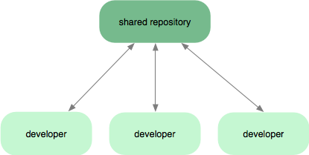
Subversion-Style Workflow

Slide 7
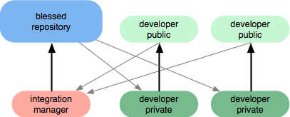
Integration Manager Workflow

Slide 8
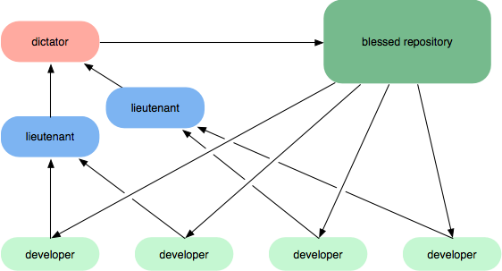
Dictator and Lieutenants Workflow

Slide 9
Intridea’s Git-Flow
Vincent Driessen’ Git-Flow
http://nvie.com/posts/a-successful-git-branching-model/

Slide 10
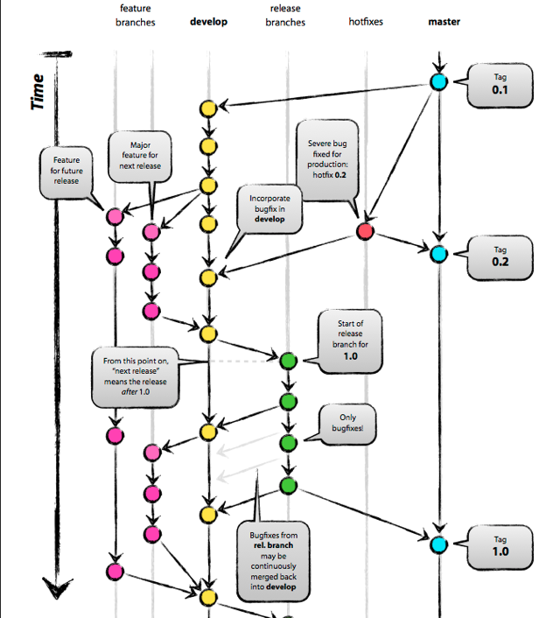

Slide 11
Tool: GitFlow
https://github.com/nvie/gitflow
http://ihower.tw/blog/archives/5140
http://jeffkreeftmeijer.com/2010/why-arent-you-using-git-flow

Slide 12
Tool: Git-Goggles
https://github.com/nowells/git-goggles
http://teebes.com/blog/22/introducing-git-goggles

Slide 13
Git Tricks
Git auto-completion
http://www.codethatmatters.com/2010/01/git-autocomplete-in-mac-os-x/
Easy log
alias gl='git log --pretty=format:"%Cgreen%h%Creset%x09%an%x09%Cblue%ar%Creset%x09%s"'
Display branch name in terminal
export PS1="\u@\h\w\[$txtcyn\]\$git_branch\[$txtrst\]:”

Slide 14
More Resources
Git Official Site
http://git-scm.com/
http://gitbook.liuhui998.com/
Learn Git via PPT
http://www.slideshare.net/littlebtc/git-5528339
Why Git is Better than X
http://zh-cn.whygitisbetterthanx.com/

Slide 15
Thank You!

