Slide 1

The Mina Way
andy@intridea.com

Slide 2
Faster Deployer &
Server Automation Tool

Slide 3
Capistrano Alternative

Slide 4
Why?
Tiny & Clean
Easy to config
Fast
Overall usage is well documented

Slide 5
Capistrano Is Dead

Slide 6
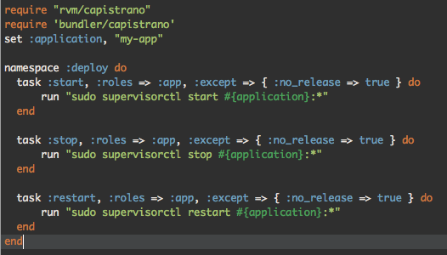
Cap Config

Slide 7
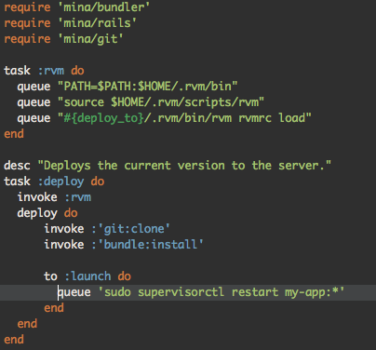
Mina Config

Slide 8
Mina Wins!
Simpler and Faster

Slide 9
$ time mina deploy
real 0m23.999s
user 0m0.188s
sys 0m0.054s
$ time cap deploy
real 0m40.561s
user 0m0.897s
sys 0m0.191s
https://weluse.de/blog/capistrano-is-dead-use-mina.html

Slide 10
Mina Walk Through
http://nadarei.co/mina/

Slide 11
Mina In Real Case

Slide 12
Sources
https://github.com/alfuken/mina-rails-unicorn-nginx-god
http://codedecoder.wordpress.com/2012/10/19/rails-deployment-with-mina/
https://trello.com/board/mina/4fc8b3023d9c9a4d72e573e6

Slide 13
Thanks!

