Slide 1

Git &
WorkFlow Practice
@yorzi
Lightning Talk in Xi'an Rubyists Party
2014/12/21

Slide 2


Slide 3
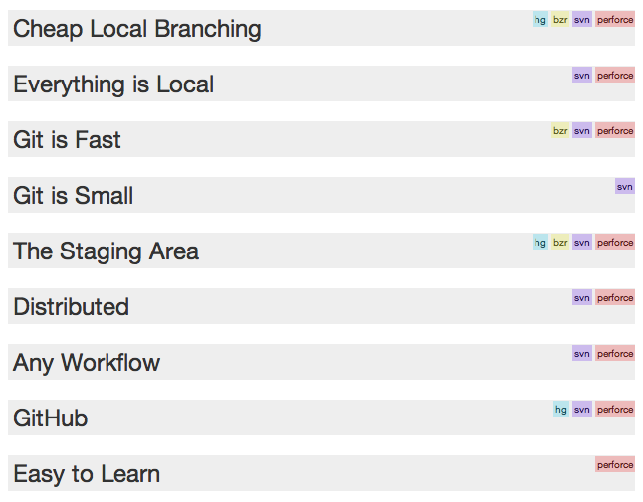
http://zh-cn.whygitisbetterthanx.com

Slide 4
Workflow

Slide 5
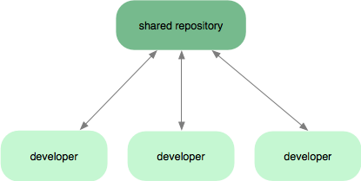
Subversion-Style Workflow

Slide 6
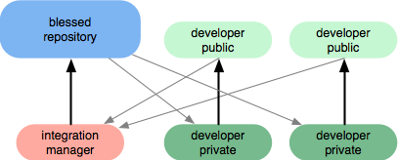
Integration Manager Workflow

Slide 7
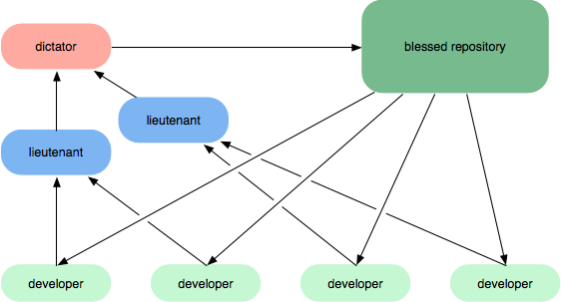
Dictator and Lieutenants Workflow

Slide 8
Intridea’s Git-Flow
Vincent Driessen’ Git-Flow
http://nvie.com/posts/a-successful-git-branching-model/

Slide 9
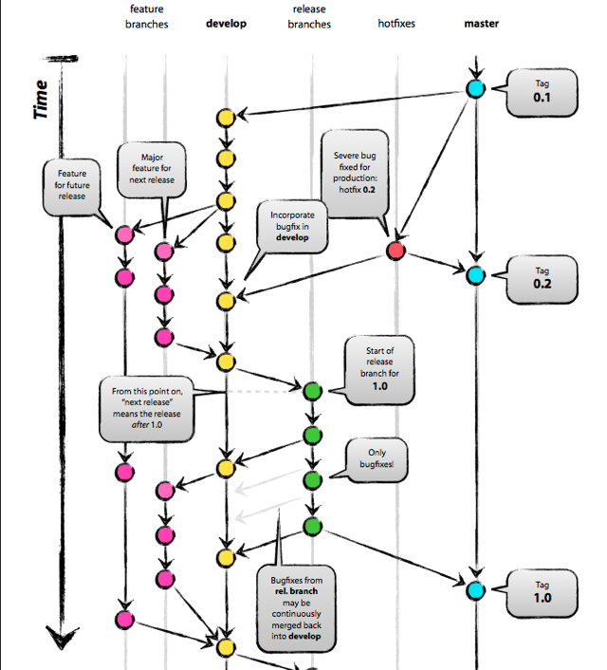

Slide 10
Tool: GitFlow
https://github.com/nvie/gitflow
http://ihower.tw/blog/archives/5140
http://jeffkreeftmeijer.com/2010/why-arent-you-using-git-flow

Slide 11
Tool: Git-Goggles
https://github.com/nowells/git-goggles
http://teebes.com/blog/22/introducing-git-goggles

Slide 12
Git Tricks
Git auto-completion
  http://www.codethatmatters.com/2010/01/git-autocomplete-in-mac-os-x/
Easy log
alias gl='git log --pretty=format:"%Cgreen%h%Creset%x09%an%x09%Cblue%ar%Creset%x09%s"'
Display branch name in terminal
export PS1="\u@\h\w\[$txtcyn\]\$git_branch\[$txtrst\]:”

Slide 13
Git Commands
merge & rebase
new and delete branches
one local → multiple remotes

Slide 14
More Resources
Git Official Site
  http://git-scm.com/
  http://gitbook.liuhui998.com/
Learn Git via PPT
  http://www.slideshare.net/littlebtc/git-5528339
Why Git is Better than X
  http://zh-cn.whygitisbetterthanx.com/

Slide 15
Thank You!

