Slide 1
NoSql Database
NoSQL databases (aka "not only SQL") are non-tabular databases and store data differently than relational tables.
NoSQL databases come in a variety of types based on their data model. The main types are document, key-value, wide-column, and graph. They provide flexible schemas and scale easily with large amounts of data and high user loads.

Slide 2
NoSql Database Features
Horizontal Scaling
Flexible Schemas
Fast queries

Slide 3
Amazon DynamoDB
Amazon DynamoDB is a fully managed NoSQL database service that provides fast and predictable performance with seamless scalability.
DynamoDB lets you offload the administrative burdens of operating and scaling a distributed database so that you don't have to worry about hardware provisioning, setup and configuration, replication, software patching, or cluster scaling.
With DynamoDB, you can create database tables that can store and retrieve any amount of data and serve any level of request traffic.

Slide 4
Core Components of Amazon DynamoDB
In DynamoDB, tables, items, and attributes are the core components that you work with. A table is a collection of items, and each item is a collection of attributes.
DynamoDB uses primary keys to uniquely identify each item in a table and secondary indexes to provide more querying flexibility

Slide 5
Tables, Items, and Attributes
Tables – Similar to other database systems, DynamoDB stores data in tables. A table is a collection of data.
Items in DynamoDB are similar in many ways to rows, records, or tuples in other database systems. In DynamoDB, there is no limit to the number of items you can
store in a table
Attributes – Each item is composed of one or more attributes. An attribute is a fundamental data element, something that does not need to be broken down any further. For example, an item in a People table contains attributes called PersonID, LastName, FirstName, and so on.

Slide 6
Cont…
You can use DynamoDB Streams together with AWS Lambda to create a trigger—code that runs automatically whenever an event of interest appears in a stream.
For example, consider a Customers table that contains customer information for a company. Suppose that you want to send a "welcome“ email to each new customer. You could enable a stream on that table, and then associate the stream with a Lambda function.
The Lambda function would run whenever a new stream record appears, but only process new items added to the Customers table.

Slide 7
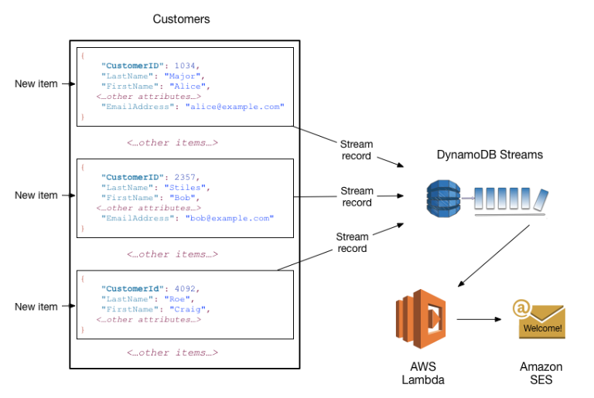
Cont…

Slide 8
DynamoDB API
To work with Amazon DynamoDB, your application must use a few simple API operations.
• Control Plane
• Data Plane
• DynamoDB Streams
• Transactions

Slide 9
Control Plane
Control plane operations let you create and manage DynamoDB tables. They also let you work with indexes, streams, and other objects that are dependent on tables
CreateTable – Creates a new table. Optionally, you can create one or more secondary indexes, and enable DynamoDB Streams for the table.
DescribeTable– Returns information about a table, such as its primary key schema, throughput settings, and index information.
ListTables – Returns the names of all of your tables in a list.
UpdateTable – Modifies the settings of a table or its indexes, creates or removes new indexes on a table, or modifies DynamoDB Streams settings for a table.
DeleteTable – Removes a table and all of its dependent objects from DynamoDB.

Slide 10
Data Plane
Data plane operations let you perform create, read, update, and delete (also called CRUD) actions on data in a table. Some of the data plane operations also let you read data from a secondary index.
Creating Data
  PutItem– Writes up single items to a table.
  BatchWriteItem – Writes up to 25 items to a table.
Reading Data
  GetItem – Retrieves a single item from a table.
  BatchGetItem – Retrieves up to 100 items from one or more tables.

Slide 11
Cont…
Updating Data
  UpdateItem – Modifies one or more attributes in an item. You must specify the primary key for the item that you want to modify.
Deleting Data
  DeleteItem – Deletes a single item from a table. You must specify the primary key for the item that you want to delete.
  BatchWriteItem – Deletes up to 25 items from one or more tables. This is more efficient than calling DeleteItem multiple times because your application only needs a single network round trip to delete the items.
  You can use BatchWriteItem to both create data and delete data.

Slide 12
Data Types
DynamoDB supports many different data types for attributes within a table.
  Scalar Types – A scalar type can represent exactly one value. The scalar types are number, string, binary, Boolean, and null.
  Document Types – A document type can represent a complex structure with nested attributes, such as you would find in a JSON document. The document types are list and map.
  Set Types – A set type can represent multiple scalar values. The set types are string set, number set, and binary set.

Slide 13
Table classes
DynamoDB offers two table classes designed to help you optimize for cost.
  The DynamoDB Standard table class is the default, and is recommended for the vast majority of workloads.
  The DynamoDB Standard-Infrequent Access (DynamoDB Standard-IA) table class is optimized for tables where storage is the dominant cost.
    For example, tables that store infrequently accessed data, such as application logs, old social media posts, e-commerce order history, and past gaming achievements, are good candidates for the Standard-IA table class
  Every DynamoDB table is associated with a table class (DynamoDB Standard by default).

Slide 14
Cont…
DynamoDB stores and retrieves each item based on its partition key value.
When you use a database like MySQL, Postgres, or MongoDB, you provision a particular server to run your database. You'll need to choose your instance size -- how many CPUs do you need, how much RAM, how many GBs of storage, etc.
It is not so with DynamoDB. Instead, you provision read and write capacity units. These units allow a given number of operations per second. This is a fundamentally different pricing paradigm than the instance-based world -- pricing can more closely reflect actual usage.

Slide 15
An Item and primary key
An item is the core unit of data in DynamoDB.
It is comparable to a row in a relational database. Each item is uniquely identifiable by a primary key that is set on a table level.
Primary Keys
Every item in a table is uniquely identified by its primary key.
A simple primary key uses a single attribute to identify an item, such as a Username or an OrderId.
A composite primary key uses a combination of two attributes to identify a particular item.

Slide 16
Attributes, Attributes Types
An item is made up of attributes, which are different elements of data on a particular item. For example, an item in the User table might have a Name attribute, an Age attribute, an Address attribute, and more.
Most attributes in a DynamoDB table are not required for every item. DynamoDB is a NoSQL database which allows for a more flexible data model than the standard relational databases.
You could store entirely different kinds of objects in a single DynamoDB table, such as a Car object with Make, Model, and Year attributes, and a Pet object with Type, Breed, Age, and Color attributes.

Slide 17
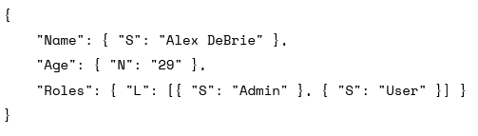
Cont…
When setting an attribute for a DynamoDB item, you must specify the type of the attribute. Available types include simple types like strings and numbers as well as composite types like lists, maps, or sets.
Ex

Slide 18
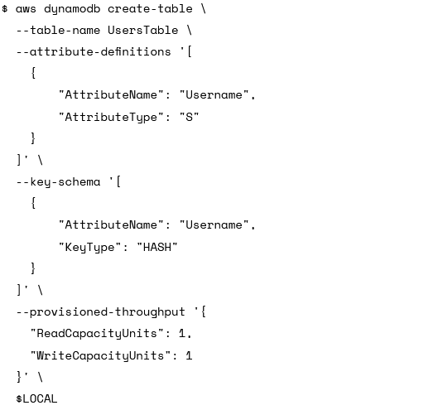
Creating table in dynamoDB

Slide 19
Cont…
You can view your tables with the list-tables command:

Slide 20

Cont…
You can see detail of table

Slide 21
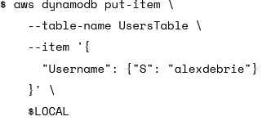
Put Item
With the PutItem call, you provide an entire Item to be placed into your DynamoDB table.

Slide 22
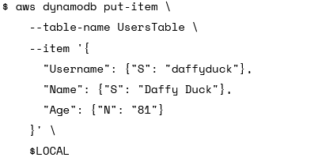
Cont…
Without defining attribute at the beginning

Slide 23
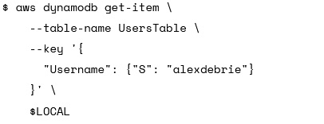
Get Item
Retrieving Items is done with the GetItem API call.
This call requires the table name and the primary key of the Item you want to retrieve. Remember: each Item is uniquely identifiable by its primary key.
Ex

Slide 24
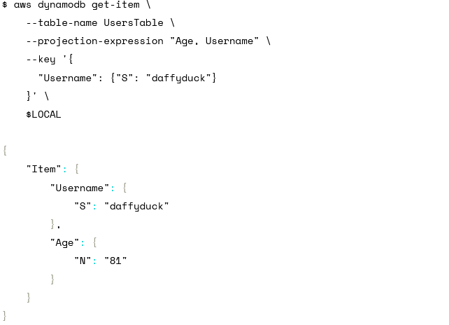
Cont…
Sometimes you may want to retrieve only certain attributes when getting an Item. This can be particularly helpful for saving network bandwidth when working with Ex

Slide 25

Expression basics
Expressions are strings that use DynamoDB's domain-specific expression logic to check for the validity of a described statement. With expressions, you can use comparator symbols, such as "=" (equals), ">" (greater than), or ">=" (greater than or equal to).
expressions are strings that check for the validity of a particular statement.
To use expression attribute names, you pass in a map where the key is the placeholder to use in your expression and the value is the attribute name you want to expand to.
For example, if I wanted to use a placeholder of "#a" for my attribute name of "Age", my expression attribute names map would look like:

Slide 26
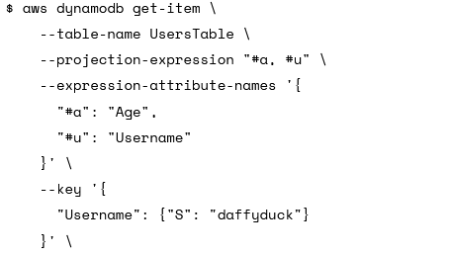
Cont…
Let’s take some attributes in the created table.
This aws cli selects age and username from table UserTable

Slide 27
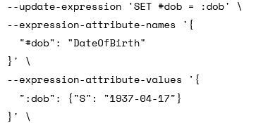
Cont…
Expression Attribute Values
Expression attribute values are similar to expression attribute names except that they are used for the values used to compare to values of attributes on an Item, rather than the name of the attribute.
expression attribute values must start with a colon (":") rather than a # sign
Ex

Slide 28
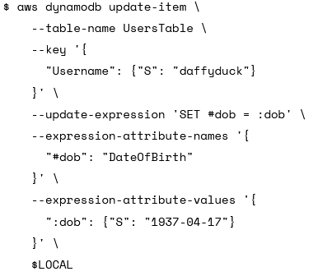
Update table
DynamoDB has an UpdateItem operation which allows you to update an Item directly without first retrieving the Item, manipulating it as desired, then saving it back with a PutItem operation.
When using the UpdateItem action, you need to specify an update expression.
Ex

Slide 29
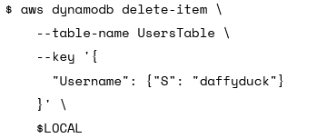
Delete Item
The DeleteItem action is pretty simple -- just provide the key of the Item you'd like to delete:

Slide 30
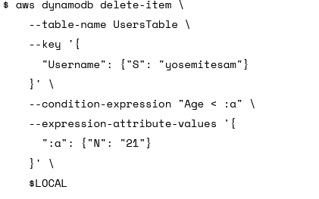
Cont…
Ex2 you can add a --condition-expression to only delete your Item under certain conditions. Let's say we want to delete Yosemite Sam, but only if he's younger than 21 years old:

Slide 31

Scan the table
The Scan call is likely the easiest of all DynamoDB calls. Simply provide a table name, and it will return all Items in the table (up to a 1MB limit):

Slide 32
Amazon S3
Amazon S3 is an object storage service that stores data as objects within buckets. An object is a file and any metadata that describes the file. A bucket is a container for objects.
Amazon S3 terms:
  Bucket – A top-level Amazon S3 folder.
  Prefix – An Amazon S3 folder in a bucket.
  Object – Any item that's hosted in an Amazon S3 bucket.

Slide 33
Cont…
To store your data in Amazon S3, you first create a bucket and specify a bucket name and AWS Region. Then, you upload your data to that bucket as objects in Amazon S3. Each object has a key (or key name), which is the unique identifier for the object within the bucket.
Buckets and the objects in them are private and can be accessed only if you explicitly grant access permissions. You can use bucket policies, AWS Identity and Access Management (IAM) policies, access control lists (ACLs), and S3 Access Points to manage access.

Slide 34

Aws cli commands
To create bucket
To list available bucket
To list available object in bucket

Slide 35
Cont…
To delete bucket
To delete object in bucket
To move object from bucket to bucket
$aws s3 mv s3://bucket-name/example s3://my-bucket/

Slide 36
Cont..
This command moves a file from your Amazon S3 bucket to your current working directory,
The following example copies all objects from s3://bucket-name/example to s3://my-bucket/.

Slide 37
The End

