Slide 1
Pulse Width Modulation Drawer Amit Graduation Project
Introduced by: Youstina Atef Salama

Slide 2
Introduction
-PWM drawer works as a mini oscilloscope that is responsible for printing the frequency and the waveform of the generated PWM signal.
-(PWM) is a modulation technique that generates variable-width pulses to represent the amplitude of an analog input signal. The output switching transistor is on more of the time for a high-amplitude signal and off more of the time for a low-amplitude signal.

Slide 3
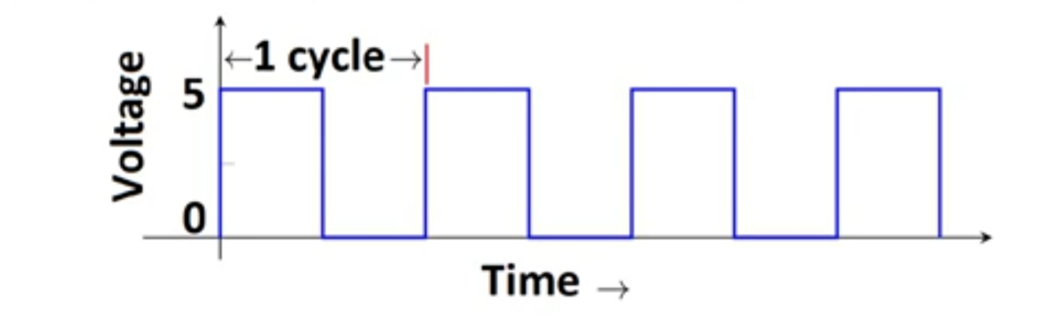
- period of a pulse consists of an ON cycle (5V) and an OFF cycle (0V). The fraction for which the signal is ON over a period is known as the duty cycle.
Frequency signals, or other waves, expresses the number of cycles of the repetitive waveform per second.
Duty Cycle (In %) = Ton /total period *100

Slide 4
-PWM applications -For example, the PWM is commonly used to control the speed of electric motors, the brightness of lights, ultrasonic cleaning applications, and many more.

Slide 5
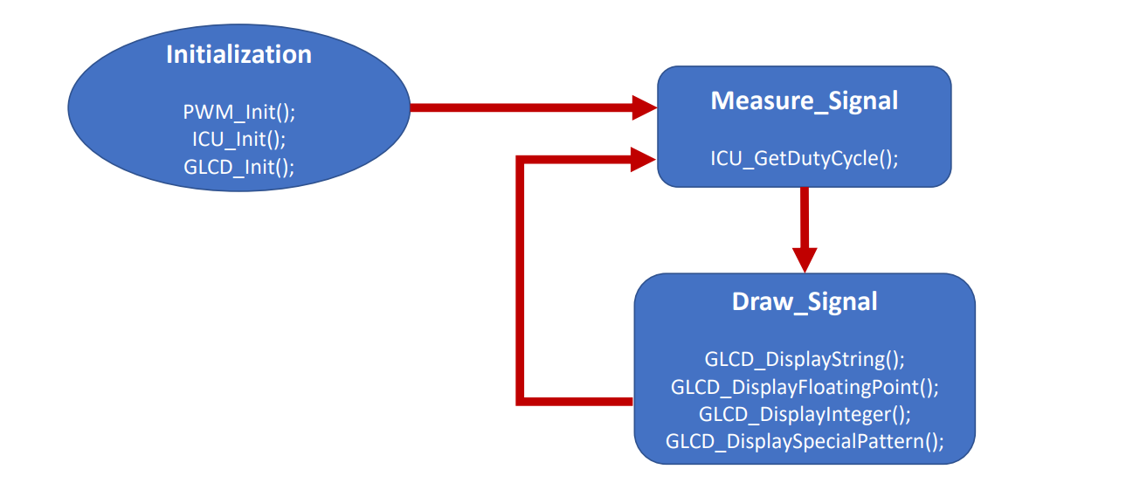
Flow Chart

Slide 6
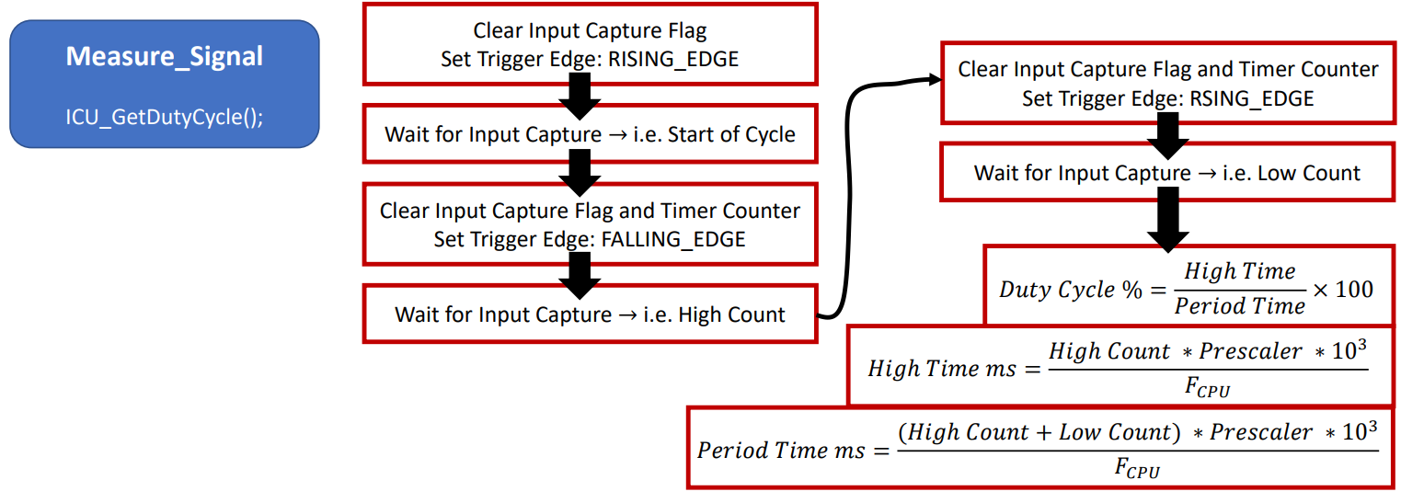

Slide 7
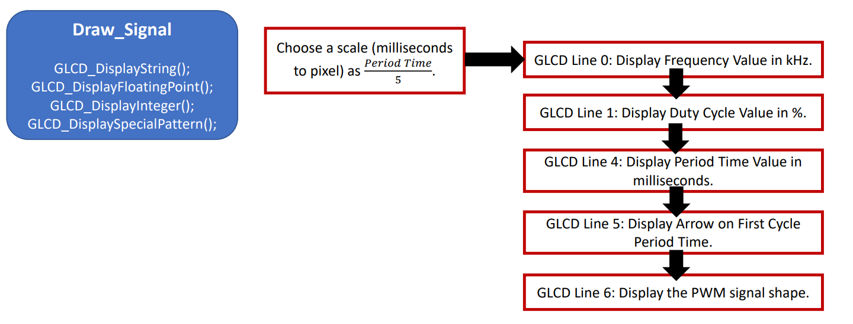

Slide 8
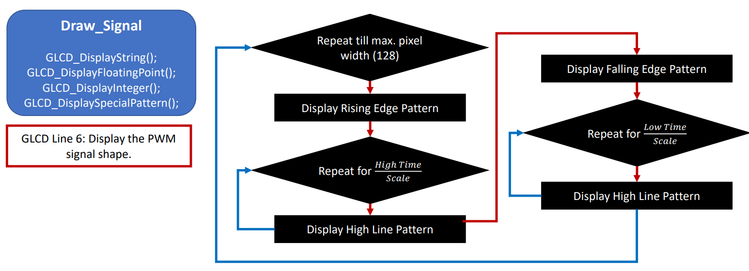

Slide 9
Thank You

