Slide 1
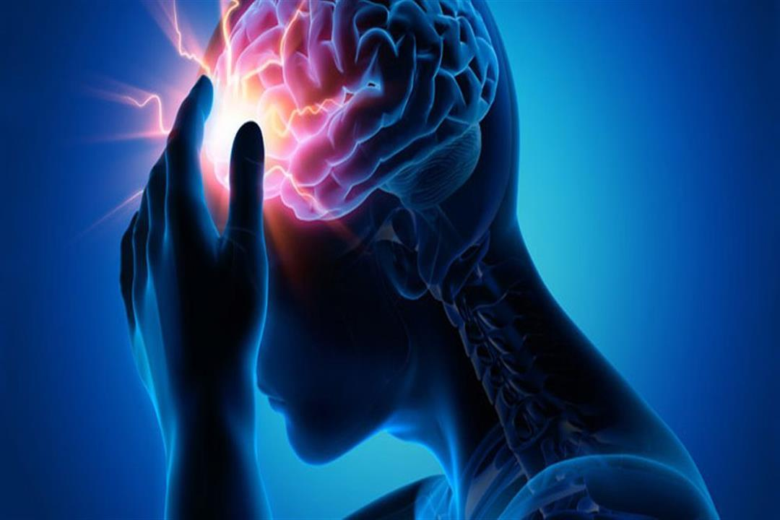
Brain Tumor Detection

Slide 2
Team members
Name
Youssef esam Mohamed gomaa awad
Ahmed Alaa
Omar yassen ahmed
Maxim Mamdouh Salib
Abanoub Refaat Ibrahim
Youssef Esam – Contributed across all stages: preprocessing, EDA, model building, evaluation, and deployment.
Ahmed Alaa – Contributed across all stages: preprocessing, EDA, model building, evaluation, and deployment.
Omar Yassen– Supported data preprocessing and exploratory data analysis.
Abanoub – Assisted in model training and evaluation.
Maxim – Assisted in deployment and testing of the Streamlit application.

Slide 3
Brain Tumor Detection using Deep Learning
Final Project – GTC Scholarship
This project applies AI to the medical field, aiming to classify brain tumors from MRI scans using deep learning.

Slide 4
Introduction
The human brain is highly complex, and detecting tumors early is crucial for treatment.
Manual diagnosis from MRI scans can be time-consuming and error-prone.
Goal: Build an AI model that can classify MRI scans into different tumor types automatically.
This project bridges healthcare and technology, making tumor detection faster and more accurate.

Slide 5
Dataset
The dataset used contained MRI scans categorized into 4 classes:
Glioma
Meningioma
Pituitary
No Tumor
Images were resized to a fixed input shape for consistency.
Normalization was applied to scale pixel values between 0 and 1.
Data augmentation (rotation, flipping, shifting) was added to prevent overfitting.
📊 This prepared the data for robust training and testing.

Slide 6
Libraries & Tools
TensorFlow/Keras → building and training the CNN model
NumPy & Pandas → data handling and preprocessing
Matplotlib → data visualization and performance plots
PIL → image processing
Streamlit → building an interactive web app
ngrok → hosting the app online for global access
(Here, you can use logos of the libraries for visual appeal)

Slide 7
Preprocessing & EDA
Preprocessing Steps:
Converted images to grayscale or RGB depending on input needs.
Resized all images to match the model’s expected dimensions.
Normalized pixel intensities to speed up training convergence.
Applied augmentation techniques like rotation and flipping to increase dataset diversity.
Exploratory Data Analysis (EDA):
Visualized random MRI scans to confirm labeling quality.
Checked dataset balance across the 4 classes.
Identified potential noise or unclear scans.

Slide 8
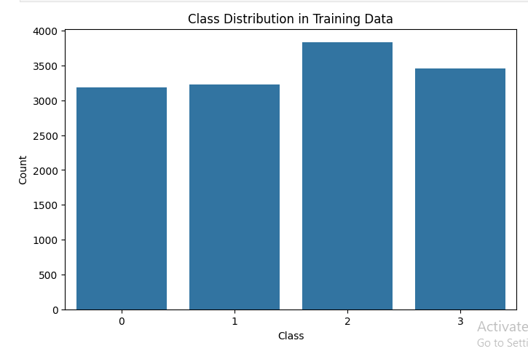
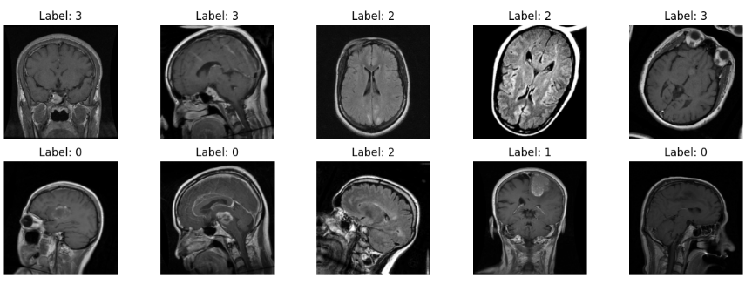
Preprocessing & EDA

Slide 9
Model Architecture
Built a Convolutional Neural Network (CNN) using the Keras Sequential API.
Layers included:
Convolution + ReLU → feature extraction
MaxPooling → dimensionality reduction
Dropout → prevent overfitting
Dense layers → final decision-making
Output Layer: Softmax activation for multi-class classification.
The model was designed to balance complexity and efficiency for accurate predictions.

Slide 10
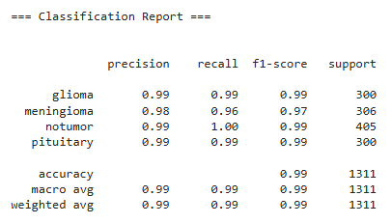
Training & Evaluation
Training:
Model trained over multiple epochs with tuned hyperparameters (batch size, learning rate).
Used categorical cross-entropy loss and Adam optimizer.
Evaluation:
Plotted training vs validation accuracy/loss to monitor performance.
Confusion matrix used to confirm correct classification across all tumor classes.
Results showed strong accuracy and generalization ability.

Slide 11
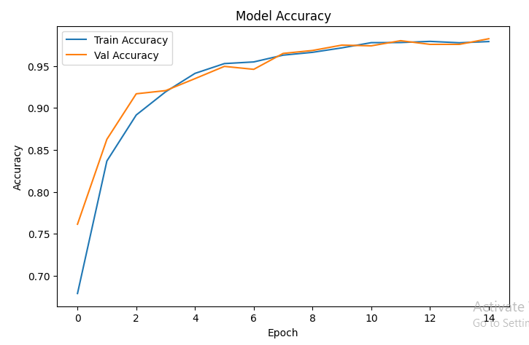
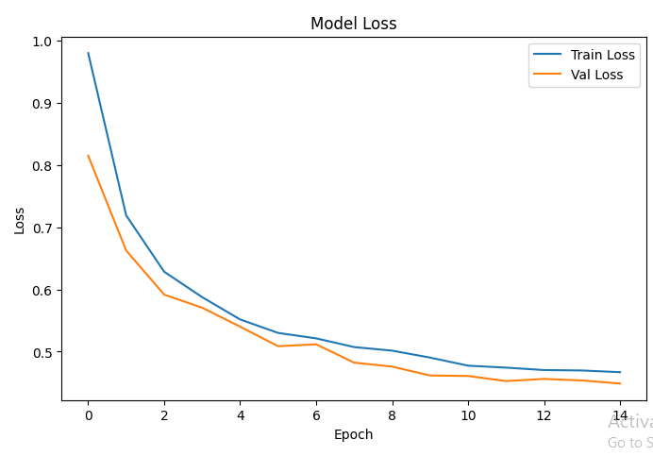
Training & Evaluation

Slide 12
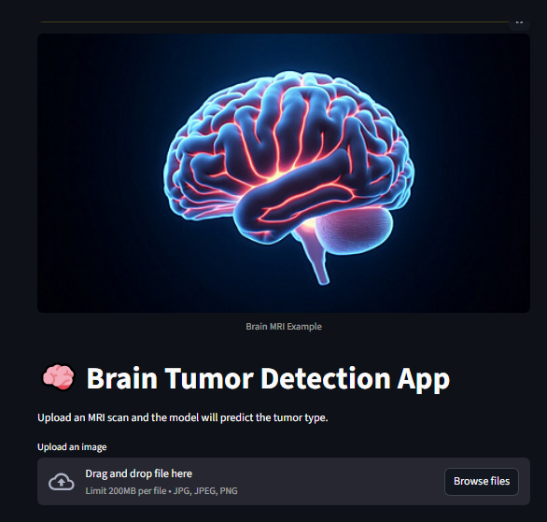
Deployment
To make the solution practical, the model was deployed as a Streamlit web app.
Features of the app:
User can upload an MRI scan image.
The image is automatically preprocessed.
The trained model classifies the tumor type instantly.
Deployment made live using ngrok, allowing access from any device worldwide.

Slide 13
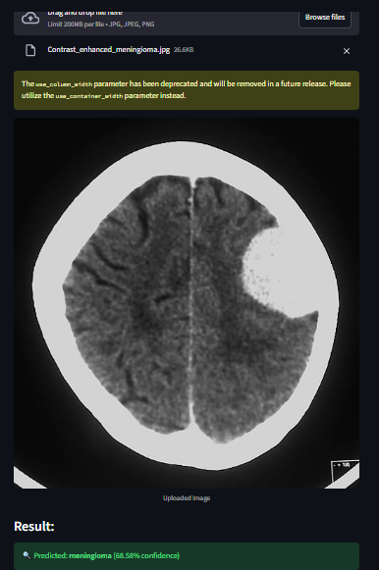
Deployment Examble
When an MRI scan is uploaded, the system predicts:
“Predicted: Name of tumor(the percentage)”
The app interface clearly displays the result to the user.
This demonstrates how AI can provide fast, accurate, and user-friendly medical support tools.

Slide 14
Conclusion
Successfully built a full pipeline:
Data preprocessing → Model training → Evaluation → Deployment
Showed how deep learning can help in real-world healthcare problems.
Key takeaways:
Importance of clean data
Role of CNNs in image classification
Power of deployment tools like Streamlit & ngrok
Future improvements:
Use larger and more diverse datasets
Apply transfer learning with pre-trained models (e.g., VGG, ResNet)
Deploy on cloud for scalability (AWS/GCP).

Slide 15
A big thank you to GTC for providing the opportunity, mentorship, and resources to complete this project. This scholarship helped me connect AI theory with real-world applications. Special thanks to mentors, peers, and the community for continuous support. ❤️Thanks❤️

