Slide 1
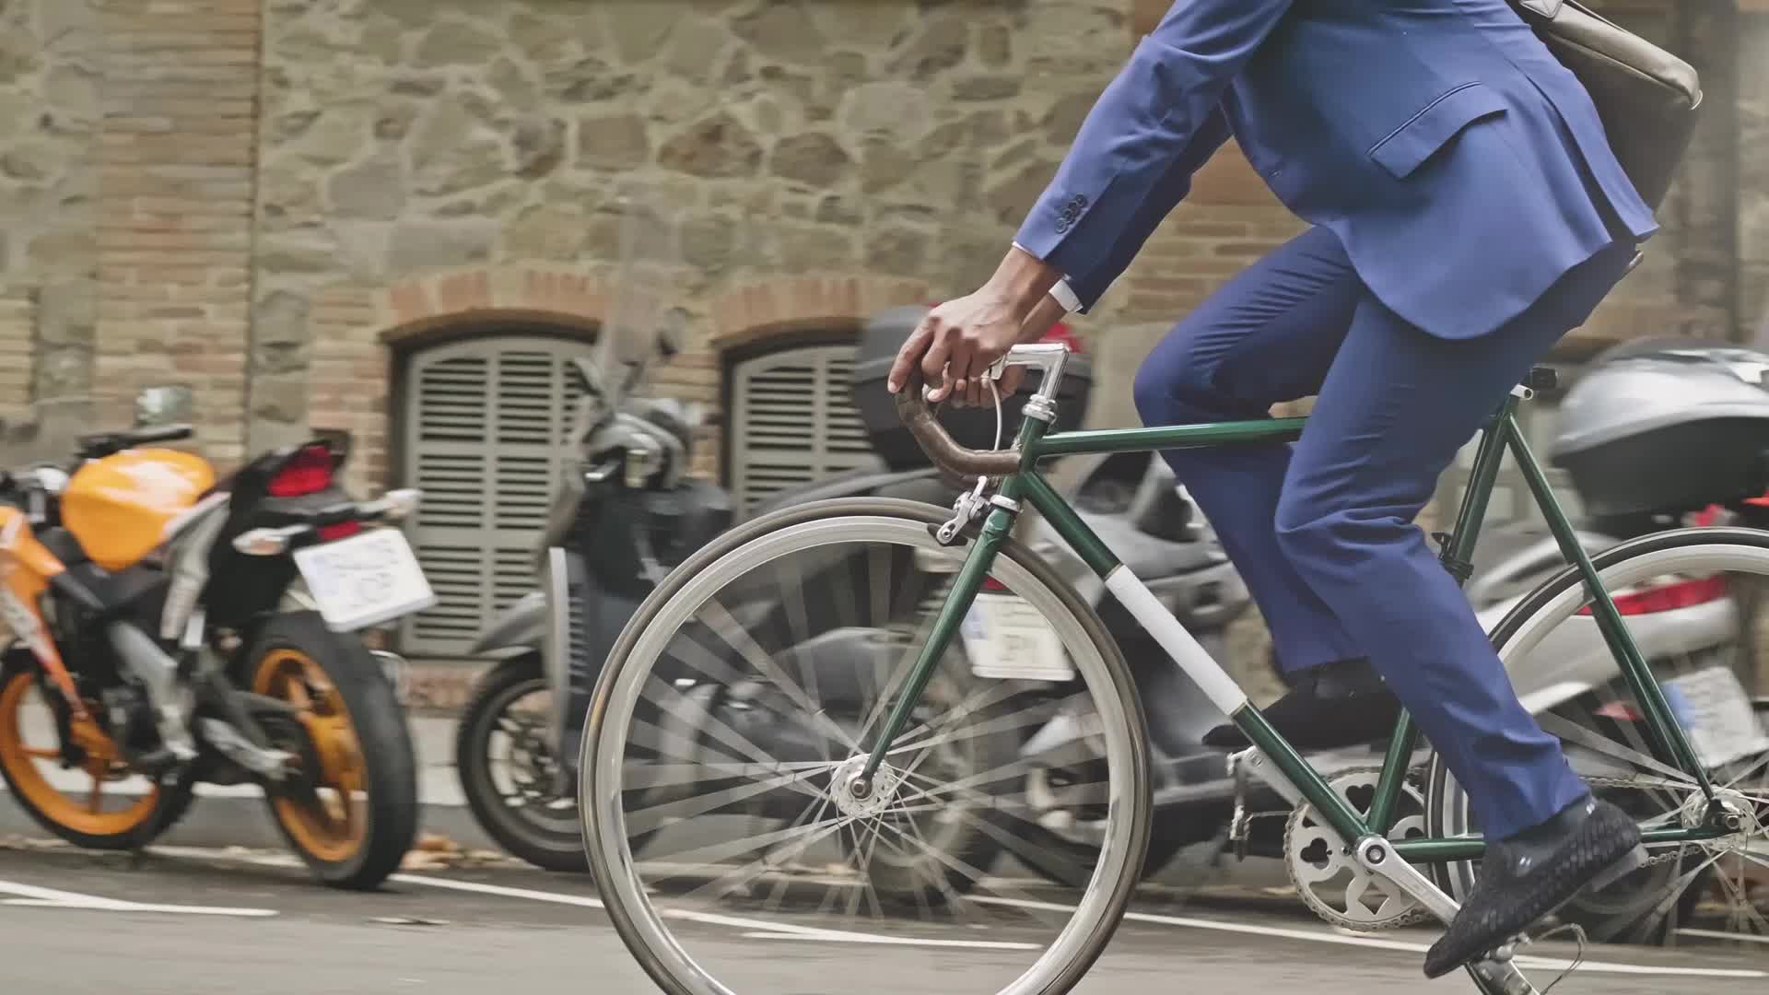
Cyclistic Bike-Share Case Study Data Analysis & Insights Report
YOSEF ADEL
July 2026

Slide 2
Introduction
Objective: Understanding how annual members and casual riders use Cyclistic bikes differently.
The Goal: Design marketing strategies to convert casual riders into annual members.

Slide 3
Data Process
Source: Cyclistic historical trip data (763,000+ records).
Process: Cleaned and manipulated data using SQL, and visualized insights using Excel.
Key Action: Created calculated fields (ride_length, day_of_week) to enable deep analysis.

Slide 4
Key Insights
Ride Length: Casual riders take significantly longer trips (average 1303s) compared to members (747s), indicating a leisure-oriented usage.

Slide 5
Key Insights
Weekly Trends: Casual activity peaks on weekends, while member activity is stable throughout the week, confirming members use bikes for commuting.

Slide 6
Key Insights
Seasonality: Casual usage drops significantly during winter months, while member usage remains consistent year-round.

Slide 7
Strategic Recommendations
Recommendation 1: Launch a "Summer Membership Pass" targeting casual riders when their activity is at its peak (May–September)
Recommendation 2: Introduce weekend-focused marketing campaigns to highlight the value of annual membership for frequent weekend riders.

