Slide 1
least common multiple {LCM}
Yosef Hossam Zayan
ID : 222711

Slide 2
Transform and conquer
The "transform and conquer" strategy is a problem-solving approach used in algorithm design. It involves transforming a given problem into a different, often simpler, form and then solving the transformed problem. Once the transformed problem is solved, the solution is somehow related back to the original problem to obtain the final answer.
This strategy is applied in three different ways:
instance simplification
representation change
problem reduction

Slide 3
Problem reduction
This strategy is particularly useful when the original problem is complex or difficult to solve directly, but a simpler version of the problem can be identified and solved more easily. The transformation step should be carefully chosen to simplify the problem without losing the essential characteristics that make it equivalent to the original problem.

Slide 4
LCM and GCD
LCM = Least Common Multiple
GCD = Greatest Common Factor
EX) 20 & 15
LCM = 20 : 20, 40, 60, 80, 90,….
15 : 15, 30, 45, 60, 75, 90,……
LCM = 60
GCD = 20 : 1, 2, 4, 5, 10, 20
15 : 1, 3, 5, 15
GCD = 5

Slide 5
GCD of X and Y using Euclid’s algorithm.
EX) x = 20 , y = 15
Sol : x = y , y = x mod y
until y = 0 ,so GCD = x
X | Y | X mod Y
20 | 15 | 5
15 | 5 | 0
5 | 0 | ----
Y = 0, So
GCD = 5 (X)
LCM = ( X * Y ) / GCD(X,Y)
( 20 * 15 ) / 5
= 60

Slide 6
CODE
def GCD(x, y):
if y == 0:
return x
return GCD(y , x % y)
def LCM(x, y):
g = GCD(x, y)
l = (y*x)//g
return l
y = 15
x = 20
print(LCM(x, y))

Slide 7
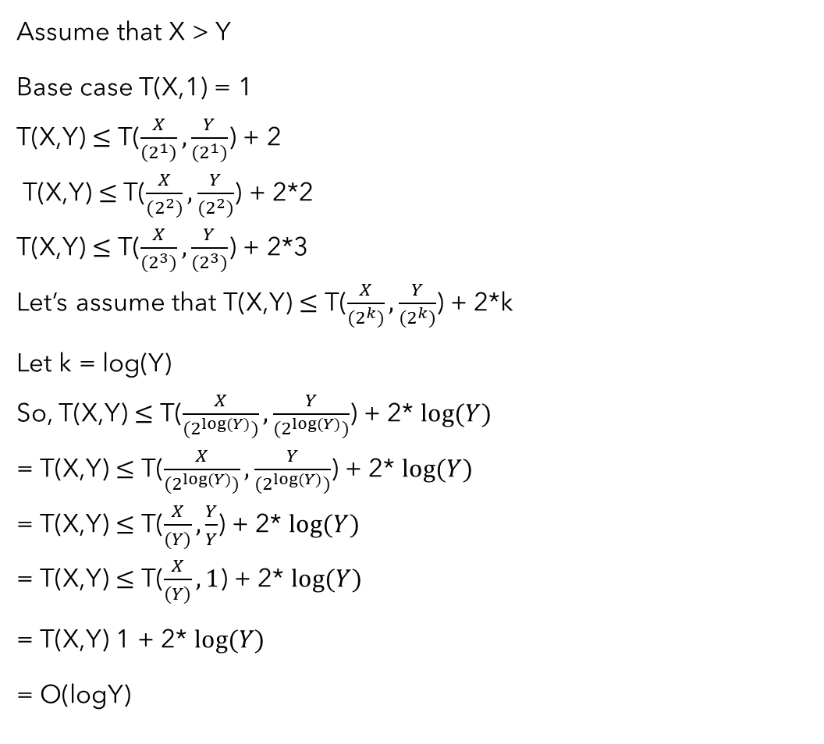
analysis
Assume that X > Y
Base case T(X,1) = 1
T(X,Y) $≤$ T($\frac{X}{\left(2^{1}\right)},\frac{Y}{(2^{1})}$) + 2
T(X,Y) $≤$ T($\frac{X}{(2^{2})},\frac{Y}{(2^{2})}$) + 2*2
T(X,Y) $≤$ T($\frac{X}{(2^{3})},\frac{Y}{(2^{3})}$) + 2*3
Let’s assume that T(X,Y) $≤$ T($\frac{X}{(2^{k})},\frac{Y}{(2^{k})}$) + 2*k
Let k = log(Y)
So, T(X,Y) $≤$ T($\frac{X}{(2^{log⁡(Y)})},\frac{Y}{(2^{log⁡(Y)})}$) + 2* $log⁡(Y)$
= T(X,Y) $≤$ T($\frac{X}{(2^{log⁡(Y)})},\frac{Y}{(2^{log⁡(Y)})}$) + 2* $log⁡(Y)$
= T(X,Y) $≤$ T($\frac{X}{(Y)},\frac{Y}{Y}$) + 2* $log⁡(Y)$
= T(X,Y) $≤$ T($\frac{X}{(Y)},1$) + 2* $log⁡(Y)$
= T(X,Y) 1 + 2* $log⁡(Y)$
= O(logY)

