Slide 1
Koveah
Gavriel Epstein, Yair Fax, Avi Hirsch, Amos Remer, Yosef Sklar

Slide 2
Purpose
To track the amount of time you read each book/ספר
How much progress you make each time
Remind yourself where you left off last time and easily allow you to continue learning
Write a note
Take a picture
Record a voice memo

Slide 3

Logo

Slide 4
Screenshots

Slide 5
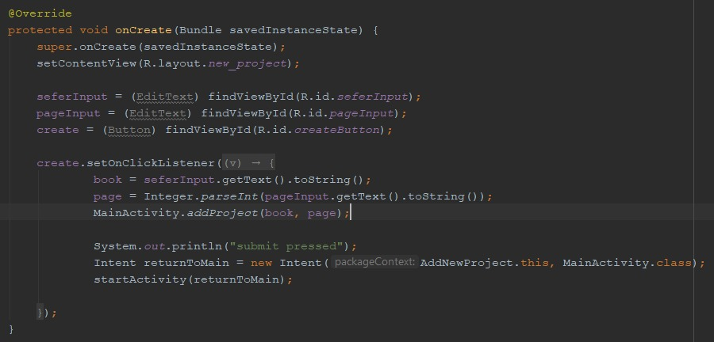

Slide 6
