Slide 1
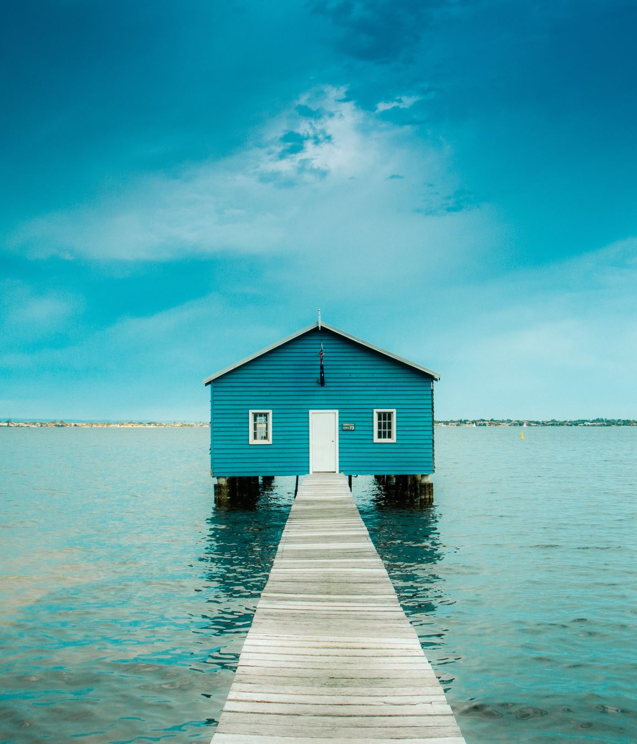
Slide with a house
How pretty!

