Slide 1
Rethinking Bioenergy A Comparative Sustainability Analysis
Yoseph Habtu
DATA 205 , CRN 34669
Prof. Perine
Montgomery College, Spring 2025

Slide 2
Introduction
Bioenergy is a renewable energy source derived from biomass, or organic material (e.g., plants, wood, food waste). Though widely used, questions remain about its true sustainability and economic competitiveness.
Fossil fuels, including coal, petroleum, and natural gas, still dominate the U.S. energy sector but pose well-known environmental and cost-related challenges.
This project aims to evaluate whether bioenergy is a viable long-term substitute for fossil fuels by comparing the two groups across four sustainability metrics:
Carbon Intensity – Emissions per unit of energy generated
Energy Conversion Efficiency – Energy produced relative to fuel consumed
Infrastructure Impact – Construction cost per generation capacity
Economic Performance – Fuel cost/price trends and volatility over time

Slide 3
Project Goal
The goal of this project is to assess whether bioenergy can serve as a viable alternative to fossil fuels for electricity generation in the U.S.
To do this, the project compares the performance of bioenergy and fossil fuels across various environmental and economic metrics.
Environmental Analysis
How does carbon intensity (emissions per unit of energy) compare between biomass and fossil fuels over time?
How efficiently does each fuel type convert feedstock into usable electricity?
Economic Analysis
How does the relationship between construction cost and generation capacity differ between biomass and fossil fuel generators?
What are the trends in fuel prices/costs over time, and how stable are they?

Slide 4
Data Overview
This project utilizes publicly available U.S. government datasets from the Environmental Protection Agency (EPA) and the Energy Information Administration (EIA), covering annual emissions, electricity generation, consumption, infrastructure costs, and fuel prices from 2010 to 2024. The data includes values for both bioenergy and fossil fuels (coal, natural gas, petroleum), and is standardized where needed to support valid cross-fuel comparisons.
Datasets Used:
EPA GHG Reporting (2010–2023): Annual emissions (MTCO2e) by fuel source
EIA Electricity Generation (2014–2023): Net generation (MWh) by energy type
EIA Energy Consumption (1949–2023): Primary energy use (quad. Btu) by source
EIA Construction Costs (2013–2022): Cost and capacity of electric generators by source (excludes coal data)
EIA Densified Biomass Fuel Report (2016–2024): Prices and volumes of densified biomass fuel and feedstock
EIA Fossil Fuel Costs (2013–2023): Annual average cost of coal, gas, and petroleum fuels

Slide 5
Tools & Methods
Tools: Google Colab, Excel, GitHub
Programming language: Python
Libraries: Pandas, NumPy, Matplotlib, Seaborn, SciPy, Statsmodels
Methods:
Applied standard assumption checks (normality, variance) prior to all parametric tests
Conducted comparative analyses using t-tests, Mann-Whitney U tests, and effect size metrics
Implemented regression modeling (where appropriate) to evaluate trends and model fit
Used correlation analysis to explore inter-variable relationships (e.g., infrastructure cost vs. generation capacity)

Slide 6
Data Cleaning & Preprocessing
Key Highlights & Tasks:
Merged multi-year tables and reshaped datasets for consistency (e.g., wide to long format)
Handled missing values using median imputation or row removal based on context
Created group-level categories (e.g., All Biomass, All Fossil Fuels) for aggregation
Categorized ambiguous or overlapping fuel types using EPA/EIA documentation and domain research​
Harmonized units, column names, and energy source names across datasets for integration and comparability
Constructed summary tables that aggregated data by fuel type (biomass vs. fossil fuels) and year for each area of analysis
Derived normalized variables (e.g., carbon intensity, energy efficiency) from the summary data
Challenges & Limitations:
Balancing fossil fuel and biomass representation
Limited data availability for certain fuel types or years

Slide 7
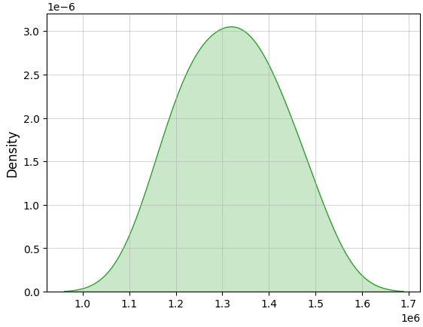
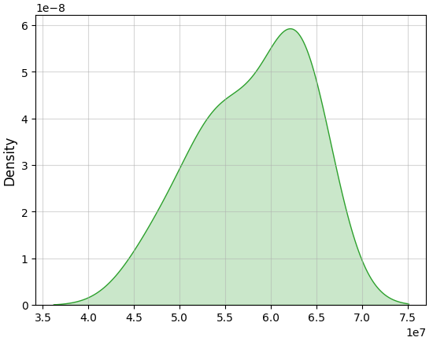
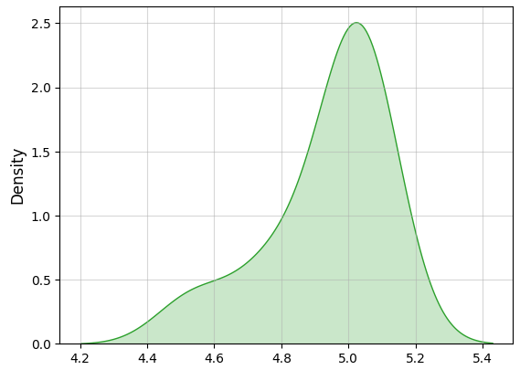
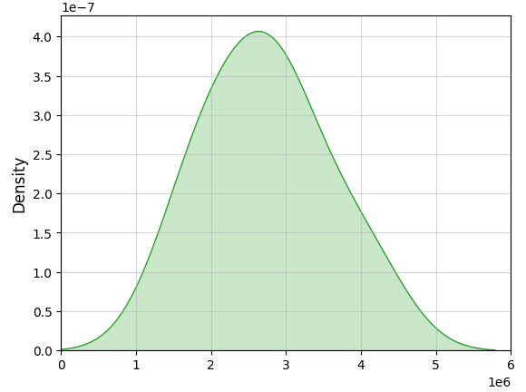
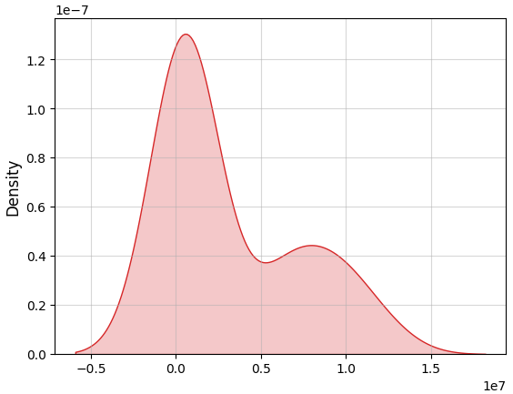
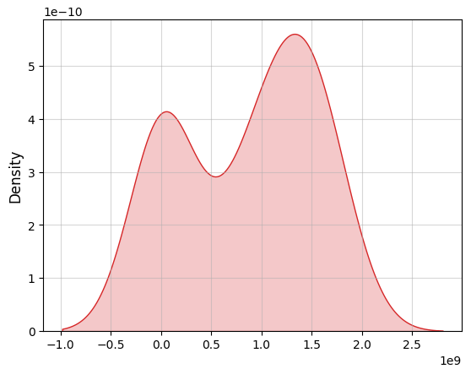
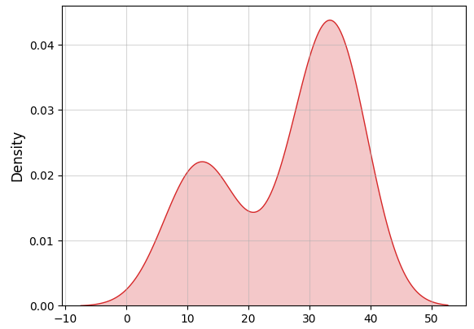
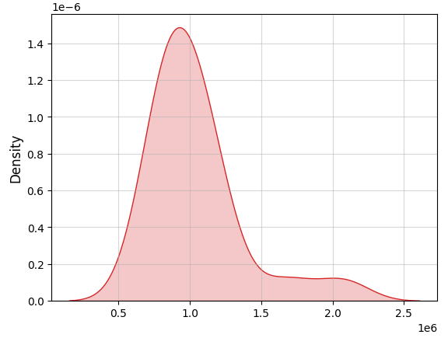
Initial Distribution Comparisons
Emissions (MTCO2e)
Electricity Generation (MWh)
Energy Consumption (quad. Btu)
Construction Cost per Capacity ($/MW)
Biomass
Fossil Fuels
Fossil fuels dominate in scale but show high variability across emissions, consumption, and generation, potentially due to their diverse sources and long-term shifts.
Biomass is consistent but small-scale, with tight clustering across all metrics and minimal fluctuation.
Construction cost per MW is higher for biomass, suggesting higher investment needs despite lower output.
Overall, these plots reveal greater stability in biomass operations vs. fossil fuels' more volatile and transitional nature.

Slide 8
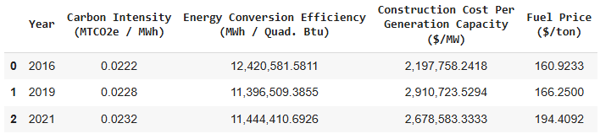
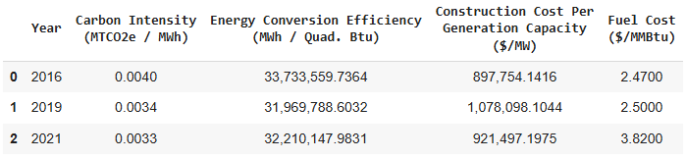
Sustainability Metrics at a Glance
Biomass
Initial Insights:
Biomass has consistently higher carbon intensity than fossil fuels in all selected years (roughly 5-7 times higher)
Fossil Fuels convert fuel to electricity much more efficiently, producing 2.7-3x more output per unit of energy
Biomass electric generators cost significantly more to build per MW of capacity (~ 2.5-3x higher construction costs)
Biomass fuel prices rose steadily from 2016 to 2021, while fossil fuel costs fluctuated and spiked in 2021
These descriptive statistics show a clear performance gap favoring fossil fuels; however, deeper evaluation is needed to understand the full context and magnitude of these differences.
Fossil Fuels

Slide 9
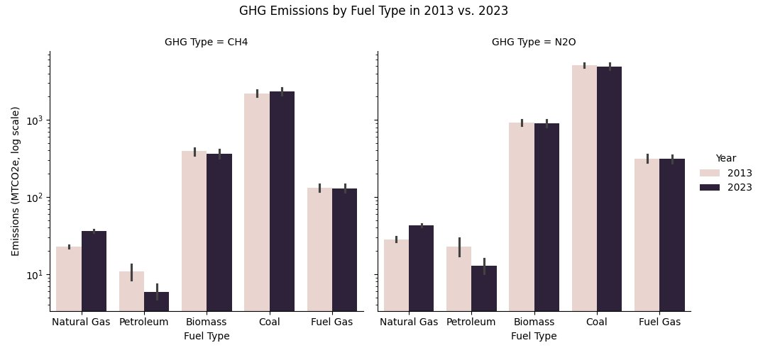
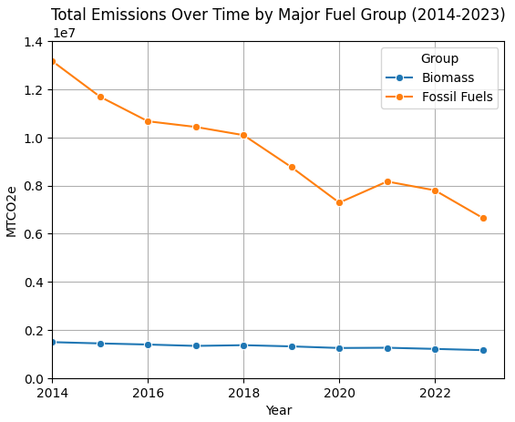
Emissions Over Time
Coal continues to dominate in emissions output for both CH₄ (methane) and N₂O (nitrous oxide) greenhouse gas types by a large margin — over 1,000 times more than natural gas in some cases.
Biomass emissions have remained moderate and relatively stable over the past decade, showing minimal change in average CH₄ or N₂O output.
Natural gas and petroleum are consistently on the lower-emission end.
Fossil fuels, as a whole, have shown a steady decline since 2014, indicating progress in decarbonization efforts.
In contrast, biomass emissions have declined at a slower and more gradual rate compared to fossil fuel emissions, likely because they started from a lower baseline to begin with. This suggests that while biomass combustion is already relatively less carbon-intensive, achieving further reductions may require more precise interventions rather than broad structural shifts.

Slide 10
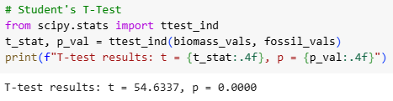

Comparing Carbon Intensities
To formally compare the carbon intensity of biomass and fossil fuel electricity generation, I conducted a Student’s t-test.
The t-test yielded a t-statistic of 54.63 with a p-value less than 0.0001, indicating a highly significant difference in average carbon intensity between the two groups.
In practical terms, this means biomass emits significantly less CO₂ per unit of energy generated than fossil fuels.
To measure the magnitude of this difference, I calculated Cohen’s d, which came out to 24.43.
This is an extremely large effect size, far exceeding conventional thresholds.
It confirms that the observed difference isn’t just statistically significant — it’s also substantial in real-world terms.
These results strongly support the idea that biomass is far less carbon-intensive than traditional fossil fuels in current U.S. electricity generation.

Slide 11
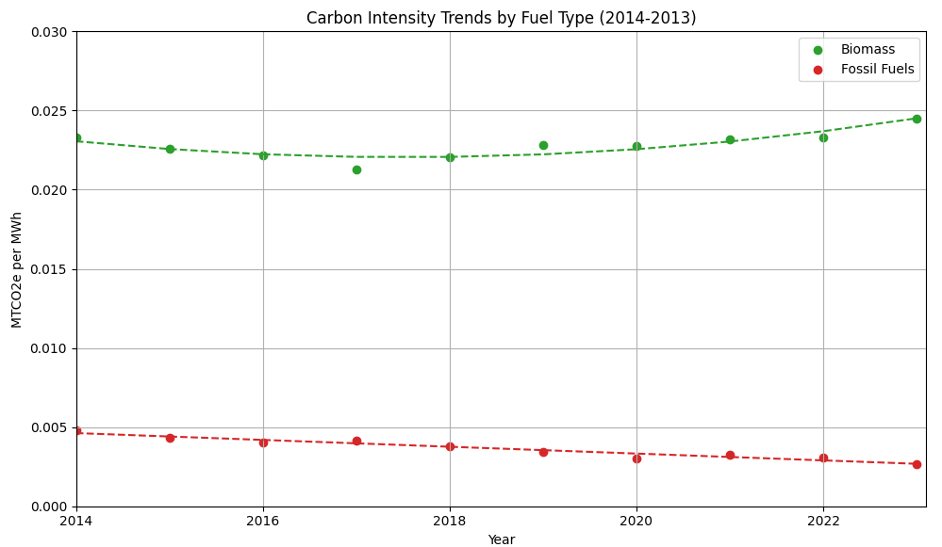
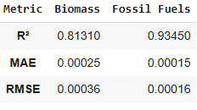
Carbon Intensity: Trend Analysis
Fossil fuels show a clear and steady decline across the decade, especially from 2014 to 2020, with a small uptick in 2021 before continuing downward. This trend aligns with a shift toward cleaner-burning fuels and is well-modeled linearly (R² ≈ 0.93).
Biomass, in contrast, shows a more complex pattern. There’s a gradual decline in the earlier years, but it flattens out and slightly increases from around 2018 onward. The curved trajectory is better captured by a quadratic fit (R² ≈ 0.81).
These trends contrast those shown in the earlier total emissions plot: although biomass has higher carbon intensity, it emits far less in total, likely due to overall energy (i.e., electricity) production.

Slide 12
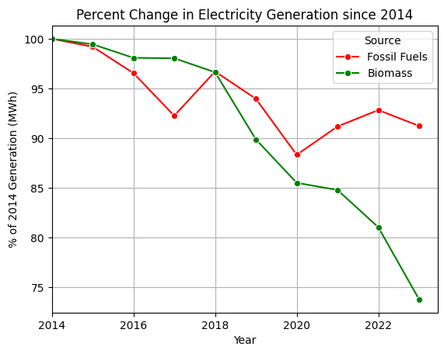
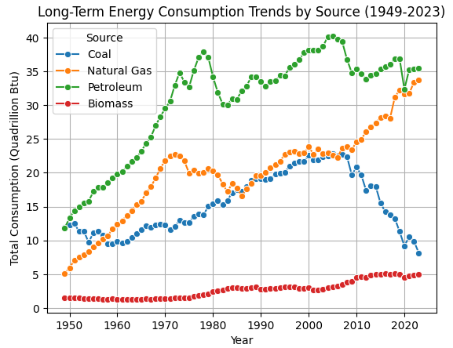
Energy Production & Consumption Over Time
Biomass electricity generation has declined by ~26% since 2014, while fossil fuels declined by ~9%, suggesting stagnation in bioenergy growth amid broader renewable expansion.
Long-term trends show major shifts within fossil fuels: coal use has plummeted since the 2000s, while natural gas has surged and overtaken coal.
Biomass consumption has grown steadily but remains marginal compared to fossil fuels, reinforcing its limited—but stable—role in the overall energy mix.

Slide 13
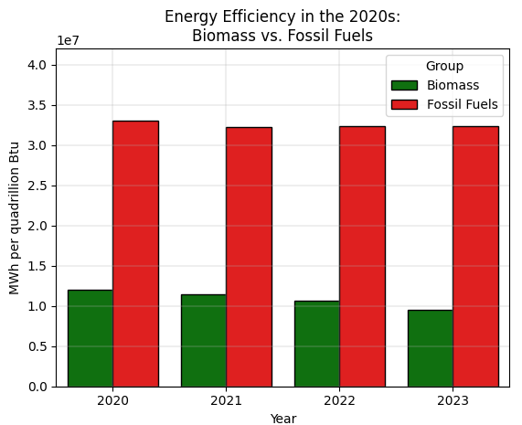

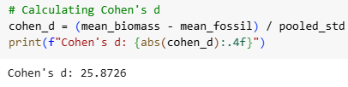
Energy Efficiency Comparative Analysis
Across the last four years, fossil fuels have shown much higher energy conversion efficiency than biomass — with a consistent gap of about 2x to 3x.
Biomass efficiency has steadily declined from 2020 to 2023, while fossil fuel efficiency has remained relatively stable.
This persistent and widening gap is reflected in the statistical analysis:
Student’s t-test confirms the difference in group means is statistically significant (t = 36.59, p < 0.001).
Cohen’s d = 25.87 indicates an extremely large effect size, supporting a strong performance divide.
When paired with earlier findings (e.g., stagnant generation growth), the low output-to-input ratio suggests biomass currently lags behind fossil fuels in terms of energy return, which is a key metric of long-term sustainability.

Slide 14
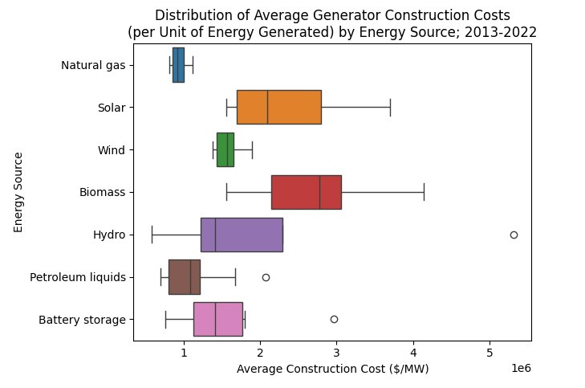
Construction Cost Disparities by Source
Biomass shows the widest cost variability, ranging from roughly $1.5M to over $4M per MW.
Natural gas is both the most cost-consistent and least expensive on average, with costs tightly clustered between $800k - $1.1M per MW​.
Petroleum liquids exhibit moderate costs, mostly within the same range as natural gas, though a few higher-cost outliers appear.
Renewable sources (solar, wind, hydro) generally show higher construction costs per MW than fossil fuels, though with varying consistency.
Together, these patterns highlight the potential economic risk of biomass infrastructure investment, especially compared to the predictability and affordability of fossil fuel-based systems.​

Slide 15
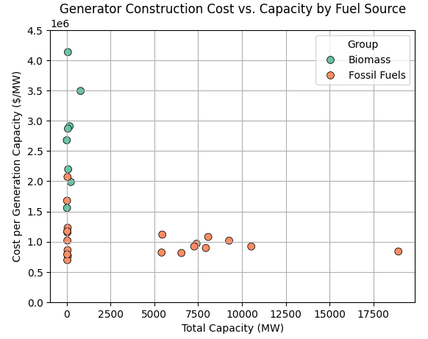
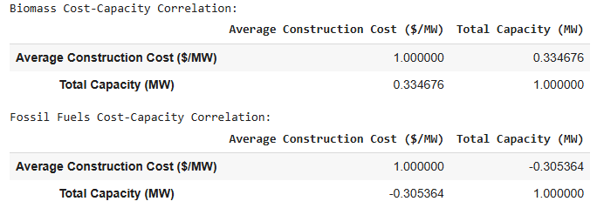
Cost vs. Capacity Relationships
Fossil fuels show a weak negative correlation (r = –0.31), suggesting that larger plants may achieve slightly lower per-MW costs — a possible, though modest, indication of economies of scale.
Biomass shows a weak positive correlation (r = 0.33), implying that cost per MW may increase with capacity, possibly due to logistical, technological, or site-specific inefficiencies in scaling biomass projects.
However, both correlation values are very weak by conventional standards (|r| < 0.4) and neither is statistically significant.
Given these limitations, the observed relationships are suggestive at best — not strong enough to claim that one group has a “better” or more efficient cost-capacity dynamic.
Still, the directional differences hint at structural challenges in scaling biomass infrastructure relative to fossil fuels.

Slide 16
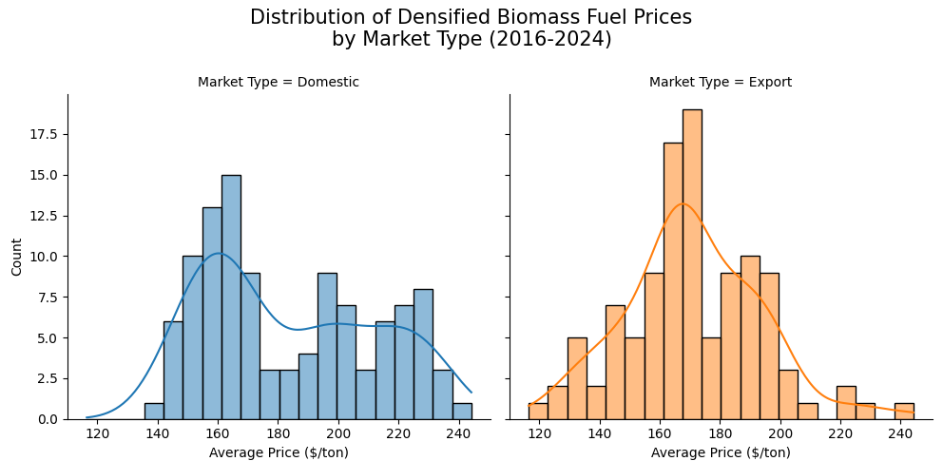
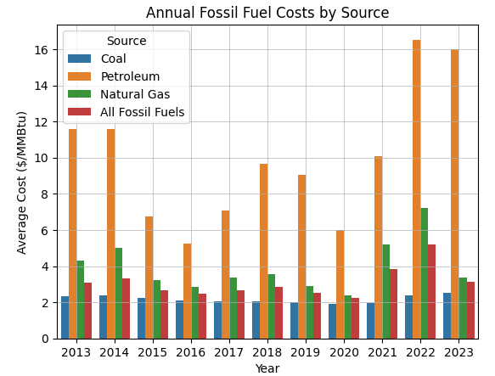
Biomass and Fossil Fuel Economic Landscape
Biomass fuel prices differ by market: domestic prices are higher and more variable ($180/ton), while export prices are lower ($170/ton) and more stable — a difference that could impact bioenergy’s economic outlook depending on demand dynamics.
Fossil fuel prices show mixed long-term behavior: coal remained low and stable ($2.00–$2.50/MMBtu), petroleum was consistently high and volatile, and natural gas experienced major price swings, especially in 2021–2022.
Overall, fossil fuel price volatility — particularly for petroleum and natural gas — raises concerns about long-term affordability and market stability, strengthening the case for bioenergy exploration despite its own pricing uncertainties.

Slide 17
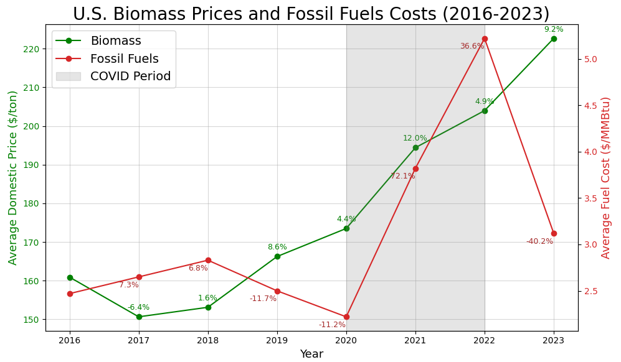
Fuel Price/Cost Trends
Biomass prices followed a steady upward trend, with moderate year-over-year increases nearly every year. This consistency suggests relative stability in bioenergy markets over time.
In contrast, fossil fuel costs showed a much more volatile trajectory, with a dramatic spike during the COVID-19 period (2021–2022), followed by a steep decline in 2023.
The divergence in behavior is especially clear in 2021, when fossil fuel costs surged by over 70%, while biomass prices rose less than 12%.
These patterns indicate that fossil fuel markets are more vulnerable to short-term shocks and global disruptions, whereas biomass has shown more predictable price dynamics.
Although biomass prices are not immune to increases, their smoother trajectory could offer greater price stability, an important consideration for long-term energy planning and investment.

Slide 18
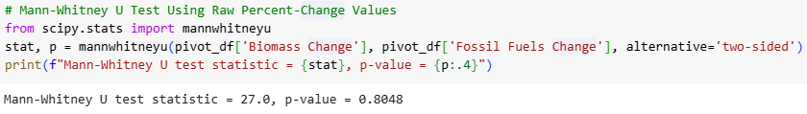
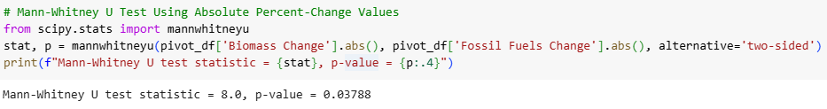
Comparing Year-Over-Year Percent Changes
When comparing the raw percent-change values, there was no statistically significant difference between biomass and fossil fuels (p = 0.80). This suggests that the direction and magnitude of yearly changes varied similarly across groups when considering increases and decreases together.
However, when looking at the absolute percent-change values — which capture volatility regardless of direction — the difference was statistically significant (p = 0.038).
These findings support the earlier visual observation that fossil fuel costs exhibited greater year-to-year volatility than biomass fuel prices over the 2017-2023 period.

Slide 19
Project Conclusions
Environmental Tradeoff: Biomass did not outperform fossil fuels in carbon intensity — a key emissions metric — and currently emits more CO₂ per unit of electricity generated. This challenges the assumption that bioenergy is inherently cleaner, despite its renewable classification.
Efficiency Barrier: Biomass also lags behind fossil fuels in energy conversion efficiency. The sizable performance gap presents a significant obstacle to large-scale substitution unless technical advancements in biomass systems are achieved.
Infrastructure Parity: No strong cost-capacity relationship was found for either group, suggesting that biomass projects are not inherently more cost-efficient or scalable than fossil fuel plants — a reminder that infrastructure decisions are highly context-specific.
Economic Stability Advantage: Where biomass does show clear strength is in fuel cost stability. Unlike fossil fuels, which experienced extreme price volatility in recent years, biomass prices followed a steady, predictable trajectory — a critical asset for long-term energy planning.
Overall Viability Judgment: Bioenergy cannot fully replace fossil fuels in its current form due to clear disadvantages in carbon emissions and conversion efficiency. However, its long-term viability remains plausible, particularly as a stable, renewable complement in a diversified energy mix. If technical improvements can close the performance gap, biomass could play a meaningful role in the U.S. transition away from fossil fuels.

Slide 20
References & Acknowledgements
Data Sources:
U.S. Energy Information Administration (EIA)
Construction Costs, Electricity Generation, Biomass Prices, Fossil Fuel Costs, Primary Energy Consumption
U.S. Environmental Protection Agency (EPA)
Greenhouse Gas Reporting Program (GHGRP)
Acknowledgements:
Special thanks to the Data Science faculty at Montgomery College for their support and guidance throughout my learning journey:
Prof. Perine
Prof. Mohamed
Prof. Saidi
Prof. Evans

Slide 21
THANK YOU FOR YOUR TIME

