Slide 1
Title
Sub Title

Slide 2
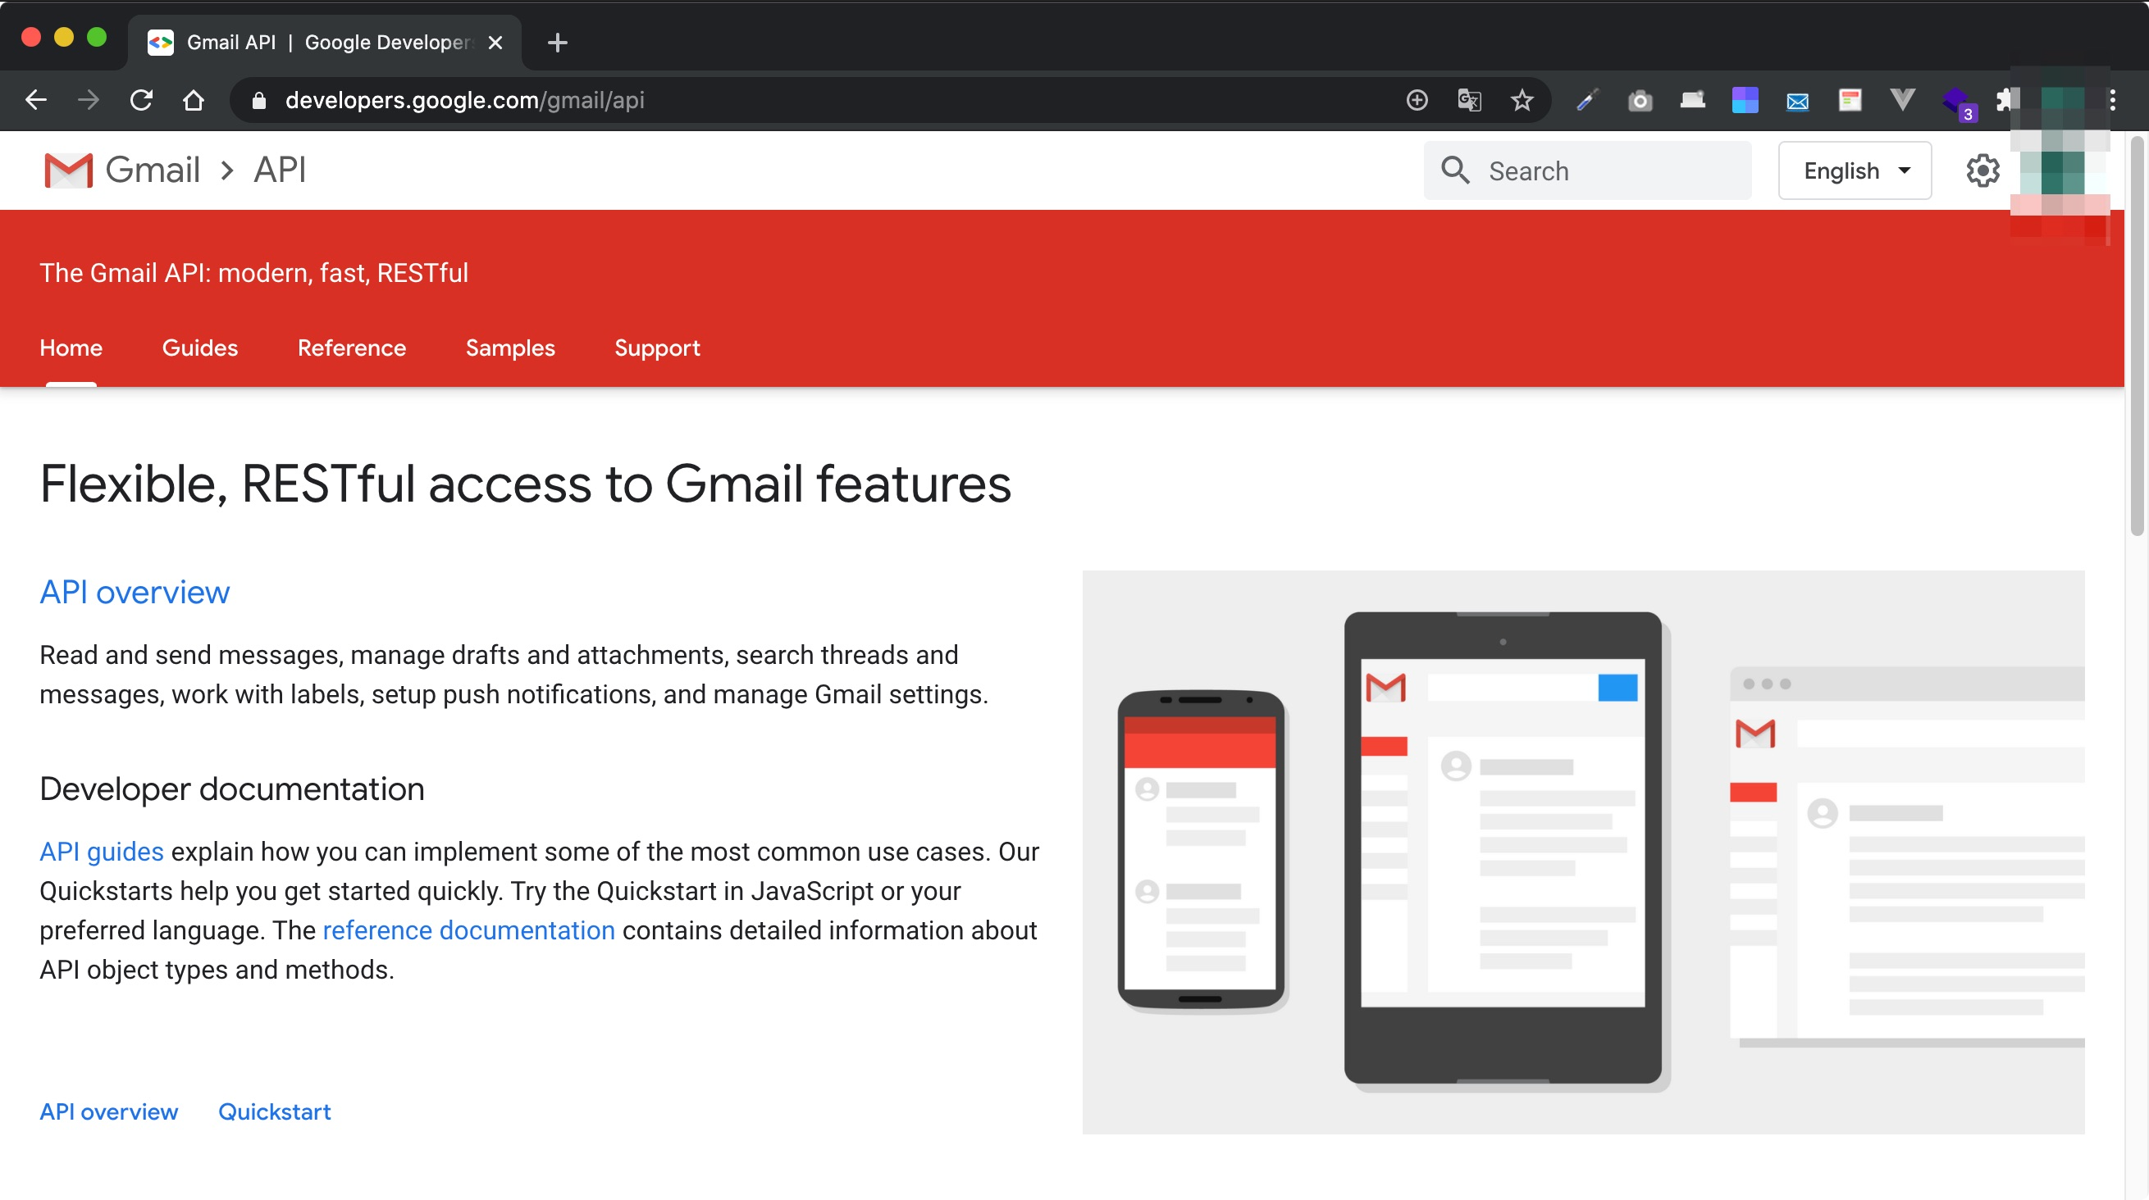
GmailAPI

