Slide 1


CSE3150 – Front-end Full Stack Development
Department of Computer Science Engineering
School of Engineering

Slide 2
JQuery
jQuery is a lightweight, "write less, do more", Open source JavaScript library.
The purpose of jQuery is to make it much easier to use JavaScript on your website.
jQuery takes a lot of common tasks that require many lines of JavaScript code to accomplish, and wraps them into methods that you can call with a single line of code.
jQuery also simplifies a lot of the complicated things from JavaScript, like AJAX calls and DOM manipulation.

Slide 3
Jquery Features:
HTML/DOM manipulation
CSS manipulation
HTML event methods
Effects and animations
AJAX
Utilities

Slide 4
Why Jquery?
There are lots of other JavaScript libraries out there, but jQuery is probably the most popular, and also the most extendable.
Many of the biggest companies on the Web use jQuery, such as:
Google
Microsoft
IBM
Netflix

Slide 5
Advantages:
Wide range of plug-ins. jQuery allows developers to create plug-ins on top of the JavaScript library.
Large development community
It has a good and comprehensive documentation
It is a lot more easy to use compared to standard javascript and other javascript libraries.
JQuery lets users develop Ajax templates with ease, Ajax enables a sleeker interface where actions can be performed on pages without requiring the entire page to be reloaded.
Being Light weight and a powerful chaining capabilities makes jQuery more strong.

Slide 6
Disadvantages:
While JQuery has an impressive library in terms of quantity, depending on how much customization you require on your website, the functionality may be limited thus using raw javascript may be inevitable in some cases.
The JQuery javascript file is required to run JQuery commands, while the size of this file is relatively small (25-100KB depending on the server), it is still a strain on the client computer and maybe your web server as well if you intend to host the JQuery script on your own web server.

Slide 7
Adding jQuery to Your Web Pages
There are several ways to start using jQuery on your web site. You can:
Download the jQuery library from jQuery.com
Include jQuery from a CDN, like Google
A CDN is a network of servers that distributes content from an “origin” server throughout the world by caching content close to where each end user is accessing the internet via a web-enabled device.

Slide 8
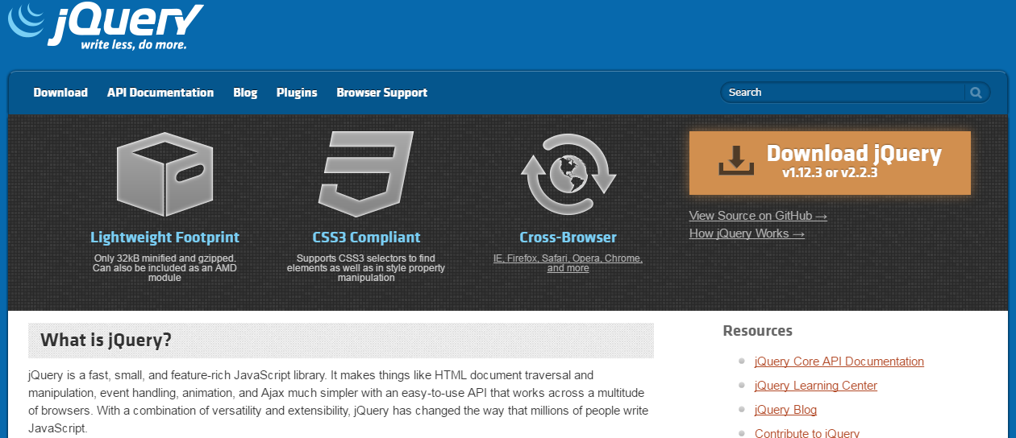
Downloading jQuery

Slide 9
There are two versions of jQuery available for downloading:
Production version - this is for your live website because it has been minified and compressed
Development version - this is for testing and development (uncompressed and readable code)
Both versions can be downloaded from jQuery.com.

Slide 10
jQuery CDN
If you don't want to download and host jQuery yourself, you can include it from a CDN (Content Delivery Network).
Google is an example of someone who host jQuery:

Slide 11
Code for Downloading Jquery and Jquery CDN
Downloading Jquery:
<head><script src="jquery3.6.3.min.js"></script> </head>
<head>
Jquery CDN:
<script src="https://ajax.googleapis.com/ajax/libs/jquery/3.6.3/jquery.min.js"></script> </head>

Slide 12
jQuery Syntax
With jQuery you select (query) HTML elements and perform "actions" on them.
The jQuery syntax is tailor-made for selecting HTML elements and performing some action on the element(s).
Basic syntax is: $(selector).action()
A $ sign to define/access jQuery
A (selector) to "query (or find)" HTML elements
A jQuery action() to be performed on the element(s)

Slide 13
Examples:
$(this).hide() - hides the current element.
$("p").hide() - hides all <p> elements.
$(".test").hide() - hides all elements with class="test".
$("#test").hide() - hides the element with id="test".

