Slide 1
ADC clearance and its implications to payload PK and tumor dynamics
A simulation study using T-DM1 QSP model
Yoshi Kuroki | Aug 16, 2024

Slide 2
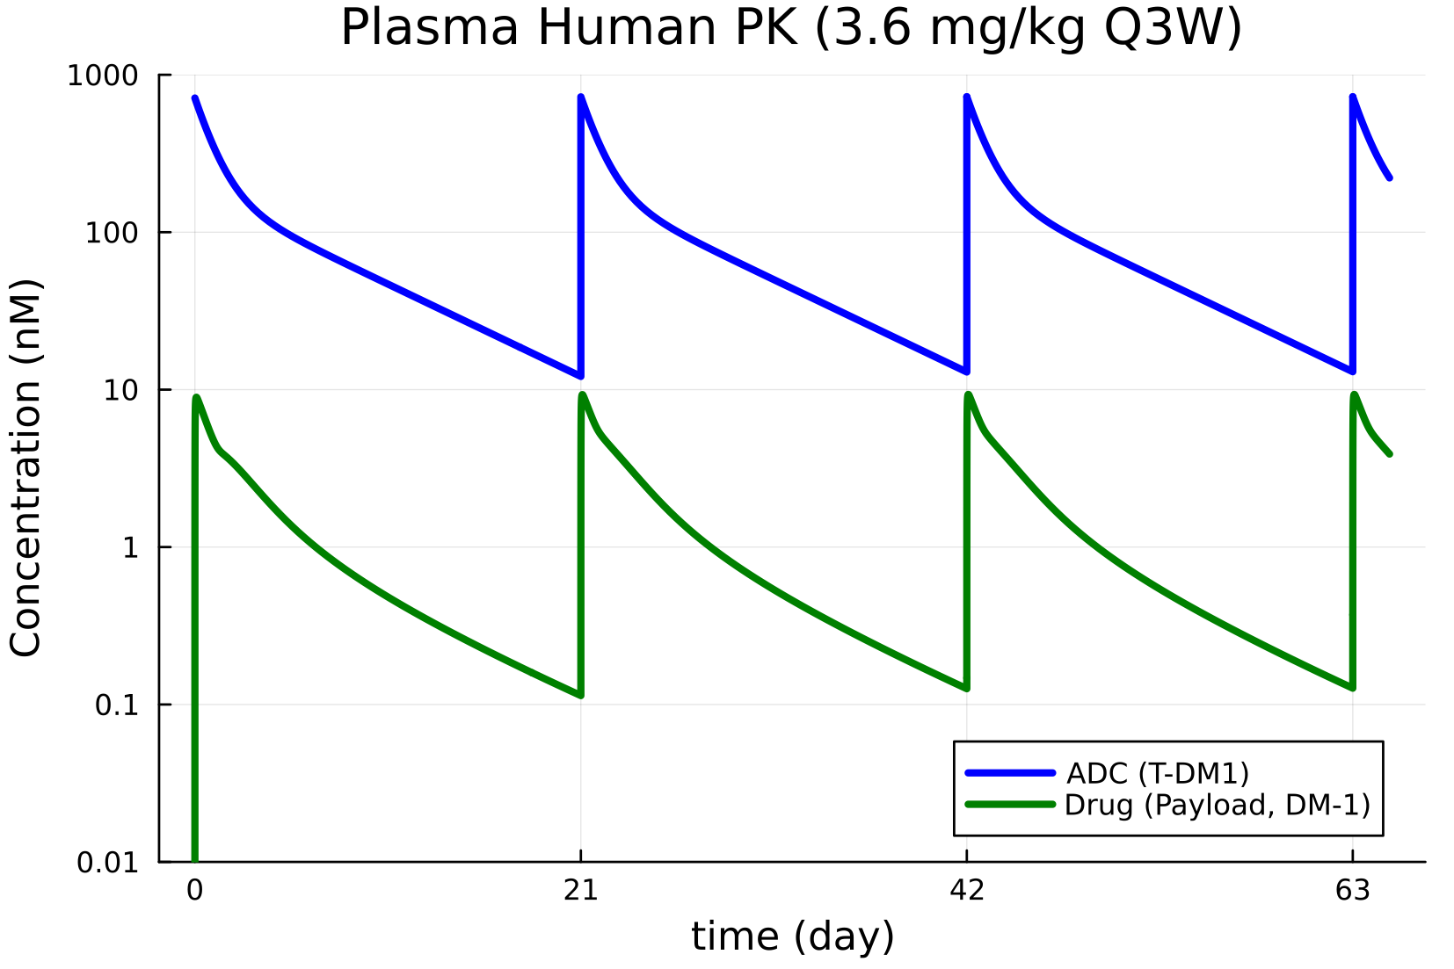
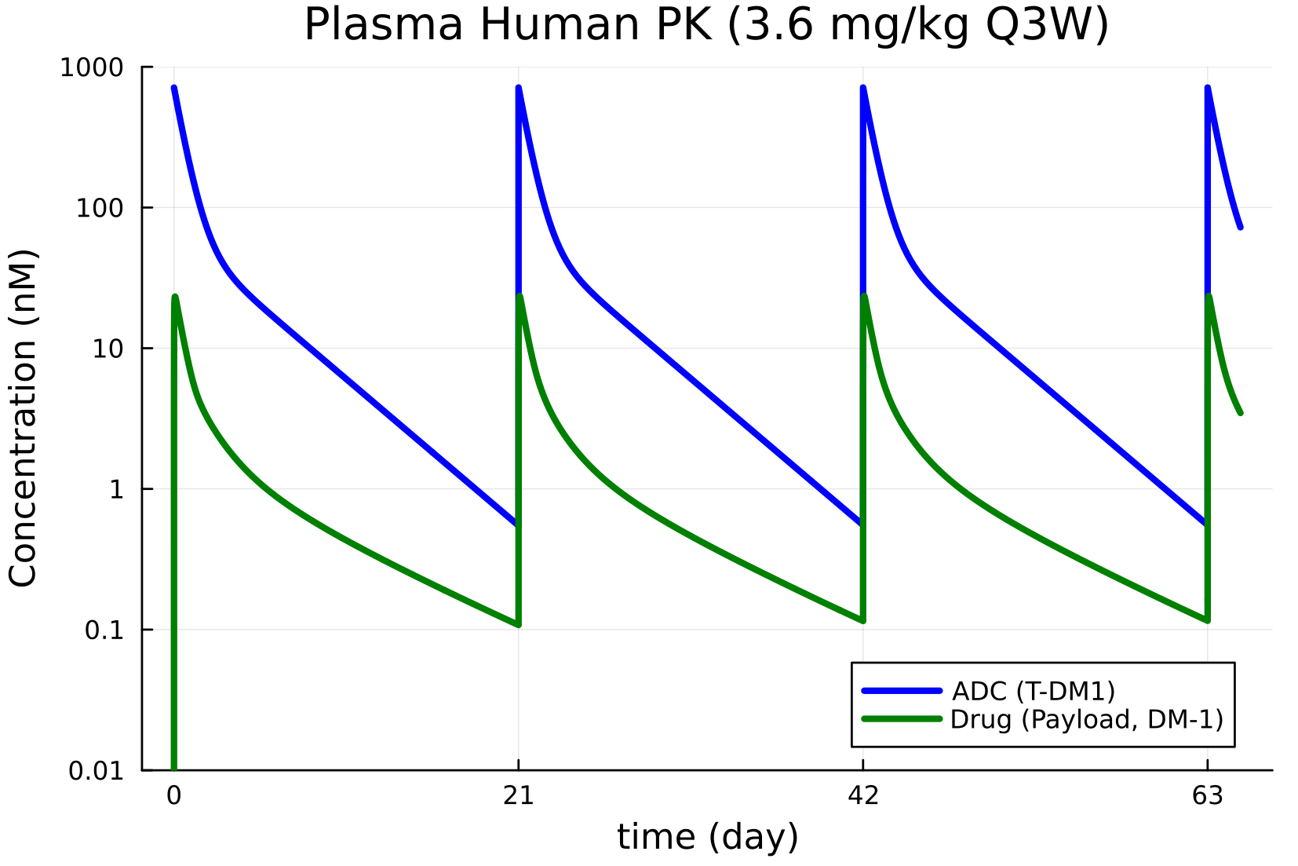
PK simulations of ADC and Payload by using T-DM1 QSP model
What does happen if CL of ADC lowering?
Central CL of ADC = 0.0043/24 L/h/kg (typical parameter value)
Central CL of ADC = 6*0.0043/24 L/h/kg (6x higher ADC CL scenario)
T-DM1 QSP model code written in julia language is available at https://github.com/metrumresearchgroup/PMSimulatorSimulate.jl/blob/main/test/ADCExample.jl based on https://www.metrumrg.com/wp-content/uploads/2023/11/ACoP14-workshop-ADC-example.pdf

Slide 3
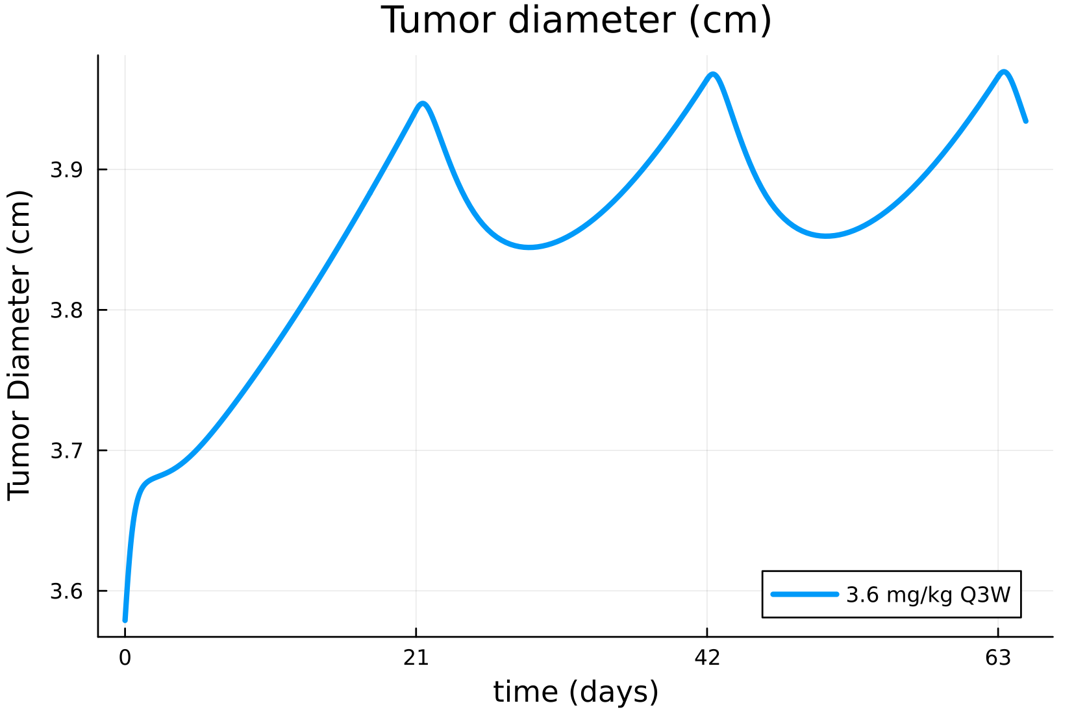
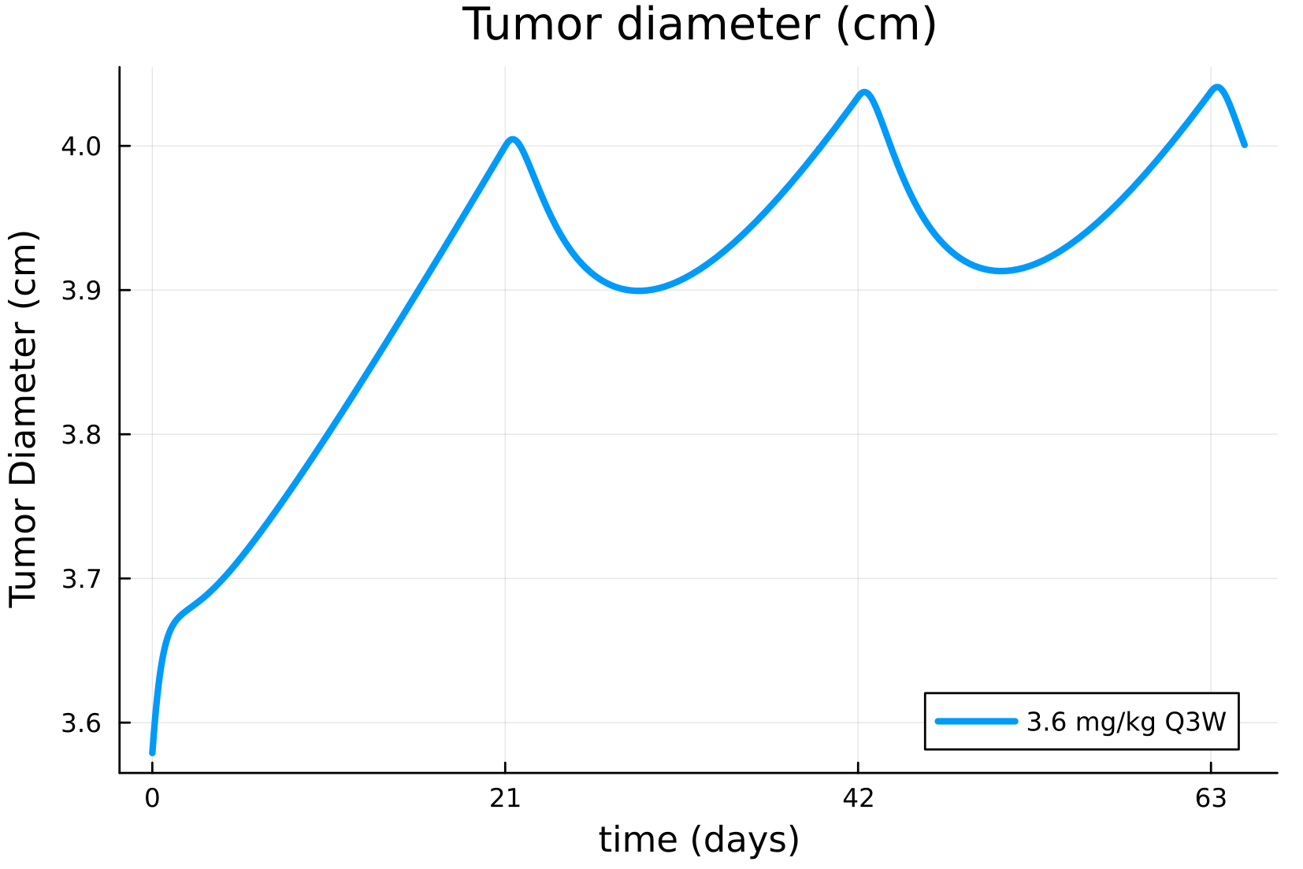
Tumor growth simulations by using T-DM1 QSP model
What does happen if CL of ADC lowering?
Central CL of ADC = 0.0043/24 L/h/kg (typical parameter value)
Central CL of ADC = 6*0.0043/24 L/h/kg (6x higher ADC CL scenario)
T-DM1 QSP model code written in julia language is available at https://github.com/metrumresearchgroup/PMSimulatorSimulate.jl/blob/main/test/ADCExample.jl based on https://www.metrumrg.com/wp-content/uploads/2023/11/ACoP14-workshop-ADC-example.pdf

