Slide 1
Operating System
Lab 2
TA : E-Cheng Cheng(程一正) eccheng@csie.nctu.edu.tw

Slide 2
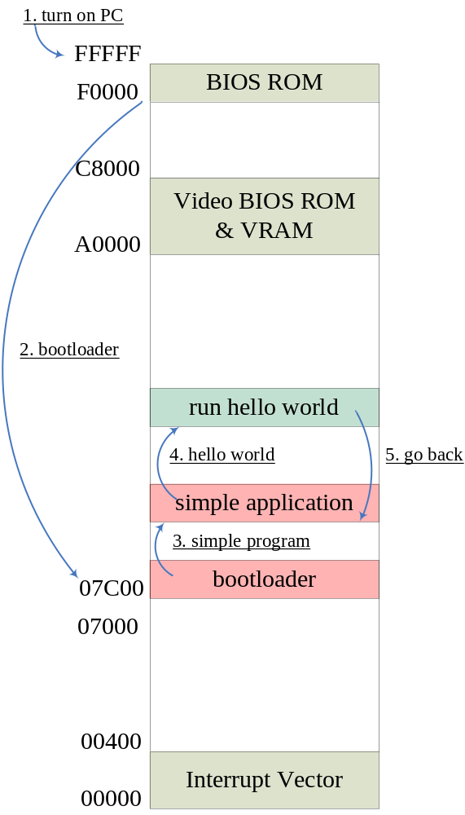
Lab 2 Process/Schedule
Lab 2.1 - Non-preemptive single task OS
  Simple shell
There are 4 files needed to do
  Bootloader for lab2.1
  Simple application
    A simple shell
    Load and run a program on the floppy disk
  “Hello world” application
  Floppy image including all files

Slide 3
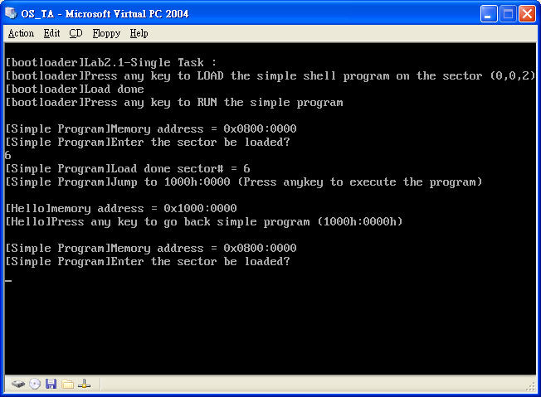
Lab 2 Process/Schedule
Lab 2-1 Running example

Slide 4
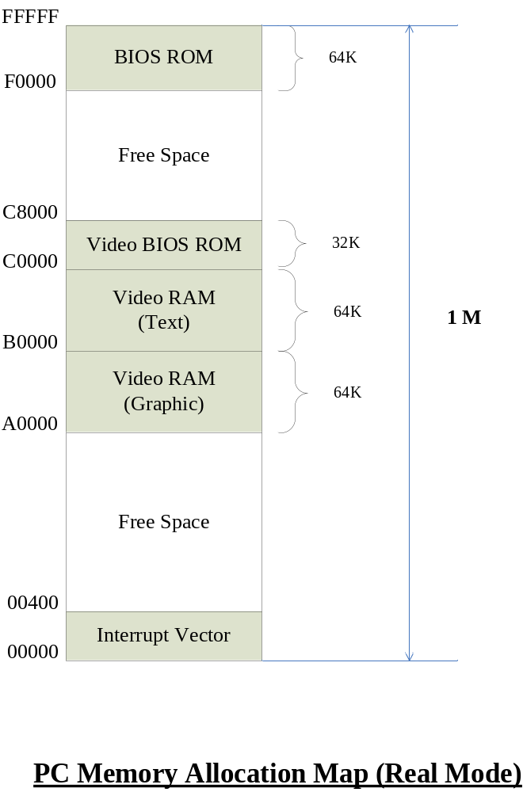
Lab 2 Process/Schedule
Hint
  Memory allocation
  I/O function support
    Int 16h
      Keyboard input
    Int 10h
      Print message

Slide 5
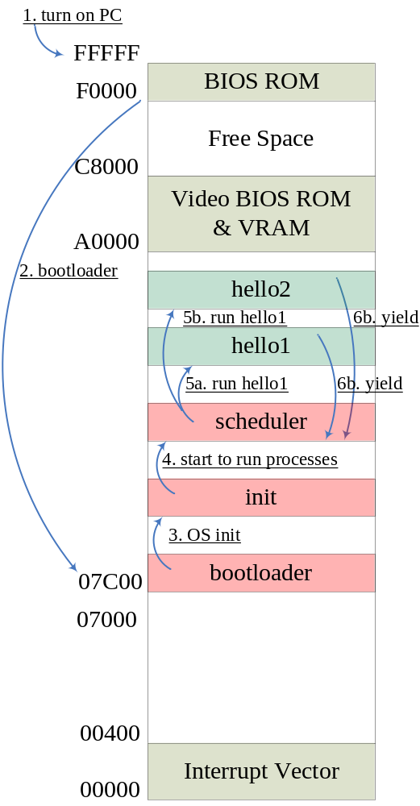
Lab 2 Process/Schedule
Lab 2.2 - Cooperative multi-tasking OS
  Task state management/Context switch
  Yield functions
There are 6 files needed to do
  Bootloader for lab2.2
  init
    Initialize scheduler
    Initialize task queue & management
    Load applications
      Hello1 & Hello 2
  Scheduler - yield() function
    Task switching & status saving
  Hello1
  hello2
  Floppy image including all files

Slide 6
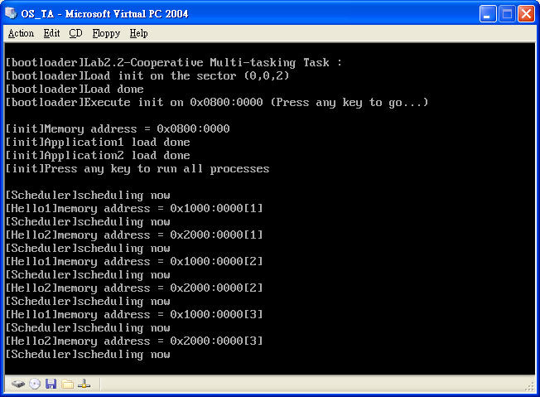
Lab 2 Process/Schedule
Lab 2-2 Running example

Slide 7
Lab 2 Process/Schedule
Hint
  Memory allocation
  Hello application

Slide 8
Lab 2 Process/Schedule
Bonus - Preemptive multi-tasking OS
  Re-design the scheduler using interrupt mechanism
    BIOS Timer
    Task state management/context switch

Slide 9
Lab 2 Report Items
Memory allocation map
Source code comment & its flowchart
Running screen

Slide 10
Lab 2 Grading
Lab 2 example (14)
report(6) |  | DEMO(8)
Code Explaination(3) | Other -based on the hints (3) | Requirment(6) | Bonus(2)
A | B | C | D
final Lab 1 score = A+B+C+D

Slide 11
DEMO
Deadline
  Source code , floppy image and report should be uploaded to the ftp before 4/17 23:59PM
  No second chance expect to very special case
DEMO Procedure
  Each one has 10 minutes at more to DEMO
    Run your floppy image in the Virtual PC at EC220
  DEMO Days will be announced later
Please check the forum

