Slide 1
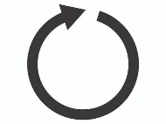

Supplier (Source, Producer)
Spring Cloud Stream
Spring Integration
Spring AMQP
IntegrationFlow
MessageChannelBinder
Spring Cloud Function
Spring Retry
Supplier
Binding
Channel
(destination)
Rabbit
Template
RetryTemplate
Default
ErrorChannel
(errorChannel)
MessageConverter

Slide 2
Consumer (Sink)
Spring Cloud Stream
Spring AMQP
Spring Integration
MessageChannelBinder
Spring Retry
RetryTemplate
Spring Cloud Function
Spring Cloud Function
Message
Listener
Container
Binding
Channel
(destination)
Consumer
ErrorHandler
Rabbit
Template
Binding
ErrorChannel
(d.g.errors)
Default
ErrorChannel
(errorChannel)
DLQ

