Slide 1
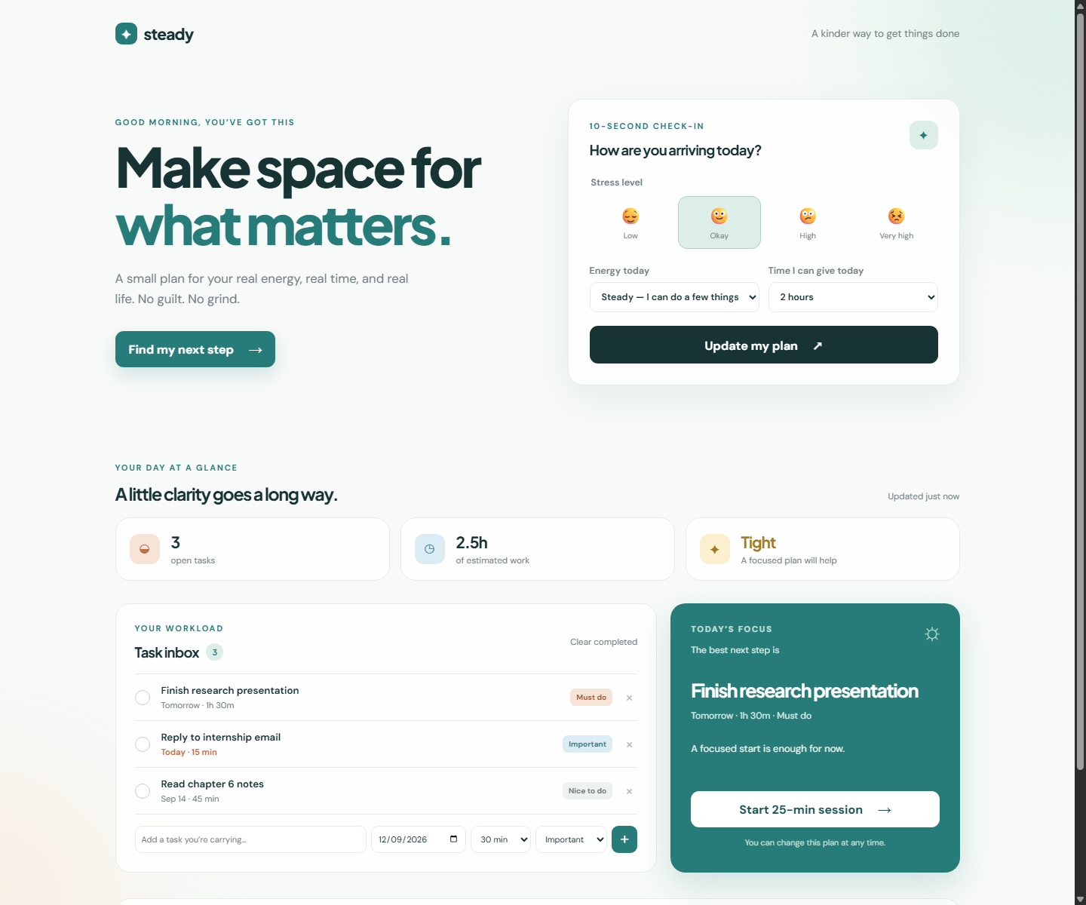
HACKATHON PROJECT
Make space for
what matters.
Steady turns a student’s deadlines, energy, and stress into one realistic next step for today.
STUDENT STRESS & WORKLOAD MANAGER
From “I have too much to do”
to “I know what to do next.”
A calmer starting point for real student life.

Slide 2
01 / SOLUTION + NOVELTY
The twist is capacity,
not more pressure.
Most productivity tools ask students to manage an ideal day. Steady plans around the day they actually have.
Three product decisions make the difference
THE USUAL TO-DO LIST
THE STEADY APPROACH
01
Capacity-aware
Do everything
Choose what matters
The plan respects the time a student actually has.
A long list treats every task as equally urgent—even when energy and time are limited.
Check in, see your capacity, and receive one useful next step—not a lecture.
02
Stress-responsive
High stress shrinks the next action and offers a reset.
More tabs
Realistic capacity
More guilt
Smaller starting step
03
Privacy-first
More avoidance
Private by default
Check-ins stay in the browser; no account is required.

Slide 3
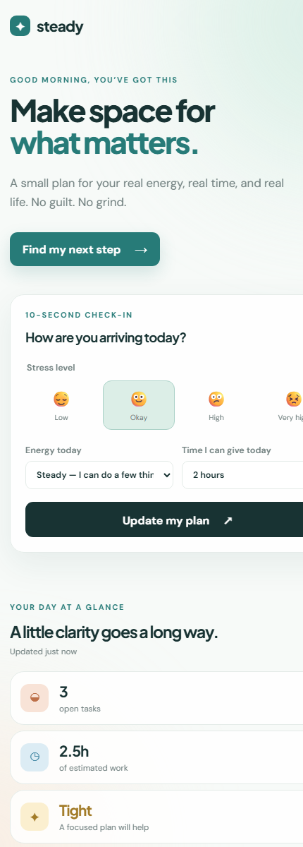
02 / PROTOTYPE DEMO
A four-step journey from
overwhelm to action.
The prototype is the interface: each screen decision makes the next action feel smaller and clearer.
1
Check in
Stress, energy, and time set the day’s constraints.
2
See the load
Open work is translated into effort and status.
3
Pick one
The focus card recommends the best next task.
4
Start small
A 25-minute session turns intention into motion.
DEMO MOMENT
Set stress to high → watch Steady recommend the smallest useful start.

Slide 4
03 / TECH STACK + BUILD PLAN
Simple enough to ship.
Thoughtful enough to matter.
The MVP stays lightweight so the team can spend its build time on the planning experience—not infrastructure.
3-week build plan
Flask
HTML / CSS / JS
localStorage
Page server
Responsive UI
Private state
WEEK 1
Foundation
Tasks, check-in, persistence, responsive dashboard
NO ACCOUNT / NO API KEY / NO DATA LEAVES THE BROWSER
WEEK 2
Intelligence
Capacity scoring, task breakdown, weekly workload view
Definition of done
WEEK 3
Trust + launch
Accessibility, insights, user test, deploy, demo
A student can add a deadline
Steady recommends one next step
The plan updates after completion

Slide 5
04 / Impact + close
A student should not
need more willpower
to begin.
What changes for the user?
Before
A scattered list and no clear starting point
After
They need a plan that respects their capacity, protects their attention, and makes the next step feel possible.
One prioritized task sized to today’s capacity
Next
A repeatable rhythm of focus, reset, and progress
Our impact hypothesis
When students see one realistic next action, they start sooner and carry less decision overload.
Start small. Stay steady.
steady
A productivity prototype — not a medical tool.

